Slide 1

Johannesburg Health District Research Conference Date: 28-29 August 2024 Venue: WITS School of Public Health Topic: District Health Plan (DHP) and Research Priorities
Presenter: Mr B Sikhakhane
Deputy Director: Monitoring and Evaluation Johannesburg Health District

Slide 2
Presentation Outline
Johannesburg Health District Overview
Demographics
Service Delivery Platform
District Health Plan (DHP)
What is the DHP and where does fit in the Governmentwide Planning Framework?
DHP Planning Process
DHP Aspirations
District Research Priorities

Slide 3
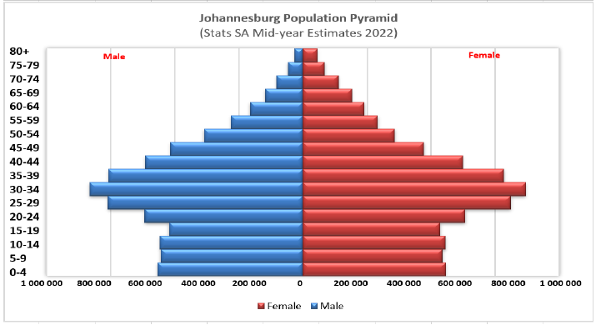
Johannesburg Population Pyramid - Implications for Health
Young population - shows a bulge in the 20 to 39 age group
Reproductive Health | Increased demand for maternal and child health services, family planning, and reproductive health education.
Infectious Diseases & Behavioural Health | Young adults may be more susceptible to certain infectious diseases due to lifestyle factors may be more prone to engaging in risky behaviours such as substance abuse
Workforce Health & safety | There may be greater emphasis on occupational health and safety measures
Chronic Disease Management | As individuals age within this demographic, there may be an increased prevalence of chronic diseases
Healthcare Infrastructure Planning | Plan for increased healthcare infrastructure, including hospitals, clinics, and healthcare professionals, to meet the needs of a growing young adult population.
Health Education and Promotion | Present opportunities for health education and promotion programs targeted towards young adults
Source: City of Johannesburg, 2023/24 IDP
Notes:
The population pyramid represents the breakdown of the population by gender and age at a given point in time
Inferences can be drawn from the shape of the pyramid in relation to health

Slide 4
Population Distribution
Unit | Total Population | % of District | % of Province
Gauteng Province | 16 723 636 | - | -
City of Johannesburg Metropolitan Municipality | 6 465 812 | - | 39%
Johannesburg A Health sub-District | 1 064 603 | 16% | 6%
Johannesburg B Health sub-District | 348 630 | 5% | 2%
Johannesburg C Health sub-District | 741 587 | 11% | 4%
Johannesburg D Health sub-District | 1 615 422 | 25% | 10%
Johannesburg E Health sub-District | 651 534 | 10% | 4%
Johannesburg F Health sub-District | 1 077 845 | 17% | 6%
Johannesburg G Health sub-District | 966 191 | 15% | 6%
Source: DHIS 2024
Notes:
The district constitutes 39% of the GP population
25% of the JHB population is in Sub-District D (Soweto)
Between 2015 and 2024, the population of sub-district A has increased by about 243k

Slide 5
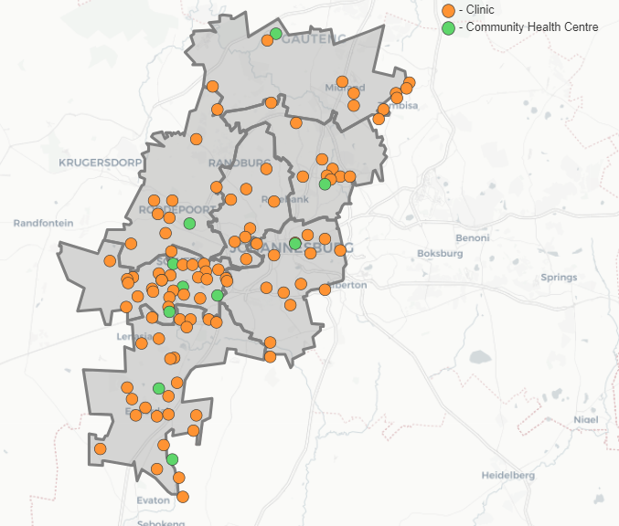
Service Delivery Platform
Type | Sub-District |  |  |  |  |  |  | JHB
 | A | B | C | D | E | F | G
Clinic | 12 | 8 | 12 | 24 | 8 | 13 | 24 | 101
CHC | 2 | 1 | 1 | 5 | 1 | 1 | 2 | 13
Mobile Service | 5 | 2 | 4 | 5 | 1 | 3 | 6 | 26
Satellite Clinic | 0 | 1 | 0 | 0 | 0 | 1 | - | 2
District Hospital | 0 | - | 0 | 1 | - | 1 | 1 | 3
Regional Hospital | 0 | 1 | 0 | 0 | 1 | - | - | 2
Provincial Tertiary Hospital | 0 | 1 | 0 | 0 | -- |  | - | 1
National Central Hospital | 0 | 0 | 0 | 1 | - | 1 | - | 2
A
E
C
B
D
F
G
Notes:
This slide shows below shows the geographical spread of the seven sub-districts and location of health facilities
The map shows PHC facilities, additional 3 CHC are not showing on the Map. Sub-district A has an additional CHC making tow CHCs in A
In sub-district B, Westbury , recently upgrade into a CHC but only the MoU is functional busy with emergency unit
Florida Clinic in process of being upgraded into a CHC
In Sub-District G, Lenasia South CHC has been upgrade into a district hospital and Lenasia line into a CHC
There are plans to increase district hospitals footprint particularly in Sub-Districts C and A within current MTSF to longer term periods

Slide 6
Where does the DHP Fit in the Governmentwide Planning Framework?
National Development Plan (NDP) 2030
Long term plan
Medium Term Strategic Framework (MTSF)
Five-year plan
Medium Term Expenditure Framework (MTEF)
Enables government institutions to do strategic planning
Sectoral & Institutional Plan
Annual Performance Plan (APP)
Cut Across all sectors
Critical steps towards 2030
Sets out actions government will take to implement the NDP for a specific electoral term
District Health Plan (DHP)
Draws up annual budgets in rolling three-year cycles.
Five-year sectoral & institutional plans
Includes priorities in the MTSF
Strategic plans are tools that enable departments to priorities and plan the incremental implementation of more long-term strategic intentions
Actions required to meet sectoral and intuitional plans in a given financial year
Strategic and operational document
Guides delivery of health services in a district
Translates APP into district actions

Slide 7
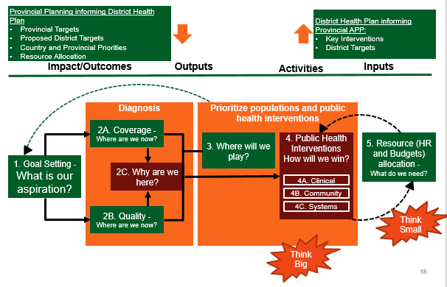
DHP Planning Process
Source: District Health Planning and Monitoring Framework, National Department of Health, August 2017
Notes:
It is an iterative process requiring skilled facilitation
Ideally as per government-wide planning timeframes the process should start in September of each year
Simplified and logical set of steps requiring District Management Team to collectively answer relevant questions that foster thinking (strategy, problem solving and learning), and encouragement through reflection
The planning employs the generally recognised planning methodologies such as the results-based approach and planning tools such as the theory of change, Logical framework and root cause analysis such the fishbone, the 5 why techniques
As shown in the picture from inputs to impacts or starting with the end in mind what impacts do we intend to achieve and working back to what resources (inputs

Slide 8
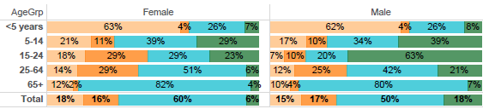

DHP Planning Process – The Diagnosis Step
Identify major problems
Communicable, maternal, perinatal, & nutritional conditions contribute significantly to <5 years deaths
HIV & TB deaths are higher in the 15-24 female cohort & 25-64 age group for both genders
Non communicable diseases are significant cause of deaths in the district with the 65+ deaths accounting for a largest proportion
Injury are notable higher in the 5-14 and 15-24 age groups for males
Conduct a root-cause analysis and identify key interventions
Percentage of deaths by broad cause and leading causes,
2012–2017, JHB Metropolitan District
Source: District Health Barometer 2019-20
Notes:
This is a critical step in the DHP development process
This is just one example of using a credible sources , lates available sources, to identify problems
The District Health Barometer is a national undertaking by NDoH to compile performance of the all 52 district
The displayed data was triangulated various sources
Burden of disease profile
For the percentage of deaths by broad cause, deaths are classified into four groups, namely: (i) injuries; (ii) noncommunicable
diseases; (iii) HIV and TB; and (iv) communicable diseases together with maternal, perinatal and nutritional
conditions. Data are given by gender and age group for the period 2012–2017.
Additional sources are used to get a more comprehensive district picture
Any recognised planning tools such as the fishbone, five whys can be used conduct a root cause analysis

Slide 9
DHP 2024/25-2026/27 Aspirations
Aspiration | Rationale
Reduce from 98.7 to 85 maternal deaths per 100,000 live births by 2026/27 year | An increased number of contacts between a pregnant woman and a skilled health provider is most likely to reduce perinatal mortality and improve women’s experience of care. Includes women’s’ health focussing on sexual and reproductive health
Reduce from 14 to 10 neonatal deaths per 1000 live births by 2026/27
Reduce from 1,8 to 1.4 of children under 5 years who die in health facilities rate by 2040/25 year | To reduce preventable deaths among children under five years through prevention and improved management of common childhood illnesses. Neonatal deaths are the major contributor to deaths under-fives in the district and therefore paying special attention to reduction of neonatal deaths will significantly reduce under-fives deaths
Notes:
Better clinical management of pregnancy and dealing mainly with the diagnosis and management of common and serious pregnancy problems enhances chances of achieving better maternal and neonatal outcomes
Common childhood illnesses refer diarrhoea, pneumonia, and severe malnutrition

Slide 10
DHP 2024/25-2026/27 Aspirations
Aspiration | Rationale
Increase people living with HIV and AIDS with suppressed viral loads to 95% by 2026/27 year through testing, initiation, and retention on treatment | Viral load suppression is not only a reliable and non-patient-based measure of adherence, but it also helps to keep PLHIV healthy and prevents illness. It is against this logic that the district will test for HIV, initiate, and retain clients on treatment to keep them healthy and monitor adherence (viral load suppression)
Increase TB treatment success rate to 95% by 2026/27 through case identification and diagnosis, treatment initiation and completion (cured and completed treatment) | TB is both preventable and curable and yet it remains one of the leading causes of deaths in the district. By scaling up TB treatment outcomes through better case identification and management, the district will reduce deaths due to this scourge
Increase MDR-TB treatment success rate to 90%

Slide 11
DHP 2024/25-2026/27 Aspiration
Aspiration | Rationale
Reduce deaths due malaria < 1% by 2026/27 year | To rapidly diagnose and better treat malaria through an active surveillance system continue to curtail deaths due to malaria and prevent further spread.
Men and Women 18 years and older with diabetes managed (identification and treatment) | Untreated/uncontrolled diabetes can lead to complications such as heart disease, stroke, kidney damage and nerve damage. To prevent and manage the condition and prevent associated complications
Men and Women 18 years and older with hypertension managed (identification and treatment) | Untreated/uncontrolled, hypertension is the single largest contributor to cardiovascular disease, causing stroke, heart failure, and coronary artery disease, and is a major contributor to kidney disease. To prevent and if already diagnosed to manage the conditions and prevent associated complications
Notes:
Malaria is not endemic to JHB District, but its surveillance remains important

Slide 12
DHP 2024/25-2026/27
Aspiration | Rationale
School Grade 1 learners screened | Is not only to identify avoidable health problems that may constitute barriers to learning, but also as an opportunity of healthy development in children
School Grade 8 learners screened
Increase % of PHC facilities that qualify as Ideal clinics from 75% to 95% by 2026/27 | Increasing the number of PHC qualifying as ideal clinics infers that infrastructural, safety issues, availability of medication and other supplies are implemented to comply with the ideal clinic standards and thus improving quality of health
Increase % of patients satisfied with their experience of care in public health facilities from 75% to 95% by 2026/27
Increase % of health facilities compliant with Occupational Health and Safety Standards to 100% by 2026/27
Health facilities refurbished and adequately maintained to ensure effective service delivery
Notes:
The ideal clinic concept provides norms and standards geared towards improving quality of health care services and to which aspects such as infrastructure, staffing, adequate medicine and supplies, good administrative processes, and sufficient adequate bulk supplies, patient and staff safety should conform.
Increasing the number of PHC qualifying as ideal clinics infers that infrastructural, safety issues, availability of medication and other supplies are implemented to comply with the ideal clinic standards and thus improving quality of health service
The ideal clinic concept provides norms and standards geared towards improving quality of health care services and to which aspects such as infrastructure, staffing, adequate medicine and supplies, good administrative processes, and sufficient adequate bulk supplies, patient and staff safety should conform.

Slide 13
DHP 2024/25-2026/27 Aspirations
Aspiration | Rationale
Increase number of patients enrolled on centralized chronic medicine dispensing and distribution programme (CCMDD) | Is to make collecting chronic medication more accessible as stable patients pick their medication at points nearest/convenient to them away from health facilities and therefore decrease waiting times and over-crowding in health facilities
Quality mental health and rehabilitation services integrated into PHC health care facilities, | Integrating mental health care into primary care and all other levels of care to ensure that mental health is accessible, affordable, and acceptable to people with mental health problems
Improve access to health services increasing the number CHC operating 24 hours | Not only access to health care service is important but access to the type of health care when needed is also important
Support Automation for data collection, flow, storage, and visualisation for effective performance information management | Organizational performance management and accountability is supported by availability of timely, accurate and usable information extracted from quality data
Notes:
Integrateing mental health into PHC wil be supported by the necessary training and support of health professionals, and effective delivery of community awareness campaigns on issues of mental health
24 hour services in particular to access to emergency care, maternal and obstetric services

Slide 14
DHP 2024/25-2026/27 Aspirations
Aspiration | Rationale
Improve equity, training and enhance management of Human Resources for Health in the district | Quality healthcare depends on the availability of talented, capable, motivated, and high-performing clinical and non-clinical staff.
Improve Financial Management | Managing limited financial resources will enhance economical and efficient delivery of outputs required to achieve desired outcomes (effectiveness), that will serve the needs of the community

Slide 15
District Research Priorities
National Health Research Strategy: Research Priorities for South Africa 2021-2024
The NHRC in identifying health research priorities, took into consideration the followings:
the burden of disease.
the cost-effectiveness of interventions aimed at reducing the burden of disease.
the availability of human and institutional resources for the implementation of an intervention at the level closest to the affected communities.
the health needs of vulnerable groups such as woman, older persons, children
people with disabilities; and the health needs of communities

Slide 16
District Research Priorities
Stream | Priority | Objective | Rationale
Non-Communicable Diseases (NCDs) | Lifestyle-Related NCDs | Study the prevalence of lifestyle-related NCDs, particularly diabetes, and hypertension | The shift towards urban lifestyles has led to an increase in NCDs, which are now among the leading causes of mortality in Johannesburg
 | Mental Health in Urban Settings | Explore mental health challenges associated with urban living, such as stress, anxiety, and depression, and evaluate existing support systems. | The fast-paced, high-stress urban environment in Johannesburg contributes to a growing mental health crisis, requiring targeted research and interventions

Slide 17
District Research Priorities
Stream | Priority | Objective | Rationale
Communicable Diseases | HIV/AIDS and TB Co-Infection | Research the co-infection rates of HIV and TB in JHB & the effectiveness of integrated treatment programs | HIV and TB co-infection remains a significant public health issue
 | Managing advanced HIV disease | Ensure sustained engagement in HIV care to prevent progression to advanced disease. | Study factors influencing loss to follow-up Explore the effectiveness of differentiated care models, such as multi-month ART dispensing, to improve adherence and retention.
 |  | Reduce morbidity and mortality from opportunistic infections and other comorbidities in people with advanced HIV. | Research the prevalence and risk factors for common opportunistic infections in advanced HIV patients..

Slide 18
District Research Priorities
Stream | Priority | Objective | Rationale
Communicable Diseases | Infectious Disease Outbreak Preparedness | Study the city’s preparedness and response to infectious disease outbreaks | JHB faces risk of and experiences infectious disease outbreaks, necessitating research into prevention and response strategies.
Substance Abuse and Public Health | Alcohol and Drug Abuse | Study the prevalence of alcohol and drug abuse in Johannesburg and its impact on public health | Substance abuse is a significant public health issue in JHB contributing to both health and social problems
 |  | Evaluate effectiveness of current substance abuse treatment & rehabilitation programs and explore strategies for improvement | Improving access to & the effectiveness of substance abuse treatment is critical for addressing this pervasive issue

Slide 19
District Research Priorities
Stream | Priority | Objective | Rationale
Urban Health and Environmental Factors | Air Quality and Respiratory | Research the impact of air pollution on respiratory diseases, particularly asthma and chronic obstructive pulmonary disease (COPD), in urban areas. | Johannesburg’s high levels of air pollution from traffic and industry contribute to a significant burden of respiratory illnesses
 | Water and Sanitation | Investigate quality of drinking water and sanitation in informal settlements and their impact on public health. | Access to clean water and proper sanitation is critical for preventing waterborne diseases, which are prevalent in densely populated areas.

Slide 20
District Research Priorities
Stream | Priority | Objective | Rationale
Maternal and Child Health | Reducing Infant and Maternal Mortality | Research the leading causes of infant and maternal mortality in Johannesburg and develop targeted interventions | Despite improvements, maternal and infant mortality rates remain concerning in certain areas

Slide 21
Gap – Availability data at local level
Conducting health research at the municipal ward level:
allows for highly localized data collection and analysis.
Can provide insights into the specific:
health needs,
challenges, and
resources of smaller communities within a municipality.
This approach can lead to:
better understanding of health disparities within a municipality
support targeted interventions that are responsive to the specific needs of each ward.
Johannesburg Metropolitan Municipality has 131 municipal wards

Slide 22
THANK YOU

