Slide 1






Safety and immunogenicity of a single dose of COVID-19 vaccine: Ad26.CoV2.S, BNT162b2 or SARS-CoV-2 rS-Protein-Nanoparticle in previously vaccinated and unvaccinated adults living with HIV in South Africa
JOHANNESBURG HEALTH DISTRICT
2024 RESEARCH CONFERENCE
Dr Vaneshree Govender
On behalf of Prof Churchyard and the study team
The Aurum Institute NPC
28-29 August 2024
#JoburgResearch2024

Slide 2
Background
JOHANNESBURG HEALTH DISTRICT
2024 RESEARCH CONFERENCE
For people with immunosuppression, the World Health Organization recommends an additional COVID-19 vaccine dose as part of the primary vaccination series.
The safety and immunogenicity of vaccine strategies was evaluated in people living with HIV (PLWH).
#JoburgResearch2024

Slide 3
Methods
JOHANNESBURG HEALTH DISTRICT
2024 RESEARCH CONFERENCE
A phase 2a randomized, observer-blinded, multicenter study was conducted at 5 Aurum Clinical Research sites in Gauteng (3 sites) and North-West Province (2 sites).
PLWH who previously received one-dose of Ad26.CoV2.S, or two-doses of BNT162b2, or were unvaccinated with prior SARS-CoV-2 acquisition (study groups), received a single-dose of Ad26.CoV2.S [VAC31518,JNJ-78436735], BNT162b2 [COMIRNATY®] or SARS-CoV-2-rS-Protein-Nanoparticle [COVOVAXTM] (study arms) at least 2-months post-vaccination.
PLWH were on antiretroviral therapy for al least 3 months, had a CD4 count >100 cells/mm³ and a HIV viral load <1000 copies/ml
Immunogenicity was evaluated pre- and two-weeks post-study vaccination.
The study design is illustrated in Figure A.
#JoburgResearch2024

Slide 4
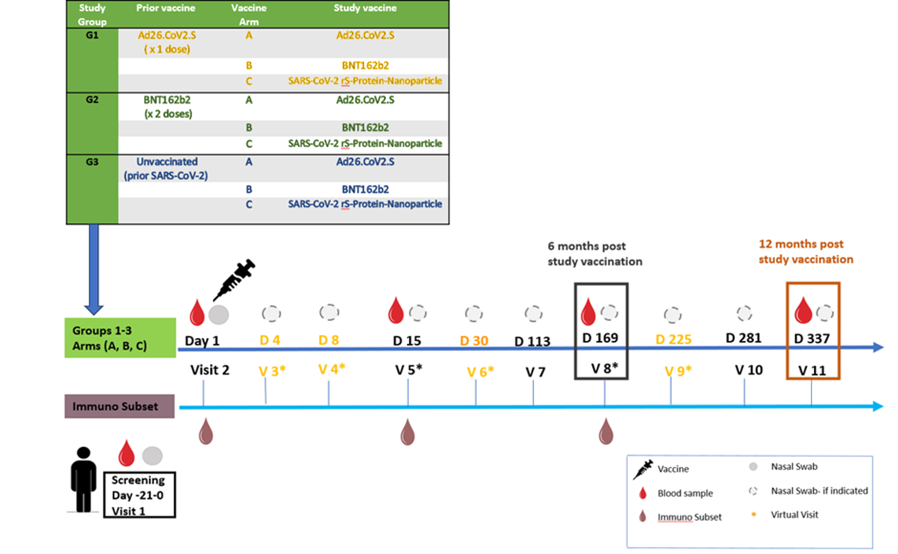
Methods – Study Design
JOHANNESBURG HEALTH DISTRICT
2024 RESEARCH CONFERENCE
Figure A
#JoburgResearch2024

Slide 5
Recruitment Clinics and Challenges
JOHANNESBURG HEALTH DISTRICT
2024 RESEARCH CONFERENCE
District | Clinics (N)
City of Johannesburg | 10
Tshwane | 11
Ekurhuleni | 16
Bojanala | 21
Doctor Kenneth Kaunda | 14
TOTAL | 72
Clinic-specific challenges:
ART records: Participants collected records from clinics.
Research staff were able to speak to the clinic managers where
required and obtain these summaries.
ARV and family planning could not always be verified. Some participants kept ARVs in non-ARV bottles for privacy.
In the absence of clinic and family planning cards, some clinics wrote return dates for ARVs on non-ARV medication boxes, and FP and chronic medication return dates on ARV boxes. Reason for return not specified.
Study-specific challenges:
Group 1 (Tembisa): Recruitment target for Janssen prior vaccine group was not met as most clinics gave Cominarty.
Group 3: challenges with vaccine hesitancy and proof of prior SARS CoV2 infection (nucleocapsid positive)
 | City of Johannesburg
# | COJ Region A: | COJ Region E:
1 | Bophelong clinic | 4th Avenue Clinic
2 | Ebony Park/ Kaalfontein clinic | 8th Avenue Clinic
3 | ​Hikhensile | River Park Clinic
4 | Mpumelelo | Alex Health Centre clinic
5 | ​Rabie Ridge
6 | Thuthukani
#JoburgResearch2024

Slide 6
Results – Participants and Safety
JOHANNESBURG HEALTH DISTRICT
2024 RESEARCH CONFERENCE
Participants
Between July 2022 and February 2023, of 599 PLWH enrolled, 258 and 254 were previously vaccinated with Ad26.CoV2.S and BNT162b2 respectively and 87 were unvaccinated.
The mean participant age was 43 years, 65.8% were female, 99.7% were Black African, 88.1% were virally suppressed, and median CD4 count was 764 (IQR 545-1008) cells/mm³.
Safety
Local reactions were reported in 19.4%, 34.5% and 12.3% and systemic reactions in 35.4%, 37.4% and 28.7% of participants in the Ad26.CoV2.S, BNT162b2 and SARS-CoV-2-rS-Protein-Nanoparticle arms respectively.
Overall 96.7% of local and systemic reactions were mild to moderate.
There were 30 unsolicited adverse events within 28-days of vaccination, 97% were mild to moderate.
#JoburgResearch2024

Slide 7
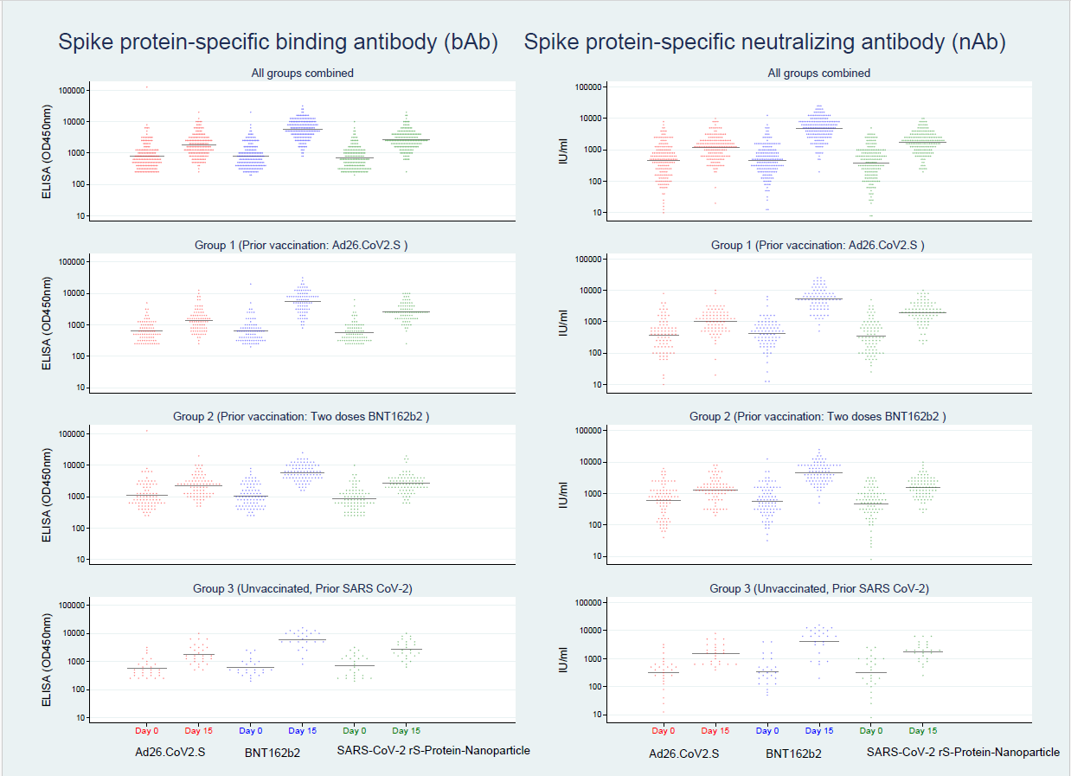
Results – Antibody Responses
JOHANNESBURG HEALTH DISTRICT
2024 RESEARCH CONFERENCE
The Geometric Mean Fold Change (GMFC) in ELISA SARS-CoV-2 spike-binding antibody titres between baseline and day 15 in each arm was: Ad26.CoV2.S (2.2 [1.9-2.5]), BNT162b2 (7.3 [6.4-8.2]), and SARS-CoV-2 rS-Protein-Nanoparticle (3.7 [3.3-4.2]).
The Geometric Mean Fold Change (GMFC) neutralizing antibody titres using a VSV pseudovirus assay was 2.6 (2.2-3.0), 10.2 (8.7-11.8) and 4.5 (3.8-5.3) respectively.
Antibody responses stratified by prior vaccination group are shown in Figure B.
BNT162b2 showed a higher fold change.
Figure B
#JoburgResearch2024

Slide 8
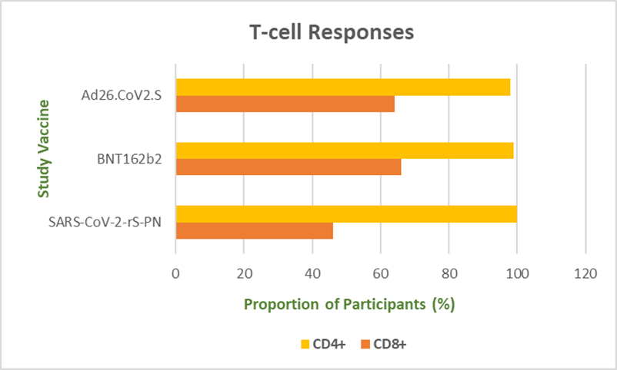
Results – T Cell Responses
JOHANNESBURG HEALTH DISTRICT
2024 RESEARCH CONFERENCE
The proportion of participants with CD4+ T-cell responses by intracellular cytokine staining at day 15 was 98.2%, 99.4% and 100% in the Ad26.CoV2.S, BNT162b2 and SARS-CoV-2-rS-Protein-Nanoparticle arms respectively.
CD8+ T-cell responses were 64.1%, 66.3% and 46.3%.
CD4+/CD8+ responses are shown in Figure C.
Figure C
#JoburgResearch2024

Slide 9
Conclusion
JOHANNESBURG HEALTH DISTRICT
2024 RESEARCH CONFERENCE
Among PLWH, whether previously vaccinated, or unvaccinated with prior SARS-CoV-2 acquisition, Ad26.CoV2.S, BNT162b2 and SARS-CoV-2-rS-Protein-Nanoparticle were well tolerated.
Single dose and mixed SARS-CoV-2 vaccine strategies induce significant antibody and CD4+/CD8+ responses 2 weeks post vaccination.
#JoburgResearch2024

Slide 10

Acknowledgments
JOHANNESBURG HEALTH DISTRICT
2024 RESEARCH CONFERENCE
Funder: Coalition for Epidemic Preparedness Innovations
Vaccine Sponsors:
Janssen Pharmaceutica NV - VAC31518, JNJ-78436735
National Department of Health - COMIRNATY®
Serum Institute of India - COVOVAXTM
The Gauteng and North-West Province:
Department of Health
Research Committees
Health Districts:
City of Johannesburg, Ekurhuleni, Tshwane
Bojanala and Kenneth Kaunda
Trial Steering Committee
Data Safety Monitoring Board
Study participants
Aurum study teams
#JoburgResearch2024

