Slide 1
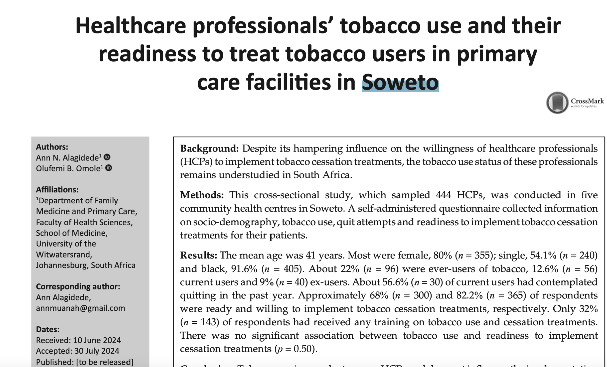
JOHANNESBURG HEALTH DISTRICT
2024 RESEARCH CONFERENCE
CONFERENCE
#JoburgResearch2024

Slide 2
Background
About 1 billion people use tobacco worldwide. It is the single biggest cause of preventable death killing about 8.7M people (2021 WHO report)
In SA, a fifth of the population use tobacco. (GATS 2021) with
attributable deaths estimated at 39000 annually in 2019²
Brief advice by HCP’s increase tobacco abstinence rates by 30%²
Nurse led interventions for smoking cessation increases quit rates by 50%³

Slide 3
Background
Despite its hampering influence on healthcare professionals’ willingness to implement tobacco cessation treatments, their tobacco use status remains understudied in South Africa.
AIM
This study examined the prevalence of tobacco use among HCPs in five primary healthcare facilities in Soweto, Johannesburg district, South Africa. It further assesses HCPs readiness and willingness to implement TCT in their patients.

Slide 4
Methods
Research Design
Cross-sectional study
Study Setting
Five primary care facilities (CHCs) in Johannesburg sub-districts D, Soweto
Zola, Mofolo, Lillian Ngoyi, Chiawelo, and Itireleng CHC’s
Sample and sampling
Ethical clearance WITS HREC M210636 and JHB DRC,
Healthcare professionals with direct patient contact who can provide counselling services (doctors, dentists, nurses, community health workers)
Recruitment was done over 20 weeks until all eligible HCP’s had been reached
Data collection
Modified (SAQ)GATS Questionnaire

Slide 5
Methods :Study variables and definitions
Current tobacco user:
use of tobacco products daily or occasionally
Former tobacco user:
no tobacco use within the last 12 months of the study
Never user:
An HCP who has never smoked
Quit attempts:
An affirmative answer to “Have you ever tried to quit tobacco use”
Readiness for TCI:
Combined measure of perceived Importance and confidence on TCI
Willingness for TCI :
How eager participants were to intervene in TCI

Slide 6
Methods
Analysis:
A total of 480 participants were sampled across 5 CHC’s, of these 36 declined to enrol, bringing the response rate to 92.5%
Descriptive statistics were used to describe participants sociodemographic characteristics, tobacco use prevalence and patterns, quit attempts, participants’ perceived importance, confidence, and readiness to implement TCI’s
Bivariate analysis was used to test associations between groups. Statistical significance was set at p< 0.05
A total of 444 healthcare professional’s data was analyzed

Slide 7
Key Results
The mean participant age was 41 years
Most were female, 80% (n=355), single, 54.1% (n=240) , and black, 91.6% (n=405).
About 22% (n=96) were ever-users of tobacco, 12.6%(n=56) current users and 9%(n=40) ex-users.
About 56.6%(n=30) of current users had contemplated quitting in the past year and 77% had made quit attempts
Only 32% (n=143) of respondents had received any training on tobacco use and cessation treatments.
There was no significant association between tobacco use and readiness to implement cessation treatments (p=0.50).

Slide 8
results
 |  | Ever used tobacco |  | Pearson’s chi-square
 |  | No | Yes
 |  | Frequency (%) |  | Test statistic | df | p-value
Professional category | Doctor | 60 (78.9) | 16 (21.1) | 27.107 | 3 | <.001
 | Dentist | 9(75) | 3(25)
 | Nurse | 189(87.5) | 27(12.5)
 | Community health worker | 90(64.3) | 50(35.7)

Slide 9
Results Importance, confidence and willingness for TCI
9

Slide 10
Results
Item | Frequency (%) |  | n | p-value
 | Yes | No
Ready to implement tobacco cessation treatments | 300 (68) | 144 (32) | 444 | <.001*

Slide 11
Bottom line findings
1. High tobacco use prevalence especially among males and CHW
2. Most current users have made unsuccessful attempts to quit
3. Most HCPs were ready and willing to implement tobacco cessation interventions despite little training
4. Readiness to implement TCI was irrespective of sociodemographic characteristics, tobacco use status, quit attempts or prior tobacco training.
5. Despite their readiness to perform TCT’s, few HCPs are skilled enough to treat tobacco users

Slide 12
What are the implications and the way forward?
The high tobacco use prevalence among HCP has implications for the general population, it undermines the message that tobacco use is harmful and that quitting is important
Further underscores the need to strengthen targeted tobacco cessation for this population:
Identifying factors in well designed studies associated with success or failure of quit attempts can guide policy makers in targeted interventions
There is a need to scale up undergraduate and in-service training on tobacco use and integrate services such as tobacco counsellors and low costs tobacco cessation products in primary health care.

Slide 13
Conclusion
Tobacco use prevalence in HCP’s is high and most of these professionals have made quit attempts
Efforts towards its further reduction are important to obtain a decrease in the high prevalence in the general population and calls for targeted interventions, tobacco cessation training e.g. CPD’s, and integrated cessation services in healthcare
Further qualitative and quantitative studies utilizing bigger and more nationally representative samples are needed to explore the unsettled evidence of how tobacco use status influences the willingness/readiness of HCP to implement TCI

Slide 14
Limitations
cross-sectional design
Self-report may have caused recall and social desirability bias
Study setting - under-representation of other racial entities leading to underestimation of the tobacco prevalence
Not a national study: different provinces may have different prevalence and patterns of tobacco use

Slide 15

Thank you.
Questions?

