Slide 1
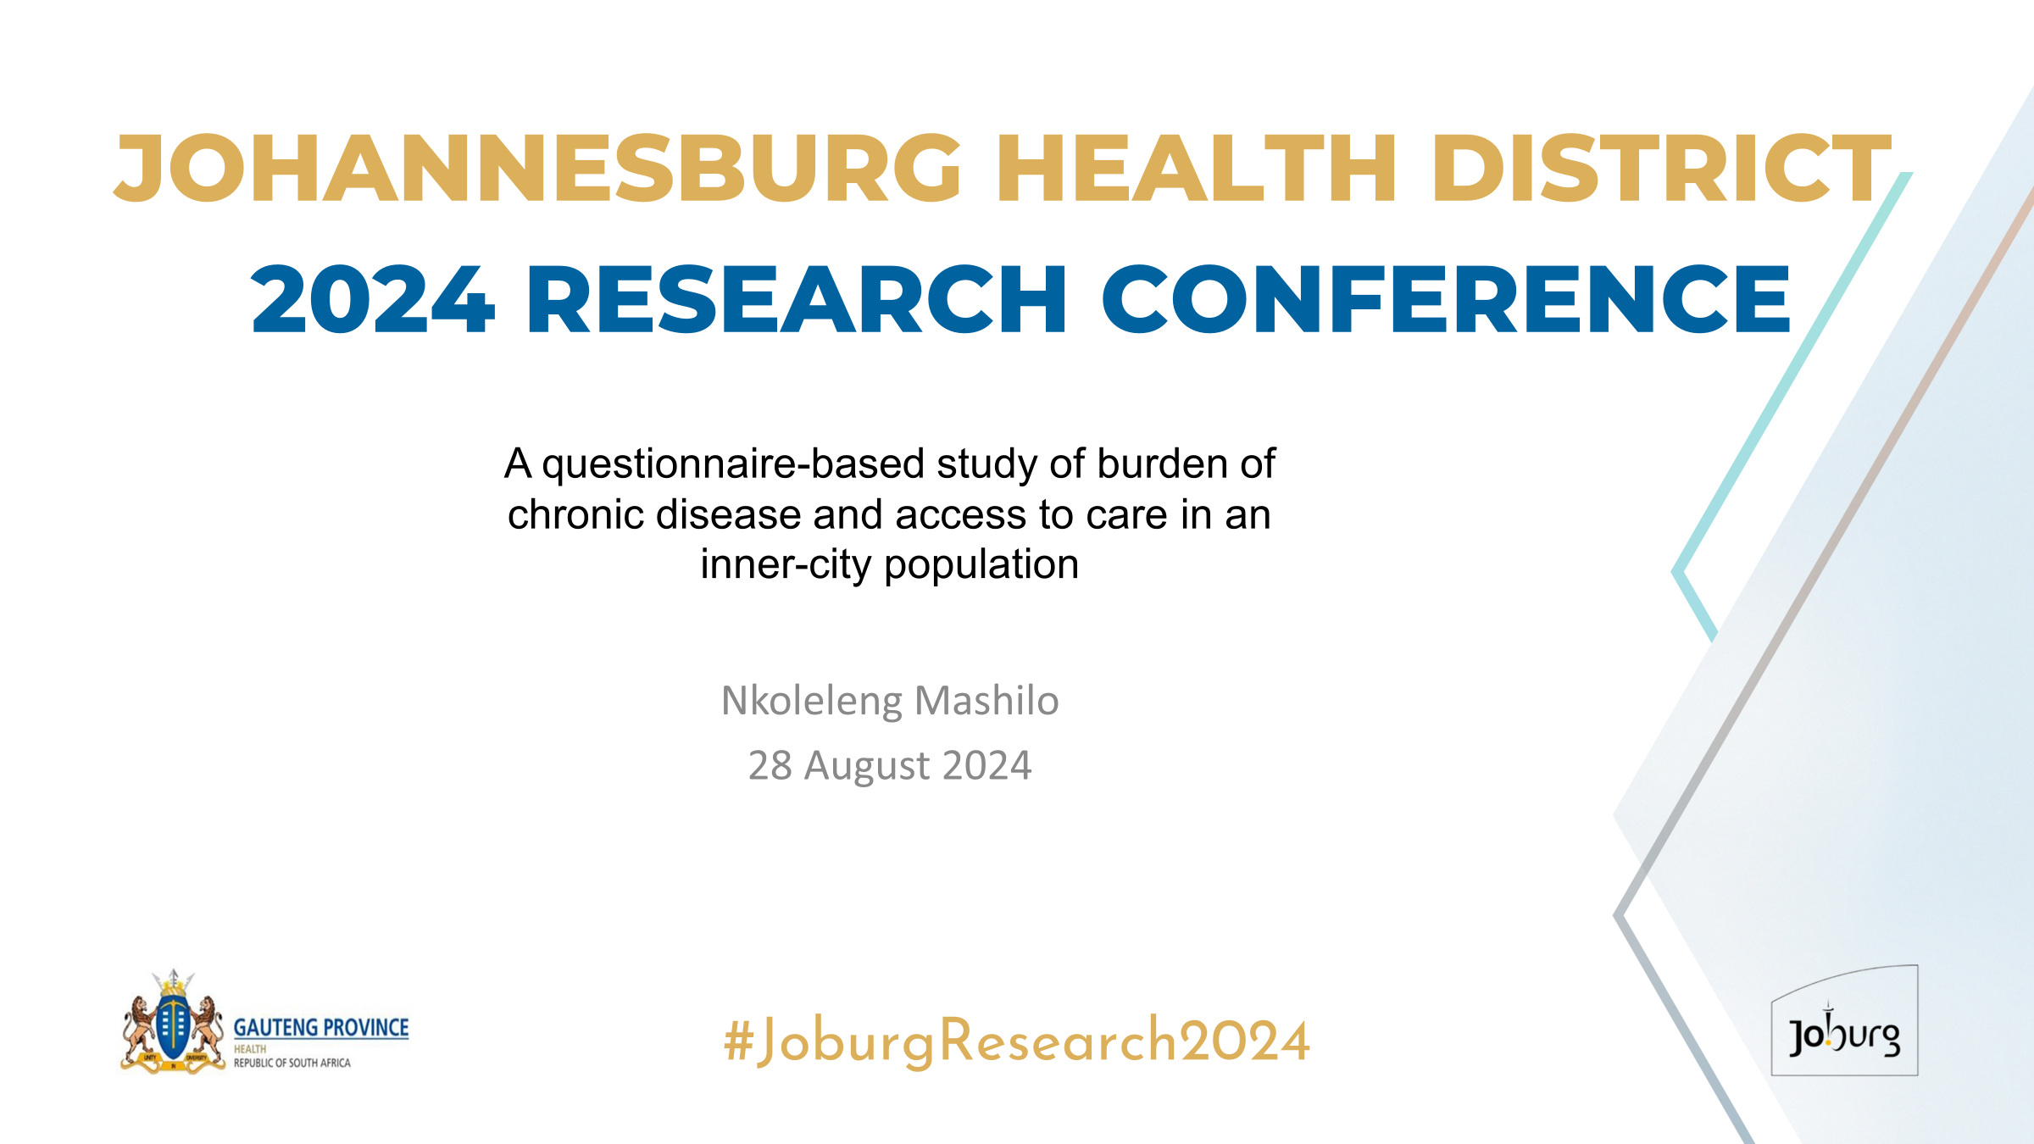

Slide 2





Background
JOHANNESBURG HEALTH DISTRICT
2024 RESEARCH CONFERENCE
Keeping people healthy as they increase in age and vulnerability to chronic illness has become a public health priority
Screening, effective treatment and holistic care depends on patient-focused, efficient delivery of services, often not possible in over-burdened primary healthcare settings where curative care is a priority.
South Africa has quadruple burden of disease whereby HIV and tuberculosis are prioritized with clear programmes of care as compared to non-communicable diseases like hypertension, diabetes respiratory and mental diseases with no clear programmes.
Both communicable and non-communicable diseases are globally the leading cause of death.
#JoburgResearch2024

Slide 3
Aim and Objectives
JOHANNESBURG HEALTH DISTRICT
2024 RESEARCH CONFERENCE
To evaluate the feasibility and acceptability of patients and healthcare workers using Ezintsha Chronic Care Centre as a future healthcare facility option for the treatment of chronic conditions
To evaluate the feasibility of patients and healthcare workers utilizing the services of Ezintsha Chronic Care Centre
To evaluate the acceptability of using Ezintsha Chronic Care Centre as an option for treatment of chronic conditions
#JoburgResearch2024

Slide 4
Eligibility Criteria
JOHANNESBURG HEALTH DISTRICT
2024 RESEARCH CONFERENCE
Inclusion
Age ≥ 18 years
Comfortable reading English
Accessing or working in healthcare services in Ezintsha Research Site, Region F clinics and surrounding clinics, CMJAH and South Rand Hospital
Agree to signing consent form
Exclusion
Less than 18 years of age
Refusal to sign consent form
#JoburgResearch2024

Slide 5
Method
JOHANNESBURG HEALTH DISTRICT
2024 RESEARCH CONFERENCE
A quantitative cross-sectional study was done.
Five hundred and three participants( 503) were recruited in inner city of Johannesburg health institutions( Yeoville, Esselen, Jeppe clinics and Charlotte Maxeke Johannesburg Academic Hospital).
A once-off visit for screening and enrolment was conducted.
REDCap was used for consenting and questionnaire.
#JoburgResearch2024

Slide 6
Results
JOHANNESBURG HEALTH DISTRICT
2024 RESEARCH CONFERENCE
Ages 30-39 | 381
Females | 71%
Unemployed | 44%
South Africans | 67%
Reside in the inner city of Johannesburg | 69%
Diagnosed as HIV positive | 58%
Diabetes Mellitus | 3%
Hypertension | 14%
No chronic condition | 27%
#JoburgResearch2024

Slide 7
Results Continued…
JOHANNESBURG HEALTH DISTRICT
2024 RESEARCH CONFERENCE
Use free health services | 90%
Would prefer to use Ezintsha Chronic Care Centre, attributed to: Less time spent at clinic Availability of medication Friendly staff | 96% 66% 62% 56%
Had prior encounter with Ezintsha | 30%
No prior encounter with Ezintsha | 53%
#JoburgResearch2024

Slide 8
Take Aways
JOHANNESBURG HEALTH DISTRICT
2024 RESEARCH CONFERENCE
NCDs are common in relatively young, female and unemployed populations
HIV prevalence was high as adult population prevalence is 13.7%
Intersection of HIV and NCDs ( HPT, DM) and its potential negative health effects as people age, is concerning
Primary health care needs be strengthened to accommodate the NCD/ HIV bulge at clinics such as Ezintsha
#JoburgResearch2024

Slide 9
Recommendations
JOHANNESBURG HEALTH DISTRICT
2024 RESEARCH CONFERENCE
A larger sample size needed and to include other Gauteng metropolitans and regions.
A qualitative study to be done to get more in-depth to clarify if there is a need for a chronic care centre in the inner city of Johannesburg
#JoburgResearch2024

Slide 10
Acknowledgements
JOHANNESBURG HEALTH DISTRICT
2024 RESEARCH CONFERENCE
Gauteng Provincial Health Department
Johannesburg District Health Department
Ezintsha Research Centre
Facilities: Yeoville, Esselen, Jeppe clinics, Ezintsha research Centre and Charlotte Maxeke Johannesburg Academic Hospital patients and health workers.
#JoburgResearch2024

