Slide 1





Combining HIV Prevention Options with Mental Health Service Delivery for Adolescent Girls (CHOMA) Results of a Pilot Hybrid Effectiveness-Implementation Randomized Trial
JOHANNESBURG HEALTH DISTRICT
2024 RESEARCH CONFERENCE
Jennifer Velloza, Nomhle Ndimande-Khoza, Lisa Mills, Nicole Poovan, Elizabeth Sherwin, Carrie Mathew, Zinhle Sokhela, Ruth Verhey, Dixon Chibanda, Sybil Hosek, Connie Celum, Sinead Delany-Moretlwe
#JoburgResearch2024

Slide 2
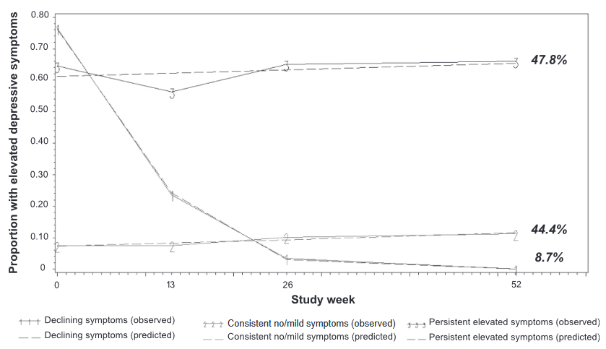
Background
JOHANNESBURG HEALTH DISTRICT
2024 RESEARCH CONFERENCE
Data from HPTN 082 on persistence of depression symptoms
Overlapping risk of HIV acquisition and common mental disorders (CMD) among adolescent girls and young women
CMD & HIV driven by overlapping social/structural determinants of health
CMD associated with low PrEP adherence
Associated with 25% lower PrEP adherence
Velloza et al., JIAS, 2021; Velloza et al., AIDS & Beh, 2020
#JoburgResearch2024
Notes:
Adolescent girls and young women face dual burdens of HIV and mental health CLICK
Which are often driven by overlapping social and structural determinants of health like stigma and economic insecurity CLICK
Common mental disorders have been associated with low PrEP adherence across a number of African cohorts CLICK
In HPTN 082 for example, persistent depressive symptoms were associated with 25% lower PrEP adherence.

Slide 3
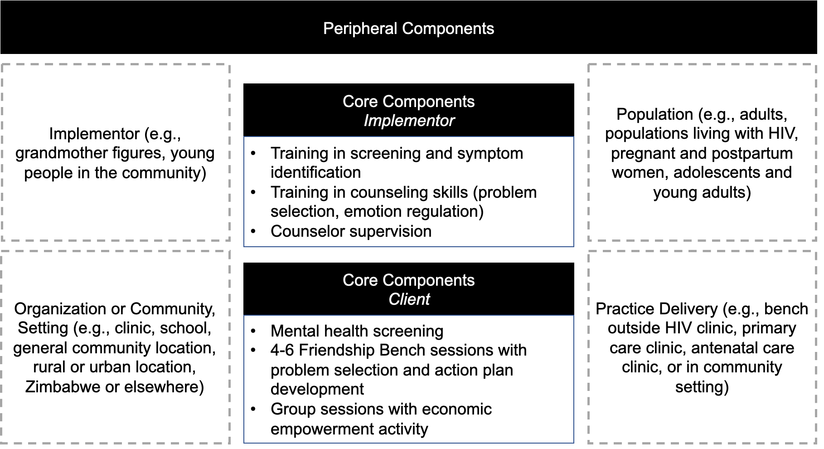
Mental health intervention
JOHANNESBURG HEALTH DISTRICT
2024 RESEARCH CONFERENCE
Friendship Bench problem-solving, cognitive behavioral intervention
4-6 individual therapy sessions + 1 group session
Delivered by a lay counselor in a safe space
#JoburgResearch2024
Notes:
This data highlights the need for targeted mental health interventions delivered alongside HIV prevention services
The Friendship Bench is a problem-solving cognitive behavioral therapy that has been highly effective in reducing mental health symptoms after 4-6 individual sessions, and 1 group session on economic empowerment.
The Friendship Bench was originally developed for adults in Zimbabwe for delivery by grandmother figures on benches outside clinics. In our prior formative research, we adapted the Friendship Bench intervention to be more suitable for young women in our setting, this included delivery by young female lay counsellor in a private room, and offering the counselling alongside PrEP adherence counseling.

Slide 4
Our goal was to evaluate preliminary effectiveness, acceptability, feasibility, and appropriateness of our “Youth Friendship Bench SA” intervention to address common mental disorders and PrEP adherence among young South African women
JOHANNESBURG HEALTH DISTRICT
2024 RESEARCH CONFERENCE
#JoburgResearch2024
Notes:
In this hybrid effectiveness-implementation trial, we sought to evaluate…

Slide 5
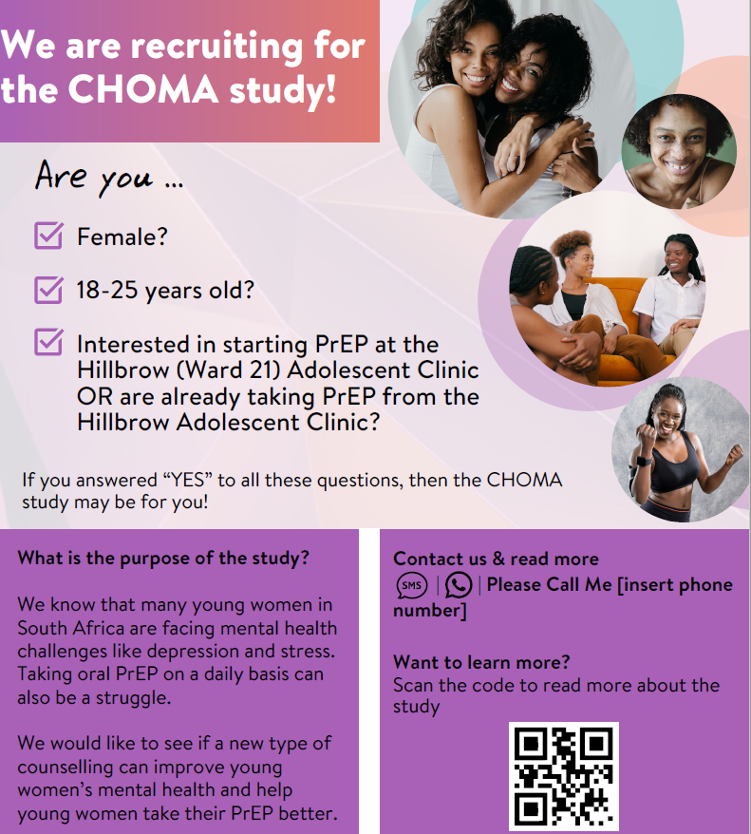
Study setting and population
JOHANNESBURG HEALTH DISTRICT
2024 RESEARCH CONFERENCE
Single-site, open-label pilot hybrid effectiveness-implementation trial
Conducted from April 2023 – Feb 2024
Already taking PrEP or interested in initiating PrEP
Elevated CMD symptoms based on Self-Reporting Questionnaire-20 item [SQR-20] score ≥7
No active, unmanaged psychosis or suicidal intent
#JoburgResearch2024
Notes:
Our study was conducted at Ward 21 CRS, and participants were recruited predominantly from Ward 21 Adolescent Clinic, and Esselen Clinic
We recruited young women aged 18-25 years, taking PrEP, and with elevated mental health symptoms
Young women with active and unmanaged psychosis or suicidal intent were excluded and linked to care with a social worker or psychologist for further treatment

Slide 6
Study Design
JOHANNESBURG HEALTH DISTRICT
2024 RESEARCH CONFERENCE
Recruit AGYW receiving PrEP from public clinic in Johannesburg
Refer out any AGYW with evidence of self-harm intent or psychiatric symptoms to social work team for further assessment and intervention
Screen for eligibility, based on South African Adult Primary Care Guidelines and SRQ-20
Enroll & Randomize
Youth Friendship Bench SA + SOC:
Counseling at Enrollment, Week 2 (optional over phone), Week 4, Week 8 (optional over phone), and Week 12
SOC:
Mental health symptom screen and referrals to social workers as needed at Enrollment, Week 4, and Week 12
Outcomes: PrEP adherence & common mental disorder symptom reduction at Week 12
#JoburgResearch2024
Notes:
Participants were randomized to either the Friendship Bench intervention plus SOC services or SOC alone.
Those in the intervention arm received 5 individual Friendship Bench counseling sessions over three months. For two sessions, they had a choice of in-person or remote counselling over the phone. They were also invited to a group session on career and financial planning.
All participants received standard of care mental health services in accordance with South African Adult Primary Care Guidelines, including mental health screening and referral.
Our co-primary outcomes were PrEP adherence and common mental disorder symptom reduction at Week 12.

Slide 7
Statistical analysis
JOHANNESBURG HEALTH DISTRICT
2024 RESEARCH CONFERENCE
Co-primary outcomes, assessed at Week 12:
Proportion with PrEP adherence as measured by detected tenofovir (TFV) in urine using a urine point-of-care assay
Proportion with reduced symptoms of CMD as measured by SRQ-20 scores <7
Secondary outcomes:
PrEP adherence and CMD symptoms at Week 4
Acceptability, feasibility, appropriateness (in-depth interviews; AIM, FIM, and IAM 4-item Likert scales)
Intent-to-treat analyses
Poisson regression with a log-link and robust standard errors
Weiner et al., Implement Sci, 2017
#JoburgResearch2024
Notes:
PrEP adherence was measured as the presence or absence of tenofovir in urine using a urine point-of-care assay that corresponds to PrEP use in the prior 2-7 days
Reduced mental health symptoms were measured as a score less than 7 on the SRQ20 CLICK
We also explored the effect of our intervention on PrEP adherence and mental health symptoms at Week 4, conducted in-depth interviews, and quantified the acceptability, feasibility, and appropriateness of our intervention with three validated scales CLICK
All primary analyses were intent to treat CLICK
And we used Poisson regression with a log-link and robust standard errors to determine relative risks

Slide 8
Results
JOHANNESBURG HEALTH DISTRICT
2024 RESEARCH CONFERENCE
106 excluded, including:
44 with low SRQ-20 score
40 with unmanaged mental health disorders
7 with report of suicidal intent
1 aged 26 years or older
1 HIV positive
14 did not complete procedures or declined enrollment
222 screened
116 enrolled* and randomized
57 assigned to Youth Friendship Bench SA + SOC
58 assigned to SOC
Week 12 retention: 37 (65%)
Week 12 retention: 41 (71%)
57 included in ITT analysis
35 included in per-protocol analysis
58 included in ITT analysis
48 included in per-protocol analysis
#JoburgResearch2024
Notes:
We screened 222 AGYW CLICK. and enrolled 116. However, 1 participant exited between enrollment and randomization. CLICK
57 were assigned to the Youth Friendship Bench SA intervention and 58 to the standard of care CLICK
At Week 12, retention was 65% in the intervention arm and 71% in the standard of care arm.

Slide 9
Participant characteristics
JOHANNESBURG HEALTH DISTRICT
2024 RESEARCH CONFERENCE
 | Intervention N=57 | SOC N=58
 | N (%) or Median (IQR)
Age | 21 (19 – 22) | 21 (20 – 23)
Some college education | 21 (37%) | 19 (33%)
SRQ-20 score for depression symptoms | 9 (8 – 10) | 8 (7 – 10)
GAD-7 score for anxiety symptoms | 7 (5 – 11) | 6 (4 – 10)
Positive PC-PTSD score for traumatic stress symptoms | 28 (49%) | 20 (35%)
Gender-based violence | 44 (77%) | 41 (71%)
Sexual partner in last month | 37 (65%) | 42 (72%)
Transactional sex in last month | 11 (19%) | 11 (19%)
#JoburgResearch2024
Notes:
Arms were balanced on participant characteristics at enrollment
The median age was 21 years CLICK
The median SRQ-20 score at enrollment was 8-9 CLICK
71-77% reported gender based violence prior to enrollment CLICK
and most were sexually active

Slide 10
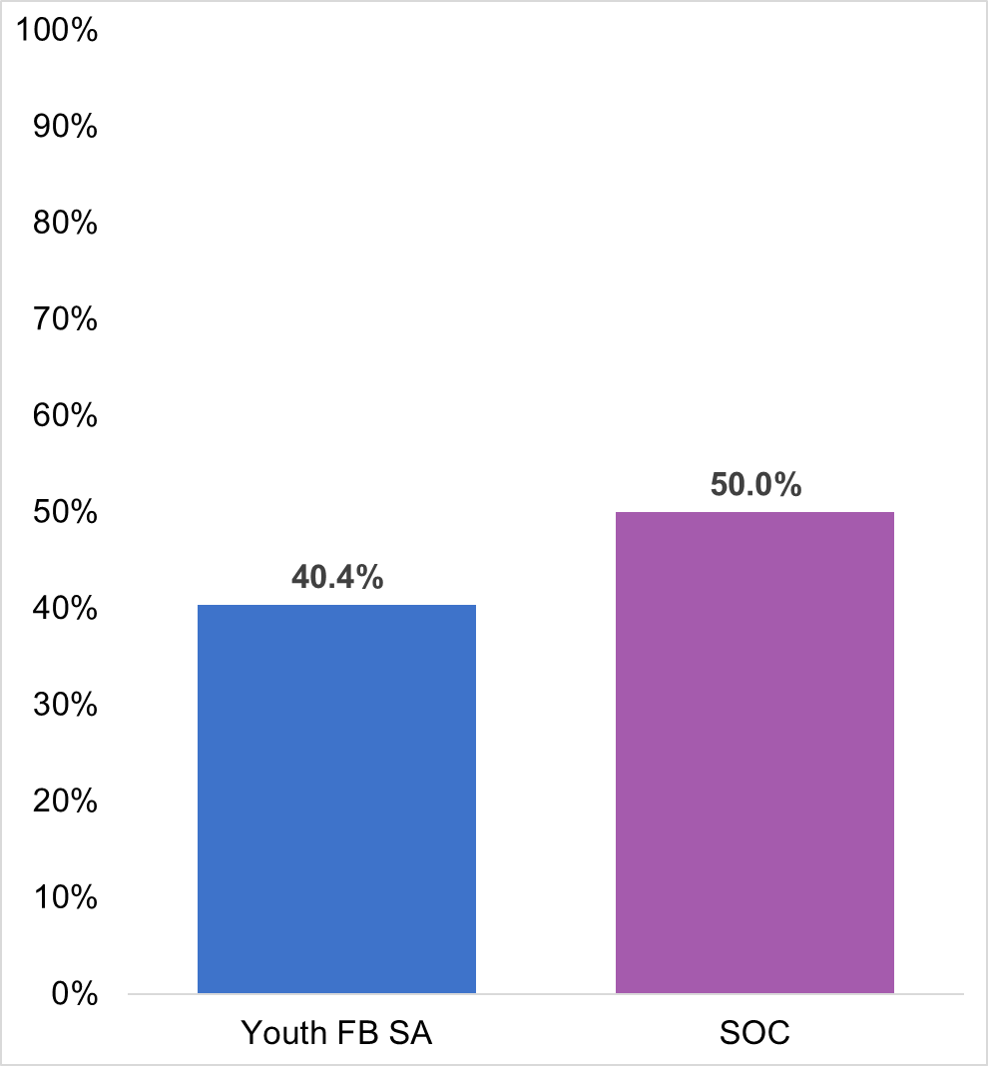
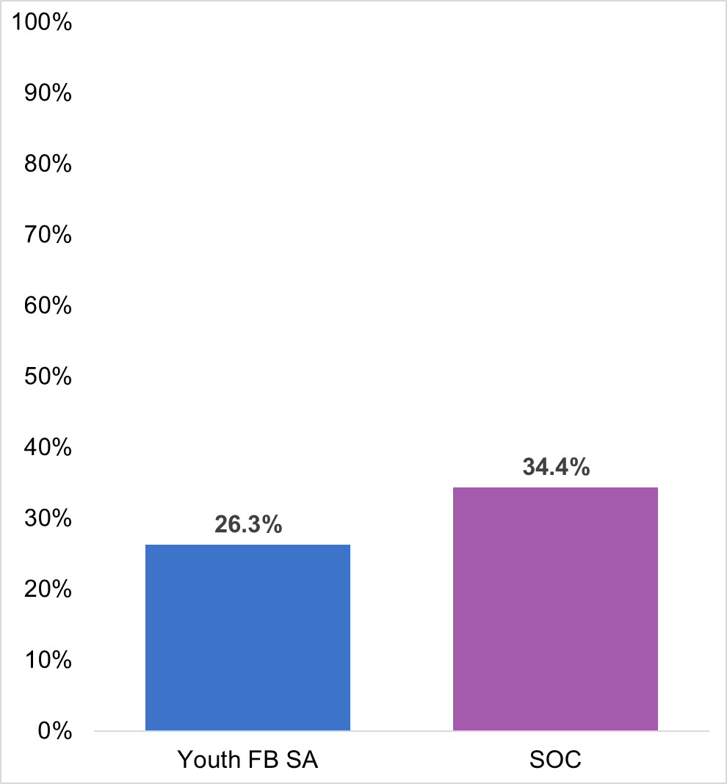
Effect of the intervention on Mental Health
JOHANNESBURG HEALTH DISTRICT
2024 RESEARCH CONFERENCE
Primary Outcome: Week 12 (N=115)
Secondary Outcome: Week 4 (N=115)
SRQ-20 Score <7
SRQ-20 Score <7
CMD symptoms declined overall:
SRQ-20 <7 among 30% at Week 4 versus 45% at Week 12; p<0.01
RR=1.00 (95% CI: 0.71-1.42)
% of participants
% of participants
RR=0.81 (95% CI: 0.50-1.29)
(N=29/58)
(N=23/57)
(N=20/58)
(N=15/57)
#JoburgResearch2024
Notes:
There was no significant difference in mental health symptoms between the groups at week 12 or at week 4.
However overall depressive symptoms declined significantly in the cohort over time. 30% had low SRQ-20 scores at Week 4 but by Week 12 almost half of the cohort had no or very mild symptoms of common mental disorders

Slide 11
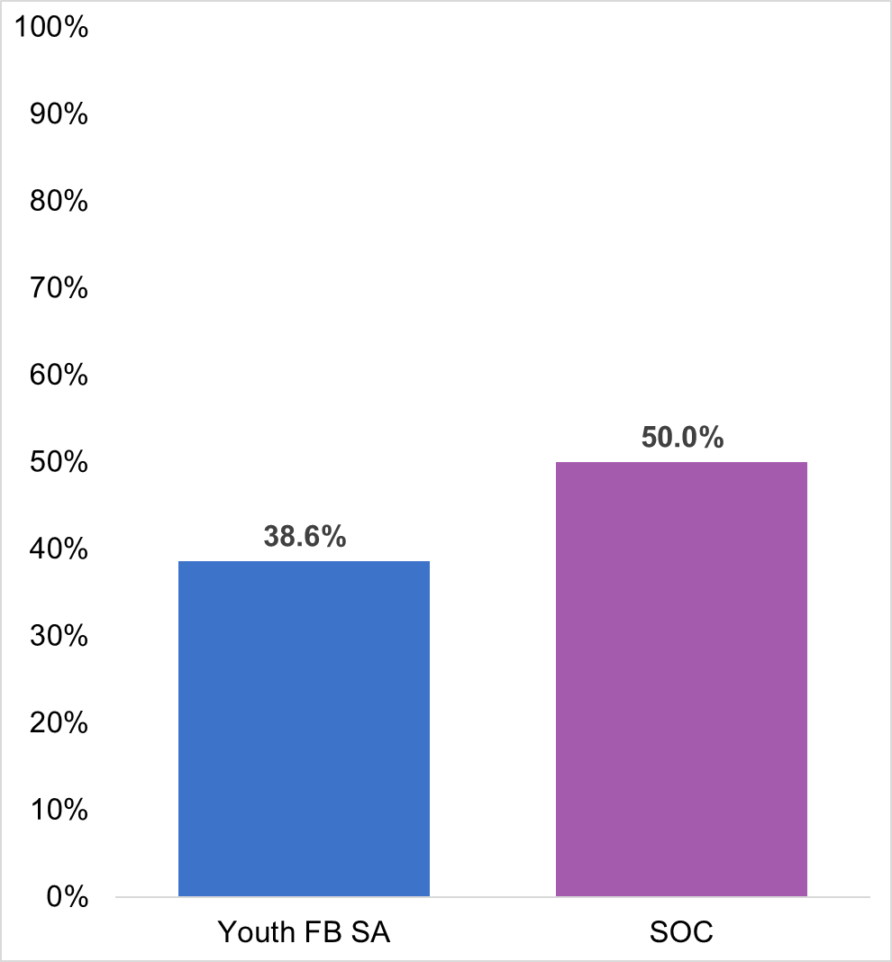
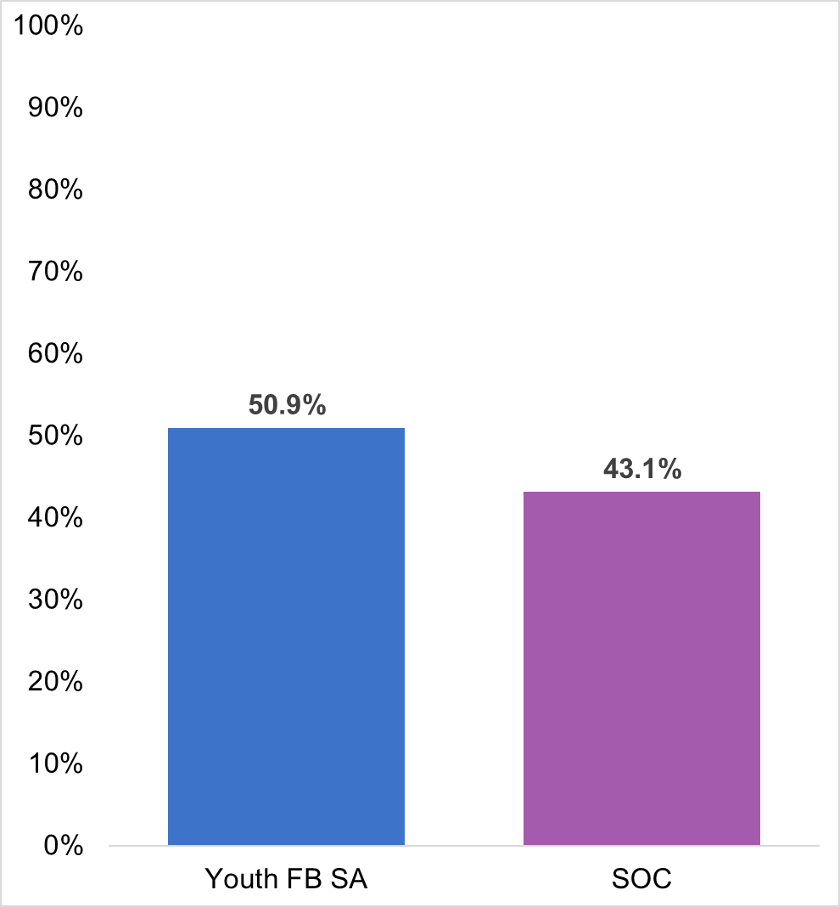
Effect of the intervention on PrEP Adherence
JOHANNESBURG HEALTH DISTRICT
2024 RESEARCH CONFERENCE
Primary Outcome: Week 12 (N=115)
Secondary Outcome: Week 4 (N=115)
Positive Urine POC Assay Result
Positive Urine POC Assay Result
RR=1.40 (95% CI: 1.03-1.89)
PrEP adherence over time:
Urine positive test among 47% at Week 4 versus 43% at Week 12; p=0.25
RR=0.88 (95% CI: 0.64-1.22)
% of participants
(N=29/58)
% of participants
(N=29/57)
(N=25/58)
(N=22/57)
#JoburgResearch2024
Notes:
For PrEP adherence at week 12, we did not observe a statistically significant difference between the arms CLICK
At week 4, PrEP adherence was significantly higher in the intervention arm, indicating a short-term intervention effect. CLICK
PrEP adherence overall in the cohort did remain stable between Week 4 and 12 with 47% having a positive urine assay at Week 4 and 43% at Week 12

Slide 12
Intervention acceptability & feasibility
JOHANNESBURG HEALTH DISTRICT
2024 RESEARCH CONFERENCE
Acceptability, appropriateness, feasibility scores were high (AIM, IAM, FIM 4-item measures)
Most participants had not previously received CMD screening or SOC procedures
Youth Friendship Bench SA acceptable, integration with PrEP as critical
Not formal, counsellors approachable
Problem-solving approach was empowering
“No one ever asked me how I’m feeling before” SOC arm study participant
“I won’t be given pills and go home…I get to talk about what is happening in my life” Intervention arm study participant
“This felt like talking to a friend” Intervention arm study participant
“This felt like talking to a friend” Intervention arm study participant
#JoburgResearch2024
Notes:
Acceptability, appropriateness, and feasibility scores were high among intervention participants
Data from in-depth interviews indicated that most participants had never been screened or provided mental health services prior to joining the study
Young women were positive about the intervention and acceptability hinged on approachability of the counsellors and coming up with their own solutions

Slide 13
Conclusions and recommendations
JOHANNESBURG HEALTH DISTRICT
2024 RESEARCH CONFERENCE
Interventions are needed to address high burden of poor mental health and risk for HIV in this population
No intervention effect on CMD symptoms at 12 weeks
Significant reductions in mental health symptoms in both arms
Both arms received an ‘intervention’
No intervention effect on PrEP adherence at 12 weeks
Short-term intervention effect on PrEP adherence at Week 4
May benefit from LA agents
Acceptability, feasibility, and appropriateness was high
Services need to promote standard-of-care mental health service delivery in resource-constrained settings
Future research is needed to improve integrated mental health and PrEP services for AGYW over a long-term period
#JoburgResearch2024
Notes:
Interventions are needed to address the high burden of poor mental health and risk for HIV in this population
We saw overall reductions in mental health symptoms irrespective of arm. Both arms received SOC services, which seemed to be happening more regularly with our study than in true standard of care settings. It may have been that the SOC offered in the study including screening and referral, was an intervention in itself and impacted participants in both arms CLICK
We did not find an effect of our intervention on PrEP adherence Week 12 CLICK
However, we did see a short term intervention effect on PrEP adherence at Week 4. It could be that the intervention helped participants during the first month when they were frequently engaging with counselors, but the novelty and participant’s willingness to implement their action plan reduced over time, or there were other challenges that interfered with PrEP use, illustrating the potential benefit of long acting agents CLICK
Overall, the Youth Friendship Bench was acceptable, feasible and appropriate for AGYW in Johannesburg CLICK
Services need to promote SOC mental health service delivery in resource-constrained settings, and CLICK future research is needed to improve mental health and PrEP services over a long-term perio

Slide 14















Acknowledgements
JOHANNESBURG HEALTH DISTRICT
2024 RESEARCH CONFERENCE
Jennifer Velloza
Nomhle Ndimande-Khoza
Nicole Poovan
Elizabeth Sherwin
Carrie Mathew
Zinhle Sokhela
Ruth Verhey
Dixon Chibanda
Sybil Hosek
Connie Celum
Sinead Delany-Moretlwe
Funding:
K99 MH123369 (PI: Velloza)
R00 MH123369 (PI: Velloza)
#JoburgResearch2024
Notes:
I am presenting this work on behalf of our study team at University of California, San Francisco and Wits RHI.

