Slide 1





Challenges in establishing a Pregnancy Surveillance Program in Soweto
JOHANNESBURG HEALTH DISTRICT
2024 RESEARCH CONFERENCE
Presenter: Bongani Ntimani
Date: 28 August 2024
#JoburgResearch2024

Slide 2
INTRODUCTION
Pregnancy surveillance (PS) refers to measures that identify and track pregnancies and their outcomes
Pregnancy surveillance is an important approach for monitoring maternal and newborn health, as well as for identifying stillbirths and neonatal mortality.
Establishing a PS Program can be quite complex, and various challenges may be encountered.
This paper outlines key challenges in conducting population-based PS in Soweto and Thembelihle.

Slide 3
Why Pregnancy Surveillance?
Sentinel measure of health system’s performance
Pregnancy acts as a critical indicator of the overall health system's effectiveness.
Opportunity for health promotion
Increased healthcare interactions during pregnancy enable targeted health education.
Enhanced public health initiatives
Leverage pregnancy surveillance to improve maternal and child health outcomes.
Women are required to access healthcare services during pregnancy, providing a unique touchpoint for evaluation.
Facilitates the promotion of healthy behaviors and preventive interventions for both mother and child.
Strengthen healthcare system performance and accessibility through targeted interventions.

Slide 4


STUDY AIM AND OBJECTIVES
The aim of the pregnancy surveillance program is to measure pregnancy outcomes, detect stillbirths and neonatal deaths, monitor pregnancy and health-related factors, and evaluate interventions.
The objective of the study is to provide guidance for life-saving maternal and child health interventions by accurately and timely identifying pregnancies and their outcomes.

Slide 5
METHODS
The program began collecting data in March 2022 at ANCs around Soweto and Thembelihle area.
01
Comprehensive data is being collected from antenatal cards, clinical records, Maternity Case Records, and through interviews with Pregnant women or family members.
04
Prospective and retrospective data collection
03
Pregnant or recently delivered women regardless of age within CHAMPS catchment area were eligible for enrollment.
02

Slide 6





Pregnancy surveillance - Process
  Screening
2. Enrolment
3. File review
4. Delivery info
5. Follow up
Research Study Assistants (RSAs), stationed at ANC facilities, determine eligibility:
  Pregnant or delivered within 42 days
  Resident of catchment area
Informed consent, enrolment and assign CHAMPS ID.
Enrolled Nurses (ENs) stationed at MOUs and Hospital capture visits, deliveries and review files.
RSAs and ENs: telephonic follow up for post EDD participants and arrange home visit for those who delivered for completion of day 1 forms.
RSA and ENs: telephonic follow up for day 42 and arrange home visit for completion of forms.

Slide 7
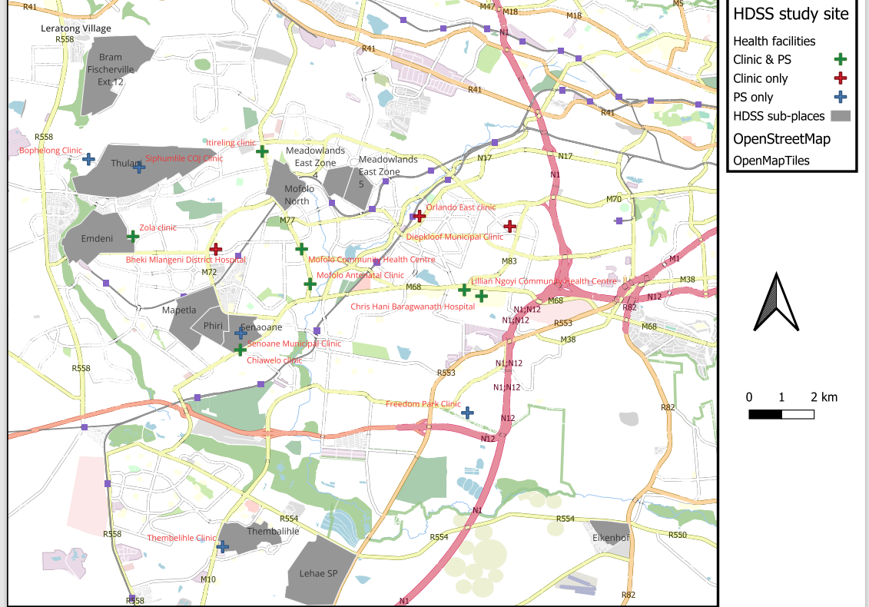
Ps - healthcare Facilities
Facilities ANC/MOU/Hospital
Freedom Park ANC
Thembelihle ANC
Meadowlands ANC
Senaone ANC
Bophelong ANC
Siphumlile ANC
Itireleng ANC/MOU
Zola ANC/MOU
Chiawelo ANC/MOU
Mofolo ANC/MOU
Lillian Ngoyi ANC/MOU
Bheki Mlangeni District Hospital
Chris Hani Baragwanath Academic Hospital

Slide 8
RESULTS
.
The pregnancy surveillance program screened 4805 pregnant women from March 2022 to May 2024.
The total of 4607 (95.9%) were enrolled, with 77.6% enrolled while pregnant and 6.3% within six weeks of delivery.
Most participants (72.6%, n=3345) were of childbearing age (20-35 years), with about one-third (n=1415) booking in the first trimester.
The program recorded 97% live births and 1.7% stillbirths.

Slide 9
Pregnancy Stage at Enrolment

Slide 10
Pregnancy Outcomes
 | Livebirth | Stillbirth | Miscarriage | TOP | Ectopic | Total
2022 | 1022 | 9 | 14 | 0 | 0 | 1045
2023 | 1694 | 32 | 21 | 1 | 1 | 1749
2024 | 1103 | 33 | 6 | 0 | 0 | 1142
Total | 3819 | 74 | 41 | 1 | 1 | 3936

Slide 11
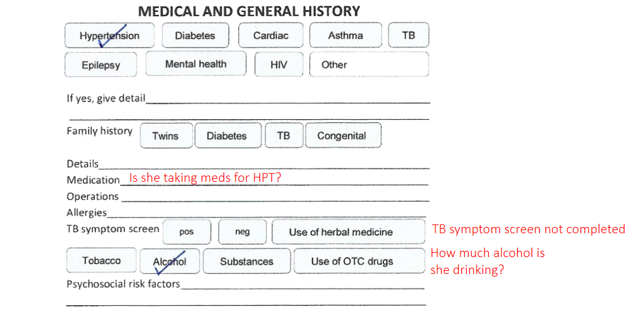

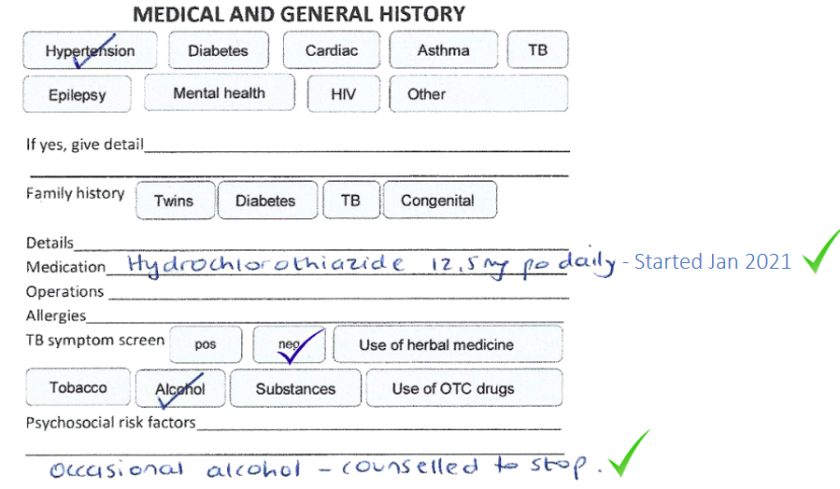
CHALLENGES
.
Incomplete clinical records such as syphilis test results, EDD, HIV medication exposure.
Women providing incorrect answers to shorten interviews.
Difficulty in multiple household visits due to work schedules and stigma (Teenage Pregnancy).
Women often conceal pregnancies, preferring not to disclose before three months (Cultural factors)

Slide 12
CONCLUSION
It is essential to clearly define and thoroughly follow methodological standards for conducting pregnancy surveillance. This is because these rules can affect the quality of data, and the accuracy of information provided to maternal and child health programs.
Addressing the challenges associated with establishing pregnancy surveillance has the potential to improve data quality for PS while also allowing for the implementation and evaluation of interventions.

Slide 13
RECOMMENDATIONS
Invest in training healthcare professionals and CHWs to enhance healthcare quality and surveillance.
1
Conduct workshops and awareness campaigns in local communities emphasizing the benefits of early and regular prenatal monitoring.
2
Implementing a program to educate families on detecting abnormalities and responding is necessary.
3
Involve significant individuals in antenatal care and address the transportation barrier to make antenatal care more accessible
4
Utilize technology to track and monitor pregnancies, ensuring prompt data collection and follow-up.
5
Implementing these recommendations can help overcome the challenges in establishing an effective pregnancy surveillance programs, ultimately improving maternal and child health outcomes

Slide 14




