Slide 1





Association between Covid-19 and adverse pregnancy outcomes in South Africa: a time series analysis
JOHANNESBURG HEALTH DISTRICT
2024 RESEARCH CONFERENCE
Dr Alane Izu
Prof Ziyaad Dangor
Wits-VIDA
#JoburgResearch2024

Slide 2
Overview
JOHANNESBURG HEALTH DISTRICT
2024 RESEARCH CONFERENCE
Since 2014, Wits-VIDA has undertaken surveillance of all deliveries in Soweto (and surrounding areas)
Electronic database of all birth registries, which captures high level information such as maternal age, gestational age, maternal HIV status, mode of delivery birth weight, Apgar scores and infant outcome
Following COVID, reports that SARS-CoV-2 infection had been associated with adverse birth outcomes (intrauterine growth restriction, prematurity, low birth weight, ICU admission and stillbirth)
Use data to assess association between COVID and adverse outcomes
#JoburgResearch2024

Slide 3
Outcomes of interest
JOHANNESBURG HEALTH DISTRICT
2024 RESEARCH CONFERENCE
Live births
Stillbirths (SB)
Preterm
Preterm live births
Low birth weight (<2500g) live births (LBW
Very low birth weight (<1500g) live births (VLBW)
#JoburgResearch2024

Slide 4
Data processing
JOHANNESBURG HEALTH DISTRICT
2024 RESEARCH CONFERENCE
Gestational age and birth weight
Outcome and Apgar score
Removal of record where outcome was missing or recorded as TOP, abortion or miscarriage
Included only pregnancies with single gestation
#JoburgResearch2024

Slide 5
Methods
JOHANNESBURG HEALTH DISTRICT
2024 RESEARCH CONFERENCE
Autoregressive interrupted time series model
Terms for initial level and trend for each study period post COVID
Estimate average rate for month t
Counterfactual rate for month t
Percent change for the following periods:
2020 (Mar-Dec), 2021, 2022, 2023
Study period | Time
Pre-COVID | January 2016 – February 2020
COVID pre-Beta | March 2020 – December 2020
Post-Beta | January 2021 – June 2021
Post-Delta | July 2021 – November 2021
Post-Omicron | December 2021 – March 2022
Post-COVID | April 2022 – December 2023
#JoburgResearch2024

Slide 6
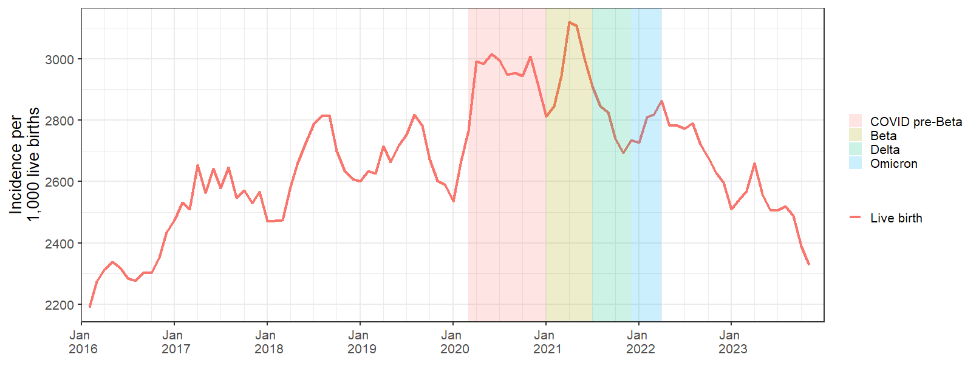
Live births
JOHANNESBURG HEALTH DISTRICT
2024 RESEARCH CONFERENCE
#JoburgResearch2024

Slide 7
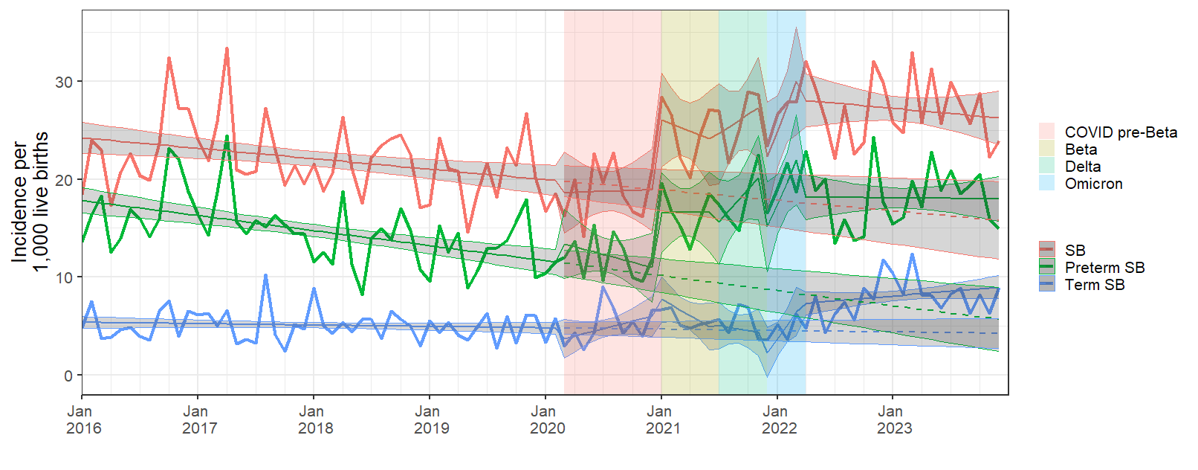
Stillbirths
JOHANNESBURG HEALTH DISTRICT
2024 RESEARCH CONFERENCE
37%
57%
64%
#JoburgResearch2024

Slide 8
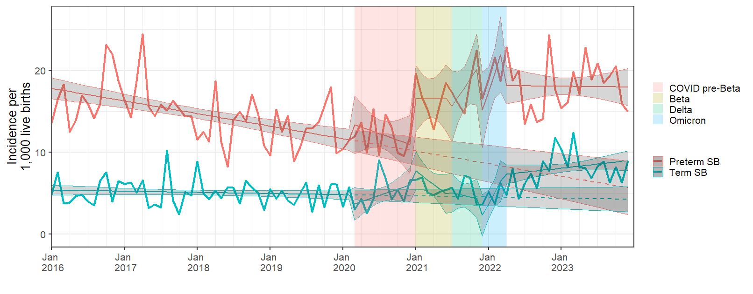
Stillbirths – by gestation
JOHANNESBURG HEALTH DISTRICT
2024 RESEARCH CONFERENCE
53%
74%
76%
39%
75%
#JoburgResearch2024

Slide 9
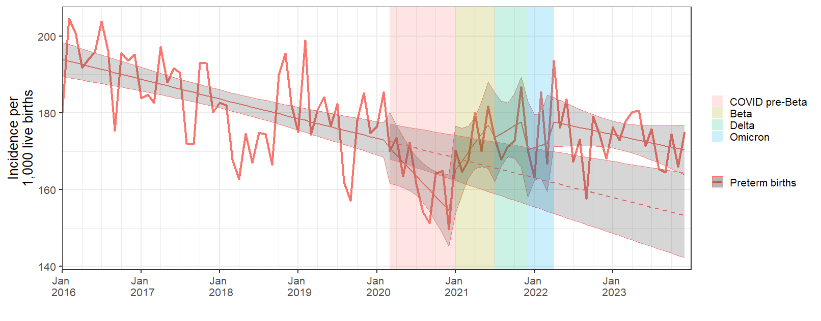
Preterm births
JOHANNESBURG HEALTH DISTRICT
2024 RESEARCH CONFERENCE
9% 11%
#JoburgResearch2024

Slide 10
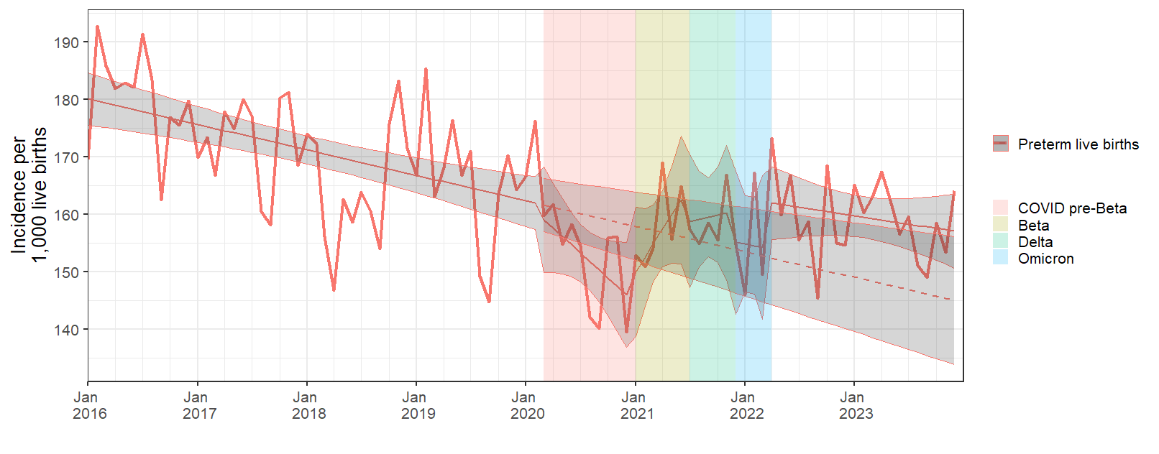
Preterm births
JOHANNESBURG HEALTH DISTRICT
2024 RESEARCH CONFERENCE
#JoburgResearch2024

Slide 11
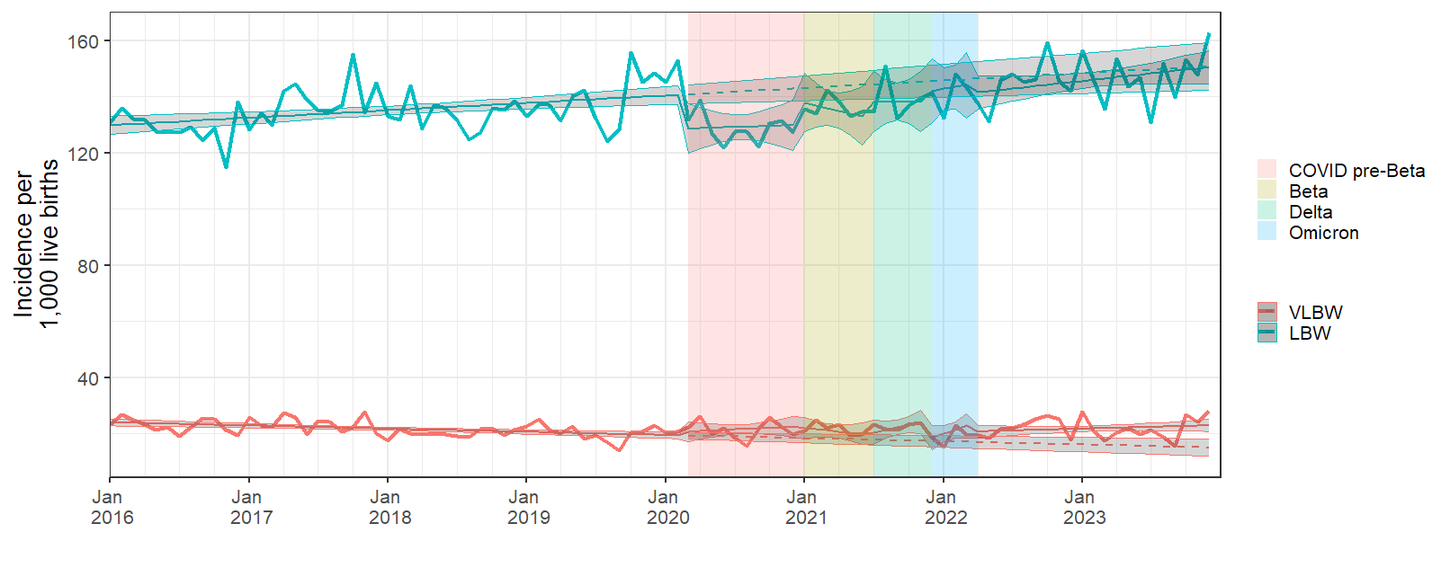
LBW and VLBW live births
JOHANNESBURG HEALTH DISTRICT
2024 RESEARCH CONFERENCE
#JoburgResearch2024

Slide 12
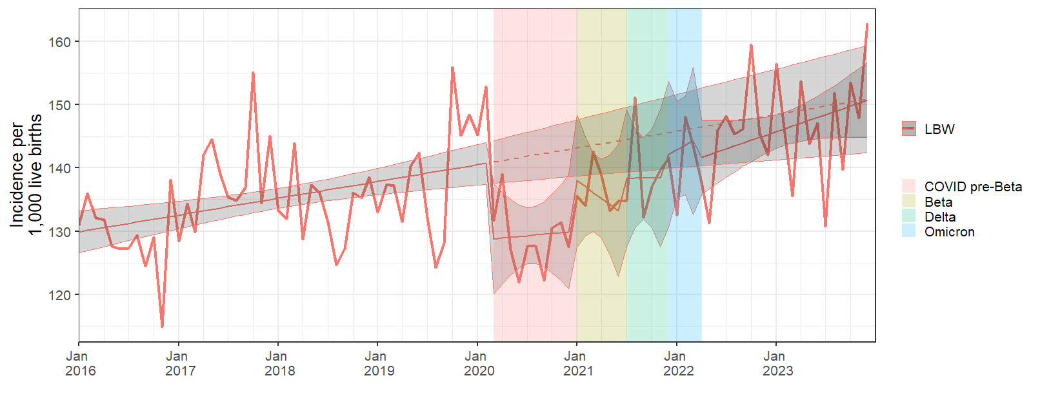
LBW live births
JOHANNESBURG HEALTH DISTRICT
2024 RESEARCH CONFERENCE
#JoburgResearch2024

Slide 13
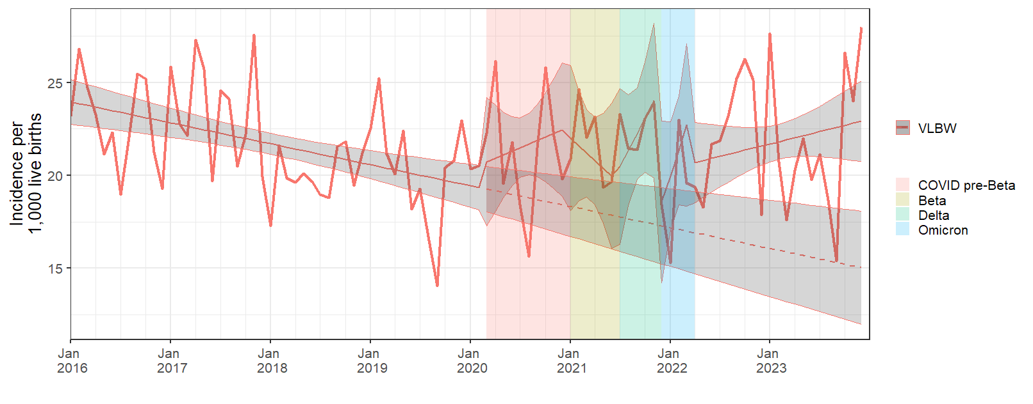
VLBW live births
JOHANNESBURG HEALTH DISTRICT
2024 RESEARCH CONFERENCE
25% 43%
#JoburgResearch2024

Slide 14
Conclusion
JOHANNESBURG HEALTH DISTRICT
2024 RESEARCH CONFERENCE
Shift in adverse outcomes
Preterm and stillbirths
Very low birth weight
Importance of surveillance and quality record keeping
Interventions and environmental changes that impact maternal health and pregnancy outcomes
#JoburgResearch2024
Notes:
Adding just a “little” bit of extra effort on existing platforms

Slide 15
Thank you
JOHANNESBURG HEALTH DISTRICT
2024 RESEARCH CONFERENCE
Mary Adam
Nisha Makan-Murphy
Bongani Ntimani
Revishka Rahmiah
Xumani Ndlovu
Yasmin Adam
Shabir Madhi
Participating MOUS and Maternity Wards
Maternity surveillance team at Wits-VIDA
#JoburgResearch2024

