Slide 1





A decade of HIV self-testing Practical lessons learnt from the HIV self-testing programme that can be leveraged into other self-care initiatives.
JOHANNESBURG HEALTH DISTRICT
2024 RESEARCH CONFERENCE
Shameema Ismail: Research Operations Manager Ezintsha
#JoburgResearch2024

Slide 2
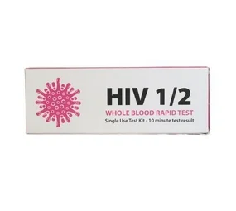
Introduction
JOHANNESBURG HEALTH DISTRICT
2024 RESEARCH CONFERENCE
HIV self-testing (HIVST) has rapidly progressed from the research and developmental phase to clinical evaluation, operational research, and large-scale implementation, exceeding most new health innovations.
Since the first major technical meeting on HIVST a decade ago, its adoption has expanded from a single country in 2013 to over 105 countries by 2023, with over 20 million tests available to be used worldwide.
We share insights from the implementation of HIVST in South Africa and beyond, providing guidance for future point-of-care and self-care products, as well as pandemic preparedness.
#JoburgResearch2024

Slide 3
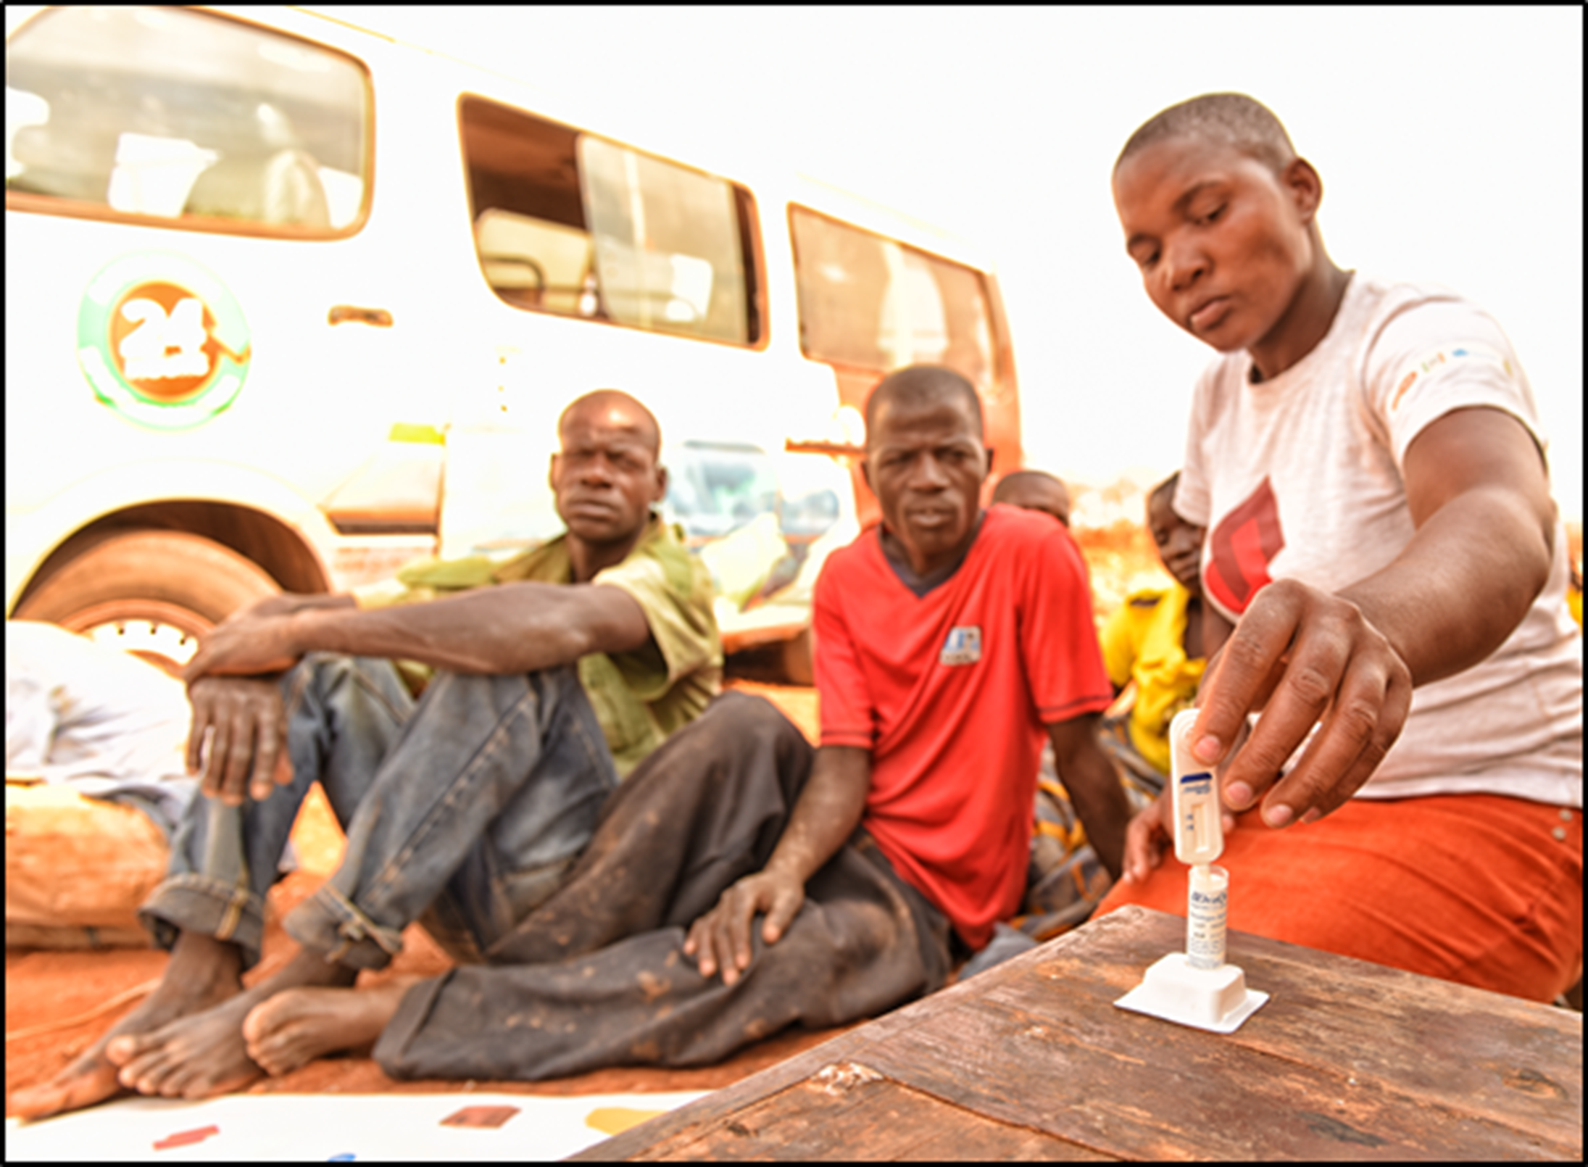
Lesssons Learnt
JOHANNESBURG HEALTH DISTRICT
2024 RESEARCH CONFERENCE
From the Self-test Africa (STAR) and HSTAR programs conducted by Ezintsha in collaboration with various partners since 2015, as well as participation with the South African National Department of Health and WHO technical working groups on HIVST, lessons were collected through experiential learning and consultation, then aggregated, themed, and summarized.
#JoburgResearch2024

Slide 4
Results
JOHANNESBURG HEALTH DISTRICT
2024 RESEARCH CONFERENCE
There are five key lessons that emerged from the rollout of HIVST in south Africa and the surroundings:
1. A test’s performance is highly dependent on its usability by the target population.
2. Acceptability of self-testing is high and creating decentralised access points for these tests is crucial.
3. Simplify monitoring and evaluation frameworks, recognising that these are screening tests requiring confirmatory testing.
4. Sustained demand creation and awareness are crucial for long-term success.
5. Self-testing interventions are designed for programme agility, and the lessons learnt can be applied to pandemic preparedness.
#JoburgResearch2024

Slide 5
Conclusion
JOHANNESBURG HEALTH DISTRICT
2024 RESEARCH CONFERENCE
By Utilizing the roadmaps developed for HIVST and the lessons learnt, we have accelerated policy development, product evaluation, and pilot programming cycles for new self-care technologies. The lessons learnt from HIVST implementation has been crucial to the foundational work being applied to Hepatitis C, Syphilis/HIV combination, and COVID-19 self-testing initiatives.
#JoburgResearch2024

Slide 6
JOHANNESBURG HEALTH DISTRICT
2024 RESEARCH CONFERENCE
Thank you
#JoburgResearch2024

