Slide 1
"I feel honored to have met CETA team because I saw many changes in my life” Positive experiences of patients living with HIV who received the CETA intervention in Johannesburg, SA
Johannesburg PHC Research Conference
Pertunia Manganye
28-29 August 2024
Notes:
LAWRENCE

Slide 2






Background
  Mental health and intimate partner violence (IPV) significantly impact women living with HIV
  High demand for mental health services, in the region is met with limited resources, creating a substantial gap in care.
  HIV-positive women who experience IPV are at high risk of:
    Mental health challenges such as depression and anxiety
  These challenges can impact HIV outcomes, such as:
    Adherence to treatment
    Viral suppression
    Retention in care

Slide 3
Common Elements Treatment Approach (CETA)
CETA is a flexible, cognitive, behavioral therapy-based intervention.
Can be delivered by lay counselors.
Tailored to address co-occurring mental and behavioral health issues.
Potential to bridge the gap in mental health support for people living with HIV.

Slide 4
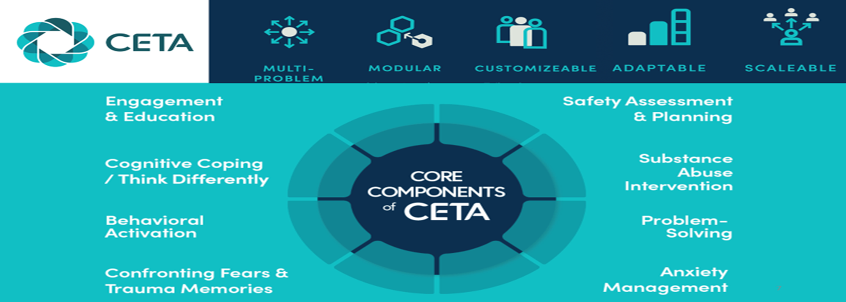
Introduction to the Common Elements Treatment Approach (CETA)

Slide 5
Study Design
Enrolled 400 women who have experienced IPV within the past 12 months
Participants had initiated ART and had at least faced challenges like:
  Unsuppressed viral load
  Defaulted treatment
  Missed or had come late for their clinic visit
Conducted in two clinics in Johannesburg, South Africa
  Themba Lethu Clinic in Helen Joseph Hospital
  Zola Clinic in Soweto
200 participants were randomly assigned to 12 weeks of CETA sessions and another 200 into control arm with SMS safety checks.

Slide 6
Safety Measures and Follow-up
All participants received an initial safety assessment and safety plan
Follow-up assessments at 3 and 12 months post-enrollment.
Gathering of participant feedback on their experiences in the study.
  310 follow-up assessments at 3 months.
  289 follow-up assessments at 12 months (assessments ongoing).

Slide 7

Life experiences and emotions before CETA
“Starting CETA, I was emotionally not okay. I couldn't accept many situations that were happening to me.”
“My partner was very abusive, and I didn't know how to tell him to go and start testing and taking his HIV medication. I was very worried about my health.”
“My partner used to abuse me verbally, emotionally, and physically before I was pregnant and after I was pregnant.”
“I was suffering from drug abuse and having a lot of depression and anxiety”

Slide 8
Positive Feedback Experiences After CETA
Participants highlighted the support received from CETA counsellors
"I see many changes in my life …may the CETA team spread the word to other women who need help like me."
“He no longer abuses me. I was able to talk to him to start taking his medication. Now we only argue like normal couples.”
"I saw changings in my life through CETA counselling and the support they gave me. I feel strong, I see happiness in my family.”
“Now my life has changed because I got helped by CETA. I am so proud today about life . It is not quite perfect, but it is better than before.”

Slide 9
Experiences from the Control Arm after SMS safety checks
Even participant in the control arm reported benefits
“The CETA sms helped me a lot thinking of my problems”
“Answering safety messages helped [me] to stay focused and not think of doing something stupid like wanting to kill myself.”
“The SMSs that I was receiving from the study helped keep me safe.”

Slide 10
MH Care integration into HIV care
Introducing CETA in primary health care facilities could have the potential to address the mental healthcare gaps
CETA counselors within the HIV clinics can improve the capacity to identify and support IPV and mental health concerns
Use of lay counselors – an opportunity for low-cost resource for MH support capacity
CETA offers a promising approach to improve mental health and HIV outcomes for women experiencing IPV

Slide 11
Limitation
Feasibility in clinical setting
  Limited resources
    Enough staff
    Space
    CETA-trained providers
      Assessors
      Counsellors
      Supervisors

Slide 12
Research challenges on the ground
Stigma and Discrimination
Access to Participants
Retention of Participants
  Safety checks
  Follow ups
Referral networks or systems
  Other health care facilities
  Mental health services
  Social services
  Community organisations

Slide 13
Thank you
Questions and Discussion

