Slide 1





Dorothy sefara presents
JOHANNESBURG HEALTH DISTRICT
2024 RESEARCH CONFERENCE
Description of Congenital Abnormalities from a Subset of Clinics in Soweto
#JoburgResearch2024

Slide 2
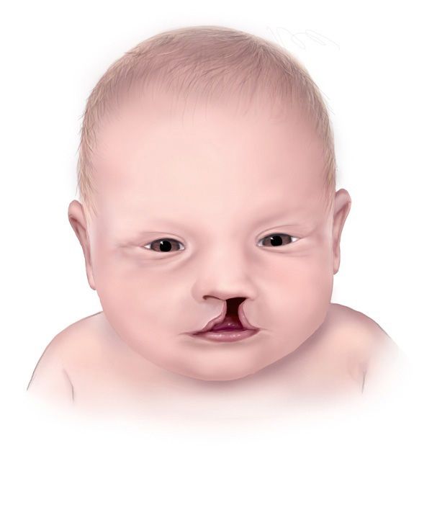
Introduction
Structural abnormality
Functional abnormality
They contribute significantly to morbidity and mortality
6% of births worldwide (WHO, 2024)
Notes:
Congenital abnormalities can be defined as structural OR functional abnormalities, that develop during the foetal period, and are present at birth.
They contribute significantly to morbidity and mortality in the paediatric population; therefore, it is important that their epidemiology is well understood
(Malherbe, 2015).
There are 6% of babies word wide born with a congenital abnormality (WHO)

Slide 3

OBJECTIVES
The objectives of the study were to determine:
The incidence rate of congenital abnormalities
Outcomes of congenital Abnormalities
Risk factors associated with congenital abnormalities

Slide 4



Methods
Enrolment
File review
Delivery info
Informed consent, enrolment at ANC visit.
Capture all ANC visits.
Capture delivery information and outcomes.
Notes:
A descriptive study was performed using enrollment from the UBOMI BUHLE.
The project enrolls pregnant women attending antenatal care and follows them up until after delivery.
Data collection started from July 2021 to date.

Slide 5
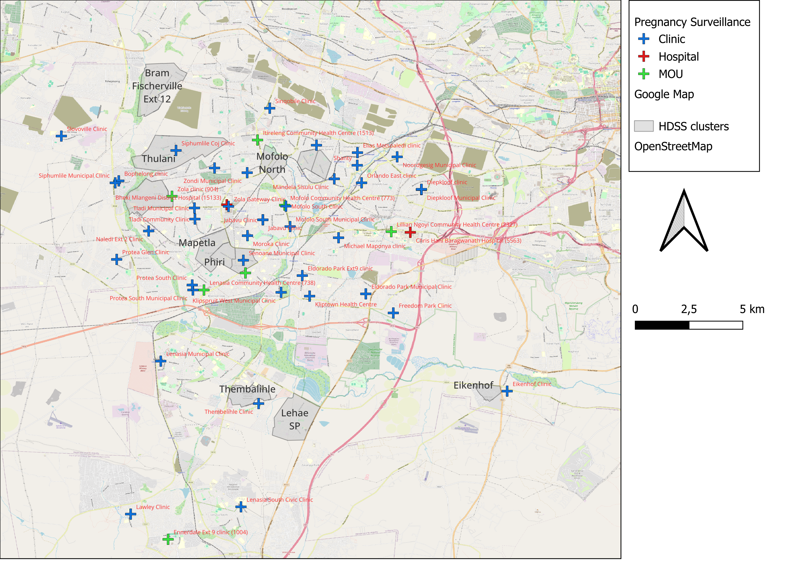
Itireleng
Lilian Ngoyi
Mofolo
Chiawelo
Bheki Mlangeni Hospital
Baragwanath Hospital
Chiawelo CHC
Notes:
In Gauteng it is done at four primary level antenatal clinics in Soweto
Chiawelo Clinic
Lillian Ngoyi Clinic
Itireleng Clinic
Mofolo

Slide 6
Results
Delivered outcome (n=6157) 100%
Other outcomes
(n=76)
1.3%
Stillbirths (n=117)
1.9%
Live births (n=5964)
96.8%
Present congenital abnormality
(n=59) 0.96%
No congenital abnormality
(n=5905) 95.9%
Present congenital abnormality (n=1) 0.016%
No congenital abnormality (n=116) 1,88%
Notes:
Prevalence and Demographics
The total number of pregnancies on the database with known outcomes was 6157.
Of those pregnancies, 96.8% (n= 5964) were live births, 1.9% (n= 117) were stillbirths, and 1.3% (n=76) had other outcomes.
Other outcomes includes miscarriages/spontaneous abortions, Termination of pregnancy, ectopic pregnancy, and maternal death before delivery.

Slide 7

Results continues…
Congenital Abnormalities
Of the infants with abnormalities
13.3 % (n= 8) had two detected abnormalities
6.7% (n=4) had three detected abnormalities
Notes:
The total number of patients congenital abnormalities identified at birth was 60, which is 0.97% of the births with known outcomes.
This is because functional issues are discovered later in life. Eg cardiac, metabolic and fetal alcohol syndrome

Slide 8
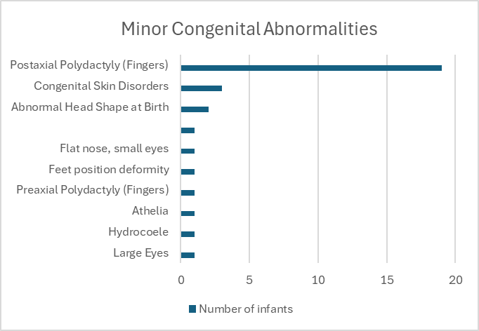
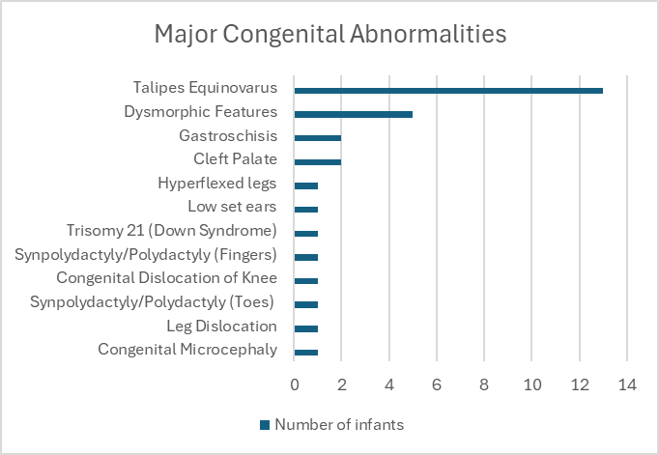
Results continues…
Notes:
Description of abnormalities at birth

Slide 9

Results continues…
Congenital Abnormalities
Of the 60 infants with congenital abnormalities, 1.6% (n=1) of them were detected via ultrasound prior to delivery.
Notes:
Few sonographers. Lack of training

Slide 10
Results continues…
 | Overall (n=6157) | With CA (n=60) | Without CA (n=6097) | p-value (comparing those with and without CA)
Advanced maternal age | 1435 (23.3%) | 12 (20.0%) | 1423 (23.3%) | 0.382
HIV exposure | 1092 (17.7%) | 12 (20.0%) | 1080 (17.7%) | 0.645
Maternal hypertension | 66 (1.1%) | 2 (3.3%) | 64 (1.0%) | 0.087
Maternal diabetes | 10 (0.2%) | 0 (0.0%) | 10 (0.2%) | 0.754
Reported alcohol use | 737 (12.0%) | 12 (20.0%) | 725 (11.9%) | 0.059
Reported smoking | 302 (4.9%) | 5 (8.3%) | 297 (4.9%) | 0.229
Mean birthweight | 2949.71g | 2813.72g | 2951.16g | 0.090
Gestational age | 38.32 weeks | 37.78 weeks | 38.33 weeks | 0.188
Notes:
These are the most common risk factors, But they are not statistically significant.
Substances are under reported.
Pertaining to risk factors for congenital abnormalities, no true level of significance could be ascertained for either of the parameters.
However, this may be attributable to the size of the sample.
As the study continues and the sample size increases, it is likely that this will change

Slide 11

Conclusion
0.97% (n=60) of infants were identified as having one or more congenital abnormality at birth.
The most common abnormality identified was polydactyly (minor)

Slide 12

Recommendation
Booking early for ANC
  Early ultrasound
  Screening for infections
  Education
  Preventable risk factors
Stillbirth examination
Reporting of birth defects
Notes:
Improving skills of sonographers
Abnormalities in stillbirths are under ported. This is a limitation
Vaccination against the rubella virus, for children and women
increasing and strengthening education of health staff and others involved in promoting prevention of congenital disorders; and
Risk factors include alcohol, smoking and drug use

Slide 13

THANK YOU

