Slide 1





Mental Health and Substance Use Impact on Tuberculosis Preventive Therapy Outcomes in People Living with HIV: A Prospective Cohort Study
JOHANNESBURG HEALTH DISTRICT
2024 RESEARCH CONFERENCE
Authors: Johnson, A., Chimoyi, L., Shenoi, S., Brault, M., Forastiere, L., Charalambous, S., Chihota, V., and Davis, J. L.
#JoburgResearch2024

Slide 2
Background
JOHANNESBURG HEALTH DISTRICT
2024 RESEARCH CONFERENCE
TB: the leading cause of death for people living with HIV¹
South Africa: high HIV and TB-related HIV deaths, tuberculosis preventive therapy (TPT) is not utilized to its full protection potential
Half of PLHIV in South Africa begin TPT, and less than half complete it²
PLHIV are predisposed to mental health and substance use comorbidities, which may impact their ability to complete TPT
Mental health and substance use disorders are common among PLHIV and associated with higher HIV mortality and lower ART adherence and retention^{3,4}
#JoburgResearch2024
¹ Global AIDS Update 2016; ²WHO 2018; ³Chibanda et al. JAIDS J Acquir Immune Defic Syndr 2014; ⁴Blashill et al. AIDS Behav 2015

Slide 3
Objectives
JOHANNESBURG HEALTH DISTRICT
2024 RESEARCH CONFERENCE
Estimate prevalence of depression, anxiety, and substance use for PLHIV initiating 3HP.
Estimate the impact of these comorbidities on the proportion of PLHIV who adhere to and complete 3HP.
#JoburgResearch2024

Slide 4
Study Design: Longitudinal Cohort Study
JOHANNESBURG HEALTH DISTRICT
2024 RESEARCH CONFERENCE
Setting:
August to December 2023
Chiawelo and Stretford CHCs
Participants: PLHIV on ART who were initiating 3HP
Procedures: Enrollment visit and 3-month follow-up visit
Exposure variables:
Depression: PHQ9¹
Anxiety: GAD7²
Alcohol use disorder: AUDIT-C³
Other substances: ASSIST⁴
Tobacco, Cannabis, Cocaine, Amphetamines, Inhalants, Sedatives, Hallucinogens, Opioids, Other
#JoburgResearch2024
¹ Cholera et al. J Affect Disord 2014; ² Bezuidenhout 2018; ³Peltzer et al. J Psychol Afr 2007; ⁴ Kaswa et al. South Afr Fam Pract 2020

Slide 5
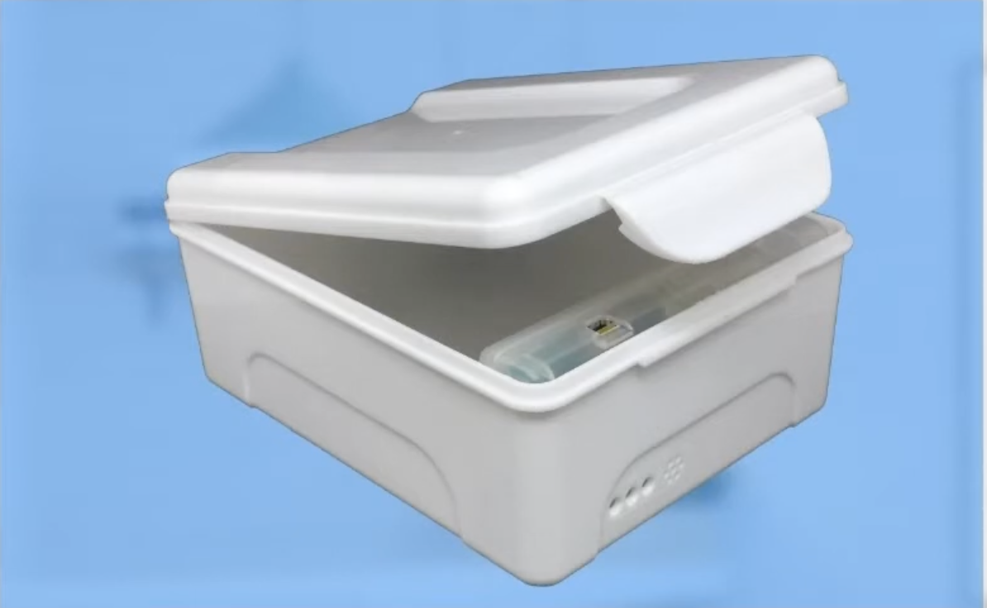
Study Design: Longitudinal Cohort Study
JOHANNESBURG HEALTH DISTRICT
2024 RESEARCH CONFERENCE
Outcomes:
3HP completion, defined as completing ≥11 doses within 12 weeks
3HP adherence, defined as the proportion of total doses completed within 12 weeks
3) Participants’ experiences with mental health and 3HP
Outcome assessment: Self-report, EvriMed boxes
#JoburgResearch2024

Slide 6
Table 1. Participant Characteristics (n=224)
JOHANNESBURG HEALTH DISTRICT
2024 RESEARCH CONFERENCE
Characteristics (n=224) | Median, IQR or n (%)
Age (years) | 44 (14)
Female Sex | 136 (61%)
Married | 94 (42%)
Secondary education or higher | 204 (91%)
Employed | 120 (54%)
Years since HIV Diagnosis | 7.6 (7.7)
Years on ART | 7.2 (7.1)
Depression | 81 (36%)
Anxiety | 63 (28%)
Unhealthy Alcohol Use | 76 (34%)
Tobacco Use | 60 (27%)
Cannabis Use | 18 (8%)
#JoburgResearch2024

Slide 7
Completion Results
JOHANNESBURG HEALTH DISTRICT
2024 RESEARCH CONFERENCE
Self Report: 190 (85%) completed 3HP
MERM box: 111/224 (50%) completed 3HP
#JoburgResearch2024

Slide 8
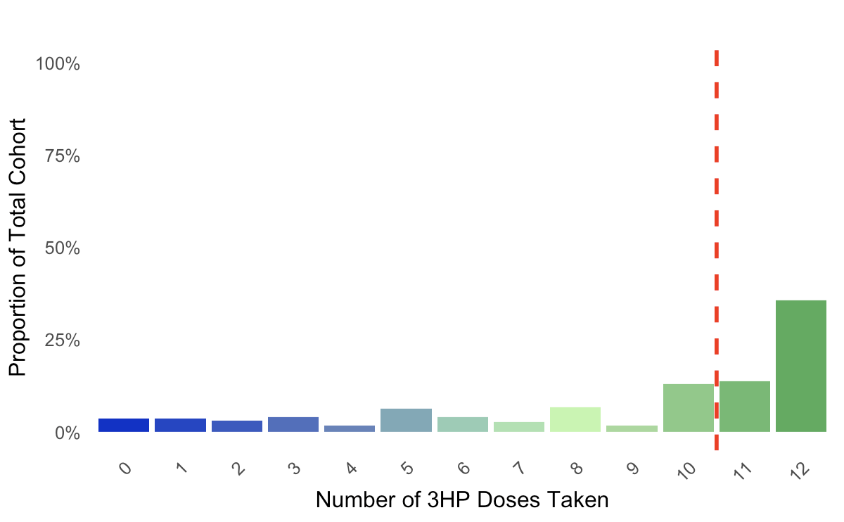
FIGURE 1. 3HP Adherence (n=224)
JOHANNESBURG HEALTH DISTRICT
2024 RESEARCH CONFERENCE
#JoburgResearch2024

Slide 9
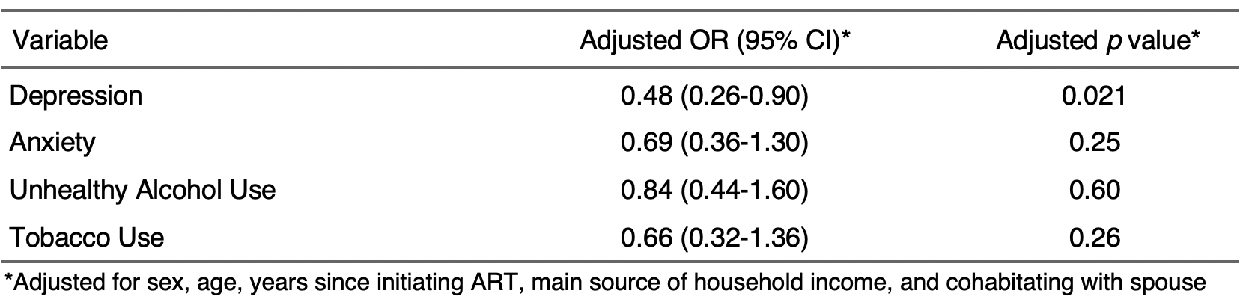
TABLE 2. Multivariate Analysis of 3HP Completion Predictors
JOHANNESBURG HEALTH DISTRICT
2024 RESEARCH CONFERENCE
#JoburgResearch2024

Slide 10
TABLE 3. Participant quotes about 3HP completion and non-completion
JOHANNESBURG HEALTH DISTRICT
2024 RESEARCH CONFERENCE
Factor | OR (95% CI) | p value | Theme | 3HP Completers | 3HP Non-Completers
Depression | 0.45 (0.26-0.79) | 0.005 | Mental health and treatment persistence | “When I felt down/ sad I would question if the medication was necessary but like I said, I forced myself for the benefit of my health.” | “I think I skipped one dose. I was feeling really tired and really just wanted to give up. I skipped 3HP that week because I felt that there was no need for it.”
Anxiety | 0.63 (0.35-1.13) | 0.12 | Mental health and treatment persistence | “When I overthink about my life and I am stressed I struggle to sleep sometimes and as a result I am tired in the morning and do not want to do anything but sit.” | “It has been the same. I still worry and cry a lot but I am coping. Sometimes I just feel like I do not want to socialize with anyone so I lock myself up in the house to avoid people.”
Unhealthy Alcohol Use | 0.69 (0.39-1.20) | 0.19 | Alcohol use as a coping mechanism | “After taking 3hp I feel like not having beer.” | “I felt like I could give up,” and that as a result she felt “in a way that I should consume a lot of alcohol.”
Time on ART (Years) | 1.06 (1.00-1.12) | 0.067 | Established routine from length of time on ART | “I didn’t have any special routine. I just took the 3HP at the same time as my ARV's. Only difference was the 3HP was on Thursdays only.” | “I tried to take it at the same time on Tuesdays but I think there were times I took earlier or a bit later”
Married | 1.03 (0.61-1.75) | 0.91 | Family support | “My child reminded me all the time to take my medication.” | “At home, they would discourage me from taking so many pills but I kept taking them.”
#JoburgResearch2024

Slide 11
Acknowledgements
JOHANNESBURG HEALTH DISTRICT
2024 RESEARCH CONFERENCE
Gauteng Department of Health
Johannesburg Health District
Chiawelo CHC and Stretford CHC
The Aurum Institute and Opt4TPT Study Team
Study Participants
Funding Support
YCCI Pre-Doctoral Fellowship
MacMillan International Dissertation Research Fellowship
#JoburgResearch2024

Slide 12
Key Recommendations
JOHANNESBURG HEALTH DISTRICT
2024 RESEARCH CONFERENCE
Summary:
High prevalence of depression, anxiety, unhealthy alcohol use, and tobacco use
Depression was significantly and negatively associated with adherence and completion
Recommendations:
1. Use existing resources: clinic psychologists and social workers
2. Expand mental health and substance use support through integration within HIV care
Incorporating screening, referrals, and therapeutic interventions
3. Adapt strategies from ART adherence to TPT adherence
Psychoeducation and rehearsal strategies for PLHIV
#JoburgResearch2024

