Slide 1





A Phase 2/3, Randomized, Double-Blind, Double-Dummy, Placebo-Controlled Study to Evaluate the Safety and Efficacy of 2 Regimens of Orally Administered PF07321332/Ritonavir in Preventing Symptomatic SARS-CoV-2 Infection in Adult
Household Contacts of an Individual With Symptomatic COVID-19.
JOHANNESBURG HEALTH DISTRICT
2024 RESEARCH CONFERENCE
Dr Luthando Adams
MBChB (UCT), MBA (UCT), MACCP, CPI
#JoburgResearch2024

Slide 2
INTRODUCTION
JOHANNESBURG HEALTH DISTRICT
2024 RESEARCH CONFERENCE
The purpose of this study was to evaluate the efficacy and safety of PF-07321332/ritonavir, hereafter referred to as nirmatrelvir/ritonavir, as postexposure prophylaxis for adult household contacts of an individual with symptomatic COVID-19.
COVID-19 manifests as a wide range of illness, from asymptomatic infection to severe pneumonia, ARDS, and death. Although most (approximately 80%) cases are asymptomatic or mild, patients who are hospitalized with COVID-19 may have significant morbidity and mortality and are at increased risk of developing complications such as severe inflammation associated with elevations in proinflammatory cytokines, ARDS, acute cardiac injury, thromboembolic events, hypercoagulability, and/or kidney injury.
Although there are symptomatic and/or supportive treatments for COVID-19, few antiviral drugs are available or in late-stage development to help treat COVID-19 in patients with mild to moderate COVID-19. In addition, vaccines take time to deploy and may not be taken by everyone.
#JoburgResearch2024

Slide 3
INVESTIGATIONAL PLAN
JOHANNESBURG HEALTH DISTRICT
2024 RESEARCH CONFERENCE
Global Phase 2/3, randomized, double-blind, double-dummy, placebo-controlled study in 2880 participants who had a negative screening SARS-CoV-2 RAT result and who were asymptomatic household contacts of individuals who were symptomatic and recently tested positive for SARS-CoV-2.
Study compared the efficacy of 2 regimens of nirmatrelvir/ritonavir versus placebo.
Eligible participants for this study were randomly assigned (1:1:1) within 96 hours after collection of the index case’s first positive SARS-CoV-2 test to treatment in 1 of 3 intervention groups.
The total duration of the study was up to 42 days.
18 sites in South Africa, 9 sites in Gauteng, BMDH was the only public facility site.
400 patients were planned to be enrolled in South Africa, 6 enrolled at BMDH.
Independent Ethics Committee (Pharmaethics), SAHPRA and Johannesburg Health District Research Committee approvals for BMDH.
#JoburgResearch2024

Slide 4
INVESTIGATIONAL PLAN
JOHANNESBURG HEALTH DISTRICT
2024 RESEARCH CONFERENCE
#JoburgResearch2024

Slide 5
STUDY INTERVENTION
JOHANNESBURG HEALTH DISTRICT
2024 RESEARCH CONFERENCE
Eligible participants for this study were randomly assigned (1:1:1) within 96 hours after collection of the index case’s first positive SARS-CoV-2 test to receive:
Nirmatrelvir/ritonavir every 12 hours (q12h) for 5 days followed by matching placebo q12h for 5 days; or
Nirmatrelvir/ritonavir q12h for 10 days; or
Matching placebo for nirmatrelvir/ritonavir q12h for 10 days.
The planned treatment duration is 10 days or 11 days depending if 2 doses or 1 dose of study
intervention were administered on Day 1, respectively
#JoburgResearch2024

Slide 6
SUMMARY OF RESULTS
JOHANNESBURG HEALTH DISTRICT
2024 RESEARCH CONFERENCE
Demographic and Other Baseline Characteristics
The mean age of participants was 43.38 years.
Similar proportion of Males (46.1%) and Females (53.9%). 50% at BMDH.
At Baseline, most participants (95.0%) had a negative RT-PCR confirmed SARS-CoV-2 result.
At Baseline, most participants had a positive serology antibody test (91.2%).
Most participants (73.7%) had at least 1 protocol-defined risk factor for progression to severe COVID-19.
Most participants (87.9%) had not received a COVID-19 vaccine.
Most participants (71.8%) were in the United States.
#JoburgResearch2024

Slide 7
SUMMARY OF RESULTS
JOHANNESBURG HEALTH DISTRICT
2024 RESEARCH CONFERENCE
Efficacy Results
The study was powered to detect a 70% risk reduction of developing symptomatic, RT-PCR
or RAT confirmed SARS-CoV-2 infection through Day 14 relative to placebo.
The proportion of participants who developed symptomatic RT-PCR or RAT confirmed SARS-CoV-2 infection through Day 14 was 2.4% for the nirmatrelvir/ritonavir 5-day regimen. 0% at BMDH.
The proportion of participants who developed symptomatic RT-PCR or RAT confirmed SARS-CoV-2 infection was 2.2% for the nirmatrelvir/ritonavir 10-day regimen.
The proportion of participants who developed symptomatic RT-PCR or RAT confirmed SARS-CoV-2 infection was 3.7% for placebo.
The risk reduction vs placebo was 31.6% (p=0.1419) and 37.1% (p=0.0948) for the 5-day and 10-day regimens, respectively
#JoburgResearch2024

Slide 8
SUMMARY OF RESULTS
JOHANNESBURG HEALTH DISTRICT
2024 RESEARCH CONFERENCE
Safety Results
The overall incidence of all-causality adverse events (AEs) was generally similar across the treatment groups. AEs were mostly mild (Grade 1) or moderate (Grade 2) in severity, except:
1 severe (Grade 3) event of Dysgeusia in the 5-day regimen group.
1 severe (Grade 3) event Fibrin D dimer increased in the 5-day regimen group.
1 severe (Grade 3) event of Dysgeusia in the 10-day regimen. None of these occurred at BMDH – mild adverse events of dysgeusia, diarrhea and myalgia were reported, including at BMDH.
There were no deaths related to an AE in any treatment group. There were no discontinuations from the study due to AEs.
No clinically meaningful differences were observed between the 5-day and 10-day
nirmatrelvir/ritonavir regimens and placebo with respect to hematology and clinical
chemistry laboratory test results.
#JoburgResearch2024

Slide 9
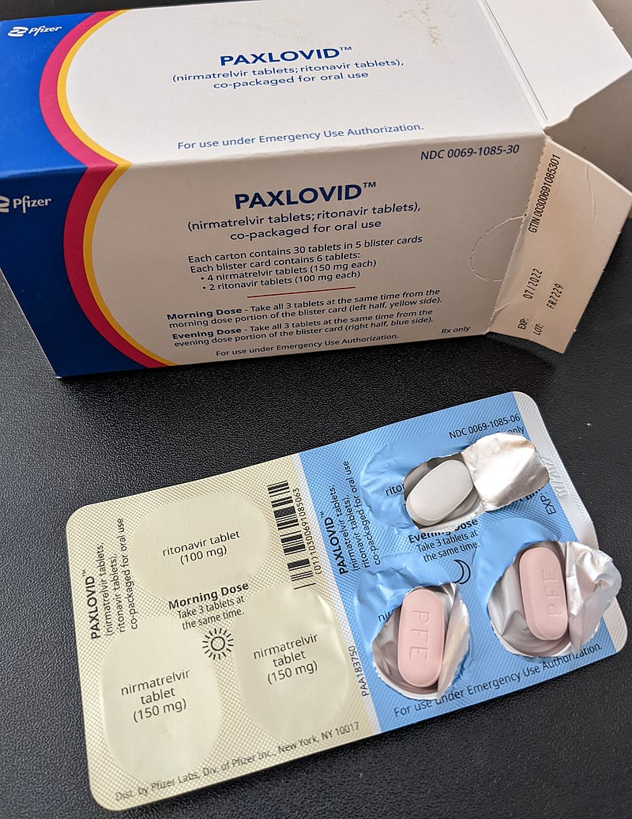
CHALLENGES
JOHANNESBURG HEALTH DISTRICT
2024 RESEARCH CONFERENCE
Conduct of clinical research in the public sector is very challenging as follows:
Lack of resources (physical infrastructure (no dedicated office space), staff etc.)
Approval delays
Participant misinformation
Lack of interest from healthcare professionals
#JoburgResearch2024

