Slide 1






Efficacy, safety & immunogenicity of H56:IC31 vaccine for Prevention of Recurrent TB (POR)
JOHANNESBURG HEALTH DISTRICT
2024 RESEARCH CONFERENCE
Lydia Mngomezulu, Project Manager
Statens Serum Institute, IAVI,
EDCTP, The Aurum Institute, POR Consortium
Lydia Mngomezulu, Álvaro H Borges, Marisa Russell, Dereck Tait, Trevor Beattie, Craig Innes, Tanya Nielson, Elana van Brakel, Andrea Cabibbe, Daniela Cirillo, Elisa Nemes, Thomas Scriba, Gavin Churchyard, Rodney Dawson, Issa Sabi, Andreas Diacon, Rasmus Mortensen, Mark Hatherill on behalf of the POR consortium.
#JoburgResearch2024

Slide 2
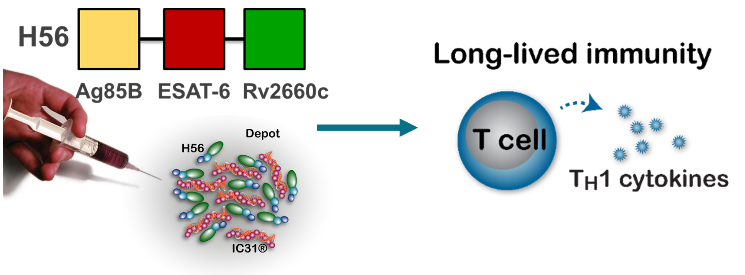
JOHANNESBURG HEALTH DISTRICT
2024 RESEARCH CONFERENCE
Background
This is the first reported trial with a POR TB design
Despite DS-TB TB cure, recurrent TB risk remains high
H56:IC31® previously shown to be safe & immunogenic, including in people with previous TB disease
Efficacy of H56:IC31® in reducing the rate of recurrent TB disease is unknown
H56:IC31® is a multistage fusion protein subunit vaccine consisting three Mtb antigens designed to introduce and boost ESAT-6 specific and BCG immunity and consists of a T helper type 1 cell (T_{H}1) stimulating adjuvant IC31 ® (Valneva)
#JoburgResearch2024

Slide 3
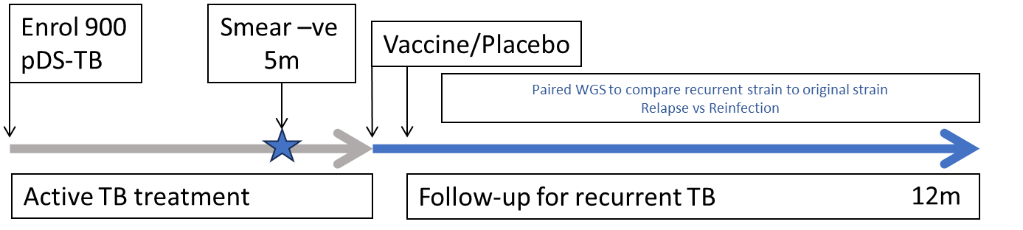
JOHANNESBURG HEALTH DISTRICT
2024 RESEARCH CONFERENCE
Methods
Trial population
Adults without HIV completing treatment for pulmonary DS-TB
Sputum smear-negative in Month 5 of DS-TB treatment
No extrapulmonary TB, or prior TB ≤ 5 years
Trial design
Blinded, placebo controlled random assignment (1:1) to receive two doses of either H56:IC31 or placebo (56 days apart)
Follow up for for culture-confirmed recurrent pulmonary TB from day 70 until end of 12 months post-vaccination
#JoburgResearch2024

Slide 4
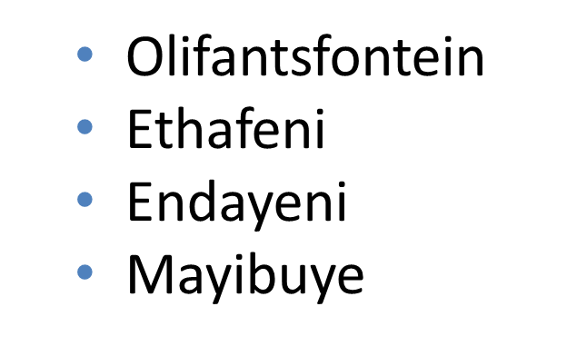
JOHANNESBURG HEALTH DISTRICT
2024 RESEARCH CONFERENCE
Methods - Continued
Primary objective:
Efficacy of H56:IC31 compared to placebo in reducing the rate of recurrent TB disease (relapse or reinfection) (POR)
Secondary objectives: To compare H56:IC31 to placebo wrt:
Safety(solicited ISR, systemic AEs, SAE & AESI and
Immunogenicity (humoral anti-H56 IgG & Ag specific CMI)
Facilities utilised for recruitment
Bophelong
Winnie Mandela
Erin
Esangweni
Tembisa Main
Rabie Ridge
Itireleng
Daveyton Main
#JoburgResearch2024

Slide 5
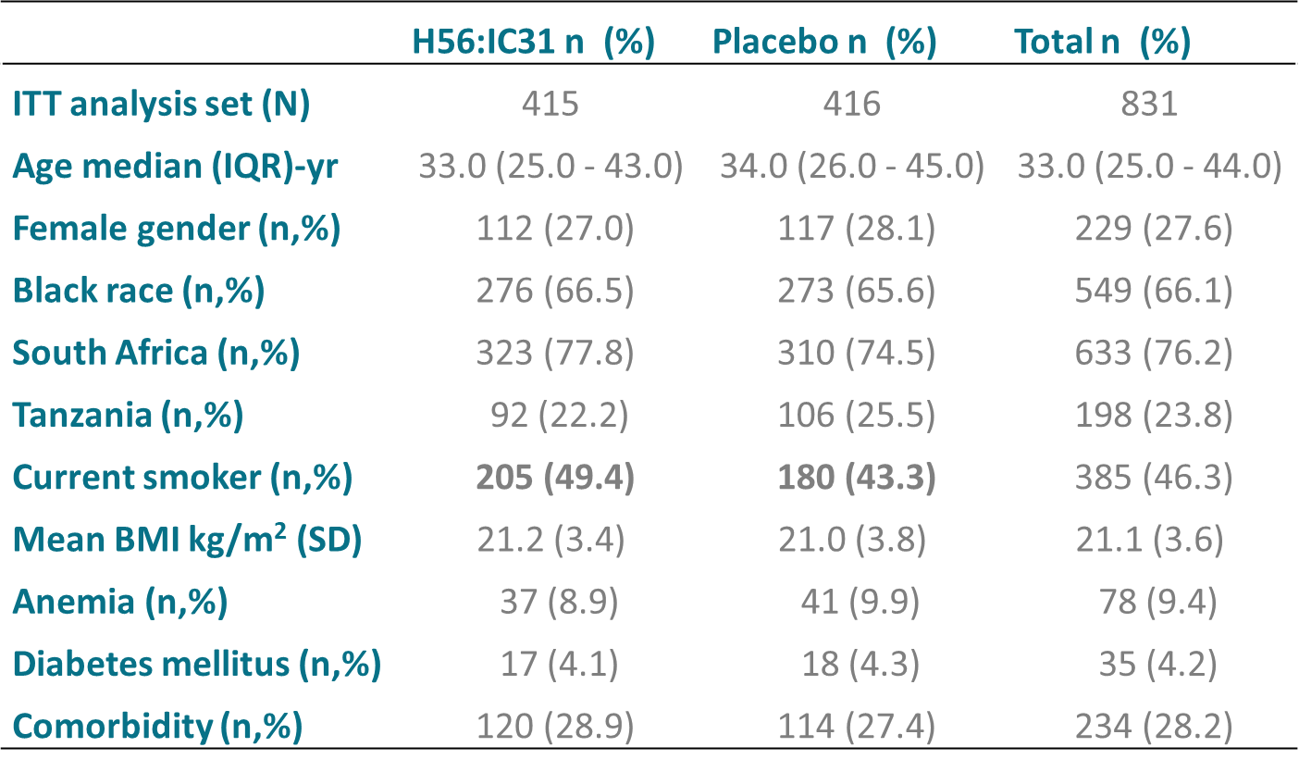
JOHANNESBURG HEALTH DISTRICT
2024 RESEARCH CONFERENCE
Results – Balanced Baseline Demographics
831 participants (mean age 34.7 years; 27.6% female; 66.1% black African; 76% from South Africa) were enrolled; 415 received H56:IC31 and 416 placebo
Baseline demographics were well balanced between the two arms, except a difference in current smoking status
#JoburgResearch2024

Slide 6
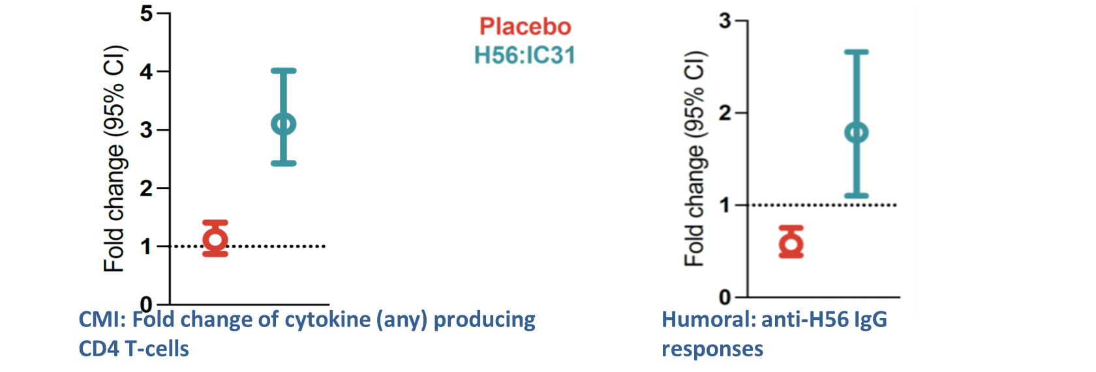
JOHANNESBURG HEALTH DISTRICT
2024 RESEARCH CONFERENCE
Results – Safety and Immunogenicity
Safe (YES)
Participants in the H56:IC31 group reported more mild-to-moderate self resolving local injection reactions than in the placebo group. No H56:IC31-related serious adverse events were observed.
Immunogenic (YES)
Cell mediated Polyfunctional CD4+ T-cell responses
Humoral anti-H56 IgG responses
#JoburgResearch2024

Slide 7
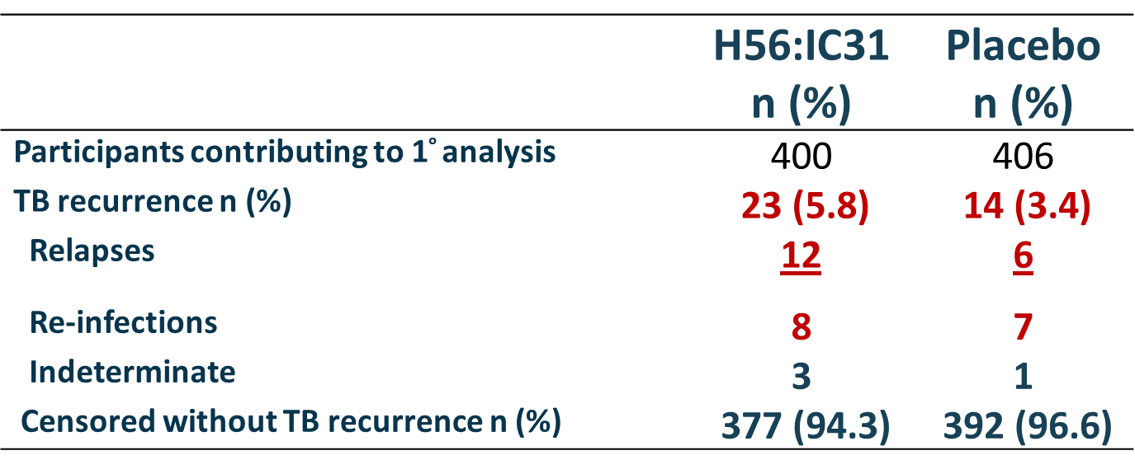
JOHANNESBURG HEALTH DISTRICT
2024 RESEARCH CONFERENCE
Results – Effectiveness
Effective (NO)
Recurrent TB was observed in 23 (12 relapse; 8 reinfection; 3 indeterminate) of 400 participants (5.8%) in the H56:IC31 group;
Recurrent TB was observed in 14 (6 relapse; 7 reinfection; 1 indeterminate) of 406 participants (3.4%) in the placebo group (Table below).
WGS showed Recurrent TB was driven more by relapses than reinfection.
VE for recurrence was -73.8% (95%CI:-246.9 to 9.8%; P=0.10).
VE for relapse was -116.1% (-522.2 to 16.3%; P=0.11)
VE for reinfection VE was -21.1% (-245.3 to 56.5%; P=0.71).
#JoburgResearch2024

Slide 8
JOHANNESBURG HEALTH DISTRICT
2024 RESEARCH CONFERENCE
Research Challenges
Recruitment due to clinic staff rotation
Loss to follow up
Participants compliance to TB treatment
Participants retention in the study ( highly mobile community)
Research misinformation
Covid-19 ( Recruitment was stopped due to covid restrictions without additional funding from funder, TB testing was decreased and limited access to primary health care facilities
#JoburgResearch2024

Slide 9










Conclusion and Acknowledgements
JOHANNESBURG HEALTH DISTRICT
2024 RESEARCH CONFERENCE
H56:IC31® was again shown to be safe and immunogenic, but was not protective against TB recurrence during 1 year post DS-TB treatment completion
H56:IC31® potentially increased the risk of TB relapses by endogenous bacteria
Ongoing epidemiological and immunological analyses to understand trial results: unbalanced risk factors for TB recurrence or potential vaccine harm?
Immunogenic, potential upregulation of suppressor T-reg responses driving relapse in H56:IC31® arm
Confounders:
Unbalanced TB-relapse baseline risk in the H56:IC31® arm
Occurred by chance?
#JoburgResearch2024

Slide 10
Recommendations
JOHANNESBURG HEALTH DISTRICT
2024 RESEARCH CONFERENCE
Long term follow up to assess the effect and safety of vaccine candidates
Robust monitoring and evaluation to evaluate the impact of vaccines on public health
Inclusion of additional sample collection to understand unexpected results
#JoburgResearch2024

