Slide 1





The YouthCan Study: Investigating perceptions of COVID-19 vaccines among youth in Soweto, South Africa Authors: Janan Dietrich, Lerato Tsotetsi, Gugulethu Tshabalala, Stefanie Vermaak, Asanda Sipapa, Happy Mboneli
JOHANNESBURG HEALTH DISTRICT
2024 RESEARCH CONFERENCE
Lerato Tsotetsi
African Social Sciences Unit of Research and Evaluation (ASSURE)
#JoburgResearch2024

Slide 2
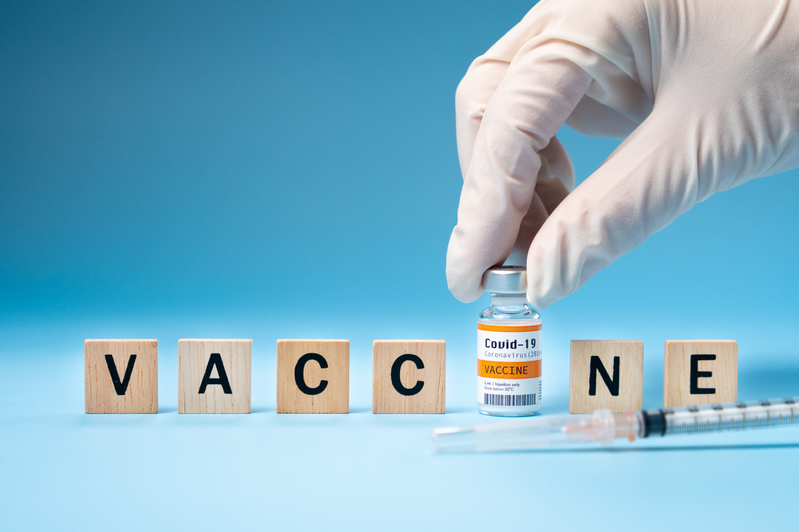
Introduction
JOHANNESBURG HEALTH DISTRICT
2024 RESEARCH CONFERENCE
Vaccine confidence globally has been influenced by a multitude of factors.
Historical mistrust, often stemming from past experiences of exploitation and discrimination, has fuelled scepticism in some communities.
High levels of vaccine confidence are essential for achieving high vaccination coverage and effectively controlling the spread of preventable diseases. On a global scale, vaccine confidence influences public health outcomes, health policy decisions, and the success of immunization programs. At the local level, vaccine confidence pertains to the trust and acceptance of vaccines within specific communities, regions, or countries
#JoburgResearch2024
Notes:
Vaccine confidence refers to the trust and belief in the safety, effectiveness, and necessity of vaccines by encompassing public attitudes, beliefs, and behaviors surrounding vaccination (Larson et al., 2015). High levels of vaccine confidence are essential for achieving high vaccination coverage and effectively controlling the spread of preventable diseases. On a global scale, vaccine confidence influences public health outcomes, health policy decisions, and the success of immunization programs. At the local level, vaccine confidence pertains to the trust and acceptance of vaccines within specific communities, regions, or countries

Slide 3
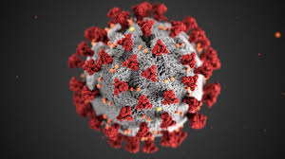
Research Aim
JOHANNESBURG HEALTH DISTRICT
2024 RESEARCH CONFERENCE
We conducted this study to investigate knowledge, attitudes, and perceptions of young people in Soweto regarding COVID-19 vaccines with the goal of identifying the determinants of vaccine confidence.
#JoburgResearch2024
Notes:
Vaccine confidence refers to the trust and belief in the safety, effectiveness, and necessity of vaccines by encompassing public attitudes, beliefs, and behaviors surrounding vaccination (Larson et al., 2015). High levels of vaccine confidence are essential for achieving high vaccination coverage and effectively controlling the spread of preventable diseases. On a global scale, vaccine confidence influences public health outcomes, health policy decisions, and the success of immunization programs. At the local level, vaccine confidence pertains to the trust and acceptance of vaccines within specific communities, regions, or countries

Slide 4
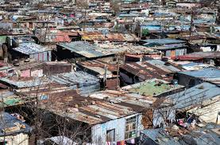
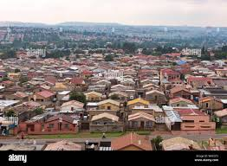
Methodology
JOHANNESBURG HEALTH DISTRICT
2024 RESEARCH CONFERENCE
Research Design
Recruitment
Eligibility Criteria
Mixed Methods design
Purposive and snowball sampling.
Young men and women
Group Discussions (8) + online survey (N=523)
15-24 years
Living in two communities in Soweto, Johannesburg (Site A & Site B)
#JoburgResearch2024
Notes:
The study was conducted from April 2023 to December 2023, using a mixed methods design, through group discussions(GD), followed by an anonymous online survey. The study was conducted in two communities in Soweto, Johannesburg. We used both purposive and snowball sampling for the GD and for the online survey. Eligibility criteria for all phases of the study included those between 15-24 years and residing in Soweto. Eight GD’s, categorized by age (15-19 years; 20-24 years) and gender were conducted. The survey was a self-adminstered survey completed on RedCap. Descriptive statistics was used to analyse the quantitavive data. The GD’s were audio-recorded, transcribed verbatim, and subsequently entered into NVivo version 12 for framework data analysis.

Slide 5
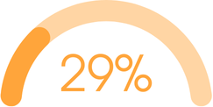
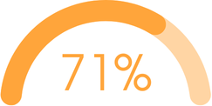


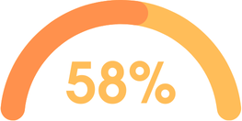

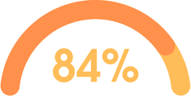

JOHANNESBURG HEALTH DISTRICT
2024 RESEARCH CONFERENCE
Survey Demographics (n=523)
GD Demographics (n= 65)
Age Category
15-19 20-24
Gender
Female
Employment Status
Unemployed
15-19
20-24
Female
Unemployed
#JoburgResearch2024
Notes:
The study was conducted from April 2023 to December 2023, using a mixed methods design, through group discussions(GD), followed by an anonymous online survey. The study was conducted in two communities in Soweto, Johannesburg. We used both purposive and snowball sampling for the GD and for the online survey. Eligibility criteria for all phases of the study included those between 15-24 years and residing in Soweto. Eight GD’s, categorized by age (15-19 years; 20-24 years) and gender were conducted. The survey was a self-adminstered survey completed on RedCap. Descriptive statistics was used to analyse the quantitavive data. The GD’s were audio-recorded, transcribed verbatim, and subsequently entered into NVivo version 12 for framework data analysis.

Slide 6
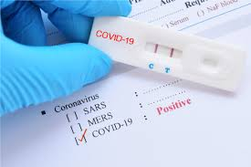
Online Survey Results
JOHANNESBURG HEALTH DISTRICT
2024 RESEARCH CONFERENCE
COVID-19 KNOWLEDGE
TESTED FOR COVID-19
93.57% tested negative
There is a drug to treat COVID-19
n=24 (4,59%)
n=381 (72,85%)
There is a vaccine to reduce infection from COVID-19
n=84 (16,06%)
71.32%
There is both a drug for the treatment of COVID-19 and a vaccine to prevent infection from COVID-19
There is currently no drug treatment for COVID-19 or vaccine to prevent infection from COVID-19
n=10 (1,91%)
#JoburgResearch2024
Notes:
Vaccine confidence refers to the trust and belief in the safety, effectiveness, and necessity of vaccines by encompassing public attitudes, beliefs, and behaviors surrounding vaccination (Larson et al., 2015). High levels of vaccine confidence are essential for achieving high vaccination coverage and effectively controlling the spread of preventable diseases. On a global scale, vaccine confidence influences public health outcomes, health policy decisions, and the success of immunization programs. At the local level, vaccine confidence pertains to the trust and acceptance of vaccines within specific communities, regions, or countries

Slide 7



Online Survey Results
JOHANNESBURG HEALTH DISTRICT
2024 RESEARCH CONFERENCE
EXPERIENCED SOME SYMPTOMS RELATED TO COVID-19 (9.65%)
Have you received a COVID-19 vaccine?
No | 22.94%
Yes, One dose | 46.65%
Yes, Two doses | 30.40%
1
I WAS EXPOSED TO SOMEONE WITH SIGNS AND SYMPTOMS OF COVID-19 OR WHO TESTED POSITIVE FOR C0VID-19 (10,46%)
2
How important is it to you to get the COVID-19 vaccine to protect your own health?
A little important | 17.78%
Extremely important | 18.93%
Moderately important | 7.46%
Not at all important | 7.46%
Very important | 48.37%
Reasons for Testing for COVID-19
3
SCHOOL RELATED REASONS (44,50%)
4
WORK RELATED REASONS (34,05%)
How important is it to you to get the COVID-19 vaccine to protect the health of
A little important | 17.21%
Extremely important | 23.90%
Moderately important | 7.46%
Not at all important | 5.16%
Very important | 46.27%
5
OTHER (1.34%()
#JoburgResearch2024
Notes:
Vaccine confidence refers to the trust and belief in the safety, effectiveness, and necessity of vaccines by encompassing public attitudes, beliefs, and behaviors surrounding vaccination (Larson et al., 2015). High levels of vaccine confidence are essential for achieving high vaccination coverage and effectively controlling the spread of preventable diseases. On a global scale, vaccine confidence influences public health outcomes, health policy decisions, and the success of immunization programs. At the local level, vaccine confidence pertains to the trust and acceptance of vaccines within specific communities, regions, or countries

Slide 8
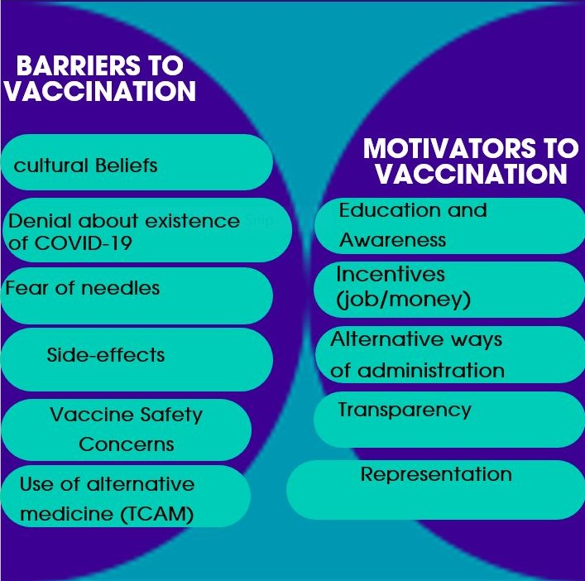
Group Discussion Results
JOHANNESBURG HEALTH DISTRICT
2024 RESEARCH CONFERENCE
#JoburgResearch2024
Notes:
Vaccine confidence refers to the trust and belief in the safety, effectiveness, and necessity of vaccines by encompassing public attitudes, beliefs, and behaviors surrounding vaccination (Larson et al., 2015). High levels of vaccine confidence are essential for achieving high vaccination coverage and effectively controlling the spread of preventable diseases. On a global scale, vaccine confidence influences public health outcomes, health policy decisions, and the success of immunization programs. At the local level, vaccine confidence pertains to the trust and acceptance of vaccines within specific communities, regions, or countries

Slide 9
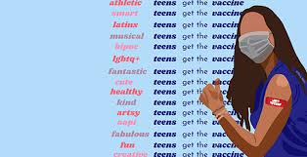
Conclusion
JOHANNESBURG HEALTH DISTRICT
2024 RESEARCH CONFERENCE
This study highlights key barriers to COVID-19 vaccination amongst youth. Youth account for a large proportion of the population and addressing their key barriers and capitalising on key motivators may offer substantial increase in vaccinations overall.
#JoburgResearch2024
Notes:
Vaccine confidence refers to the trust and belief in the safety, effectiveness, and necessity of vaccines by encompassing public attitudes, beliefs, and behaviors surrounding vaccination (Larson et al., 2015). High levels of vaccine confidence are essential for achieving high vaccination coverage and effectively controlling the spread of preventable diseases. On a global scale, vaccine confidence influences public health outcomes, health policy decisions, and the success of immunization programs. At the local level, vaccine confidence pertains to the trust and acceptance of vaccines within specific communities, regions, or countries

Slide 10








Acknowledgements
JOHANNESBURG HEALTH DISTRICT
2024 RESEARCH CONFERENCE
#JoburgResearch2024
Notes:
Vaccine confidence refers to the trust and belief in the safety, effectiveness, and necessity of vaccines by encompassing public attitudes, beliefs, and behaviors surrounding vaccination (Larson et al., 2015). High levels of vaccine confidence are essential for achieving high vaccination coverage and effectively controlling the spread of preventable diseases. On a global scale, vaccine confidence influences public health outcomes, health policy decisions, and the success of immunization programs. At the local level, vaccine confidence pertains to the trust and acceptance of vaccines within specific communities, regions, or countries

