Slide 1








Changing organisation of private primary health care services in South Africa: A Soweto qualitative study
JOHANNESBURG HEALTH DISTRICT
2024 RESEARCH CONFERENCE
Olukemi Babalola¹,
Mylene Largarde², Prudence Ditlopo¹, Nicholas Stacey², Duane Blaauw¹
¹Centre for Health Policy, Faculty of Health Sciences, University of the Witwatersrand, Johannesburg, South Africa
²Department of Health Policy, London School of Economics, United Kingdom
#JoburgResearch2024

Slide 2
Background
JOHANNESBURG HEALTH DISTRICT
2024 RESEARCH CONFERENCE
Private providers supply a significant proportion of health services in LMIC.
NHI proposals include contracting with private PHC providers.
Limited research on private PHC in South Africa
Aim: provide a clearer understanding of Soweto private PHC market
#JoburgResearch2024
Notes:
Private providers supply a significant proportion of health services in LMIC, particularly for PHC. So they can be mobilised in efforts to improve access to high quality health services
Detailed empirical investigation of the functioning of private PHC market in Soweto
This study aimed to develop a clearer understanding of the organisation and functioning of the Soweto private PHC market

Slide 3
Study methods (Dec 2021 to May 2022)
JOHANNESBURG HEALTH DISTRICT
2024 RESEARCH CONFERENCE
Soweto, urban settlement, ~ 1.9 M population, predominantly non-medical aid 12 participants (GPs, nurses, clinical associate); Senaoane Clinic & Diepkloof Clinic, via Tel/Zoom/Teams/ contact Audio-recorded, transcribed verbatim Manual coding and thematic analysis
#JoburgResearch2024
Notes:
Overall study aim: Within a 3-year study aimed to conduct Detailed empirical investigation of the functioning of private PHC market in Soweto
Transcription accuracy checks by research team
12 purposively-selected private PHC providers:
5 GPs
3 nurse practitioners
3 pharmacy clinic nurses
1 clinical associate
Manual coding: common themes and concepts, thematic analysis

Slide 4
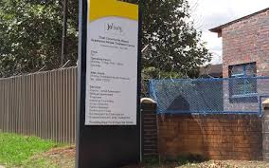


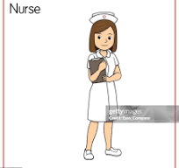
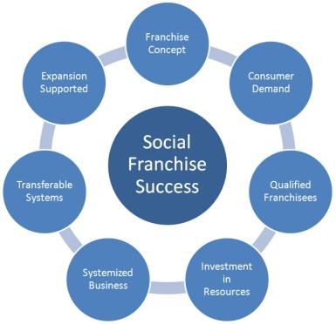

Finding 1: Changing private PHC models in Soweto
Independent Nurse Practice
prior public or private HC experience, self-funded, stand-alone house/shop, lower than GP fees/ full PHC
Traditional government clinic
Predominant PHC provider, run by trained PHC nurses, mostly free, provided by municipality/district/
province
Group GP Practice
>1 traditional GPs, shared overhead, stand-alone larger facility, +/-long-term locums
Solo GP
1 traditional GP, stand-alone offices in house/shop
More complex, a number of different types, business initiative, profit making, sometimes include franchise, with different configurations of providers/ similar brands across branches e.g., containers in schools/malls, nurse-/ clinical associate-led
Business-orientated Model
Pharmacy Clinic
nurse-led, large pharmacy branches, promotive/ preventive e.g., vaccines/FP/much lower fees
#JoburgResearch2024
Notes:
Solo GP: 1 traditional GP, stand-alone offices in house/shop
Group GP: >1 traditional GPs, shared overhead, stand-alone larger facility, +/-long-term locums
Independent private nurse: prior public or private HC experience, self-funded, stand-alone house/shop, lower than GP fees/ full PHC
Pharmacy clinic : nurse-led, large pharmacy branches, promotive/ preventive e.g., vaccines/FP/much lower fees
Business-orientated model: more complex, a number of different type, business initiative, profit making, sometimes include franchise, wit different configurations of providers/ similar brands across branches e.g., containers in schools/malls, nurse-/ clinical associate-led.

Slide 5
Finding 1: Changing private PHC models in Soweto (ctd)
JOHANNESBURG HEALTH DISTRICT
2024 RESEARCH CONFERENCE
“It's basically a Wellness clinic. More or less. So we offer like your blood pressure, sugar, cholesterol, HIV testing, Pap smear. Mostly for medical aids clients. ” (Nurse_pharmacy234)
“When I was admitted to start the clinic, we get into …… an enterprise development contract. They fund the structure ….. much of the clinical equipment, and some medication and then you would order additional..” (Nurse_Franchise206)
#JoburgResearch2024

Slide 6
Finding 2: Why these changing models?
JOHANNESBURG HEALTH DISTRICT
2024 RESEARCH CONFERENCE
At Maponya, they used to pay for it (immunisation) cash, instead of going to the public clinic. Because of the lack of stock, waking up early and queuing, attitude. Like now, I think six years vaccines have been out of stock in the country on the public side for more than two years. (Nurse_pharmacy232)
Public sector challenges:
I just wanted to move on from hospital practice. So I looked for a place …. and converted it into a practice. That's where I am now. I ended up being trapped. But things happened, I'm still there 31 years later. (Solo_GP003)
Dwindling GP enthusiasm:
Seeing PHC as a business model:
“They have introduced something, we now consult with a doctor, but not in this branch, as yet. Where they do the primary healthcare services, minor ailments. ” (Nurse_pharmacy232)
#JoburgResearch2024

Slide 7
Finding 3: Why in Soweto?
JOHANNESBURG HEALTH DISTRICT
2024 RESEARCH CONFERENCE
Business opportunity:
“Soweto is huge. (Clinic area “L”) doesn't have anything at all, there's no public, there's no private, there's no doctor. I think Soweto is a good site.” (Female, PrivNur_206 -Franchise)
“People have their own GPs that they can relate to, and they speak the same language and understand each other, they are from the same culture.” (Solo GP_003)
Race/Culture:
“When I qualified in 1988, I came and I joined him (my father). And we were working together in partnership, until he passed on and then I took over.” (Solo_GP_213)
Inheritance :
Come from Soweto:
“…..because at least you know her (wife) family, and some of the relatives, so it will be easier to set up. As opposed to starting at a place that I wouldn't know . ” (Solo_GP_205)
#JoburgResearch2024

Slide 8
Discussion: Changing Soweto private PHC models raise important questions:
JOHANNESBURG HEALTH DISTRICT
2024 RESEARCH CONFERENCE
Will Soweto practitioners engage with NHI?
Although emerging models may enhance competitiveness: what will be the quality and efficiency of the different models?
To what extent will expanding models influence public sector challenges?
#JoburgResearch2024

