Slide 1





Evaluation of self-collected tongue swabs for
M. tuberculosis detection in adults using the
Xpert MTB/RIF Ultra assay
JOHANNESBURG HEALTH DISTRICT
2024 RESEARCH CONFERENCE
Anura David
Wits Diagnostics Innovation Hub, University of the Witwatersrand, and The National Priority Program of the National Health Laboratory Service, Johannesburg, South Africa
#JoburgResearch2024

Slide 2
Background
JOHANNESBURG HEALTH DISTRICT
2024 RESEARCH CONFERENCE
Studies on oral swabs have demonstrated their utility for detecting Mycobacterium tuberculosis complex (MTBC)
Amongst a few swabs types, tongue swab (TS) specimens collected with a Copan FLOQ swab (FLOQSwab™ 501CS01; Copan Italia S.p.A., Brescia, Italy) produce the best results
The aim of our study was
  firstly, to determine the performance of self-collected TS using the Copan FLOQ swabs on the Xpert MTB/RIF Ultra assay compared to liquid culture as the reference standard for MTBC detection and
  secondly to investigate acceptability and ease-of-use of the TS by presumptive TB patients
#JoburgResearch2024

Slide 3
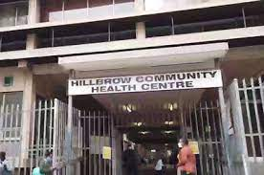
Description of study participants
JOHANNESBURG HEALTH DISTRICT
2024 RESEARCH CONFERENCE
Presumptive TB participants (>18 years) were consented and enrolled at the Hillbrow Community Health Centre (HCHC), in Johannesburg, South Africa
Recruitment: October 2021 – July 2023
Inclusion criteria:
  Symptomatic: WHO-recommended four-symptom screen (W4SS) (cough, fever, weight loss or night sweats)
  Willing to return for a second visit
  Willing to perform self-collection of a tongue swab
  Willing to complete a participant questionnaire
Exclusion criteria:
  Unable to provide the required specimens
  Receipt of any dose of TB treatment in the 6 months prior to enrolment
#JoburgResearch2024

Slide 4
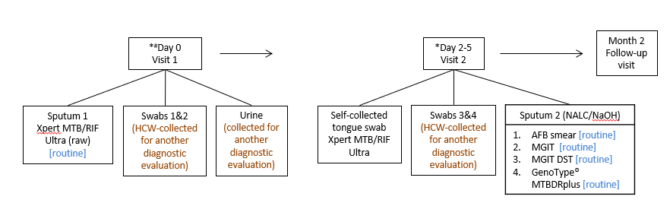
Methods
JOHANNESBURG HEALTH DISTRICT
2024 RESEARCH CONFERENCE
#JoburgResearch2024

Slide 5
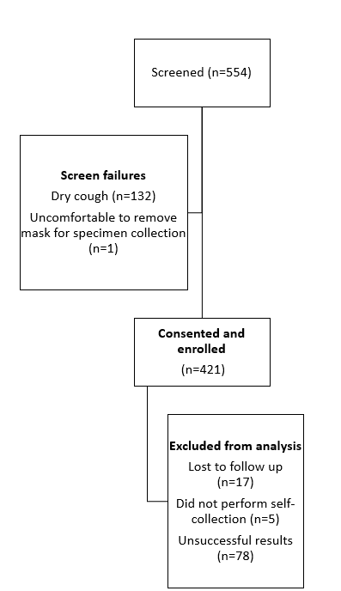
Results
JOHANNESBURG HEALTH DISTRICT
2024 RESEARCH CONFERENCE
Demographics (n=399):
  n=253, 63% male
  Mean age, 40
HIV positive, n=226 (57%), n=5 unknown
Previous TB episode self-reported, n=44 (11%)
AFB smear status: 13% positivity
Bacteriologically confirmed TB: 16%
Participants included in analysis: n=321
#JoburgResearch2024

Slide 6
Results
JOHANNESBURG HEALTH DISTRICT
2024 RESEARCH CONFERENCE
Assay results compared to a reference liquid culture
Variable | Smear microscopy | Xpert MTB/RIF Ultra (tongue swab) | Xpert MTB/RIF Ultra (sputum)
n=321
Sensitivity, % (95% CI) | 70.3 (57.6-81.1) | 78.1 (66.0–87.5) | 95.3 (86.9-99.0)
Specificity, % (95% CI) | 97.7 (95.0-99.1) | 100 (98.6–100) | 98.1 (95.5-99.4)
PPV, % (95% CI) | 88.2 (76.1-95.6) | 100 (92.9–100) | 92.4 (83.2-97.5)
NPV, % (95% CI) | 93.0 (89.2–95.7) | 94.8 (91.5–97.1) | 98.8 (96.6-99.8)
#JoburgResearch2024

Slide 7
Results
JOHANNESBURG HEALTH DISTRICT
2024 RESEARCH CONFERENCE
Participant survey responses (n=399)
Specimen type | Question | Response
Oral swab | Did you experience any discomfort during tongue swab sampling? | No (88%) |  | Yes (12%)
 | Is the specimen collection shorter for sputum or the tongue swab? | Tongue swab (95%) |  | Sputum (5%)
 | Who would you prefer to collect the specimen? | Self (48%) |  | HCW (52%)
 | What do you think of the overall sampling procedure? | Easy (98%) |  | Difficult (2%)
 | How do you rate your satisfaction for tongue swab collection? | Happy or very happy (100%) |  | Unhappy or very unhappy (0%)
Overall | Based upon your experience in this study, do you have a preferred specimen: tongue swab, sputum or urine? | Tongue swab (74%) | Urine (3%) | Sputum (4%) | All of the above (19%)
#JoburgResearch2024

Slide 8
Conclusion
JOHANNESBURG HEALTH DISTRICT
2024 RESEARCH CONFERENCE
TS self-collection is feasible and acceptable to participants
Sensitivity of self-collected TS on the Xpert Ultra assay is similar to other studies which investigated HCW- and self-collected swabs
WHO has not yet made recommendations for the use of tongue swabs for TB diagnosis, but these pragmatic studies will add to the body of evidence
Challenges at HCHC:
  Disruptions due to COVID-19
  Disruptions in participant recruitment due to protest action
#JoburgResearch2024

Slide 9






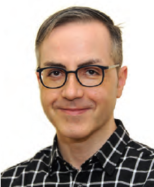
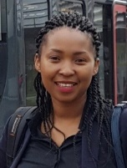
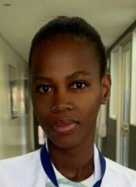

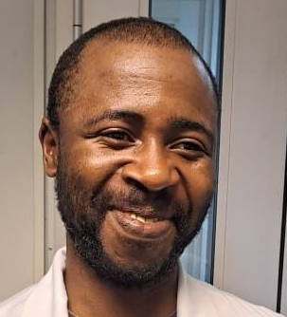
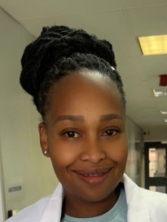
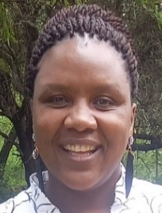
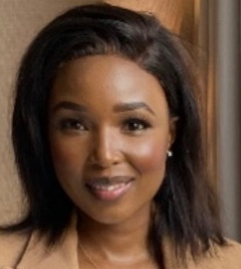

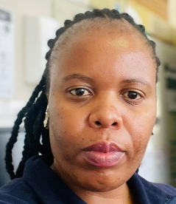
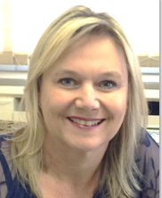

Acknowledgements
JOHANNESBURG HEALTH DISTRICT
2024 RESEARCH CONFERENCE
Johannesburg Health District
Department of Health
Study participants
Research collaborators
Funders
National Priority Program (NHLS)
#JoburgResearch2024

