Slide 1







Cough peak versus spirometry for the early detection of lung impairment in a cohort of patients receiving treatment for pulmonary TB in Johannesburg, South Africa
Evans D, Graham A, Rassool M, Lottering M, Jinga N, Ngolele L, Ramushu C, Tau H, Musina M, Mokhesi N, Tatenda Mbanje, Ballif M, Fenner L.

Slide 2
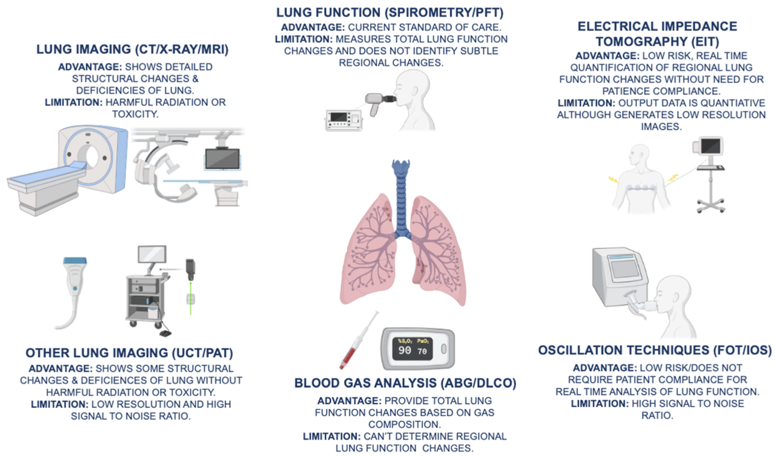
Notes:
Figure 1. The advantages and limitations of current COPD (chronic obstructive pulmonary disease) diagnostics, which include spirometry/PFT (pulmonary function testing), ABG (arterial blood gas), DLCO (diffusing capacity for carbon monoxide), and lung imaging modalities, such as CT (computed tomography), X-ray, and MRI (magnetic resonance imaging), are illustrated. In addition, emerging novel diagnostic techniques, such as EIT (electrical impedance tomography), FOT (forced oscillation technique), IOS (impulse oscillometry system), UCT (ultrasound computed tomography), and PAT (photoacoustic tomography), provide non-invasive, real-time assessment of changes in lung function.

Slide 3
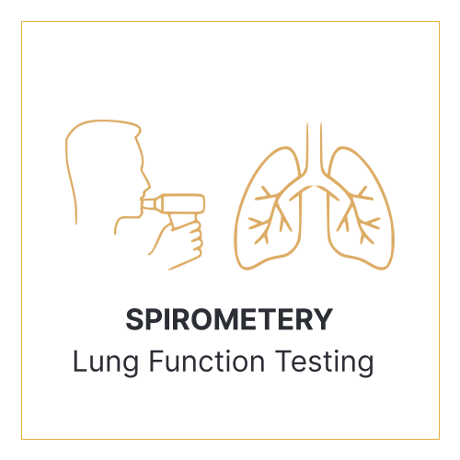
Resource intensive
Requires trained technicians to perform the test, and pulmonary clinicians to interpret the tests
Maximum patient effort
Operator-motivated results
Careful monitoring of both subject and equipment
Requires calibrated instruments – difficult to conduct onsite inspections for accreditation
Accessibility and scarcity of resources in primary care
Lack of spirometry equipment and expertise in primary care settings
Lack of required training
Reference values for all persons or ethnicities
Difficult in children and the elderly
Availability of consumables and/or technical support
Documentation of quality assurance and IC procedures
Notes:
Figure 1. The advantages and limitations of current COPD (chronic obstructive pulmonary disease) diagnostics, which include spirometry/PFT (pulmonary function testing), ABG (arterial blood gas), DLCO (diffusing capacity for carbon monoxide), and lung imaging modalities, such as CT (computed tomography), X-ray, and MRI (magnetic resonance imaging), are illustrated. In addition, emerging novel diagnostic techniques, such as EIT (electrical impedance tomography), FOT (forced oscillation technique), IOS (impulse oscillometry system), UCT (ultrasound computed tomography), and PAT (photoacoustic tomography), provide non-invasive, real-time assessment of changes in lung function.

Slide 4
Background
83%
A high proportion of patients present with severe pulmonary impairment at the time of TB diagnosis.
Spirometry is a commonly used diagnostic test to assess lung function.
Although needed in primary care is underused.
Cough peak flow (CPF) has several advantages over spirometry.
It remains uncertain whether CPF has the sensitivity, accuracy, or reliability to replace spirometry as a screening tool for pulmonary impairment.
At TB diagnosis
17%
Rachow et al., 2023 http://dx.doi.org/10.5588/ijtld.23.0040
18%
8%
14%
10%
30%
46%
42%
32%
Patil et al., 2020. http://dx.doi.org/10.4103/ijmy.ijmy_56_18

Slide 5
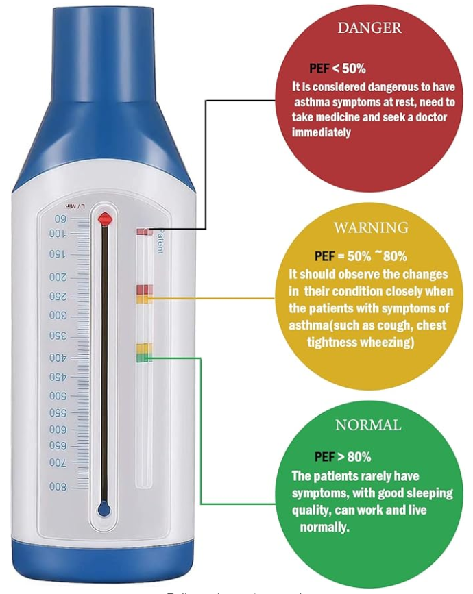
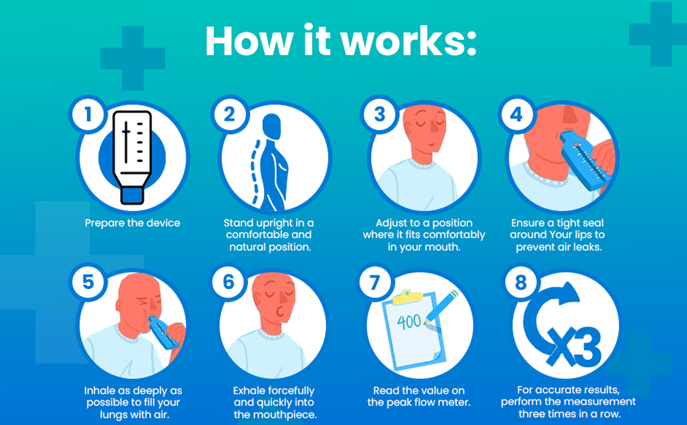
We explored the relationship between cough strength, respiratory function, and physical performance in patients with TB.

Slide 6
Methods
Ongoing prospective observational TB cohort study
City of Johannesburg – Helen Joseph Hospital, Johannesburg
Written informed consent
Cough peak flow (<240 L/min)
Spirometry was performed 8 weeks after TB treatment initiation according to American Thoracic Society/European Respiratory Society (ERS) guidelines
Global Lung Initiative (GLI) equations for standardization
https://gli-calculator.ersnet.org/docs.html
Physical performance – exercise capacity
6-minute walk distance/6MWD); <400 meters
1-minute sit to stand (STS); <19.5 repetitions
Correlations and diagnostic accuracy (Se, Sp, NPV, PPV)
Clinically diagnosed or microbiologically
confirmed pulmonary TB
<7 days on TB treatment
≥15 years of age
Between 10/2022 and 12/2023
Spirometry (usable)
CPF, 6MWT performed
Enane et al., 2024. https://doi.org/10.1136/bmjopen-2023-079138

Slide 7
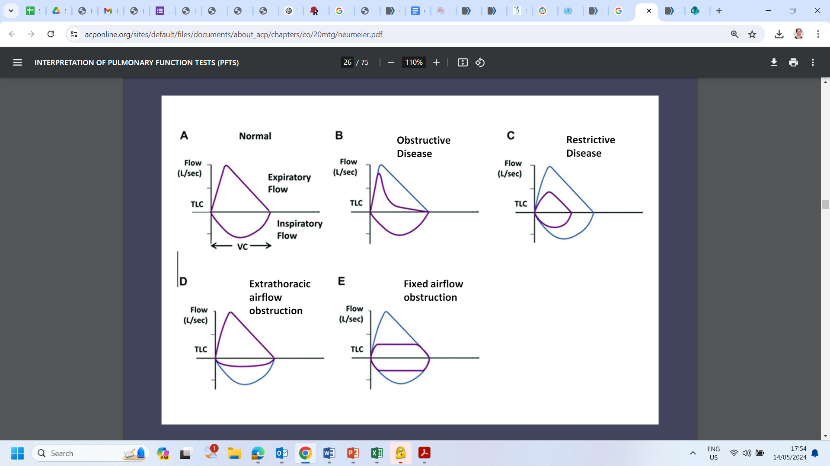
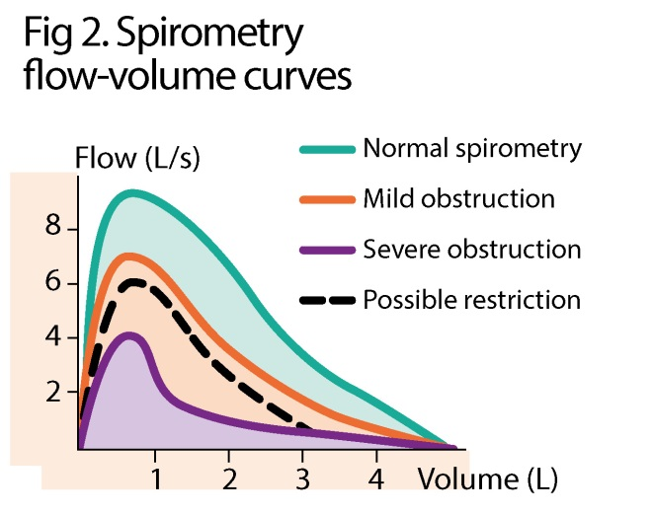
Methods
Is the FEV1/FVC ratio < LLN?
Asthma
COPD (emphysema, chronic bronchitis)
Bronchiolitis/Bronchiectasis
No
Yes
Restrictive or normal pattern
Obstructive pattern
Interstitial lung disease
Neuromuscular weakness
Pleural disease
Chest wall deformities
Obesity
Is the FVC < LLN?
Is the FVC < LLN?
Yes
No
No
Yes
Restrictive
Normal
Hyper-inflation versus mixed pattern
FEV1
Normal ≥ -1.65
Mild -1.65 and -2.5
Moderate -2.51 to 4.0
Severe < -4.0
Confirm with TLC
Al-Askhar. Cleveland Clinic Journal of Medicine. 2003

Slide 8
Results
Table 1. Characteristics by HIV status (n=73)
 | Total (n=73)* | HIV positive (n=38) | HIV negative (n=32)
Male sex | 47 (64.4%) | 19 (50%) | 26 (81.3%)
Age, median (IQR) | 38.6 (33.6-48.9) | 42.5 (33.9-48.9) | 36.2 (30.9-46.5)
Marital - Single | 61 (83.6%) | 30 (78.9%) | 29 (90.6%)
Education ≥G8 | 47 (64.4%) | 21 (55.3%) | 24 (75.0%)
Category - New | 57 (78.0%) | 29 (76.3%) | 26 (81.3%)
Previous history of TB | 19 (26.0%) | 11 (28.9%) | 5 (15.6%)
Cough peak flow | 183 (153-250) | 187 (167-250) | 202 (143-275)
< 240 L/min# | 53/73 (72.6%) | 28/38 (73.4%) | 22/32 (68.8%)
6 minute walk test | 350 (294-378) | 308 (280-378) | 357 (322-392)
< 350 m# | 32/65 (49.2%) | 20/33 (60.6%) | 11/30 (36.8%)
1 min sit to stand | 19 (16-22) | 18 (16-21) | 20 (17-25)
< 19.5 repetitions# | 37/63 (58.7%) | 21/32 (65.6%) | 14/29 (48.3%)
Clinically diagnosed or microbiologically
confirmed pulmonary TB
Usable spirometry and CPF (n=377)
South Africa cohort (n=114)
Pre-bronchodilator spirometry at 8 weeks (n=73; 64%)
Total included (n=73)
*HIV status unknown n=3; #clinically relevant cut-off values; asthma n=3; pulmonary fibrosis n=1;
COVID-19 >2 years before n=2; hypertension n=4; smoking n=31 (daily/almost daily in past 3M n=19)

Slide 9
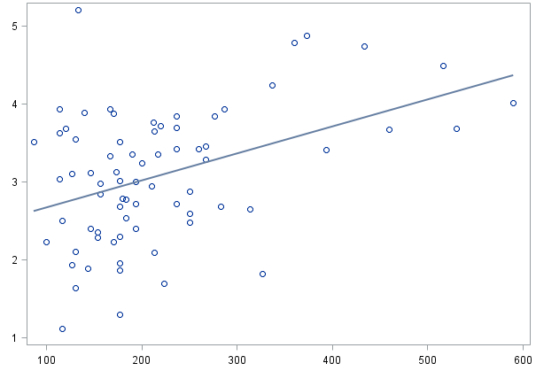
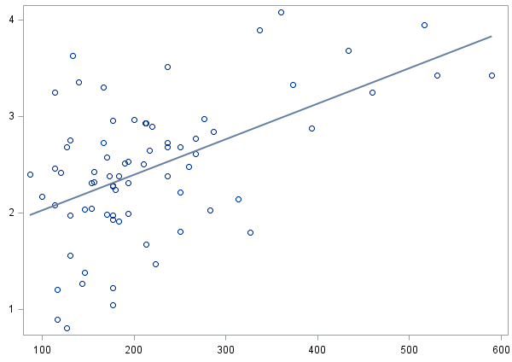
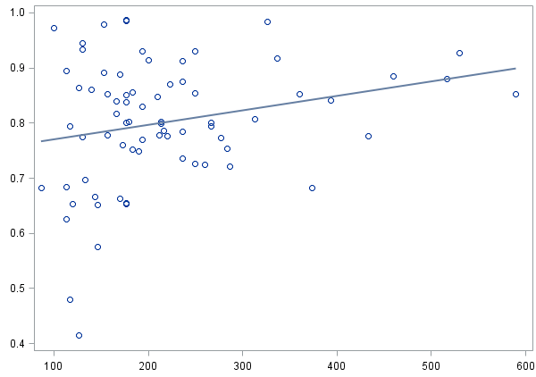
Correlation of cough peak flow with FVC, FEV1 and FEV1/FVC, by HIV status (n=70)
Forced vital capacity
Forced expiratory volume in 1s
FEV1/FVC ratio
r=0.241
p=0.039
FVC (L)
FEV1 (L)
r=0.530
p<0.0001
FEV1 /FVC (%)
r=0.418
p=0.0002
Cough peak flow (L/min)
Cough peak flow (L/min)
Cough peak flow (L/min)

Slide 10
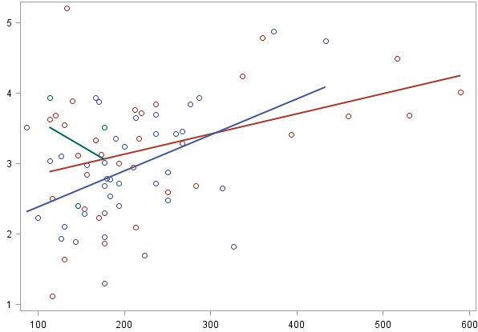
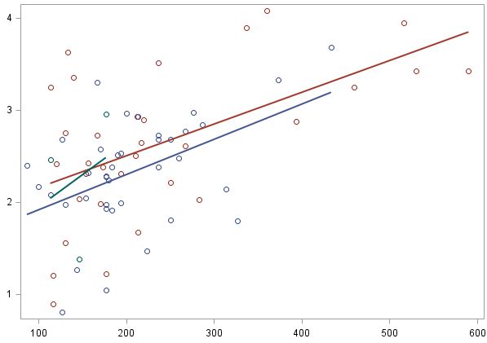
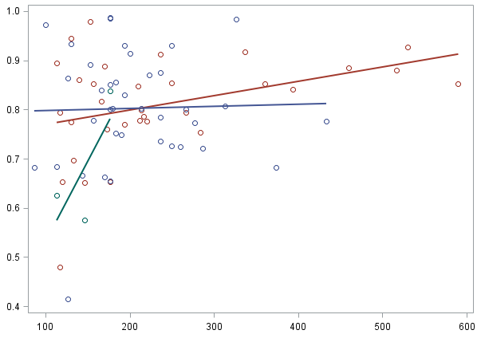
Correlation of cough peak flow with FVC, FEV1 and FEV1/FVC, by HIV status (n=70)
Forced vital capacity
Forced expiratory volume in 1s
FEV1/FVC ratio
r=0.241
p=0.039
FVC (L)
FEV1 (L)
r=0.530
p<0.0001
FEV1 /FVC (%)
r=0.418
p=0.0002
Cough peak flow (L/min)
Cough peak flow (L/min)
Cough peak flow (L/min)
HIV negative
r=0.418; p=0.017
HIV negative
r=0.469; p=0.003
HIV negative
r=0.373; p=0.035
HIV positive
r=0.553; p=0.001
HIV positive
r=0.027; p=0.872
HIV positive
r=0.463; p=0.034
FEV1 /FVC (%)
FVC (L)
FEV1 (L)
Cough peak flow (L/min)
Cough peak flow (L/min)
Cough peak flow (L/min)

Slide 11
Results
Table 2. Diagnostic accuracy to discriminate abnormal spirometry patterns (n=73)
 | FEV1/FVC Z-score <−1.64 (Obstruction; n=14) |  |  |  | FVC Z-score <−1.64 (Restrictive; n=21) |  |  |  | FEV1 Z-score <−1.64 Severity; n=14)
 | Se | Sp | PPV | NPV | Se | Sp | PPV | NPV | Se | Sp | PPV | NPV
CPF <240 L/min | 13/14 93% | 19/59 32% | 13/53 25% | 19/20 95% | 17/21 81% | 16/52 31% | 17/53 32% | 16/20 80% | 25/30 83% | 15/43 35% | 25/53 47% | 15/20 75%
CPF <270 L/min | 13/14 93% | 13/59 22% | 13/59 22% | 13/14 93% | 19/21 91% | 12/52 23% | 19/59 32% | 12/14 86% | 28/30 93% | 12/43 28% | 28/59 48% | 12/14 86%
6MWD <400 m | 11/12 92% | 9/53 17% | 11/55 20% | 9/10 90% | 15/15 100% | 10/50 20% | 15/55 27% | 10/10 100% | 23/24 96% | 9/41 22% | 23/55 42% | 9/10 90%
6MWD <350 m | 6/15 40% | 24/50 48% | 6/32 19% | 24/33 73% | 6/15 40% | 24/50 48% | 6/32 19% | 24/33 73% | 11/24 46% | 20/41 49% | 11/32 34% | 20/33 61%
1-min STSR <19.5 | 8/16 50% | 18/47 38% | 8/37 22% | 18/47 38% | 8/16 50% | 18/47 38% | 8/37 22% | 18/26 70% | 18/25 72% | 19/38 50% | 18/37 49% | 19/26 73%

Slide 12
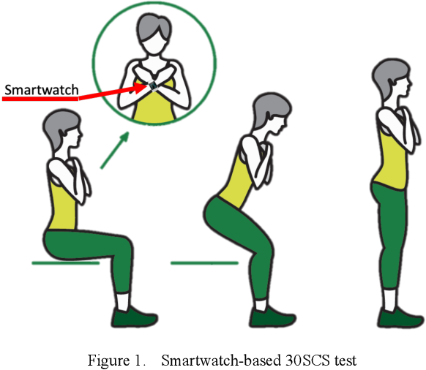
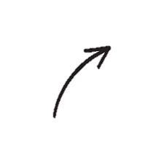
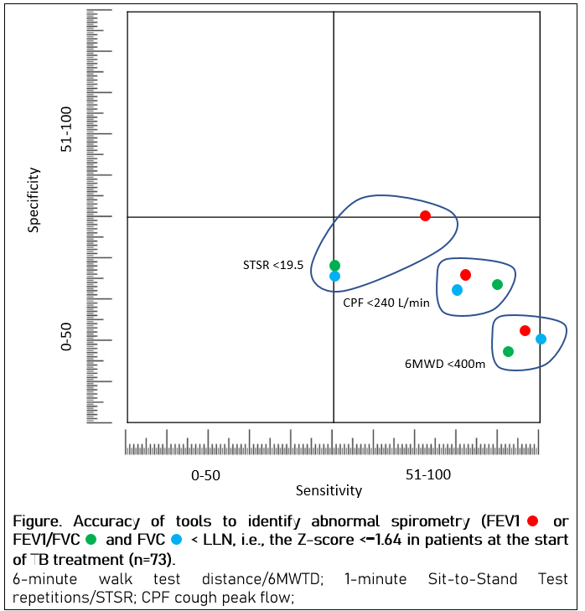
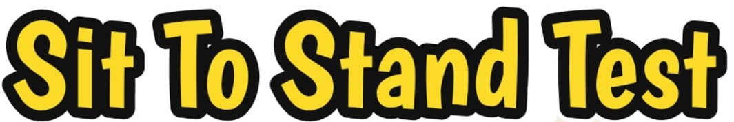



Results
1 minute sit to stand triage test (n=63)
<19.5 (n=37)
≥19.5 (n=26)
Refer for spirometry
Not refer for spirometry
19 would not need it
(FEV1 normal)
19 would not need it
(FEV1 normal)
18 would need it
(FEV1 abnormal)
7 would be missed
(FEV1 abnormal)

Slide 13
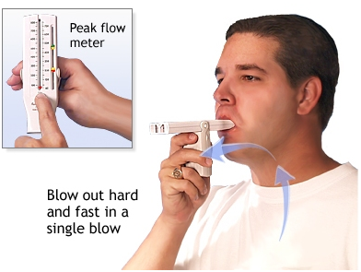
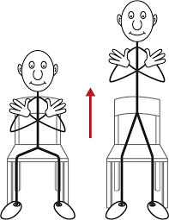
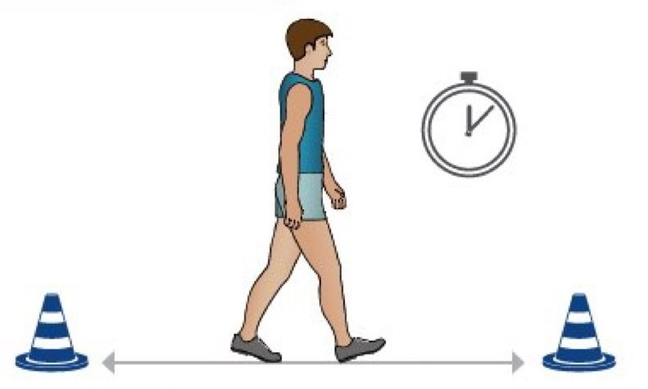
Limitations
Clinically relevant cut-off values & relatively small sample
At start of TB treatment – more severe lung impairment
CPF and severity/ lung changes on X-ray – pending
Strengths
Spirometry is performed routinely in the Pulmonology Department at Helen Joseph Hospital in Johannesburg using a CareFusion micro lab spirometer.
Next steps
South Africa and Zambia
Add HRQoL (SF-12 & SGRQ) + pulse oximetry + dyspnea score
Multiple timepoints (longitudinal) & combinations of variables
Analytic approaches to define optimal cut-offs

Slide 14
Conclusion
Our study findings suggest that CPF could be used to screen out TB patients who are unlikely to have lung impairment.
Conducting a CPF requires only a few minutes, and its easily interpretable results make it suitable for routine use. Additionally, it costs less than diagnostic spirometry.
The IeDEA TB-SRN cohort will provide more data to compare tools such as CPF to spirometry to track lung function over time and beyond treatment to accurately identify those at risk for post-TB chronic lung disease early and who need post-TB treatment spirometry.

Slide 15
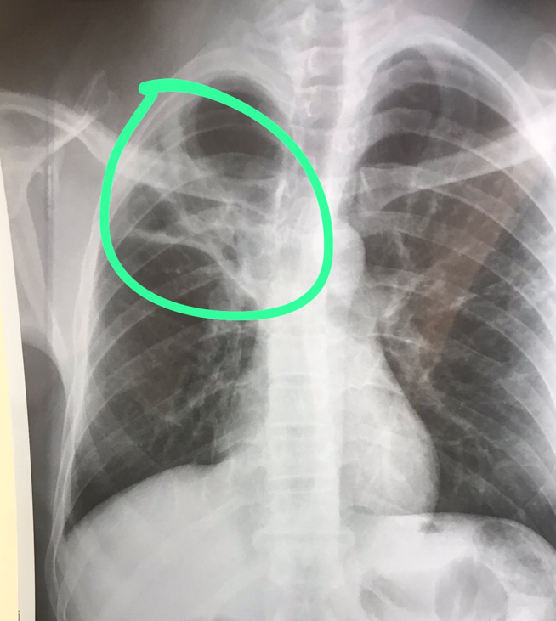

Thank you to all the
patients who are part of the cohort.
Thank you to all the staff working on the project and all the partners and funders for your contribution to the study
Case (90-DS)
Male, 39 years – EOT. Cavitation and R lobar consolidation. Some bronchiectasis and fibrosis
Case (19-DS)
Male, 31 years – 6 months after completing TB treatment. Pleural effusion, some fibrosis and infiltrate on CXR. Generally breathing fine, no issues with exercise. PTLD?

