Slide 1





BY T.KHALO
&
L.KUBHEKA
JOHANNESBURG HEALTH DISTRICT
2024 RESEARCH CONFERENCE
ROLE OF PODIATRY IN PRIMARY HEALTH CARE
#JoburgResearch2024

Slide 2

INTRODUCTION
JOHANNESBURG HEALTH DISTRICT
2024 RESEARCH CONFERENCE
South Africa is a developing country with a health care system that still needs to be advanced to ensure a higher quality of life. South Africa’s experience in implementing primary health care does appear to have some positive impact in terms of access to primary care compared with the pre-Apartheid health system (pre-1994), however, there are still a few factors hindering its success.
#JoburgResearch2024

Slide 3
PRIMARY HEALTH CARE
JOHANNESBURG HEALTH DISTRICT
2024 RESEARCH CONFERENCE
A primary healthcare system benefits the whole of society by focusing on people’s needs and delivering healthcare as early on along the continuum as possible, from health promotion and disease prevention to treatment, rehabilitation, and palliative care, and as close as possible to people’s daily lives (WHO 2018).
#JoburgResearch2024

Slide 4
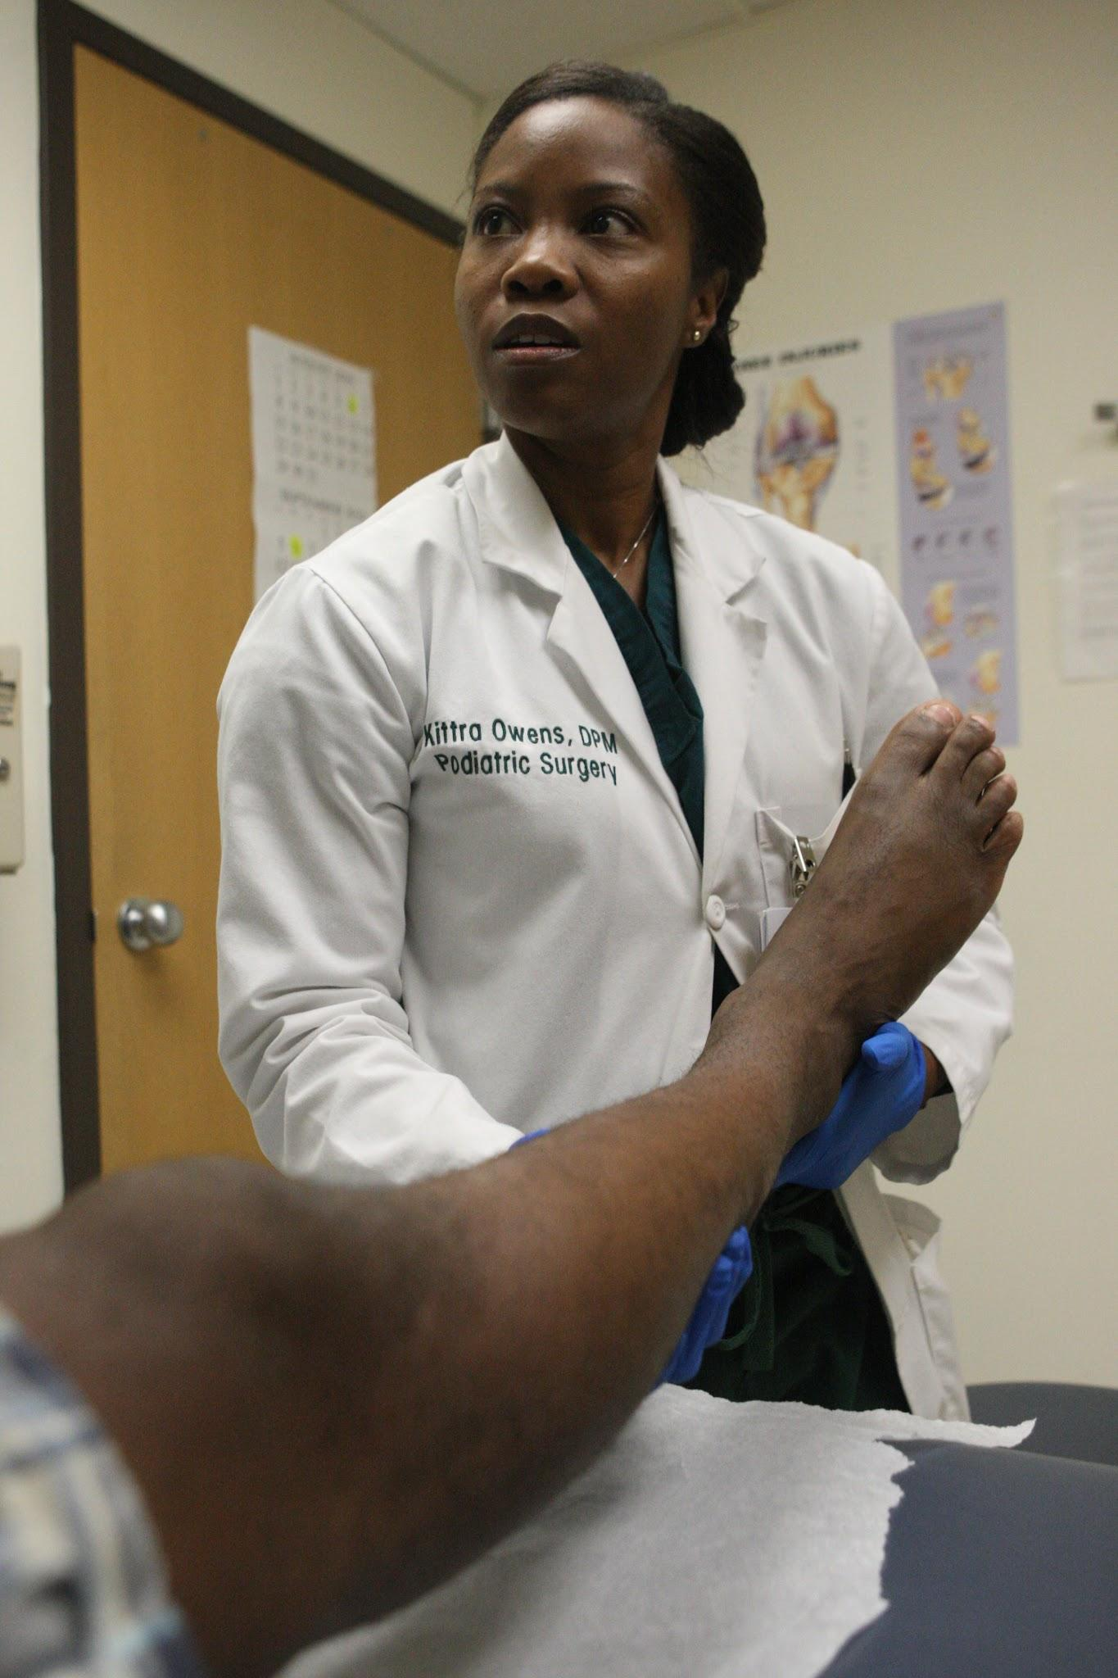
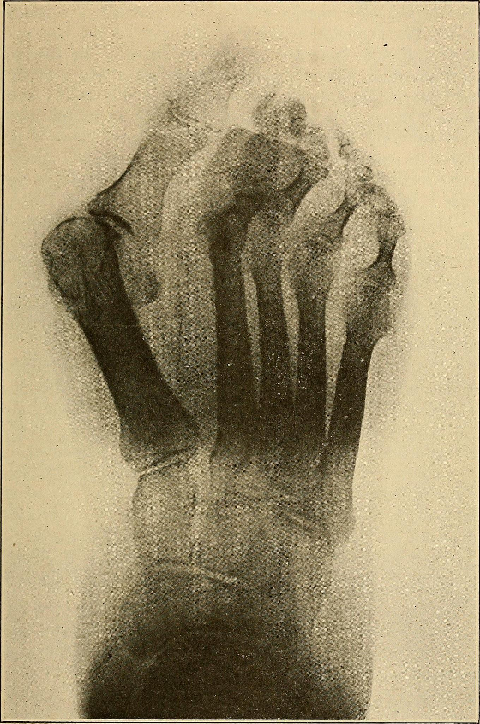
JOHANNESBURG HEALTH DISTRICT
2024 RESEARCH CONFERENCE
#JoburgResearch2024

Slide 5
PODIATRY IN PRIMARY HEALTH CARE
JOHANNESBURG HEALTH DISTRICT
2024 RESEARCH CONFERENCE
Literature has shown that most healthcare professionals do not adequately underline the value of foot health. Podiatry as part of the primary care system is defined as a branch of medicine focused on treating conditions of the foot, ankle, and lower leg. The practice of podiatry also includes diagnosing, treating, and managing different foot conditions, such as diabetic foot, rheumatoid foot, arthritic foot, corns and calluses, nail conditions, wounds, and others.
#JoburgResearch2024

Slide 6
AIM and METHODOLOGY
JOHANNESBURG HEALTH DISTRICT
2024 RESEARCH CONFERENCE
The aim of the study was to investigate the role podiatrists play in the primary health care.
Qualitative study to explore the perspective of the podiatrists in the following PHC:
Riverlea Community Clinic
Alexander Community Health Center
Tembisa Community Clinic
#JoburgResearch2024

Slide 7
RESULT AND DISCUSSION
JOHANNESBURG HEALTH DISTRICT
2024 RESEARCH CONFERENCE
As a result of these findings, it is evident that podiatry faces many challenges in the PHC. In addition, it is evident that podiatry faces poor perception among other healthcare professions in the PHC. The issue of podiatry not being included in the budget like other professions was also raised by participants. This is evidence that the Department of Health (DoH) should act on such matters so that other professionals could consider podiatry as a profession or give podiatry the value it deserves in the PHC.
#JoburgResearch2024

Slide 8
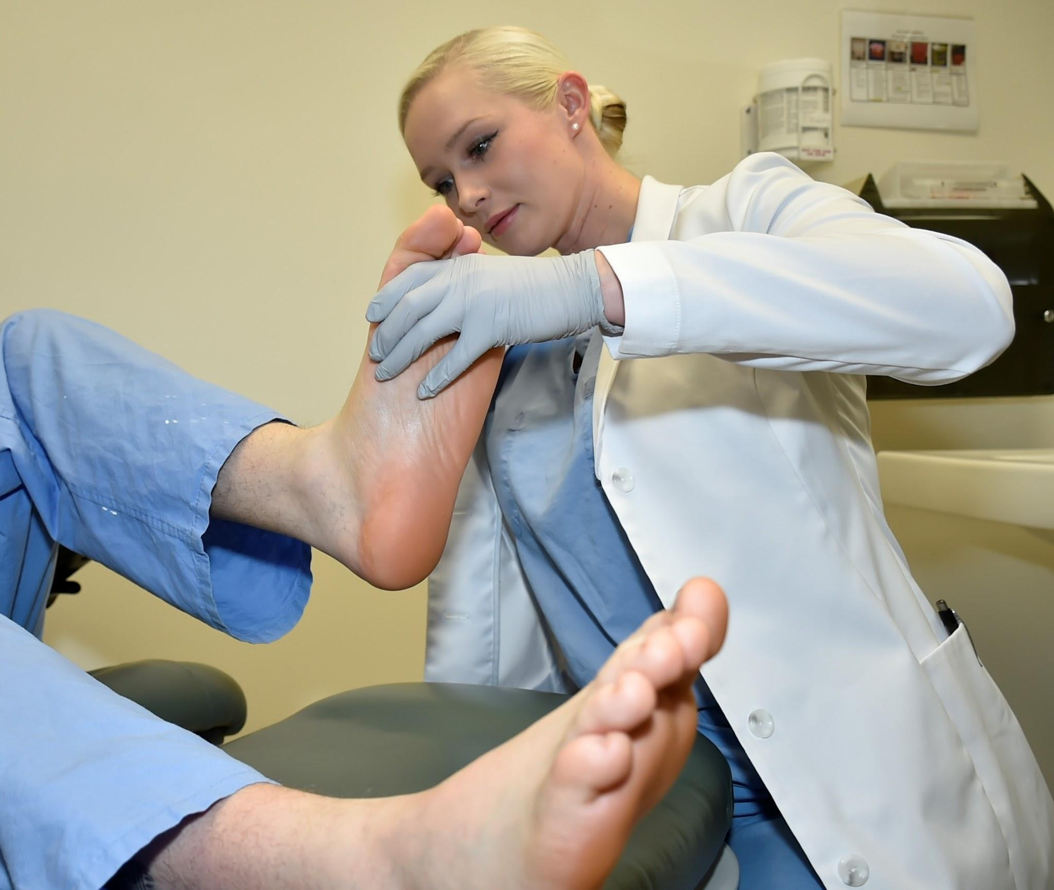
JOHANNESBURG HEALTH DISTRICT
2024 RESEARCH CONFERENCE
#JoburgResearch2024

Slide 9
CONTINUATION OF RESULTS AND DISCUSSION
JOHANNESBURG HEALTH DISTRICT
2024 RESEARCH CONFERENCE
As is evident, podiatrists in primary care facilities play a significant role in diagnosing, treating, and preventing lower leg and foot conditions. The Department of Health (DoH) should take action to implement training workshops that will share knowledge about podiatry or other professions so that all healthcare professionals are familiar with each profession’s scope of practice. As a result, professionals will be less likely to make poor referrals.
#JoburgResearch2024

Slide 10
LIMITATIONS
JOHANNESBURG HEALTH DISTRICT
2024 RESEARCH CONFERENCE
Lengthy waiting perion to acquire permission to conduct the study.
Limited sample size
Atittude of participants
#JoburgResearch2024

Slide 11
RECOMMENDATIONS
JOHANNESBURG HEALTH DISTRICT
2024 RESEARCH CONFERENCE
Repeat study with a large number
More institution that offer podiatry
Hiring more podiatrists in the primary health care
Raise awareness and education within the primary health care
#JoburgResearch2024

Slide 12
CONCLUSION
JOHANNESBURG HEALTH DISTRICT
2024 RESEARCH CONFERENCE
Currently, in South Africa, there are about 45-50 podiatrists in the public health sector, and no
conducive research on the number of podiatrists in the PHC. However, it can be safely stated
that there is a very limited number of podiatrists in the PHC as was observed as the research
was conducted. Therefore, it is suggested that more podiatrists in the PHC should be employed
across South Africa or at least in the major PHCs
#JoburgResearch2024

Slide 13
CONCLUSION
JOHANNESBURG HEALTH DISTRICT
2024 RESEARCH CONFERENCE
Lack of awareness and knowledge by other professionals continues to bea common challenge faced by podiatrists which results in inaccurate referrals. It is apparent that the profession is poorly financed in terms of medical resources.
Podiatry continues to be misunderstood in terms of the scope of practice regardless of the
awareness raised. The misconception about podiatry influences the referral system to be
incompetent.
#JoburgResearch2024

Slide 14
CONCLUSION
JOHANNESBURG HEALTH DISTRICT
2024 RESEARCH CONFERENCE
In conclusion, podiatry has an important role in primary healthcare, although there is a limited
number of podiatrists in the PHC. It is ideal and advisable for the department of health to
consider the placement of podiatry in the PHC for an efficient healthcare system.
#JoburgResearch2024

