Slide 1






Genomic characterization of Klebsiella pneumoniae causing childhood death in South Africa: an observational study
JOHANNESBURG HEALTH DISTRICT
2024 RESEARCH CONFERENCE
Courtney Olwagen, Ziyaad Danger, Vicky Baillie, Lara Van Der Merwe, Nicholas Dean, Shama Khan, Shabir Madhi
#JoburgResearch2024
Notes:
Good morning, everyone. My name is Lara Van Der Merwe, and today I’ll be presenting on behalf of Dr. Courtney Olwagen.

Slide 2
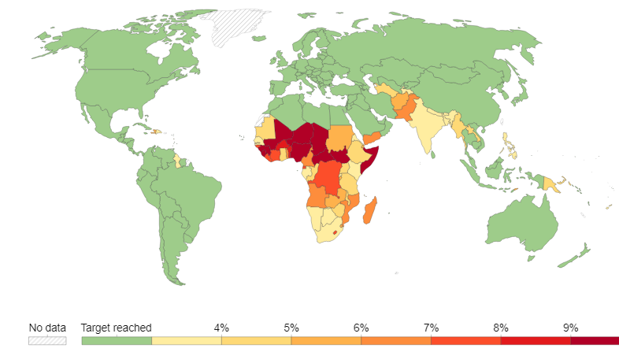

Introduction
JOHANNESBURG HEALTH DISTRICT
2024 RESEARCH CONFERENCE
Klebsiella pneumoniae (KPn) is a leading cause of neonatal sepsis and childhood deaths in South Africa and other LMICs.
There is limited genotypic characterization of KPn in Africa, including South Africa.
Verani, J.R., et al.The Lancet Microbe, 2024.
OurWorldInData.org/child-mortality
Under-five mortality (deaths per 1000 live births) by country, 2021.
#JoburgResearch2024
Notes:
Klebsiella pneumoniae (KPn) is a significant pathogen contributing to neonatal sepsis and childhood deaths, particularly in low- and middle-income countries including South Africa.
Despite its impact, there's a striking lack of genotypic characterization of KPn in this region.

Slide 3

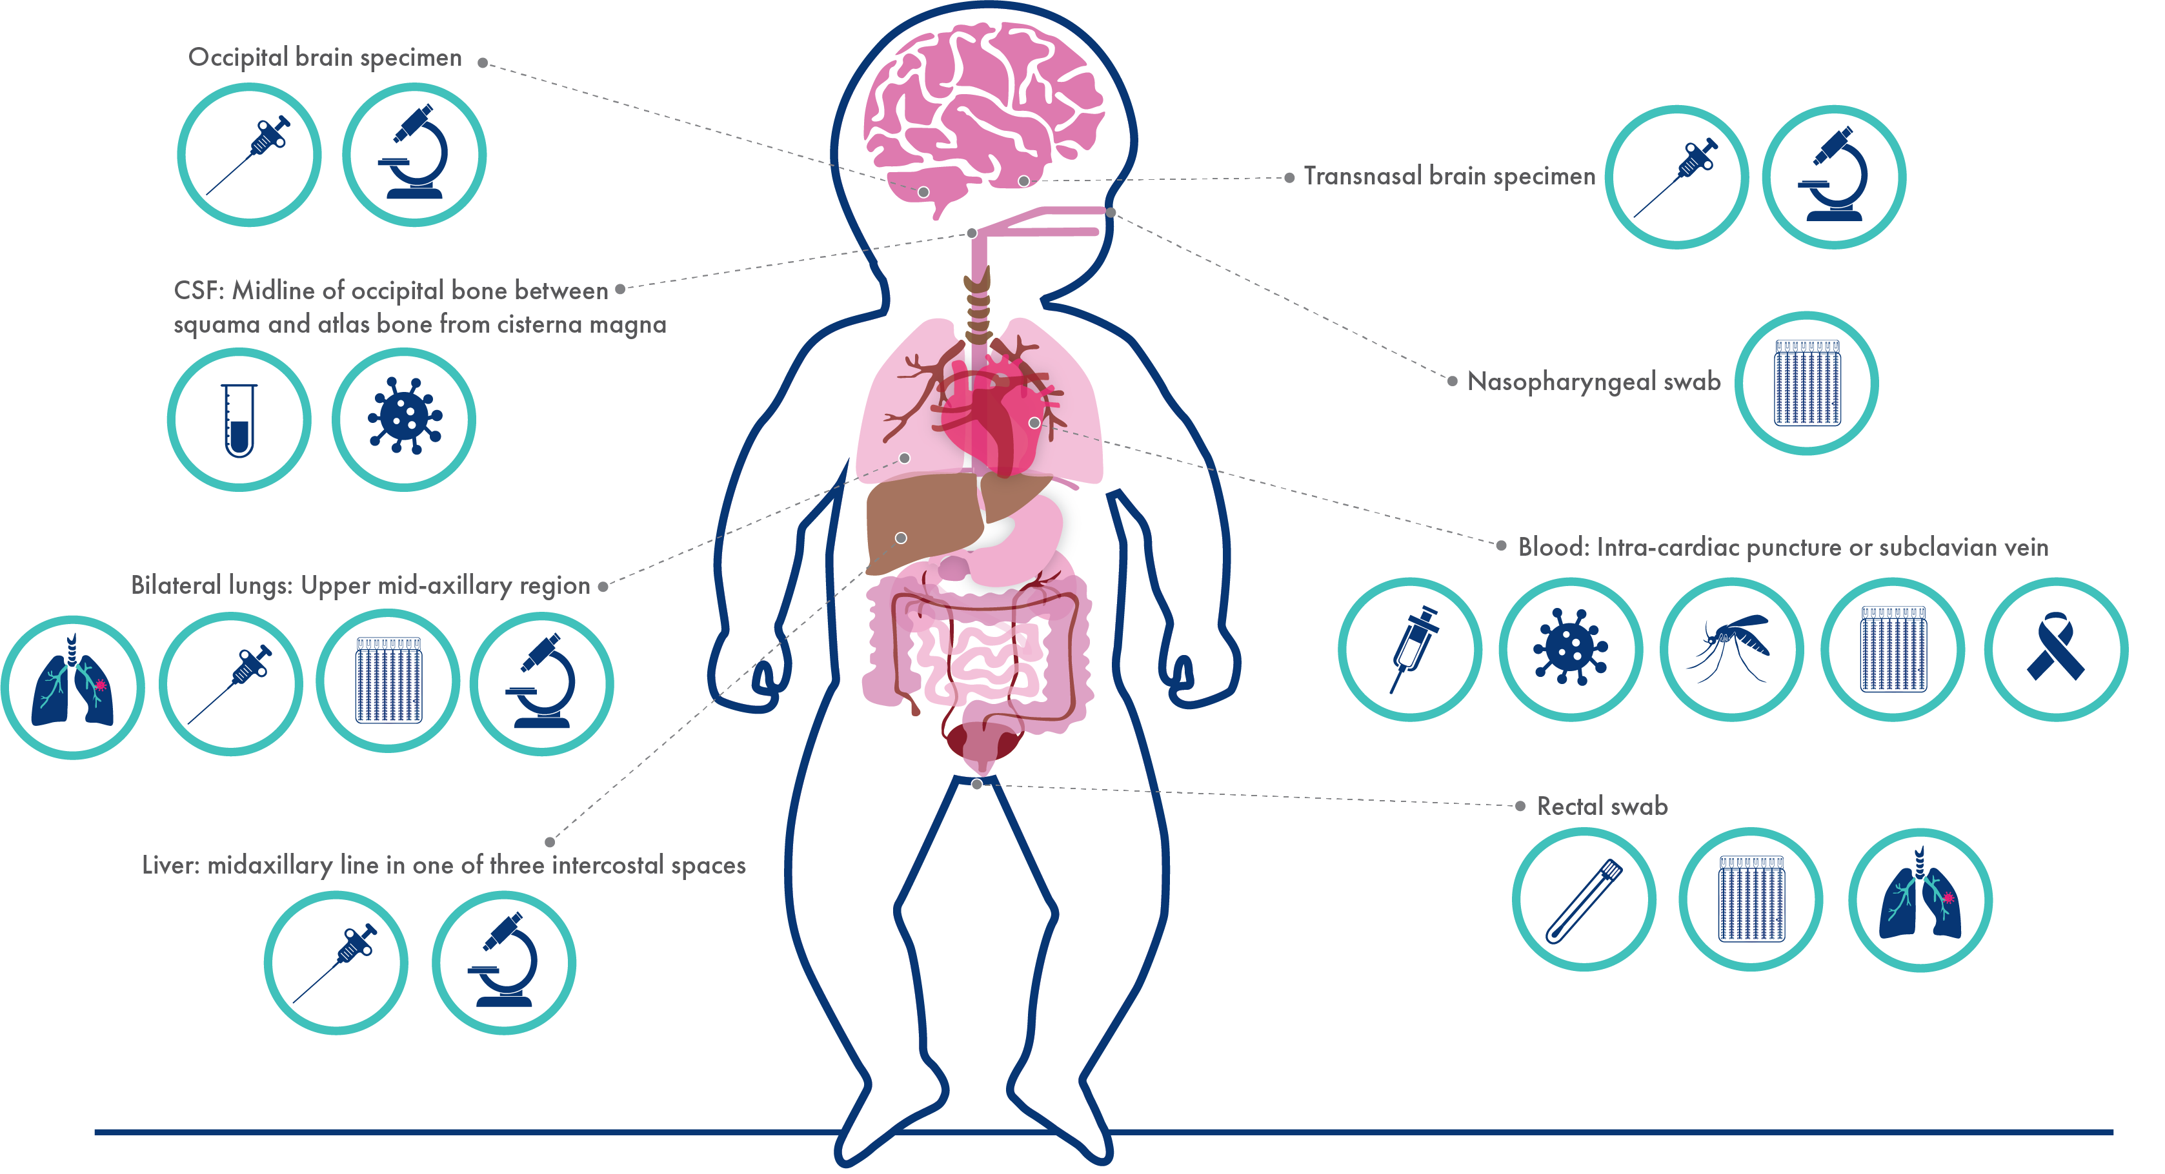

JOHANNESBURG HEALTH DISTRICT
2024 RESEARCH CONFERENCE
MITS Sampling and Testing
J. Du Toit et al. 2024 10.7196/SAMJ.2024.v114i2.1538
#JoburgResearch2024
Notes:
The CHAMPS study aims to determine the causal drivers of childhood death across seven LMICs, including South Africa.
MITS sampling is done as soon as possible and includes blood, CSF, and long tissue for culture. For each champs case a panel of local experts uses all available antemortem and postmortem data to determine the cause of death,
Analysis in the current study was limited to cases where KPn was attributed in the causal pathway to the death by the DeCoDe panel.

Slide 4

Demographic characteristics
JOHANNESBURG HEALTH DISTRICT
2024 RESEARCH CONFERENCE
64 isolates implicated in COD sequenced
#JoburgResearch2024
Notes:
We sequenced 64 isolates of KPn implicated in the causal chain of childhood deaths as shown in the sample distribution over time.
Further most of the sequenced cases were from late and early neonates.
Hospital-acquired infections (HAI) were defined as those occurring 72 hours or more after hospital admission– with most of the cases that underwent sequenced to be presumed HAI.
It is important to note that these are the demographics of the samples sequenced.

Slide 5
Sequence types (n=64)
JOHANNESBURG HEALTH DISTRICT
2024 RESEARCH CONFERENCE
#JoburgResearch2024
Notes:
When we look at the distribution of sequence types with the bar graph showing the % and the dotted line showing the cumulative % of cases what we can see is the top 10 sequence types made up > 75% of the cases, with ST17 and ST607 being the most dominant.

Slide 6
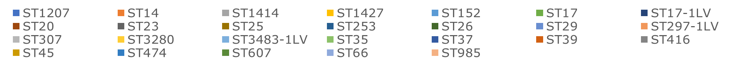
Sequence types over time
JOHANNESBURG HEALTH DISTRICT
2024 RESEARCH CONFERENCE
Notes:
This graph is showing the temporal change of the sequence types over the study period. The graph on the left is showing the number of isolates and on the right the proportion.
The dominant ST in the cases we have sequenced have changed over the study period. In the 1st part of 2018, we saw ST29 being the dominant ST.
ST17 dominated from early 2019 and continued to hold it’s position.

Slide 7
K-loci (N=64)
JOHANNESBURG HEALTH DISTRICT
2024 RESEARCH CONFERENCE
Notes:
When looking at the capsular polysaccharide, which is of interest for vaccines, KL25 was the dominant K-locus identified, accounting for over 30% of cases we sequenced followed by KL149, which has only been detected in limited studies.

Slide 8
K-loci over time
JOHANNESBURG HEALTH DISTRICT
2024 RESEARCH CONFERENCE
#JoburgResearch2024
Notes:
When looking at the temporal shift of k-loci over the 5-year period, we can see that KL149 was detected first in 2018 and then only again in spring of 2022 and summer of 2023.
Conversely KL25 was detected throughout the study period while KL102 was only detected from July 2022 onwards.

Slide 9
O-loci
JOHANNESBURG HEALTH DISTRICT
2024 RESEARCH CONFERENCE
#JoburgResearch2024
Notes:
In our study, we identified three dominant O-loci: O1/O2v2, followed by O1/O2v1, and then O5.

Slide 10
O-loci over time
JOHANNESBURG HEALTH DISTRICT
2024 RESEARCH CONFERENCE
#JoburgResearch2024
Notes:
Initially, in 2018, we observed a dominance of O1/O2v2 and O1/O2v1 loci, with O5 emerging.
By 2021 and into 2022, there was an increase in O5, which has continued to persist alongside O1/O2v1 and O1/O2v2.
Interestingly, OL101 emerged briefly in 2022, though its presence has not persisted into subsequent years.

Slide 11
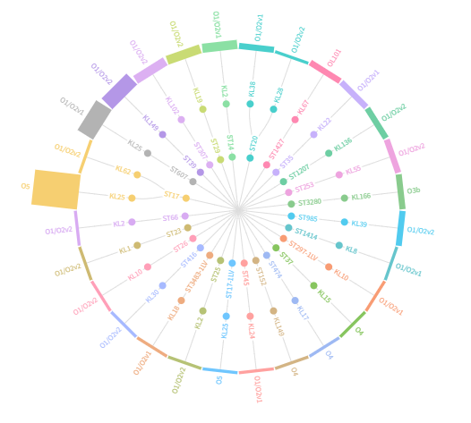
Radical tree
JOHANNESBURG HEALTH DISTRICT
2024 RESEARCH CONFERENCE
#JoburgResearch2024
Notes:
This graph shows the high genetic diversity of the cases with 28 distinct clones being identified amongst the 64 isolates that underwent seq.
Notably, the KL25 locus, associated with the O5 serotype, and the ST17 lineage, which is the dominant clone identified amongst the cases.

Slide 12
Virulence scores amongst genomes, by ST
JOHANNESBURG HEALTH DISTRICT
2024 RESEARCH CONFERENCE
#JoburgResearch2024
Notes:
It’s important to highlight that yersinabactin (Ybt), a marker of hypervirulence, was found in just under 70% of the isolates haboured the Ybt gene, .making them very difficult to treat.
If you have a look at the graph on the left different ST are associated with different levels of virulence.
ST66 and ST23 are particularly concerning, as they carry multiple gene, encoding for Ybt, colibactin and aerobactin virulence.

Slide 13
Antimicrobial resistance markers
JOHANNESBURG HEALTH DISTRICT
2024 RESEARCH CONFERENCE
#JoburgResearch2024
Notes:
These are the genes encoding AMR.
Multidrug Resistant is defined as resistant to 3 or more classes.
Under 83% of isolates haboured MDR genes.
27% of isolates harbor carbapenem-resistance associated with high case fatality risk.
The graph on the right highlights that the average number of AMR classes per isolate has increased from 3,75 in 2018 to over 5 in 2023.

Slide 14

JOHANNESBURG HEALTH DISTRICT
2024 RESEARCH CONFERENCE
CONCLUSION
A wide diversity of KPn strains, together with antimicrobial resistance and virulence factors play a complex role in KPn associated childhood mortality in South Africa.
Targeted surveillance and public health intervention tailored to local epidemiological contexts will be important to reduce the incidence of KPn infections and improve paediatric health outcomes.
#KlebsKeptAtBay
#Surveillance
SavesSociety
#JoburgResearch2024
Notes:
A wide diversity of KPn strains, together with antimicrobial resistance and virulence factors play a complex role in KPn associated childhood mortality in South Africa.
Targeted surveillance and public health intervention tailored to local epidemiological contexts will be important to reduce the incidence of KPn infections and improve paediatric health outcomes.

Slide 15
JOHANNESBURG HEALTH DISTRICT
2024 RESEARCH CONFERENCE
Key Recommendations for the Johannesburg Health District (JHD)
  Targeted IPC needed.
  Robust Antibiotic Stewardship Programs.
  - Expand Genomic Surveillance Efforts.
Contextualization to Johannesburg Health District (JHD)
Facilities Involved:
  Children under 5 years of age and stillbirths living in the catchment area (within Braamfisherville, Emdeni, Mapetla, Meadowlands Zones 4 & 5, Senaone, Mofolo North, Thulani, Freedom Park, Phiri, Senoane, Thembelihle, or Jackson) were eligible for inclusion in the CHAMPS study.
Research Challenges:
  - High Cost of Whole Genome Sequencing.
  - Limited Generalizability.
  - Need for Cost-Effective Surveillance Strategies.
#JoburgResearch2024
Notes:
The key recommendations are the need for targeted IPS, robust antibiotic stewardship programs, and expanded genomic surveillance efforts.
The catchment areas involved can be seen on the slide, with the main hospital being CHBAH.
Research challenges include high cost of WGS, Limited generalizability, and the need for cost-effective surveillance strategies.

Slide 16
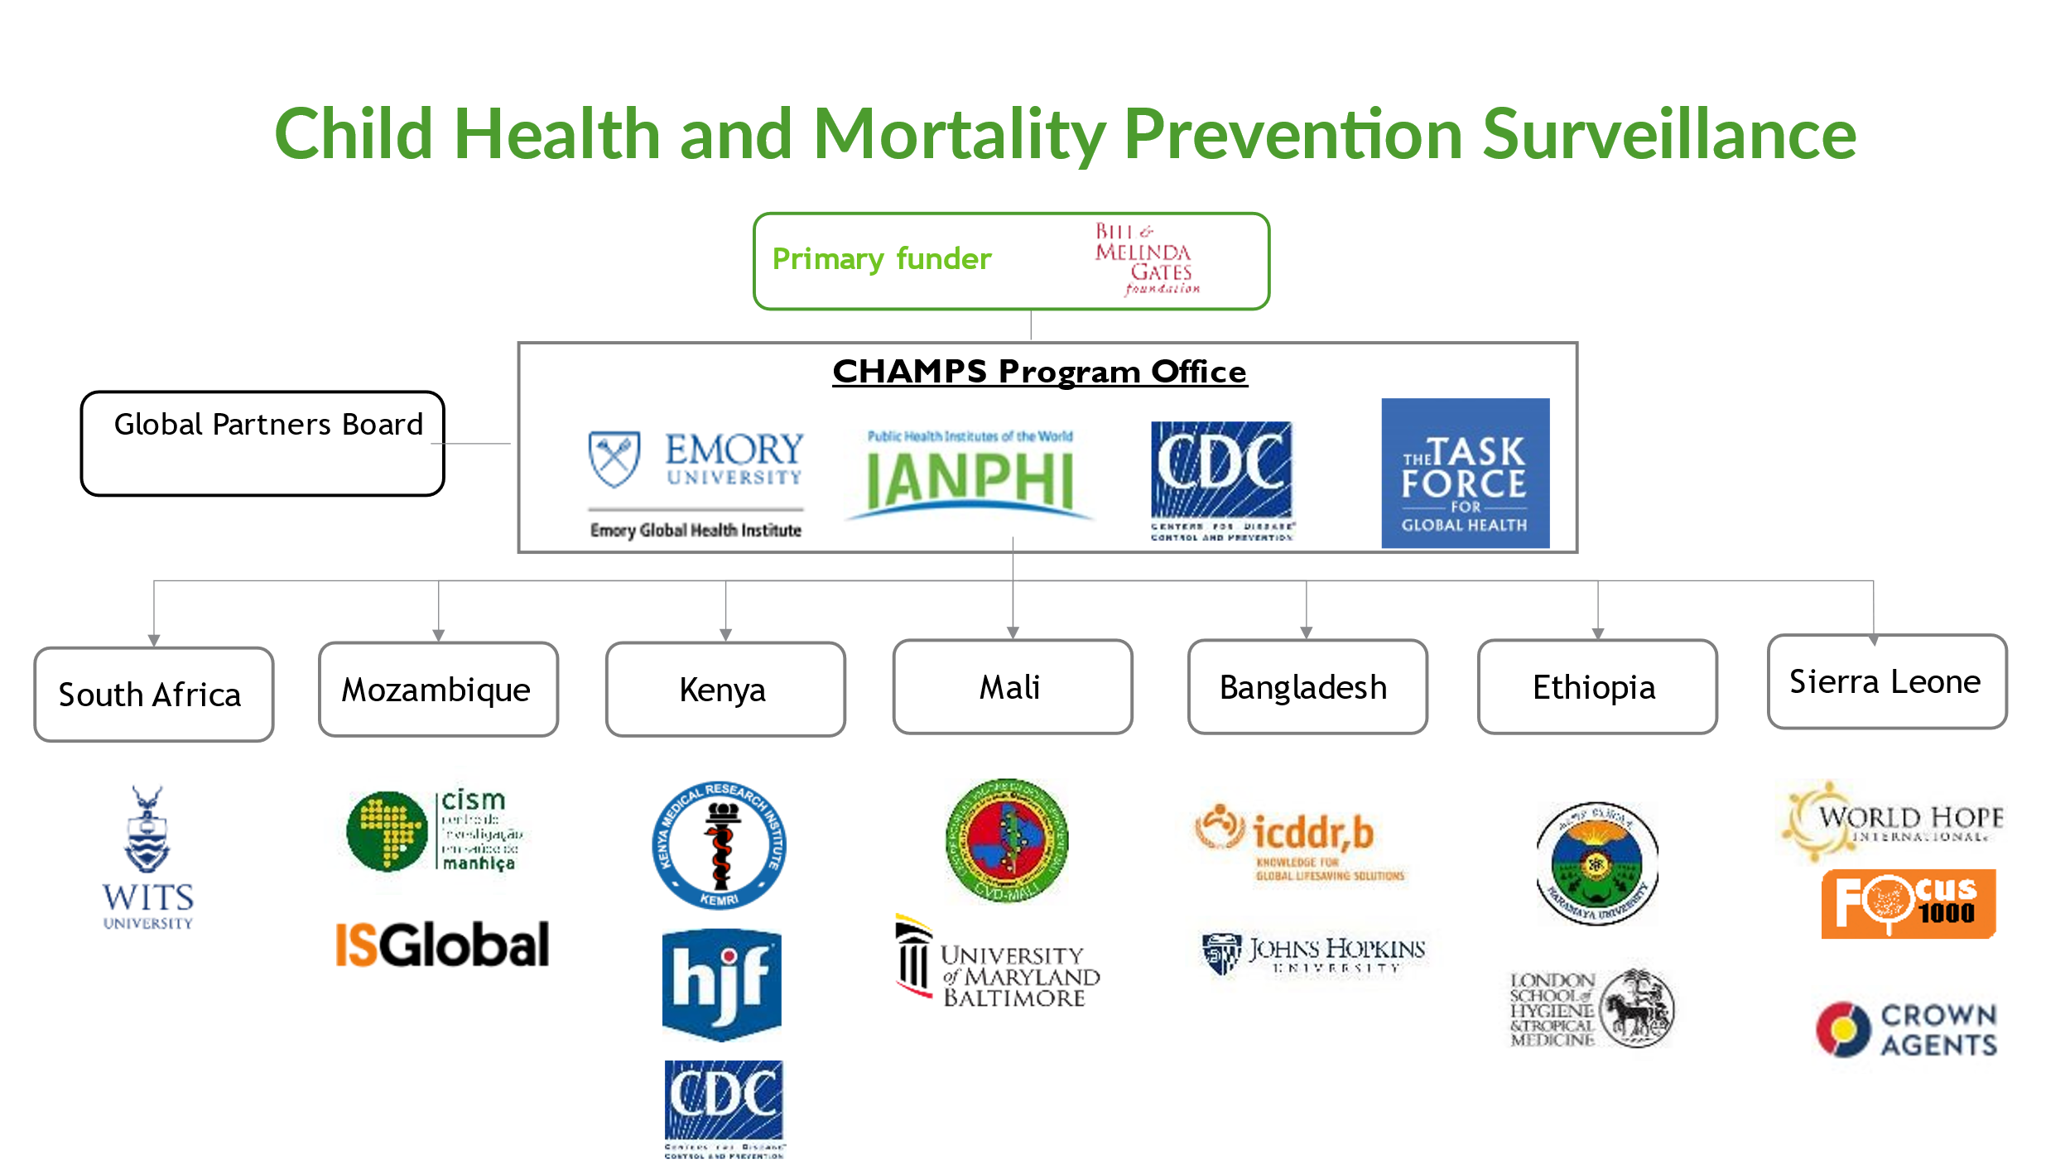

Declaration
JOHANNESBURG HEALTH DISTRICT
2024 RESEARCH CONFERENCE
Thank you
CHAMPS Network
The CHAMPS and MITS-lite study teams and all study personnel
The parents and families who participated in the study
#JoburgResearch2024
Notes:
In closing, I’d like to acknowledge the Bill & Melinda Gates Foundation for funding this research, as well as the CHAMPS Network and all the study personnel involved. A special thank you to the parents and families who participated.

Slide 17

THANK YOU

Slide 18
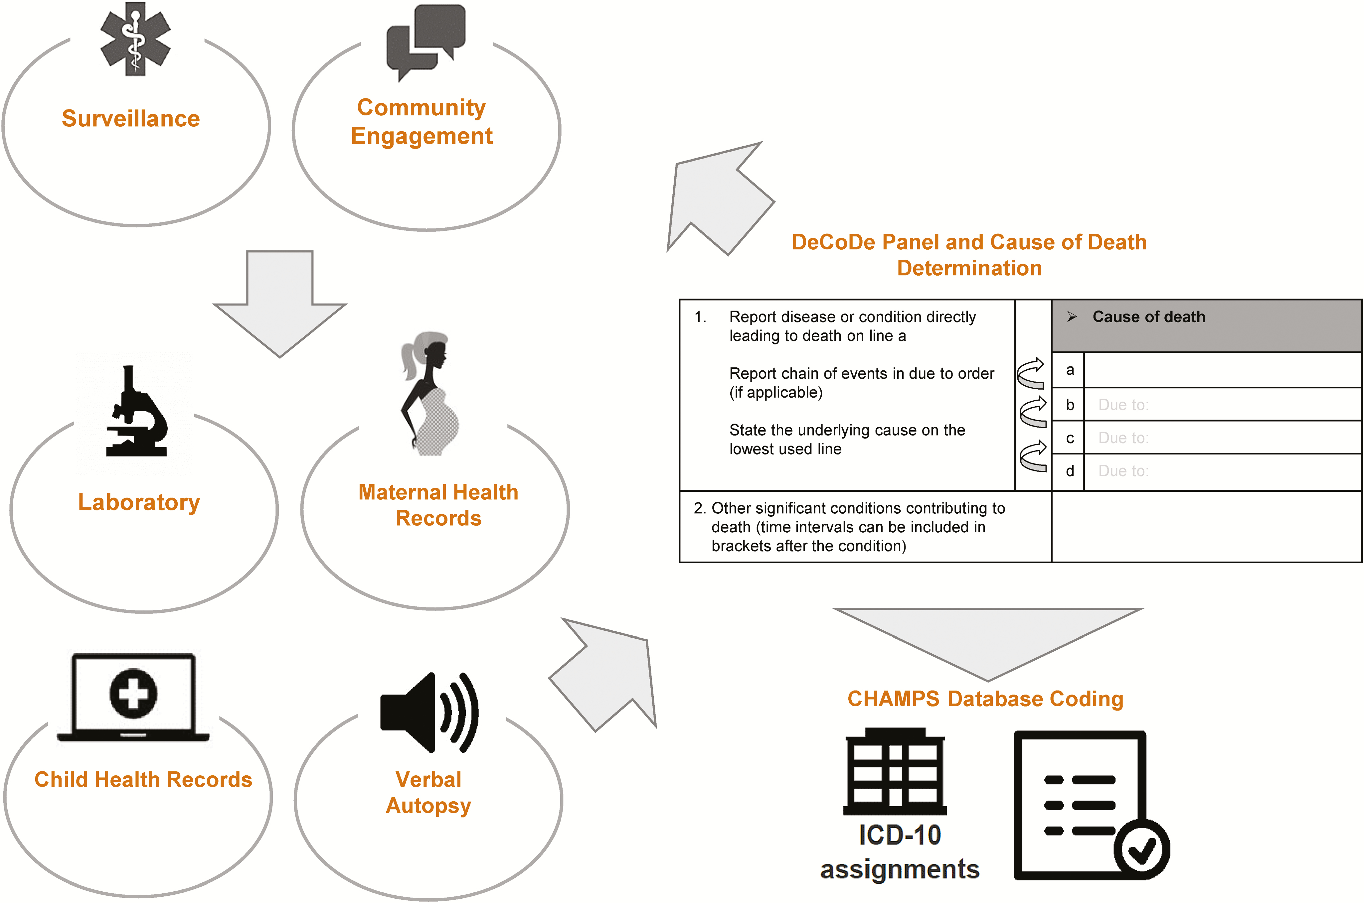
CHAMPS DeCoDe
JOHANNESBURG HEALTH DISTRICT
2024 RESEARCH CONFERENCE
#JoburgResearch2024
Notes:
For each CHAMSP case, the cause of death (COD) was determined by a multi-disciplinary determination of the cause of death (DeCoDe) panel constituted of local experts including neonatologists, pediatricians, microbiologists, and histopathologists.
The panel evaluates all available antemortem and post-mortem data to determine the COD.
Analysis in the current study was limited to cases where KPn was attributed in the causal pathway to the death by the DeCoDe panel.

Slide 19

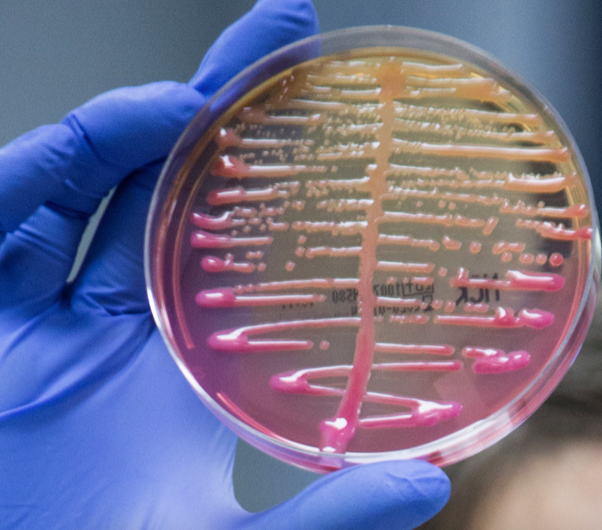

JOHANNESBURG HEALTH DISTRICT
2024 RESEARCH CONFERENCE
Methods
Sequencing
Bioinformatics Analysis
Culturing
#JoburgResearch2024
Notes:
Invasive KPn isolates were subcultured and identity was confirmed with API.
To prepare for whole genome sequencing, libraries were prepared with the Illumina Nextera DNA Flex Library Kit.
Following sequencing on the Miseq, various bioinformatic pipelines were used to analyze the genomes and to identify ST, K and O - Loci, VF, and AMR markers

Slide 20
CAUSE of Death determined by Decode panel
Notes:
ICE
Also important to note that this is not a representation of all Klebs cases – its specific to only the ones sequenced.

Slide 21
ST, by setting
ST, by case type
Notes:
Remember that some CAI stillbirths etc have fewer isolates
Probably can keep this as a slide at end if anyone asks if you looked at difference etc between these

Slide 22
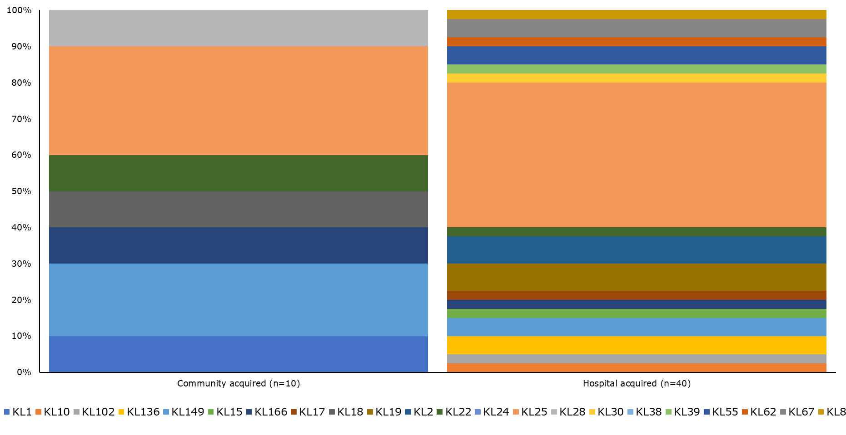
K-loci, by setting
K-loci, by case type

Slide 23
O-loci, by setting O-loci, by case type

Slide 24
Antimicrobial resistance markers
JOHANNESBURG HEALTH DISTRICT
2024 RESEARCH CONFERENCE
#JoburgResearch2024
Notes:
The distribution of antimicrobial resistance (AMR) markers across different drug classes over the years showed consistently high levels of resistance to aminoglycosides, and cephalosporins.
Notably, there's an increasing trend in carbapenem resistance, particularly in 2023, which underscores the growing challenge of treating Klebsiella pneumoniae infections.
The graph on the right highlights that the average number of AMR classes per isolate has increased from 4 in 2018 to over 5 in 2023.
This trend reflects the expanding resistance profile of these strains, posing a significant threat to public health and treatment options.

