Slide 1












DOLPHIN TOO Study
JOHANNESBURG HEALTH DISTRICT
2024 RESEARCH CONFERENCE
Simultaneous initiation of DTG-based ART & 3HP in ART-naïve PLHIV maintains efficacious DTG levels
Jayajothi Moodley, Trevor Beattie, Manasa Mapendere, Ethel D. Weld, Isadora Salles, Bareng A.S. Nonyane, Belén Perez Solans, Vinodh Edward, Tanya Nielson, Violet Chihota, Rada Savic, Kelly E. Dooley, Richard E. Chaisson, Gavin J. Churchyard
UNITAID IMPAACT4TB Research Group
#JoburgResearch2024

Slide 2

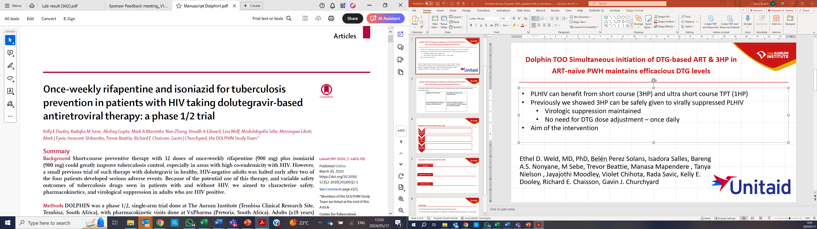
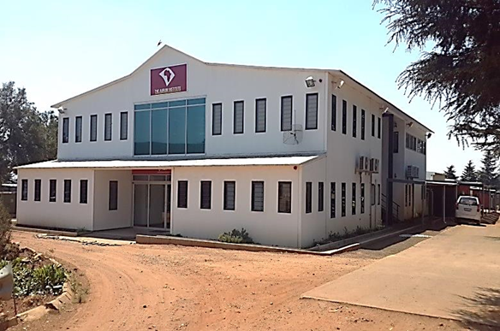
BACKGROUND : DOLPHIN Study (2018 )
JOHANNESBURG HEALTH DISTRICT
2024 RESEARCH CONFERENCE
PLHIV can benefit from short course (3HP) and ultra short course TPT (1HP)
Previously (DOLPHIN STUDY), we showed 3HP can be safely given to
virally suppressed PLHIV
Virologic suppression maintained
No need for DTG dose adjustment – once daily
No evidence to support simultaneous initiation of ART and 3HP in PLHIV
¹ Dooley KE et al, Lancet HIV. 2020 Jun;7(6):3401-e409
Tembisa CRS
#JoburgResearch2024

Slide 3
DOLPHIN TOO STUDY - DESIGN /METHODS
JOHANNESBURG HEALTH DISTRICT
2024 RESEARCH CONFERENCE
Phase I/II comparative trial of 3HP versus 6 months isoniazid (6H) among antiretroviral (ART)-naïve adults with HIV initiating once-daily DTG-based ART in South Africa
Participants sequentially enrolled from 31 August 2021 to 28 June 2022 at the Aurum Tembisa site and assigned to 6H (N=25) and 3HP (N=50)
Primary endpoints: Safety & DTG Pharmacokinetics during coadministration of TPT and DTG
Secondary endpoint: HIV Viral Load (12, 24 weeks)
#JoburgResearch2024

Slide 4
Results - Safety
JOHANNESBURG HEALTH DISTRICT
2024 RESEARCH CONFERENCE
AEs
6H group: 11/25 (44%) unique participants experienced AE’s
12 treatment-related AE’s occurred
9/50 (18%) in 3HP group
3/25 (12%) in 6H group
No IRIS events occurred
3HP group: 14/50 (28%) unique participants experienced adverse events (AE’s)
No AE’s resulting in drug discontinuation, majority mild to moderate and self resolving
Unique participants w AE’s | Overall 25 (33%) | 6H 11 (44%) | 3HP 14 (28%)
AE’s all grades | 44 (100%) | 25 (100%) | 19 (100%)
AE Grade 1, n (%) | 12 (27%)^{b} | 9 (36%) | 3 (16%)
AE Grade 2, n (%) | 31 (70%) | 15 (60%) | 16 (84%)
AE Grade 3, n (%) | 1 (2%) | 1 (4%)* | 0 (0%)
Treatment-related Grade 1 # (%) Ppts | 3 (4%) | 1 (4%)ª | 2 (4%)
Treatment-related Grade 2 # (%) Ppts | 9 (12%) | 2 (8%) | 7 (14%)
IRIS events | 0 (0%) | 0 (0%) | 0 (0%)
ª One participant had a treatment-related AE of vomiting which was attributed to BOTH DTG and TDF. Cutaneous abscess unrelated to treatment, requiring hospitalization Ppts=participants; AE’s= adverse events
Gastro-oesophageal reflux with gastritis
Transient Generalized Headache
Nausea
Peripheral neuropathy symptoms
Hyperbilirubinaemia
Isolated Hyperbilirubinaemia
Generalized Pruritus
Peripheral neuropathy symptoms
Elevated ALT
#JoburgResearch2024

Slide 5
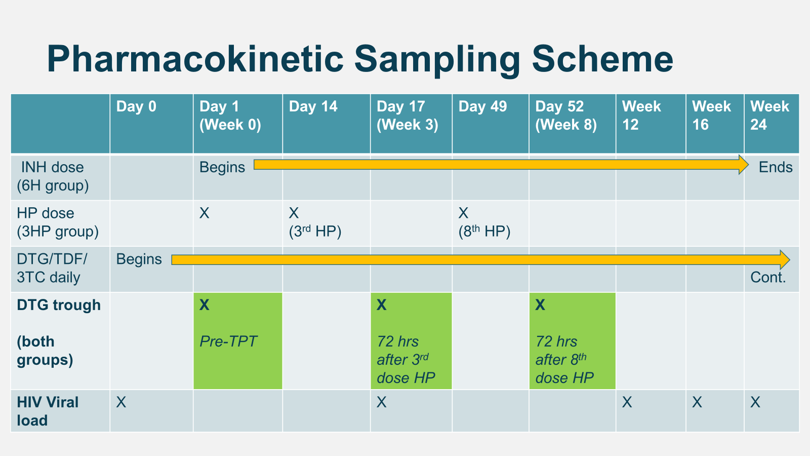
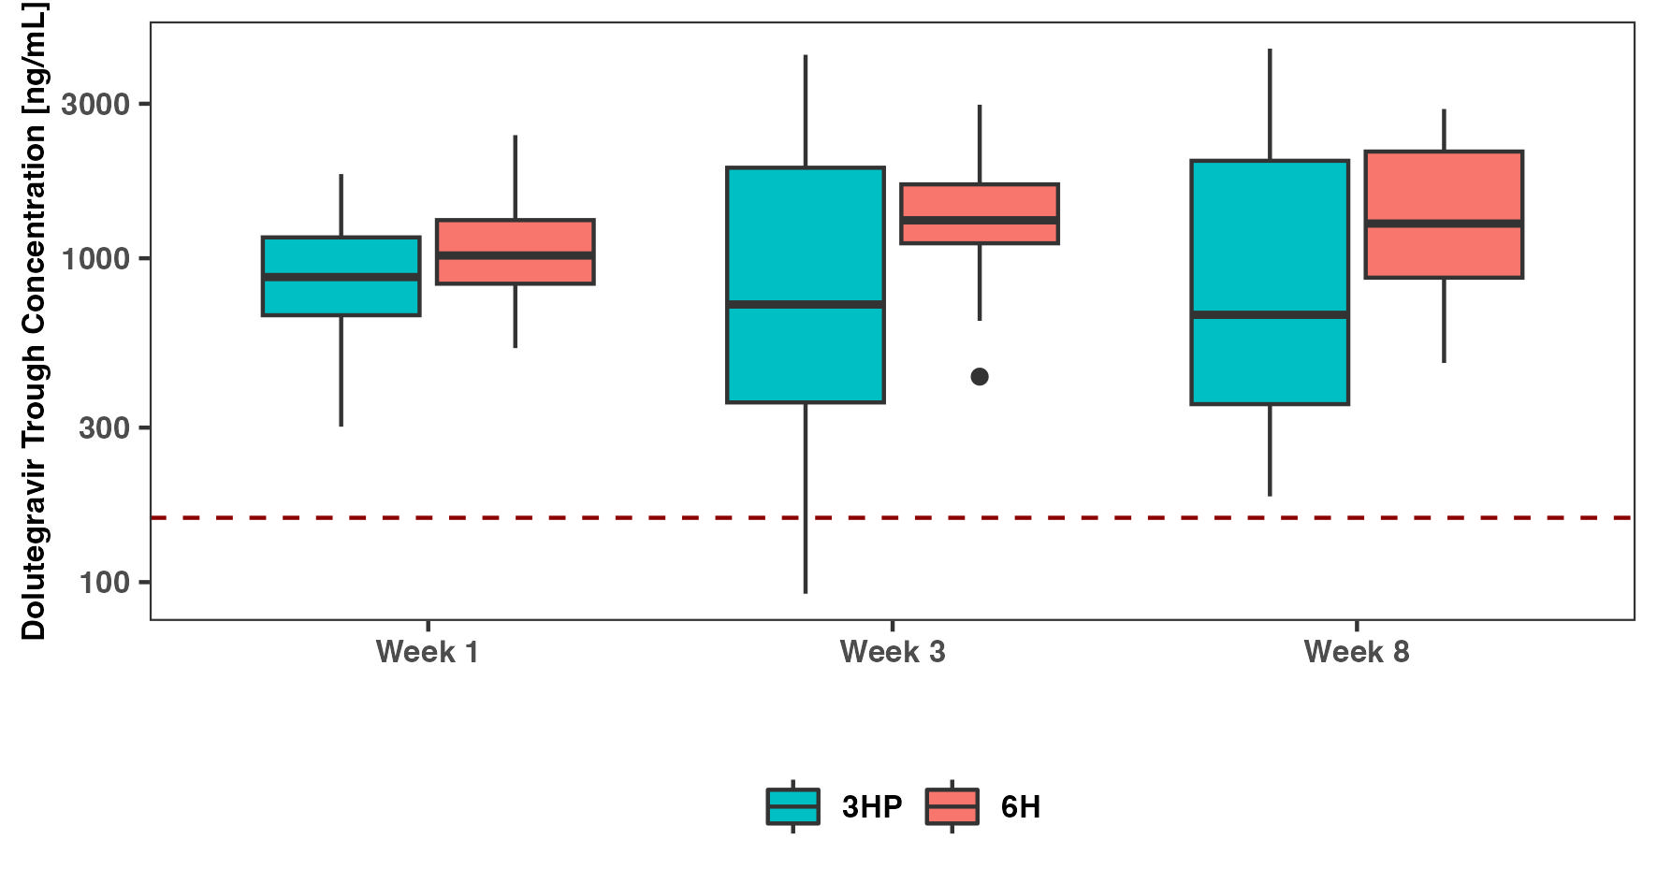
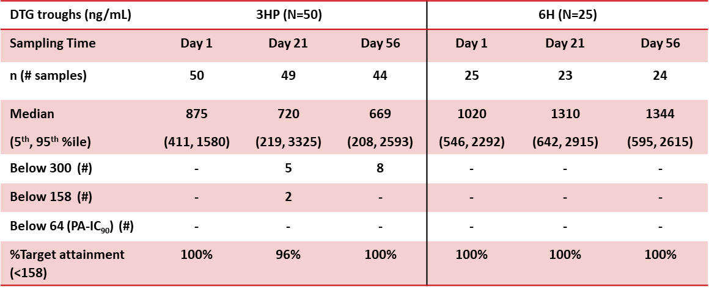
Results - PK
JOHANNESBURG HEALTH DISTRICT
2024 RESEARCH CONFERENCE
PK
Previously a 37% induction effect of RPT on DTG clearance was observed¹
Nonlinear mixed-effects modelling showed a 72% induction effect of RPT on DTG clearance (0.954 L/hr to 1.64 L/hr)
*
*
* Wilcoxon rank sum p-value <0.01
158 ng/mL (5th %ile C_{min} w/ 10 mg daily DTG in SPRING-1 Trial²)
¹ Dooley KE et al, Lancet HIV. 2020 Jun;7(6):3401-e409 ; ² Stellbrink HJ, AIDS 2013 Jul 17,27(11):1771-1778
#JoburgResearch2024

Slide 6
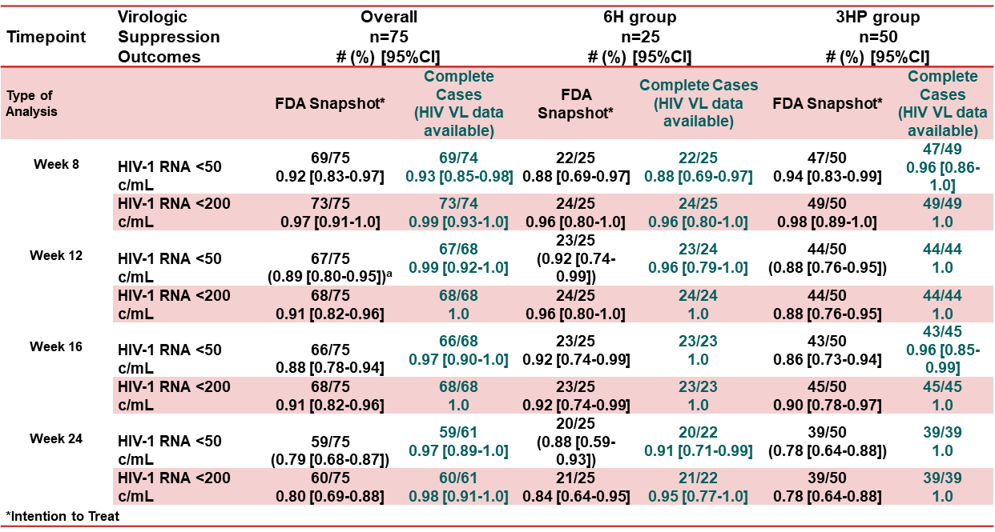
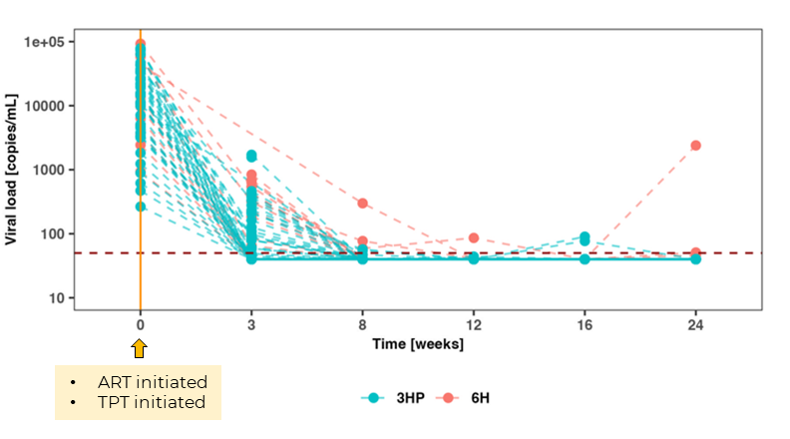
Results - PK
JOHANNESBURG HEALTH DISTRICT
2024 RESEARCH CONFERENCE
HIV VL
Median HIV VL decline from study initiation to week 12 (end of 3HP):
3HP group: 4.3 (3.7-4.9) log₁₀
6H group: 4.8 (4.1-5.3) log₁₀
#JoburgResearch2024

Slide 7
Conclusion/Interpretation
JOHANNESBURG HEALTH DISTRICT
2024 RESEARCH CONFERENCE
Simultaneous initiation of 3HP and DTG-based ART was safe, effective and well tolerated.
Although DTG clearance was increased by rifapentine (as expected), robust viral suppression was rapidly achieved and maintained.
These findings are critical to informing guidelines around simultaneous 3HP initiation in ART-naïve individuals.
Standard DTG-based ART and 3HP can be initiated simultaneously
#JoburgResearch2024

Slide 8
Facilities
JOHANNESBURG HEALTH DISTRICT
2024 RESEARCH CONFERENCE
Ekurhuleni District (North) | Johannesburg Health District
Boksburg Civic Centre | COJ Region A: | COJ Region E:
Boksburg North Clinic | Bophelong clinic | 4th Avenue Clinic
Edenvale Clinic | Ebony Park/ Kaalfontein clinic | 8th Avenue Clinic
Endayeni Clinic | ​Hikhensile | River Park Clinic
Erin Clinic | Mpumelelo | Alex Health Centre clinic
Esangweni CHC | ​Rabie Ridge
Ethafeni Clinic | Thuthukani
Itireleng Clinic
Kempton Park Civic Centre Clinic
Oilfantsfontein Clinic
Tembisa Health Clinic
Tembisa Main Clinic Spartan Clinic
Winnie Mandela Clinic
#JoburgResearch2024

Slide 9
Challenges and Solutions
JOHANNESBURG HEALTH DISTRICT
2024 RESEARCH CONFERENCE
Challenges | Solutions
Rollout of Universal Test and Treat- participants needed time to absorb HIV status | Participants were given an opportunity to digest the news of their HIV positive status and brought back when they were ready
Use of Contraceptives as per study- reluctancy to use contraceptives or go to clinics for the contraceptives | Initiation at DOH and/or CRS and were asked to come back when ready to take contraception
HIV disclosure- affecting condom use and ARV initiation | Further counselling provided and participants only invited to join once they could negotiate condom use and ARV initiation with the partners
TLD was not SOC – participants were on Efavirenz based ART combinations | List of all enrolled participants was submitted to DoH after the National rollout of TLD regimen (01 December 2020).
Concerns from DoH regarding statistics on TIER.NET to accommodate participants on TLD. | After rollout of TLD, a list was submitted to the various clinics to capture TLD use.
#JoburgResearch2024

Slide 10
JOHANNESBURG HEALTH DISTRICT
2024 RESEARCH CONFERENCE
Thank you
#JoburgResearch2024

