Slide 1





Knowledge assessment of CT scanning parameters amongst DR, NM and RT radiographers in Gauteng Province.
JOHANNESBURG HEALTH DISTRICT
2024 RESEARCH CONFERENCE
Moswatse J Thobakgale
PhD Study Report – Phase 1
University of Pretoria
Supervisor: Dr M Kekana
Co-Supervisor: Dr B Van Wyk
Statistician: Mr A Masenge
#JoburgResearch2024

Slide 2
Study Background Information
JOHANNESBURG HEALTH DISTRICT
2024 RESEARCH CONFERENCE
PhD study with University of Pretoria
Mixed method study following an explanatory sequential design
Phase 1 results – quantitative
Hospitals included in the study.
Data collection method – questionnaire
Data analysis – Excel for capturing and SPSS version 29
#JoburgResearch2024

Slide 3
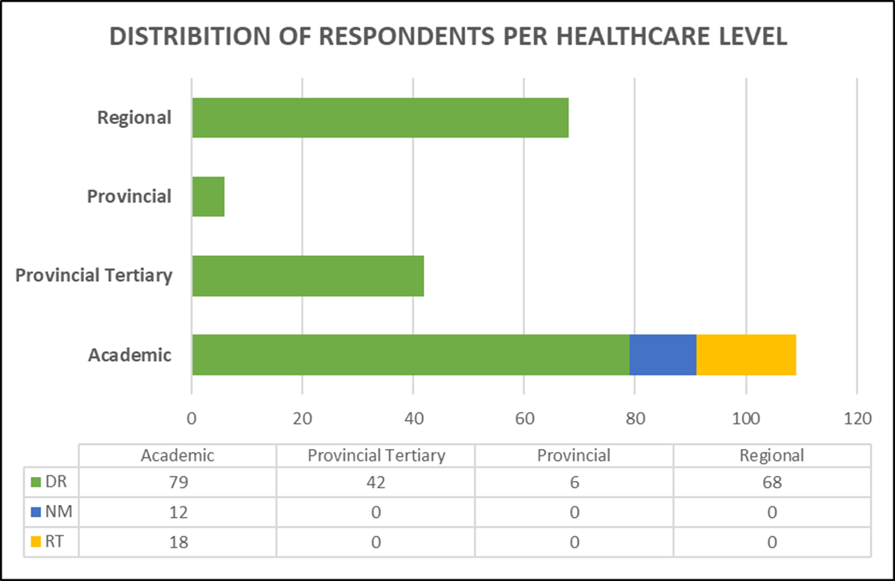
Responses
JOHANNESBURG HEALTH DISTRICT
2024 RESEARCH CONFERENCE
Total number of completed questionnaire was = 225.
DR – 87%
NM – 5%
RT – 8%
Healthcare levels
Academic – 48%
Provincial Tertiary – 19%
Provincial – 3%
Regional – 30%
#JoburgResearch2024

Slide 4
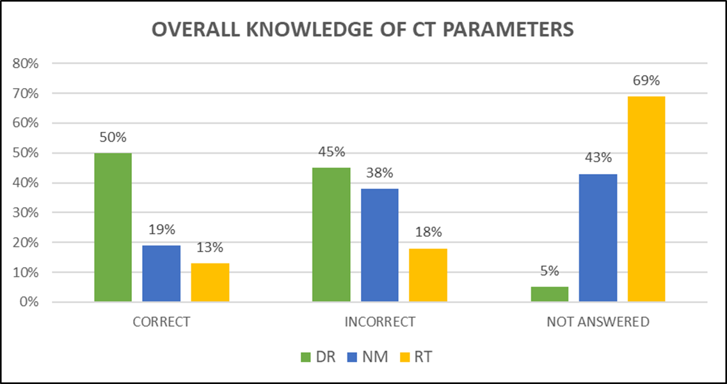
Overall knowledge of scanning parameters’ effect on image quality and patient absorbed dose.
JOHANNESBURG HEALTH DISTRICT
2024 RESEARCH CONFERENCE
Ten true/ false questions were asked.
RT and NM radiographer had a lot of unanswered questions
Better question attempt rate by DR radiographers
Overall knowledge was very low
#JoburgResearch2024

Slide 5
LITERATURE
JOHANNESBURG HEALTH DISTRICT
2024 RESEARCH CONFERENCE
Advancement in CT technology
Importance of justification and optimization
CTDIvol and DLP
#JoburgResearch2024

Slide 6
RECOMMENDATIONS
JOHANNESBURG HEALTH DISTRICT
2024 RESEARCH CONFERENCE
Frequent allocation of radiographers in CT
Less knowledgeable/competent/confident radiographers should not be allocated alone
Training very important when new CT is acquired
Radiographers should be encouraged to attend short learning programs/courses
As much as possible number of radiographers can be included during protocol development and/or update
“WORK FOR QUALITY”
#JoburgResearch2024

Slide 7
REFERENCES
JOHANNESBURG HEALTH DISTRICT
2024 RESEARCH CONFERENCE
Frush, D. , Denham, C. R. , Goske, M. J. , Brink, J. A. , Morin, R. L. , Mills, T. T. , Butler, P. F. , McCollough, C. & Miller, D. L. (2013). Radiation Protection and Dose Monitoring in Medical Imaging. Journal of Patient Safety, 9 (4), 232-238. doi: 10.1097/PTS.0b013e3182a8c2c4.
Li X, Rehani MM, Marschall TA, Yang K, Liu B. Cumulative radiation exposure from multimodality recurrent imaging of CT, fluoroscopically guided intervention, and nuclear medicine. Eur Radiol. 2024 Jun;34(6):3719-3729. doi: 10.1007/s00330-023-10299-7. Epub 2023 Nov 13. PMID: 37957362.
#JoburgResearch2024

