Slide 1







Safety Outcomes Among Infants Whose Mothers Used Dapivirine Vaginal Ring or Oral PrEP During pregnancy (MTN-042/DELIVER)
JOHANNESBURG HEALTH DISTRICT
2024 RESEARCH CONFERENCE
Lee Fairlie, Daniel W Szydlo, Ashley J Mayo, Katie Bunge, Felix Mhlanga, Jeanna Piper, Sufia Dadabhai, Vanessa M Gatsi, Elizea Horne, Phionah Kibalama Ssemambo, Vitumbiko D Mandiwa, Nyaradzo M Mgodi, Maxensia Owor, Rachel Scheckter, Catherine Chappell,
Sharon L Hillier
For the MTN-042 team
#JoburgResearch2024

Slide 2


Background
JOHANNESBURG HEALTH DISTRICT
2024 RESEARCH CONFERENCE
Dapivirine vaginal ring (“ring”) is registered for HIV prevention in cisgender women in 11 African countries, available in six of these countries
MTN-042/DELIVER (Malawi, South Africa, Uganda and Zimbabwe) was first study of ring use during pregnancy
Maternal and pregnancy safety data previously reported, no safety concerns
We report infant birth & safety outcomes post in-utero exposure to the ring or oral TDF/FTC
Dapivirine vaginal ring
Oral TDF/FTC
Makanani, JAIDS, 2018; Bunge, JAIDS, 2024; Mhlanga, CROI, 2024.
#JoburgResearch2024

Slide 3
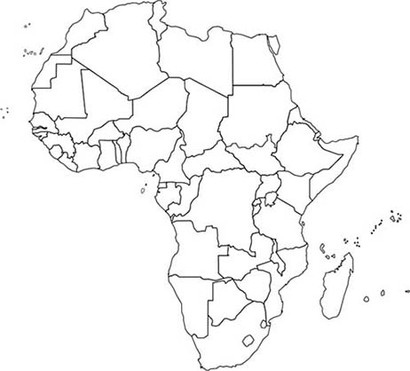






MTN-042 Study Design: Infants
JOHANNESBURG HEALTH DISTRICT
2024 RESEARCH CONFERENCE
Study Start
Infant visits at <2 weeks, 6-weeks, 6- & 12-months
Birth outcomes, Serious Adverse Events (SAEs), ≥Grade 3 AEs, growth parameters and infant development (Ages and Stages), up to 12-months for cohorts 1, 2 and 3 included
A study geneticist independently verified all reported congenital anomalies.
Stakeholders engaged in protocol development and recommended longer infant follow-up (up to 12 months)
To evaluate the value added by longer follow-up, we assessed the proportion of new onset adverse events at ≤6 weeks, >6 weeks to ≤6 months and >6 months to 12 months
Cohort 1
36+ weeks pregnant
Used product
4-6 weeks
150
Safety review
2:1
Cohort 2
30-35 weeks pregnant
Used product
7-12 weeks
150
Safety review
2:1
Used product
up to 30 weeks
Study Complete
Cohort 3
12-29 weeks
pregnant
250
4:1
#JoburgResearch2024

Slide 4
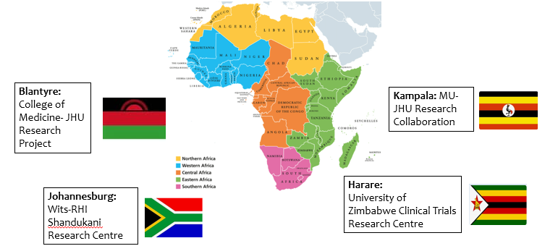
MTN-042 study sites
JOHANNESBURG HEALTH DISTRICT
2024 RESEARCH CONFERENCE
#JoburgResearch2024

Slide 5
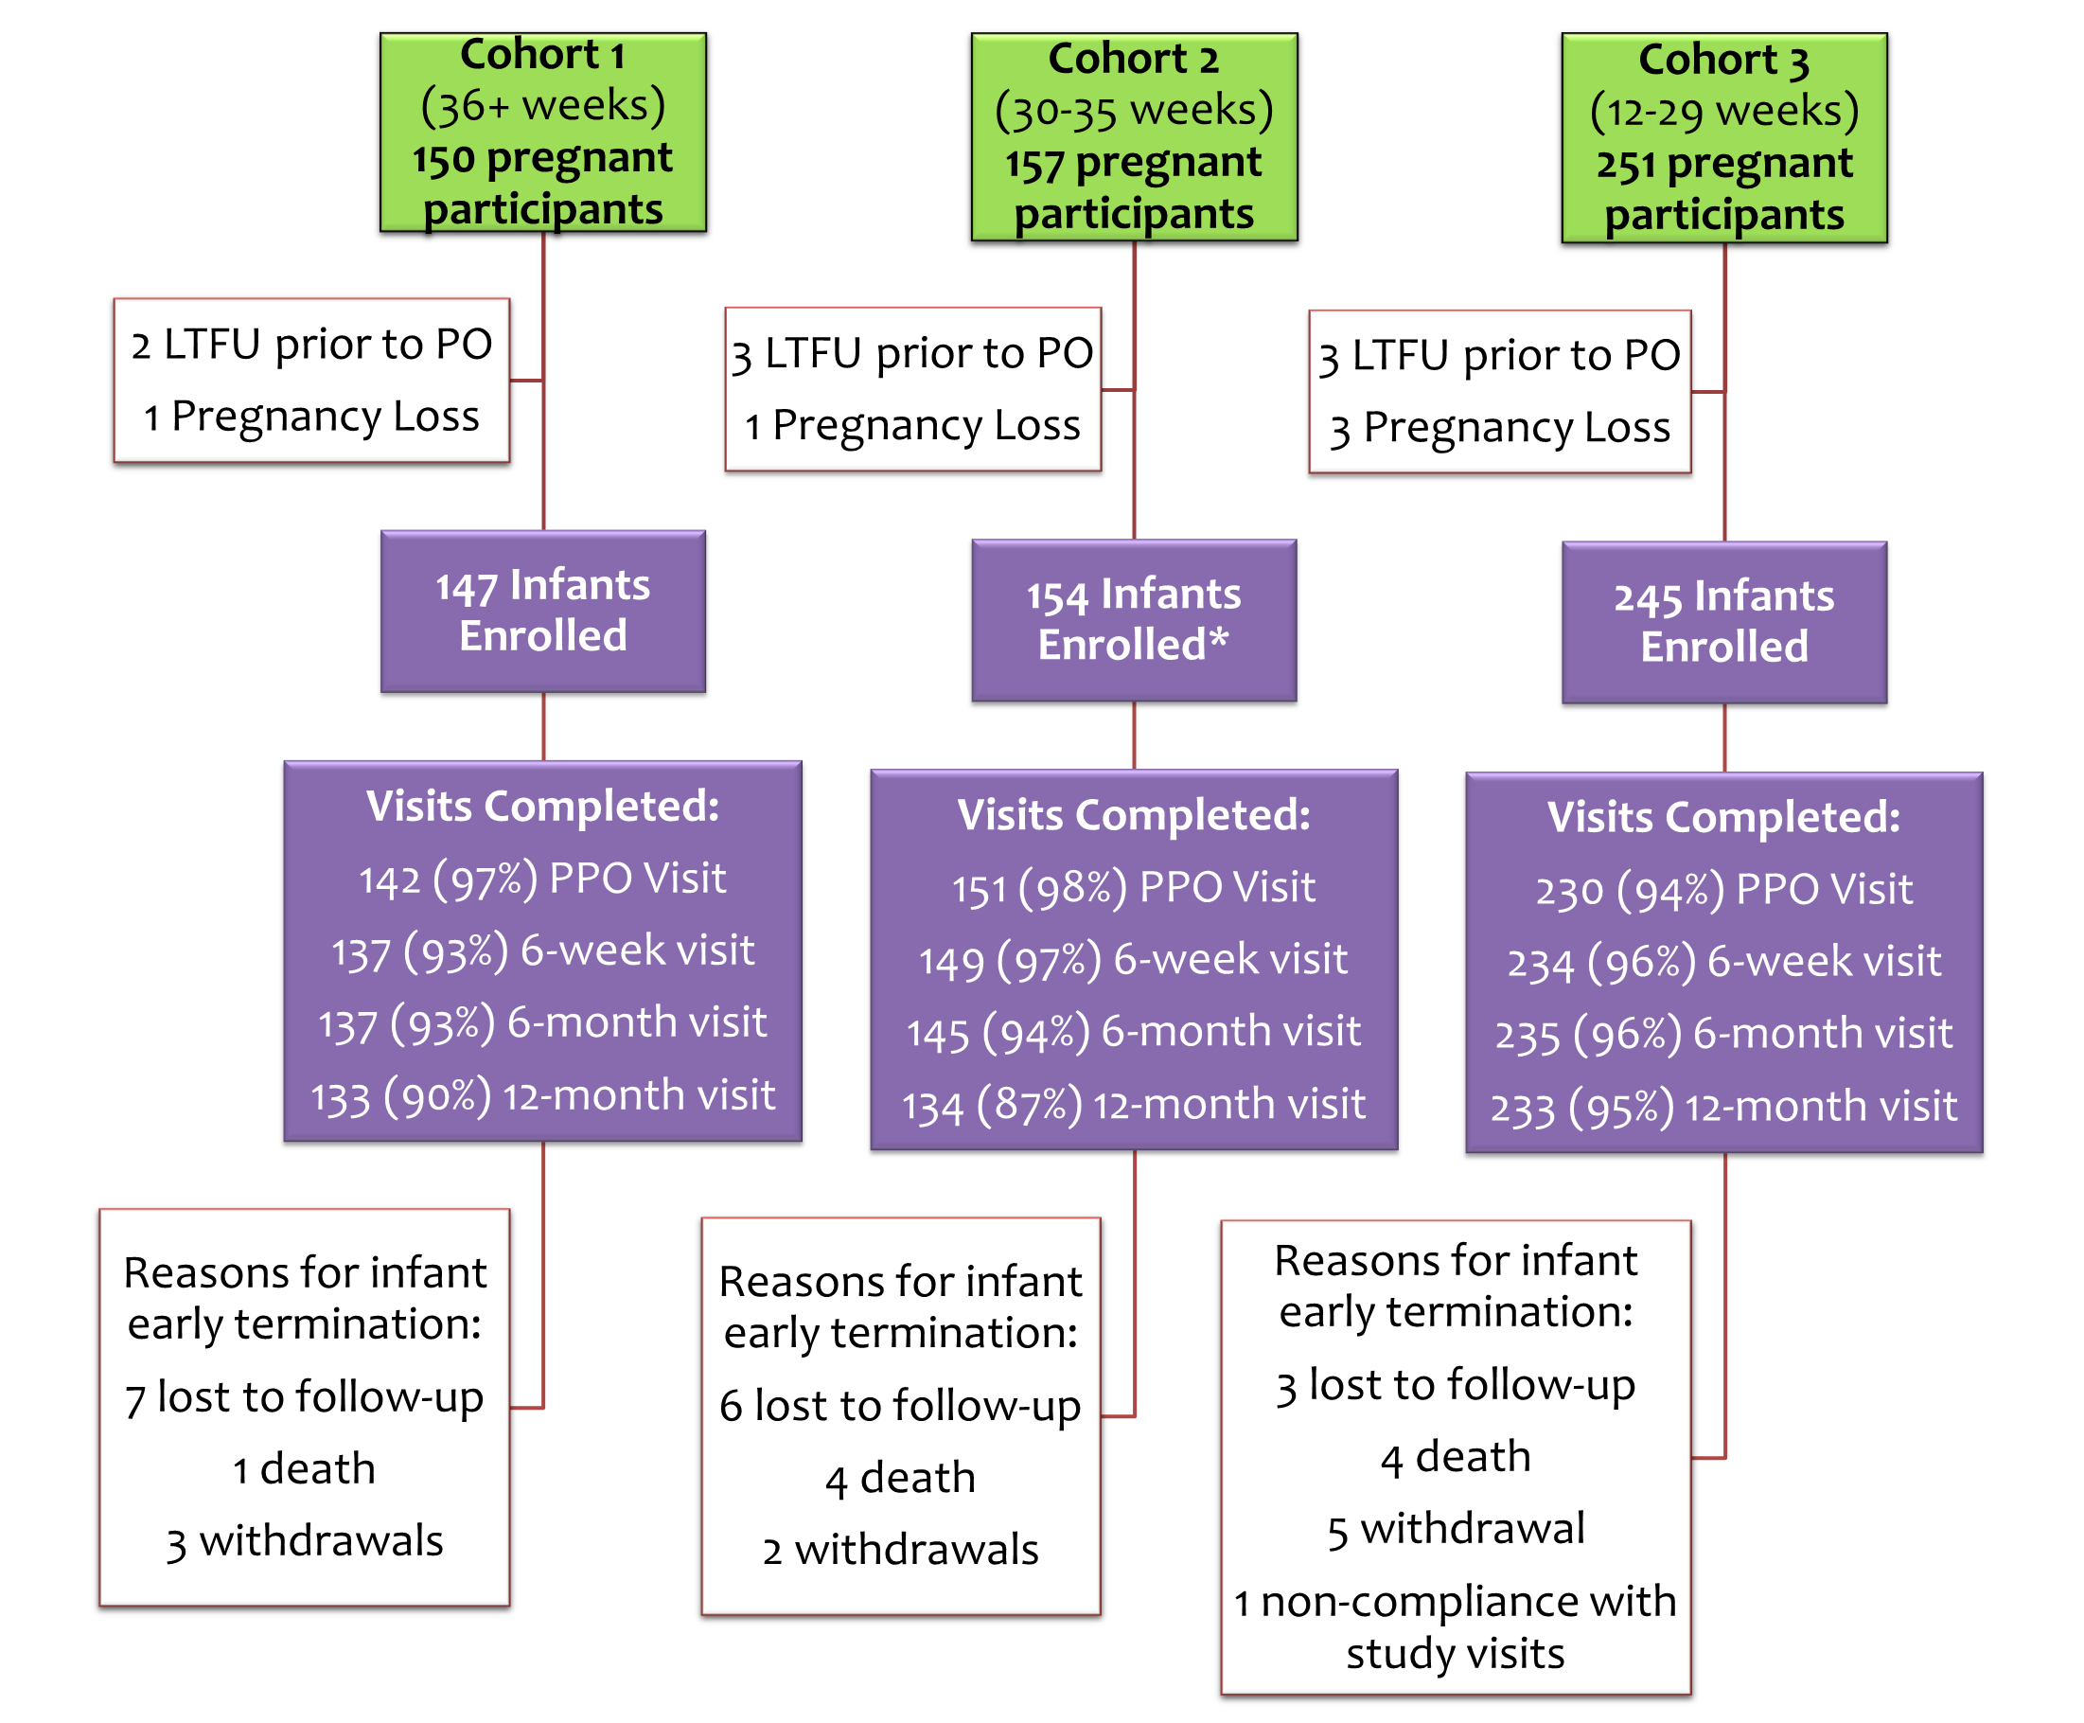
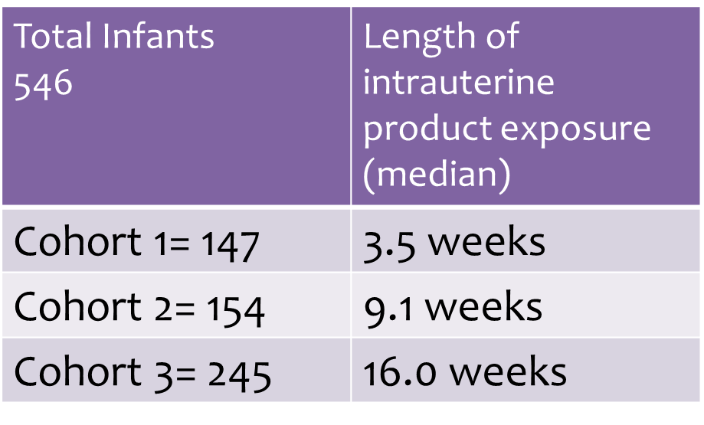
Infants enrolled in MTN-042 cohorts 1, 2 and 3
JOHANNESBURG HEALTH DISTRICT
2024 RESEARCH CONFERENCE
*Includes one twin pregnancy previously undiagnosed
LTFU=Lost to Follow-Up; PO=pregnancy outcome; PPO: Post-Pregnancy Outcome
#JoburgResearch2024

Slide 6
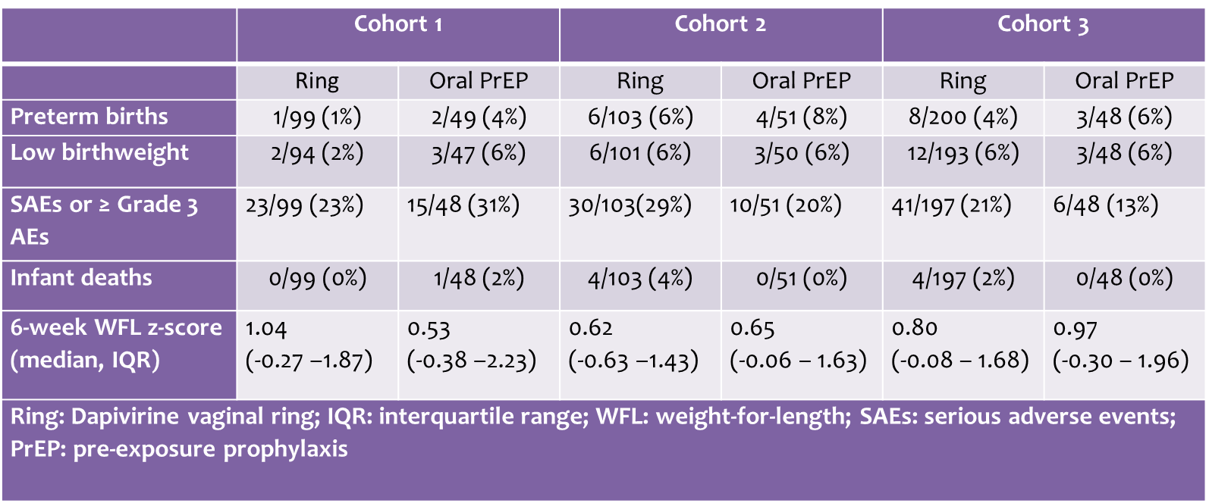
Birth outcomes, adverse events, infant deaths and early growth by cohort and product
JOHANNESBURG HEALTH DISTRICT
2024 RESEARCH CONFERENCE
Across 3 cohorts, 99% were live births, 4.4% were preterm (<37 weeks)
Low birth weight (<2500g) recorded in 5% of infants
Infant visit retention was high across all visits and cohorts
No SAEs (including death)/AEs deemed related to study product exposure by site PI or protocol medical officer
#JoburgResearch2024

Slide 7
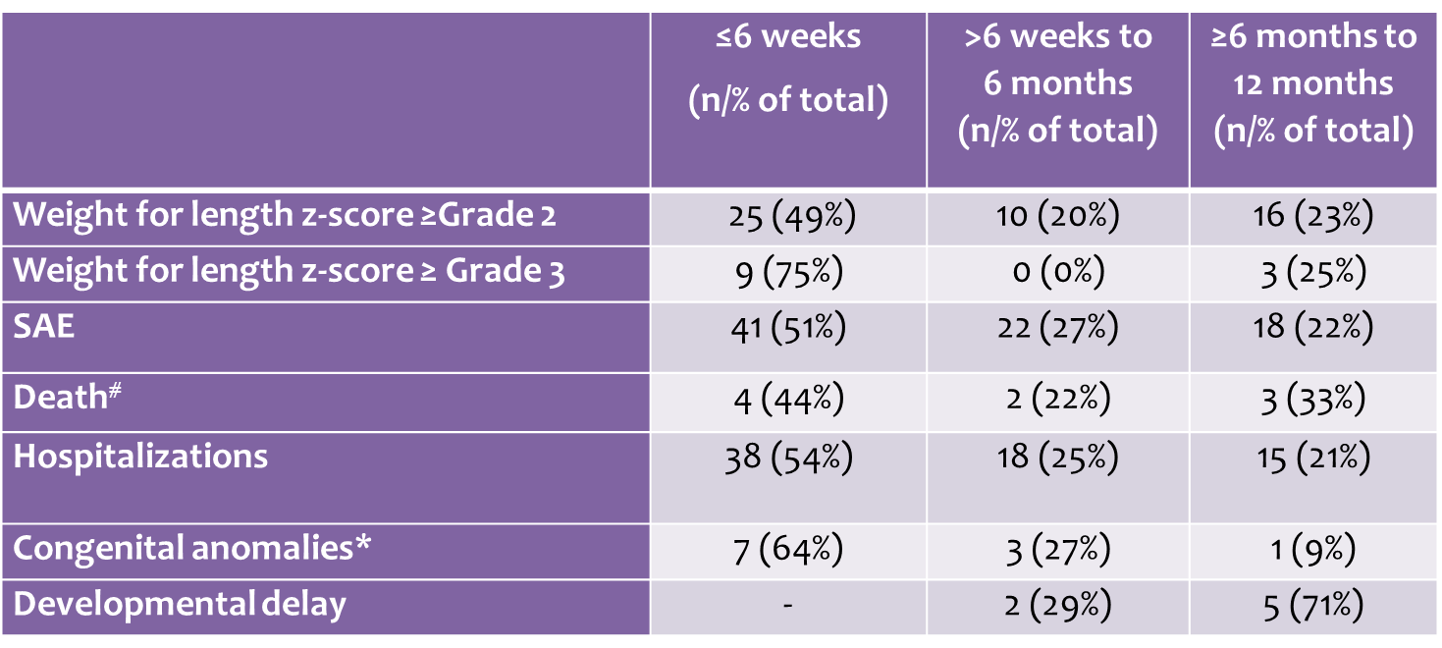
New onset adverse events by study visit: 6 weeks, between 6 weeks and 6 months, and between 6 months and a year
JOHANNESBURG HEALTH DISTRICT
2024 RESEARCH CONFERENCE
# Infant deaths: Hypoxic Ishaemic encephalopathy (1), prematurity (1), meconium aspiration syndrome (1), severe pneumonia (1), blunt head injury (1), dysmorphic features, CMV, multi-organ failure (1), Acute gastroenteritis (2)
*Congenital anomalies (reviewed by study geneticist): Missing toe nails, Trisomy 21, laryngomalacia, polydactyly, undescended testes (3), dysmorphic features, biliary atresia, pectus excavatum, tongue tie
91% of all congenital anomalies were detected by 6 months and none related to study product.
No infant deaths deemed related to study product exposure by site PI or protocol medical officer.
#JoburgResearch2024

Slide 8


Infant Outcomes Summary
JOHANNESBURG HEALTH DISTRICT
2024 RESEARCH CONFERENCE
Median WFL z-scores at 6-weeks - no difference by cohort/drug exposure
Congenital anomalies in 11 infants not considered related
  No AEs or SAEs, including deaths related to product
Developmental milestones- “typical development” range for almost all children in all cohorts, across both products
Majority of new onset adverse events and congenital anomalies across all cohorts occurred at ≤6 weeks, with similar proportions occurring between >6 weeks and 6 months and ≥6 months and 12 months
#JoburgResearch2024

Slide 9
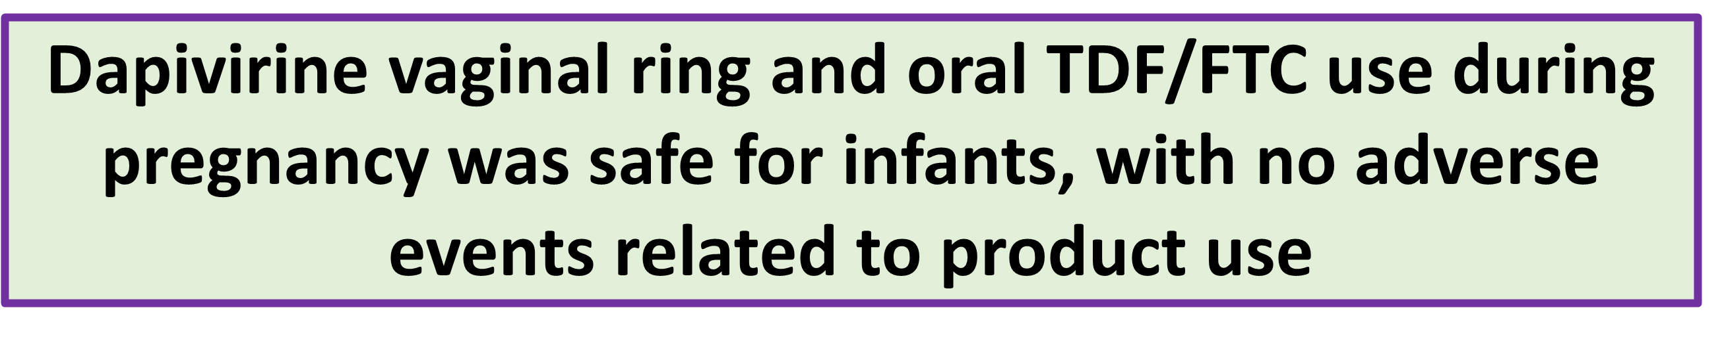
Conclusions
JOHANNESBURG HEALTH DISTRICT
2024 RESEARCH CONFERENCE
Through 6 and 12-months, no safety concerns observed in infants following maternal use of ring or oral TDF/FTC
Combined with maternal safety findings throughout pregnancy, this study supports use of the ring and oral TDF/FTC by pregnant individuals to prevent HIV
Given the timing of AE onset in infants, follow-up until 6 months may be adequate to assess safety in infants exposed to study product
#JoburgResearch2024

Slide 10

JOHANNESBURG HEALTH DISTRICT
2024 RESEARCH CONFERENCE
#JoburgResearch2024

Slide 11
Thank you!
JOHANNESBURG HEALTH DISTRICT
2024 RESEARCH CONFERENCE
Participants for their time, commitment, and trust
Study sites: Luis Gadama, MBBS, FCOG (SA), MMED UCT (IoR), Linly Seyama, Msc, RNM (Study Coordinator (SC)), Vitumbiko D. Mandiwa, MBBS (SC), Sufia Dadabhai, PhD (Clinical Research Site (CRS) Leader), and Taha E. Taha, PhD (Clinical Trials Unit Principal Investigator (CTU PI)), Johns Hopkins University (JHU) Research Project; Clemensia Nakabiito, MBChB, MMed (IoR), Phionah Bridget Kibalama Ssemambo, MBchB, MSc PH (SC), and Mary Glenn Fowler, MD, MPH (CTU PI), Makerere University - Johns Hopkins University (MU-JHU) Research Collaboration; Lee Fairlie, MBChB, FCPaeds (Protocol Co-Chair, IoR), Carlotta Mabuza, BS, PGDip, Dip (SC), Hermien Gous, PharmD (CRS Leader), and Ringson Ngozo, DipEd (Community Working Group (CWG) Representative), Wits RHI Shandukani Research Centre; Felix Mhlanga, MBChB, MMed (PC), Nyaradzo M. Mgodi, MBChB, Mmed, (IoR), Petina Musara, BSW (SC) and Z. Mike Chirenje, MD, FRCOG (CTU PI), University of Zimbabwe Clinical Trials Research Centre (UZ-CTRC)
Interim review panel: Deborah M. Money, MD, FRCSC; Annie Lyerly, MD, MA; Richard Adanu, PhD; Professor Ellen Chirwa, PhD MRNM; Paige Williams, PhD, MS; Charles Shey Wiysonge, MD, PhD; Dorothy Mbori-Ngacha, MBChB, MMed, MPH
Study Products: The dapivirine vaginal rings used in this study were developed and supplied by the International Partnership for Microbicides (IPM). Oral tenofovir disoproxil fumarate/emtricitabine (TDF/FTC) was donated by Gilead Sciences.
Funders: The study was designed and implemented by the Microbicide Trials Network (MTN). From 2006 until November 30, 2021, the MTN was an HIV/AIDS clinical trial network funded by the National Institute of Allergy and Infectious Diseases (UM1AI068633, UM1AI068615, UM1AI106707), with co-funding from the Eunice Kennedy Shriver National Institute of Child Health and Human Development and the National Institute of Mental Health, all components of the U.S. National Institutes of Health (NIH). The content is solely the responsibility of the authors and does not necessarily represent the official views of the National Institutes of Health.
#JoburgResearch2024

