Slide 1





Characterising day-to-day intimate partner violence perpetration among perinatally-infected and HIV- uninfected adolescent boys in Soweto, South Africa
JOHANNESBURG HEALTH DISTRICT
2024 RESEARCH CONFERENCE
Phumla Madi
#JoburgResearch2024

Slide 2
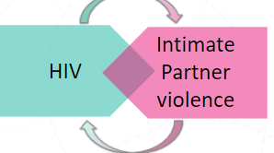
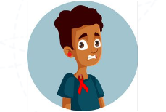
BACKGROUND
JOHANNESBURG HEALTH DISTRICT
2024 RESEARCH CONFERENCE
Intimate partner violence (IPV) and HIV incidence rises substantially during adolescence1. Furthermore, these risks are highly intertwined.
South Africa has the largest population of adolescents living with perinatally-acquired HIV (PHIV). IPV perpetration by this population could greatly increase the spread of HIV.
#JoburgResearch2024

Slide 3
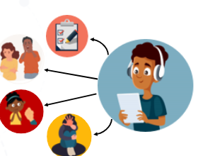
METHODOLOGY
JOHANNESBURG HEALTH DISTRICT
2024 RESEARCH CONFERENCE
We enrolled 498 (251 PHIV and 247 HIV-uninfected) in a longitudinal cohort study:​
15-19 Years old​
Resided in and around Soweto​
Face-to-face dating relationship/ had sex in the last month​
PHIV had to be aware of their HIV diagnosis
3 Clinic visits
#JoburgResearch2024

Slide 4
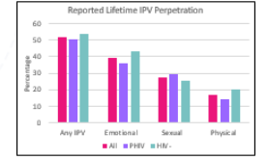
RESULTS
JOHANNESBURG HEALTH DISTRICT
2024 RESEARCH CONFERENCE
#JoburgResearch2024

Slide 5
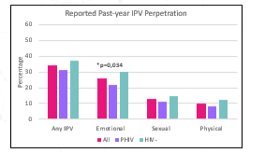
RESULTS (cont…)
JOHANNESBURG HEALTH DISTRICT
2024 RESEARCH CONFERENCE
There was no difference by HIV status. However, emotional IPV perpetrators were more likely to be HIV-uninfected (odds ratio (OR) 0.66; 95% confidence interval (CI) 0.44-0.99).
#JoburgResearch2024

Slide 6

CONCLUSIONS
JOHANNESBURG HEALTH DISTRICT
2024 RESEARCH CONFERENCE
Concerning rates of intimate partner violence (IPV) perpetration was reported by South African boys (15-19 years), half of whom had perinatally-acquired HIV (PHIV), representing a risk for onward HIV transmission.
Similar rates of IPV perpetration were reported across HIV status, suggesting prevention programs don’t need to be tailored to HIV status
IPV perpetration across this age group was high. Despite no differences by HIV status, adolescent boys living with PHIV should be included in IPV programs to potentially reduce onward HIV transmission
#JoburgResearch2024

Slide 7
RECOMMENDATIONS
JOHANNESBURG HEALTH DISTRICT
2024 RESEARCH CONFERENCE
Brief screenings for violence.
Connect adolescents to support.
Build partnerships with clinics.
Build partnerships with clinics.
#JoburgResearch2024

Slide 8
ACKNOWLEDGMENTS
JOHANNESBURG HEALTH DISTRICT
2024 RESEARCH CONFERENCE
This work was supported by the National Institutes of Health. ​
We acknowledge the contributions of Given Leshabane, Jackie Brown, Nkata Kekana and the recruitment team.​
For more information contact Rachel Kidman, Rachel.Kidman@stonybrookmedicine.edu
#JoburgResearch2024

