Slide 1






Feasibility and preliminary findings from the PLAY Study: A randomised controlled trial to improve maternal self-efficacy for promoting infant growth and development.
JOHANNESBURG HEALTH DISTRICT
2024 RESEARCH CONFERENCE
Dr Alessandra Prioreschi
#JoburgResearch2024

Slide 2
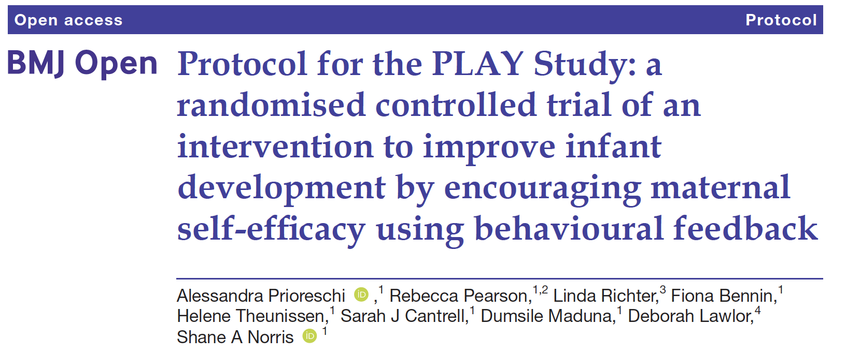
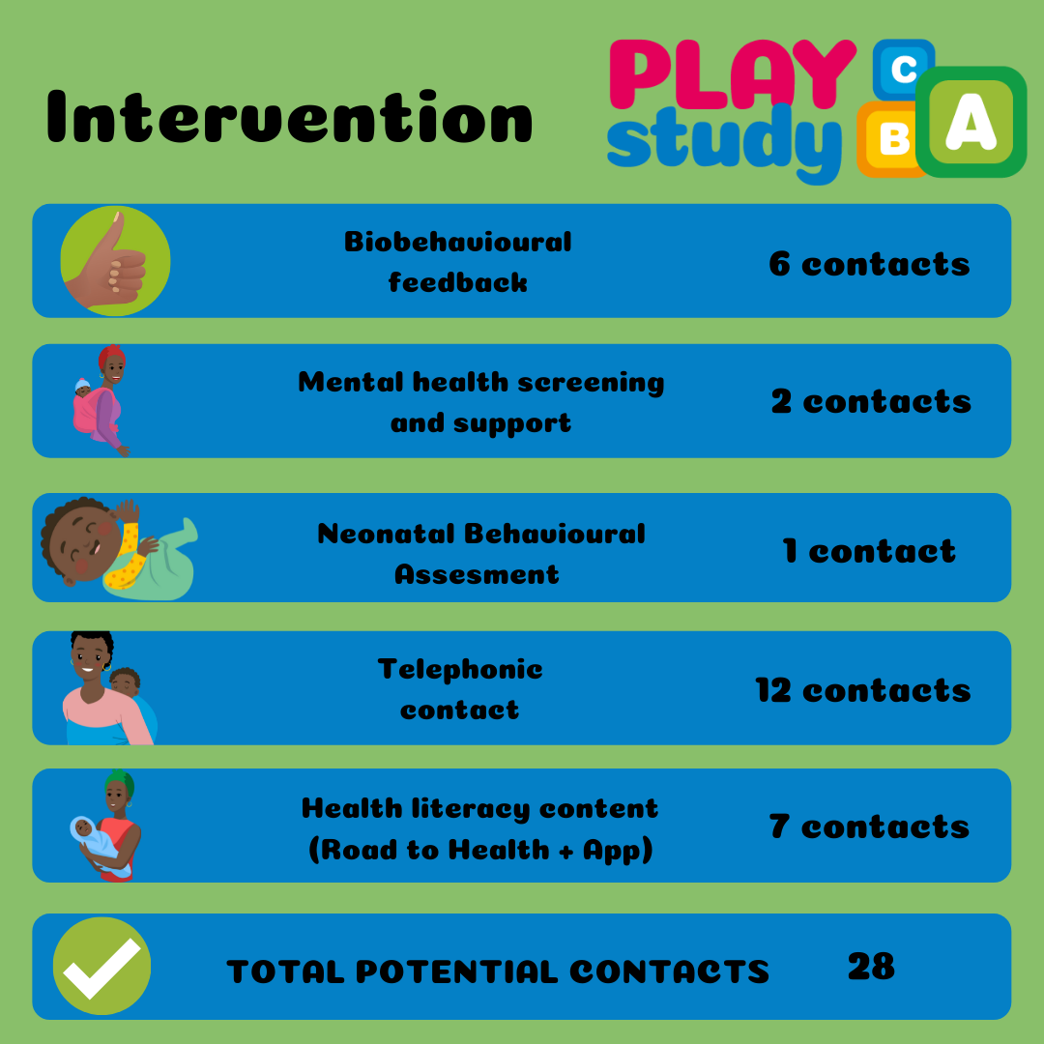
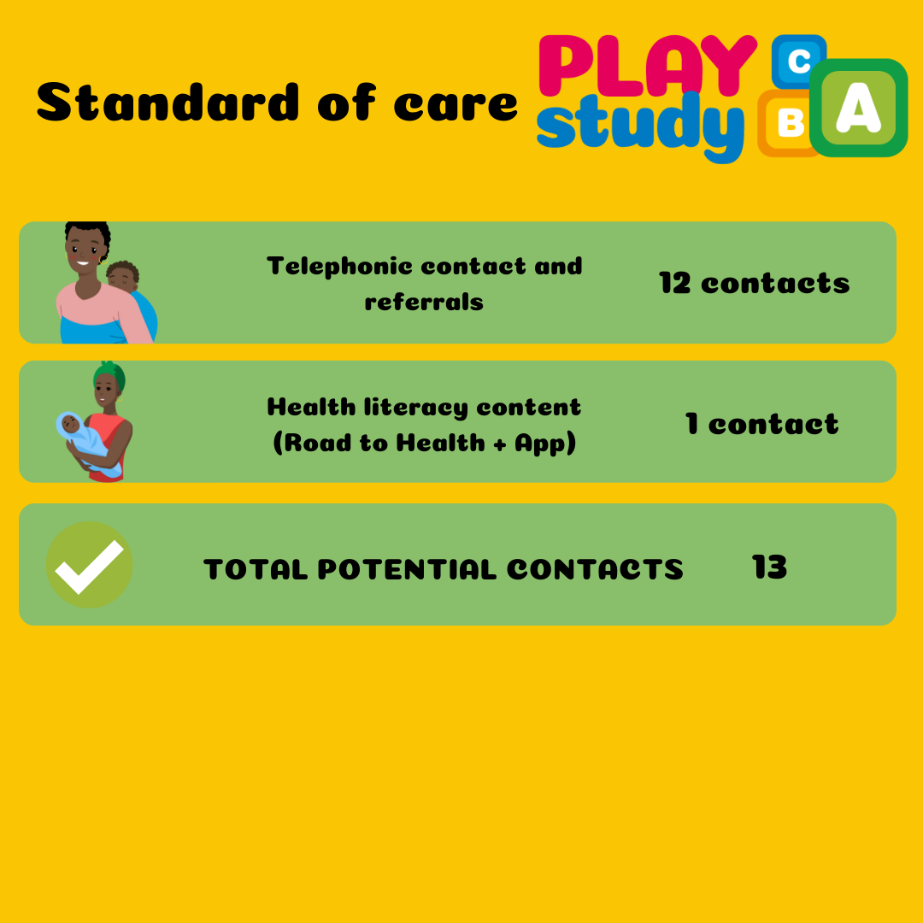
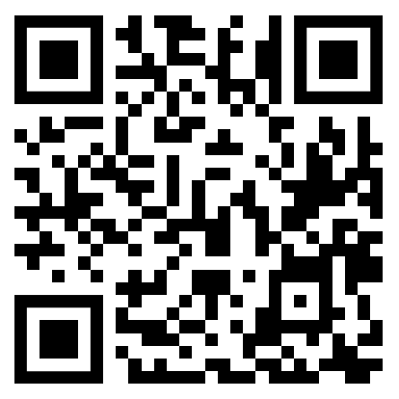
Introduction to The PLAY Study
JOHANNESBURG HEALTH DISTRICT
2024 RESEARCH CONFERENCE
#JoburgResearch2024

Slide 3
Introduction to The PLAY Study
JOHANNESBURG HEALTH DISTRICT
2024 RESEARCH CONFERENCE
#JoburgResearch2024

Slide 4
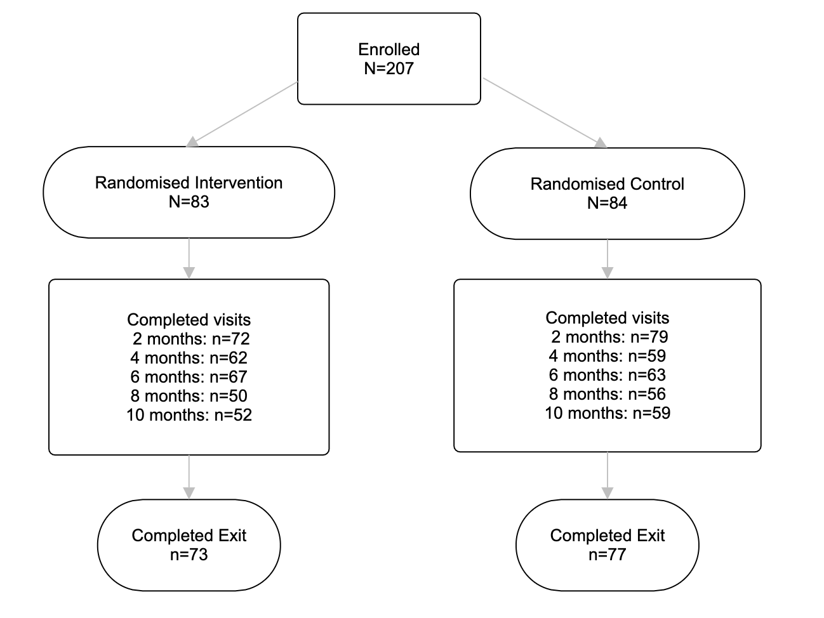
Retention and Implementation
JOHANNESBURG HEALTH DISTRICT
2024 RESEARCH CONFERENCE
#JoburgResearch2024
Notes:
88% in Intervention
92% in Control
90% Overall
Lowest retention was 60% at 8 months - device limitations
Key limitations: Electricity for charging phones – tracing and app; phone number changes

Slide 5
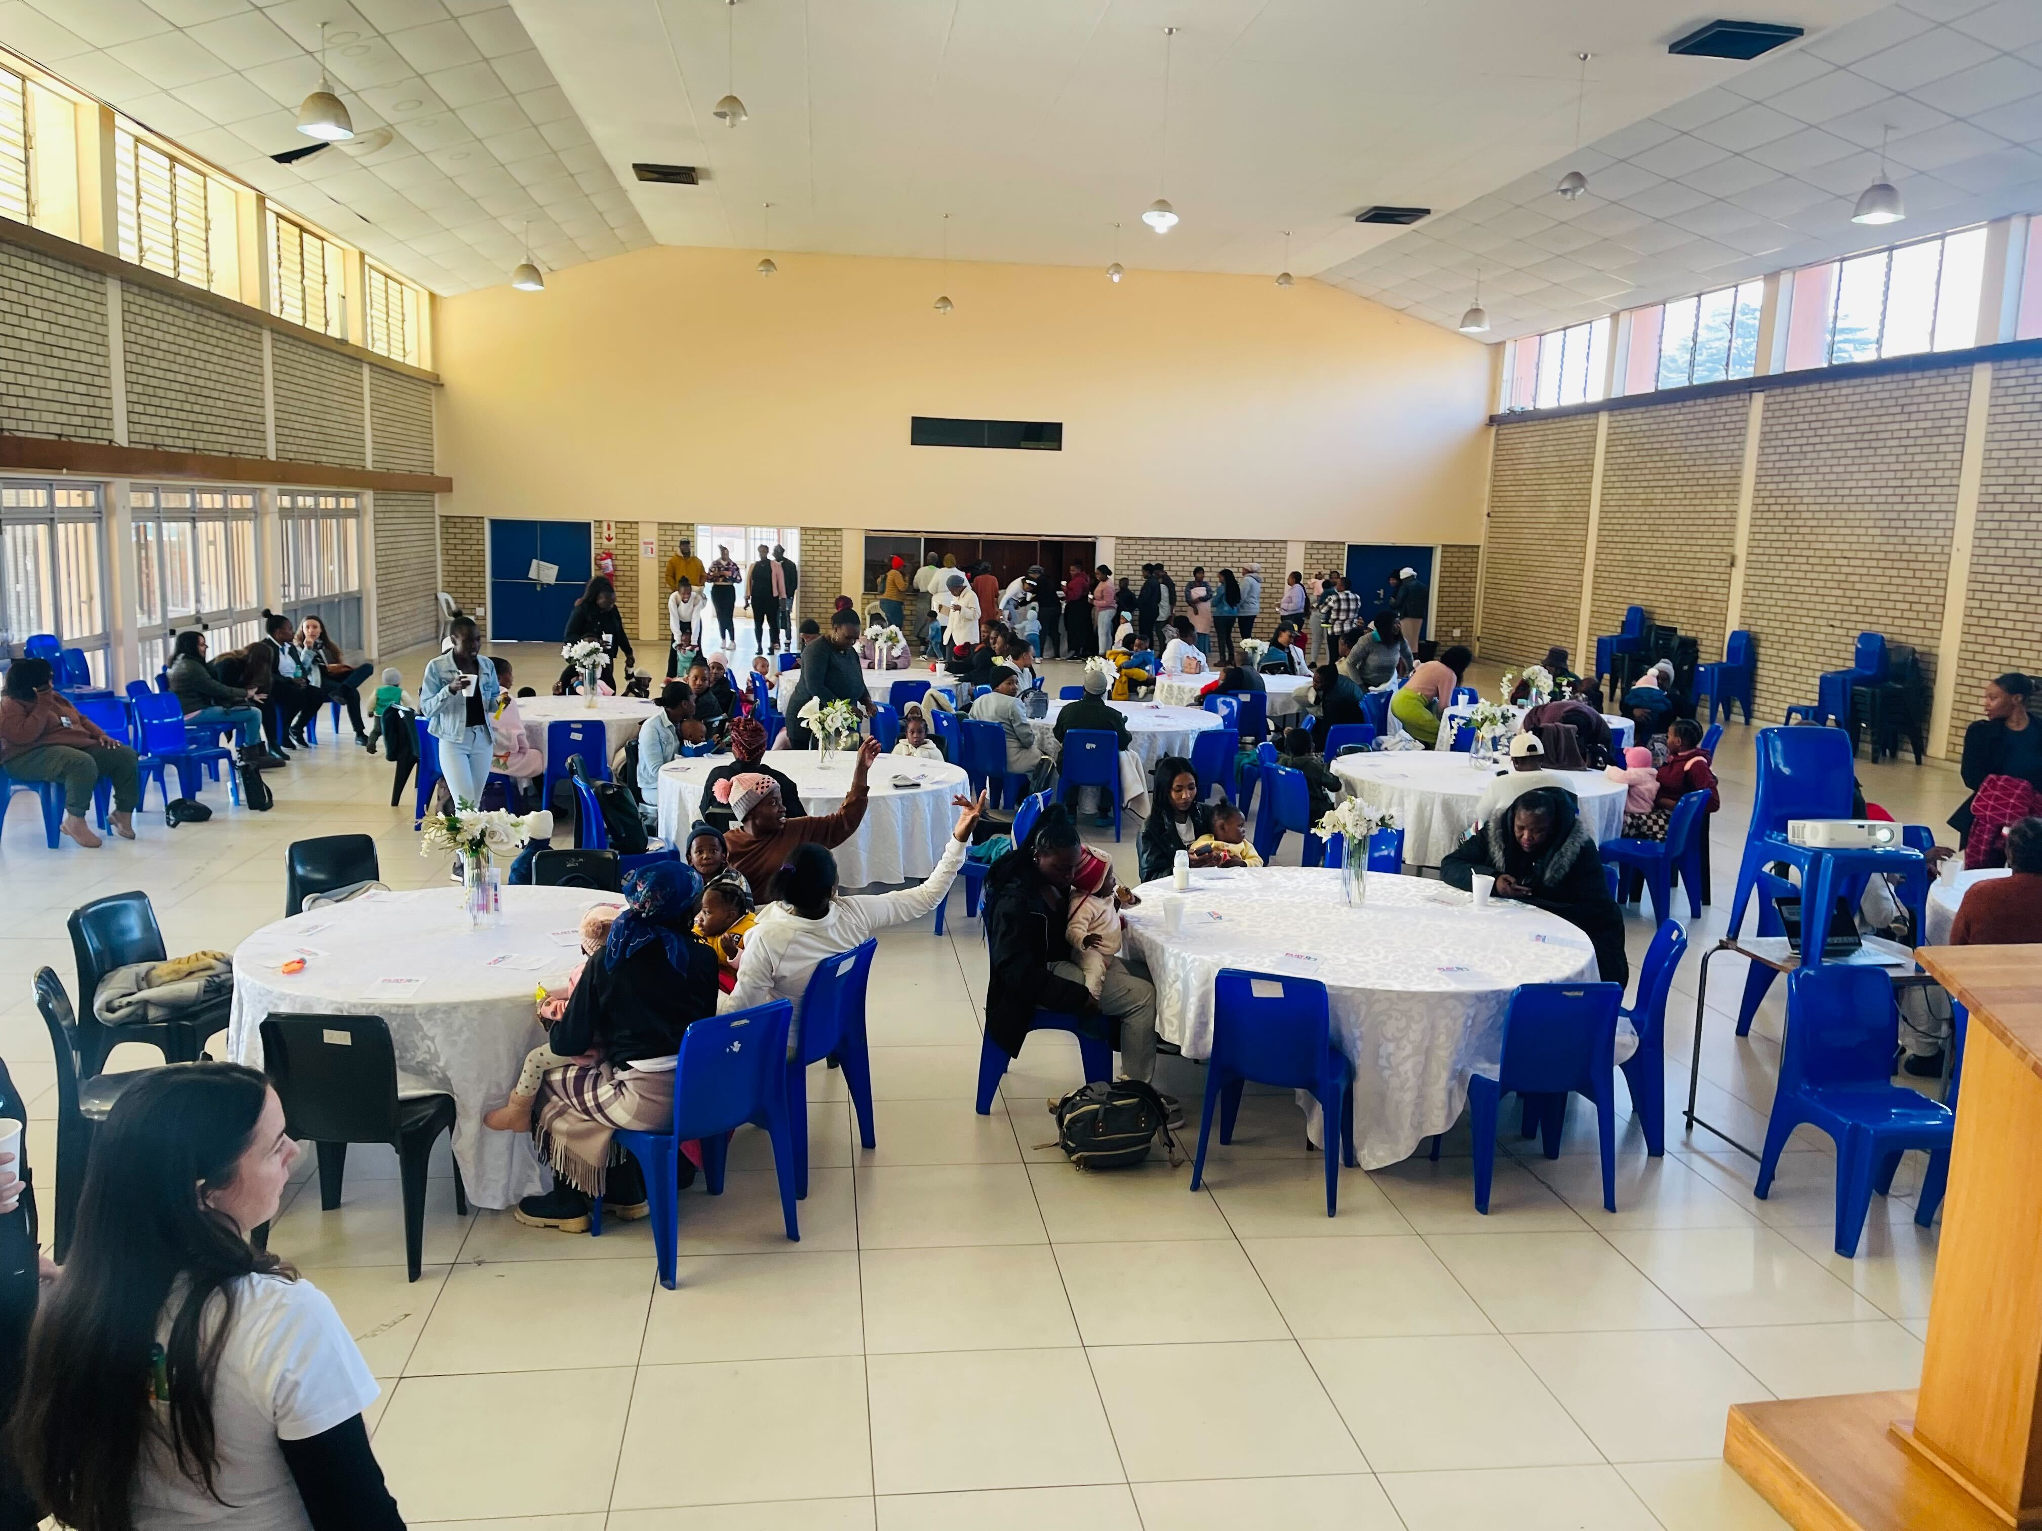
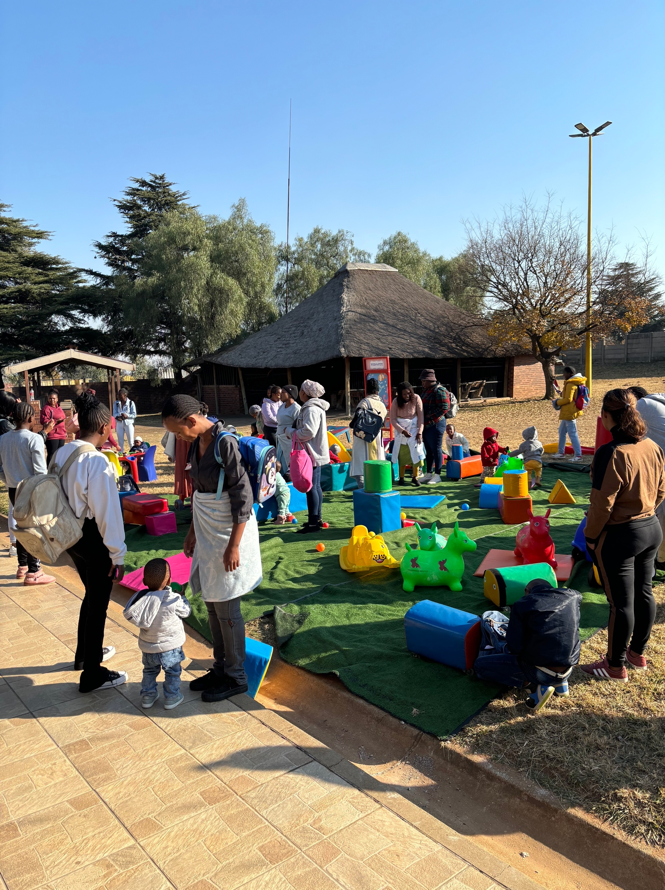
Participant feedback
JOHANNESBURG HEALTH DISTRICT
2024 RESEARCH CONFERENCE
#JoburgResearch2024
Notes:
Wits media
Wits research unit staff
Postgrads
Clinic managers
Key learnings: Importance of community engagement, participant feedback, proper process evaluation, participant perceptions

Slide 6
Support for Exclusive Breastfeeding
JOHANNESBURG HEALTH DISTRICT
2024 RESEARCH CONFERENCE
Within 4-12 days of birth:
  90% breastfeeding
  3% never initiated
  Those who stopped did within 3 days
  15% given formula (80% within 3 days)
  47% mixed feeding
  Reasons for stopping:
  Lactation problems or pain
  Pursuit of education
  Fear of HIV transmission
  Medical
  Other
#JoburgResearch2024
Notes:
Put to breast = 73%
Key: Hardly anyone exclusively breastfeeding by 6 months – WHO recommendations; Formula given early and possibly unneccesarily; need to intervene prior to birth or immediately after; reasons for stopping are almost all modifiable with support

Slide 7
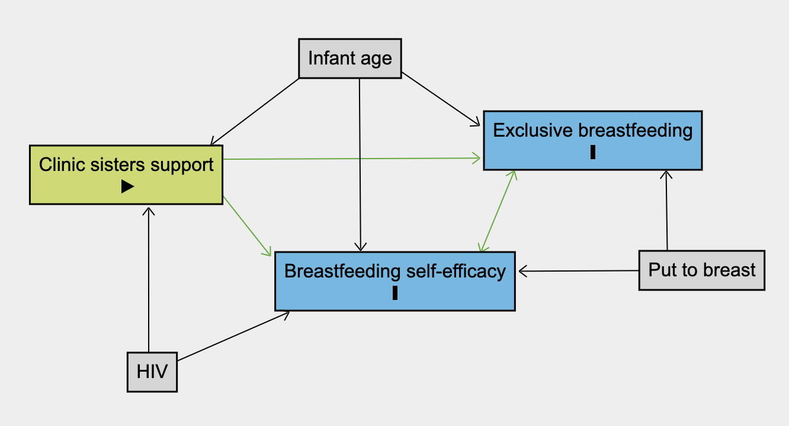
Support for Exclusive Breastfeeding
JOHANNESBURG HEALTH DISTRICT
2024 RESEARCH CONFERENCE
Table 3. G-computation estimates of total causal effect, natural direct effect and natural indirect effect of finding clinic sisters helpful on breastfeeding exclusivity, mediated by breastfeeding self-efficacy in full sample
 | G-estimates | Bootstrap SE | z-statistic | p-value | 95% CI | 95% CI (BC)
TCE | 0.13 | 0.06 | 2.04 | 0.04 | 0.01 to 0.25 | 0.02 to 0.27
NDE | 0.12 | 0.06 | 1.88 | 0.06 | -0.00 to 0.25 | 0.00 to 0.25
NIE | 0.01 | 0.01 | 0.78 | 0.43 | -0.01 to 0.03 | -0.00 to 0.07
#JoburgResearch2024
Notes:
Self efficacy very high
Key: Most didn’t always find sisters helpful; this directly impacted exclusivity, but not via self-efficacy; clinic sisters key for promoting exclusive breastfeeding regardless of mothers’ confidence in their abilities; support should be practical and anticipatory; proper training needed; Baby friendly initiatives mut be monitored and implemented

Slide 8
Support for Exclusive Breastfeeding
JOHANNESBURG HEALTH DISTRICT
2024 RESEARCH CONFERENCE
Opportunities for promoting exclusivity are critical in the first three days
Interventions need to happen prior to delivery, or immediately upon delivery
#JoburgResearch2024

Slide 9
Support for Exclusive Breastfeeding
JOHANNESBURG HEALTH DISTRICT
2024 RESEARCH CONFERENCE
Clinic sisters have a direct impact on mothers’ breastfeeding decisions
They should be trained to provide:
Nurses should undertake a 20-hour lactation course which has been shown to have a great impact on their attitude towards BFHI
Staff should:
support
knowledge
anticipatory guidance
To:
dispel myths
help with common challenges
Be trained on the code of marketing for breastmilk substitutes
Have clear recommendations regarding women with HIV
#JoburgResearch2024

Slide 10
Support for Exclusive Breastfeeding
JOHANNESBURG HEALTH DISTRICT
2024 RESEARCH CONFERENCE
All clinics need to enforce the BFHI immediately to provide mothers with a chance at exclusivity
Monitoring of implementation of the BFHI is required, and regular retraining is recommended
#JoburgResearch2024

Slide 11
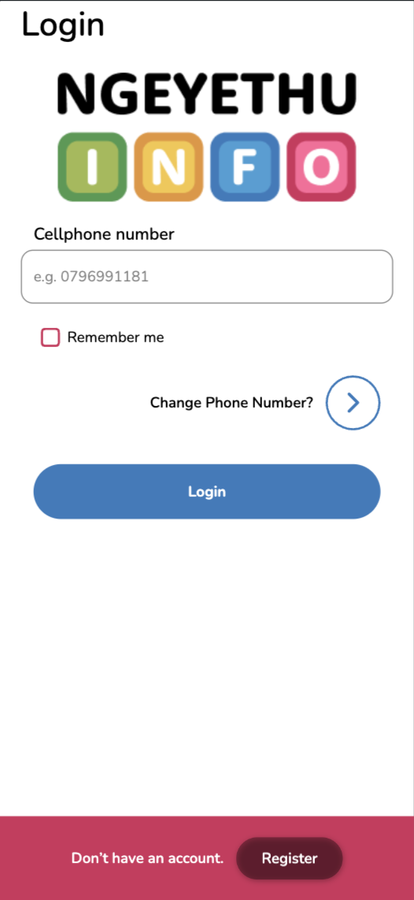
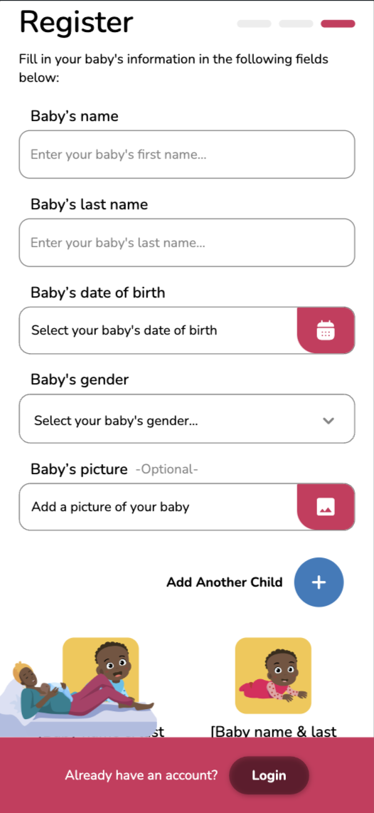
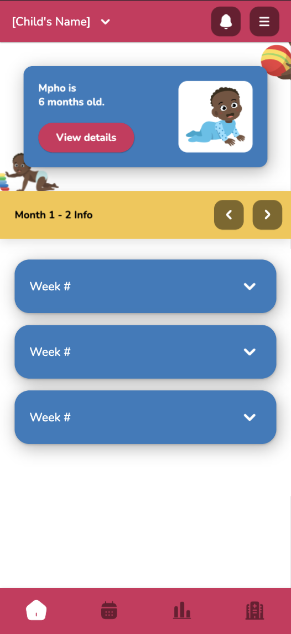
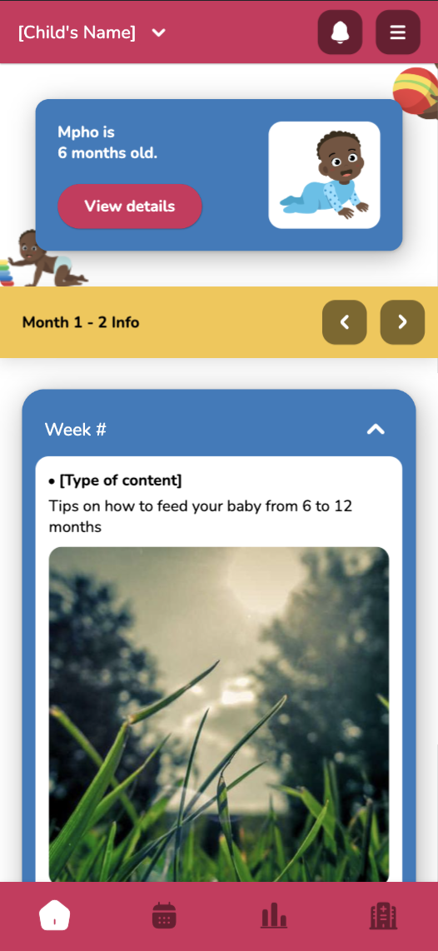
The Ngeyethu Info App
JOHANNESBURG HEALTH DISTRICT
2024 RESEARCH CONFERENCE
#JoburgResearch2024
Notes:
Resource centre
Local services
Co-developed content
Event tracker

Slide 12
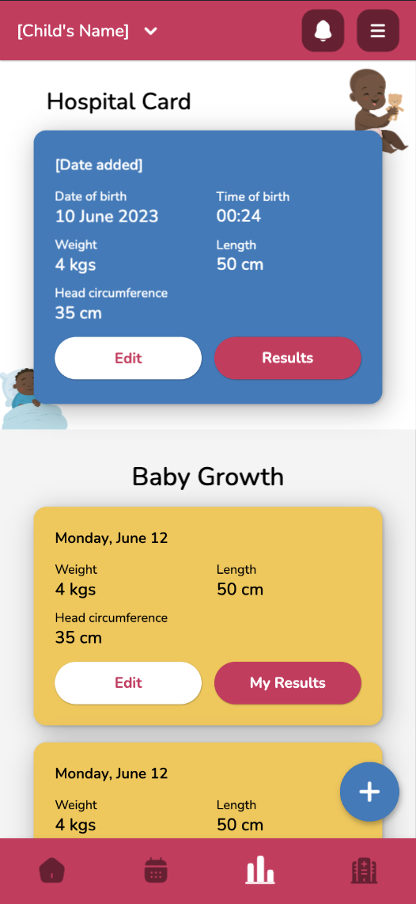
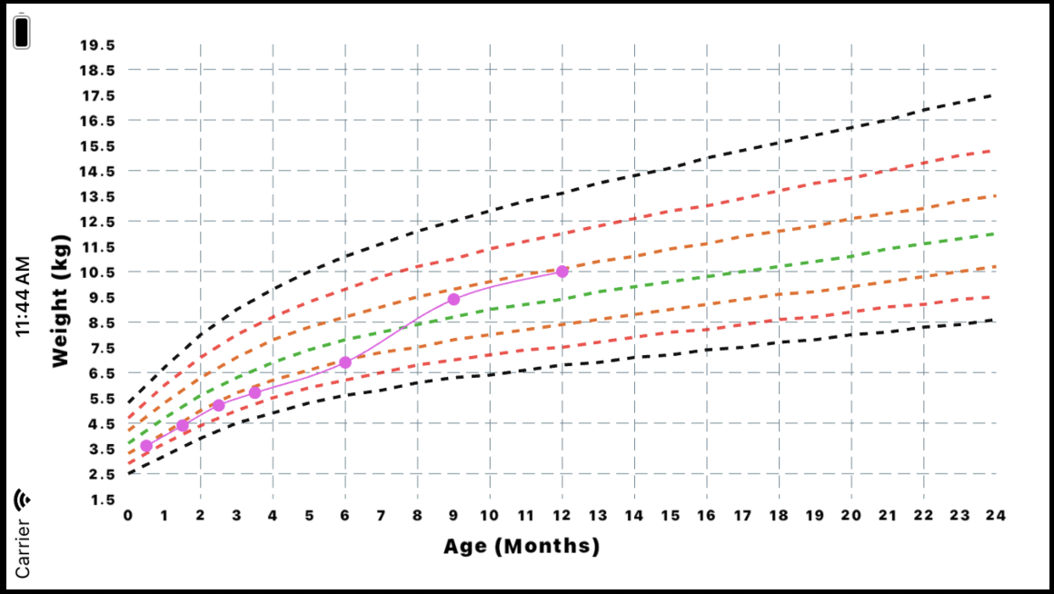
The Ngeyethu Info App
JOHANNESBURG HEALTH DISTRICT
2024 RESEARCH CONFERENCE
Keep monitoring your baby’s weight to ensure it does not start crossing over the red line
#JoburgResearch2024
Notes:
Weigh in and vaccination reminders
Messages for weight high/low
Milestone tracker questionnaire

Slide 13


Acknowledgements
JOHANNESBURG HEALTH DISTRICT
2024 RESEARCH CONFERENCE
This work was supported by the National Institute for Health Research (NIHR) (using the UK’s Official Development Assistance (ODA) Funding) and Wellcome [222007/Z/20/Z] under the NIHR-Wellcome Partnership for Global Health Research. The views expressed are those of the authors and not necessarily those of Wellcome, the NIHR or the Department of Health and Social Care.
We would like to acknowledge the Johannesburg Health District Research Committee for supporting this research
#JoburgResearch2024

