Slide 1






Investigating the Perceptions of Speech-Language Therapists working in the Public Health and Education Sectors, about the Services they provide to Children with Cerebral Palsy in the Greater Johannesburg Region, from Birth to Six Years.
JOHANNESBURG HEALTH DISTRICT
2024 RESEARCH CONFERENCE
Supervisor: Dr (PhD) Berna Gerber
Faculty of Medicine and Health Sciences
Department of Health and Rehabilitation Sciences
Division of Speech, Language and Hearing Therapy
by
Martha Lydall
#JoburgResearch2024

Slide 2

JOHANNESBURG HEALTH DISTRICT
2024 RESEARCH CONFERENCE
HEALTH
Background
Prior to entering the basic education system at six years of age, speech
and language assessment, diagnosis, and treatment of children with cerebral
palsy (CP), take place in hospitals and primary healthcare settings in the South
African public sector. This is informed by governmental guidelines. Paediatric patients
are directed through a referral pathway, ideally from a hospital setting to a primary healthcare
facility for rehabilitation and issuing of appropriate assistive devices. Once children are of
school-going age, they are referred to the education sector for schooling. Nearly twenty
years since the establishment of the National Rehabilitation Policy, strides have been
made to improve accessibility to rehabilitation services as well as the quality of life of
children with CP in the health and education sectors. Shortfalls however still exist in
implementing this policy. It is therefore important to explore the referral pathway
that bridges these two sectors, to identify possible gaps that may occur and
affect the continuity of therapy for children with CP.
EDUCATION
#JoburgResearch2024
Notes:
I am a speech-language therapist & audiologist who has worked in the public education sector for 15 years. Very early on in my career, I developed a special interest in cerebral palsy. Interest became passion and ultimately, the driving force behind this Study.

Slide 3
JOHANNESBURG HEALTH DISTRICT
2024 RESEARCH CONFERENCE
Meeting held on August 15, 2018.
Children with CP entering the education system at five and six years of age do so with no assistive devices or communication aids.
General lack of referral documentation.
No open lines of communication between referring SLTs in the health and education sectors.
Speech-language therapy in the education system may begin under the premise that no or limited prior therapy has been administered.
#JoburgResearch2024
Notes:
On the 15th August 2018, a meeting was held in Johannesburg, between six therapists working in central and tertiary hospitals and therapists working at four special needs schools, including myself. The purpose of the meeting was to discuss the carryover of speech- and language services, for children with CP, between the two sectors. <CLICK> A common frustration experienced by SLTs working in the education sector was that children with CP entering the education system at five and six years of age do so with no assistive devices or communication aids. <CLICK> Furthermore, they reported a general lack of referral documentation, … <CLICK> … with no open lines of communication between referring SLTs in the health and education sectors. <CLICK> Therefore, speech-language therapy in the education system may begin under the premise that no or limited prior therapy has been administered. The therapists working in central and tertiary hospitals reported that they provide services to children from birth to three years of age, including provision of assistive devices and communication aids. The children are then referred to community health centres and clinics in the surrounding areas. The problems identified with this process are that clinics and community health centres are generally under-resourced and consist predominately of community service SLTs that change every year. These factors may contribute to a lack in continuity in service delivery to the paediatric population with CP and their caregivers, as they move between the health and education sectors. It became apparent to me that a more in-depth study into the procedures and practices of SLTs working with the paediatric population with CP in the public sector, would be beneficial in identifying and understanding weaknesses and shortfalls of the rehabilitation process.

Slide 4
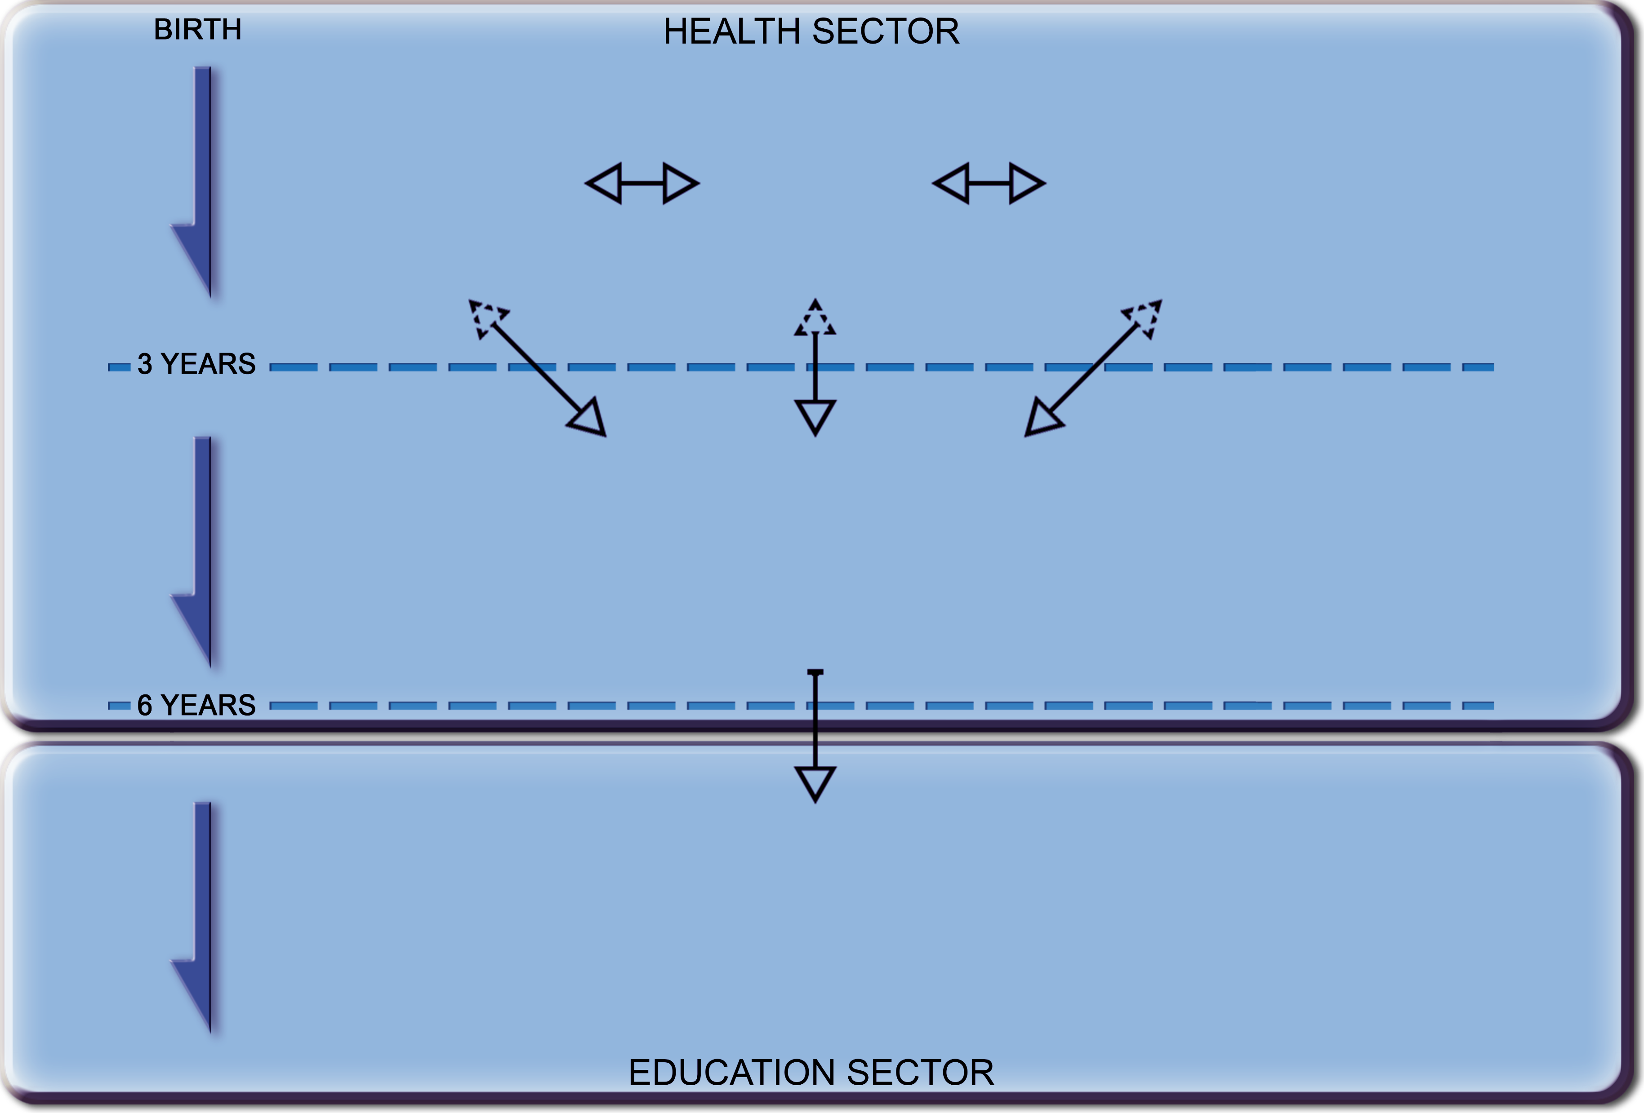
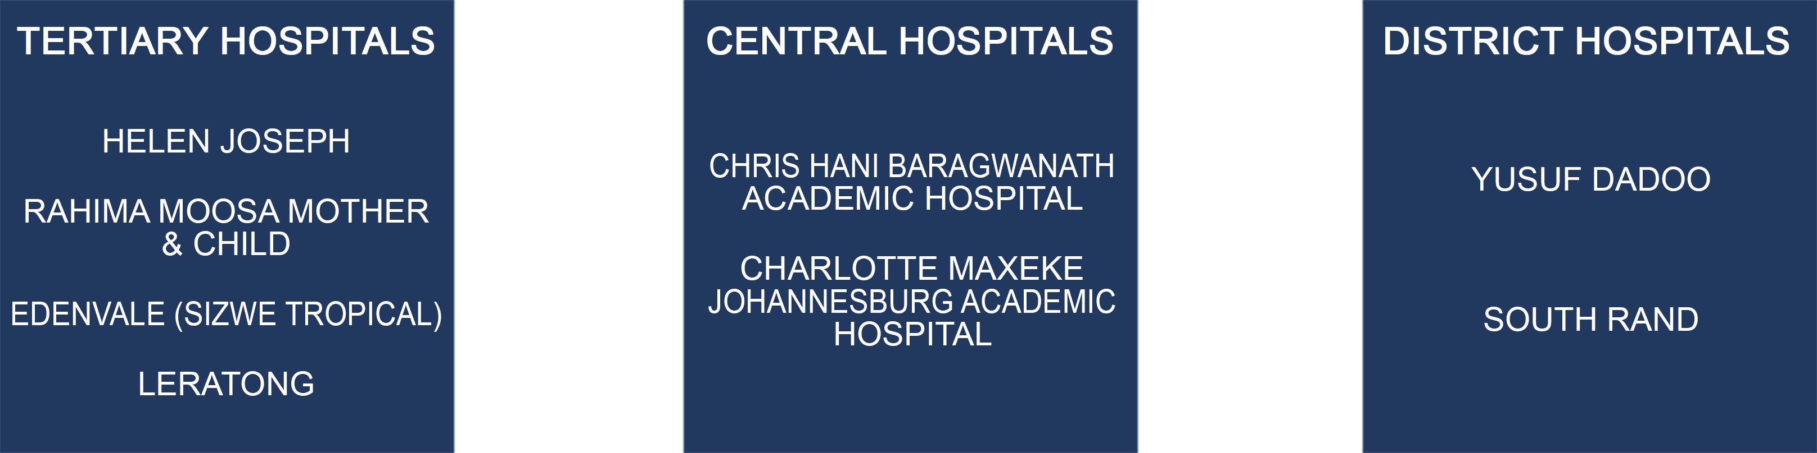
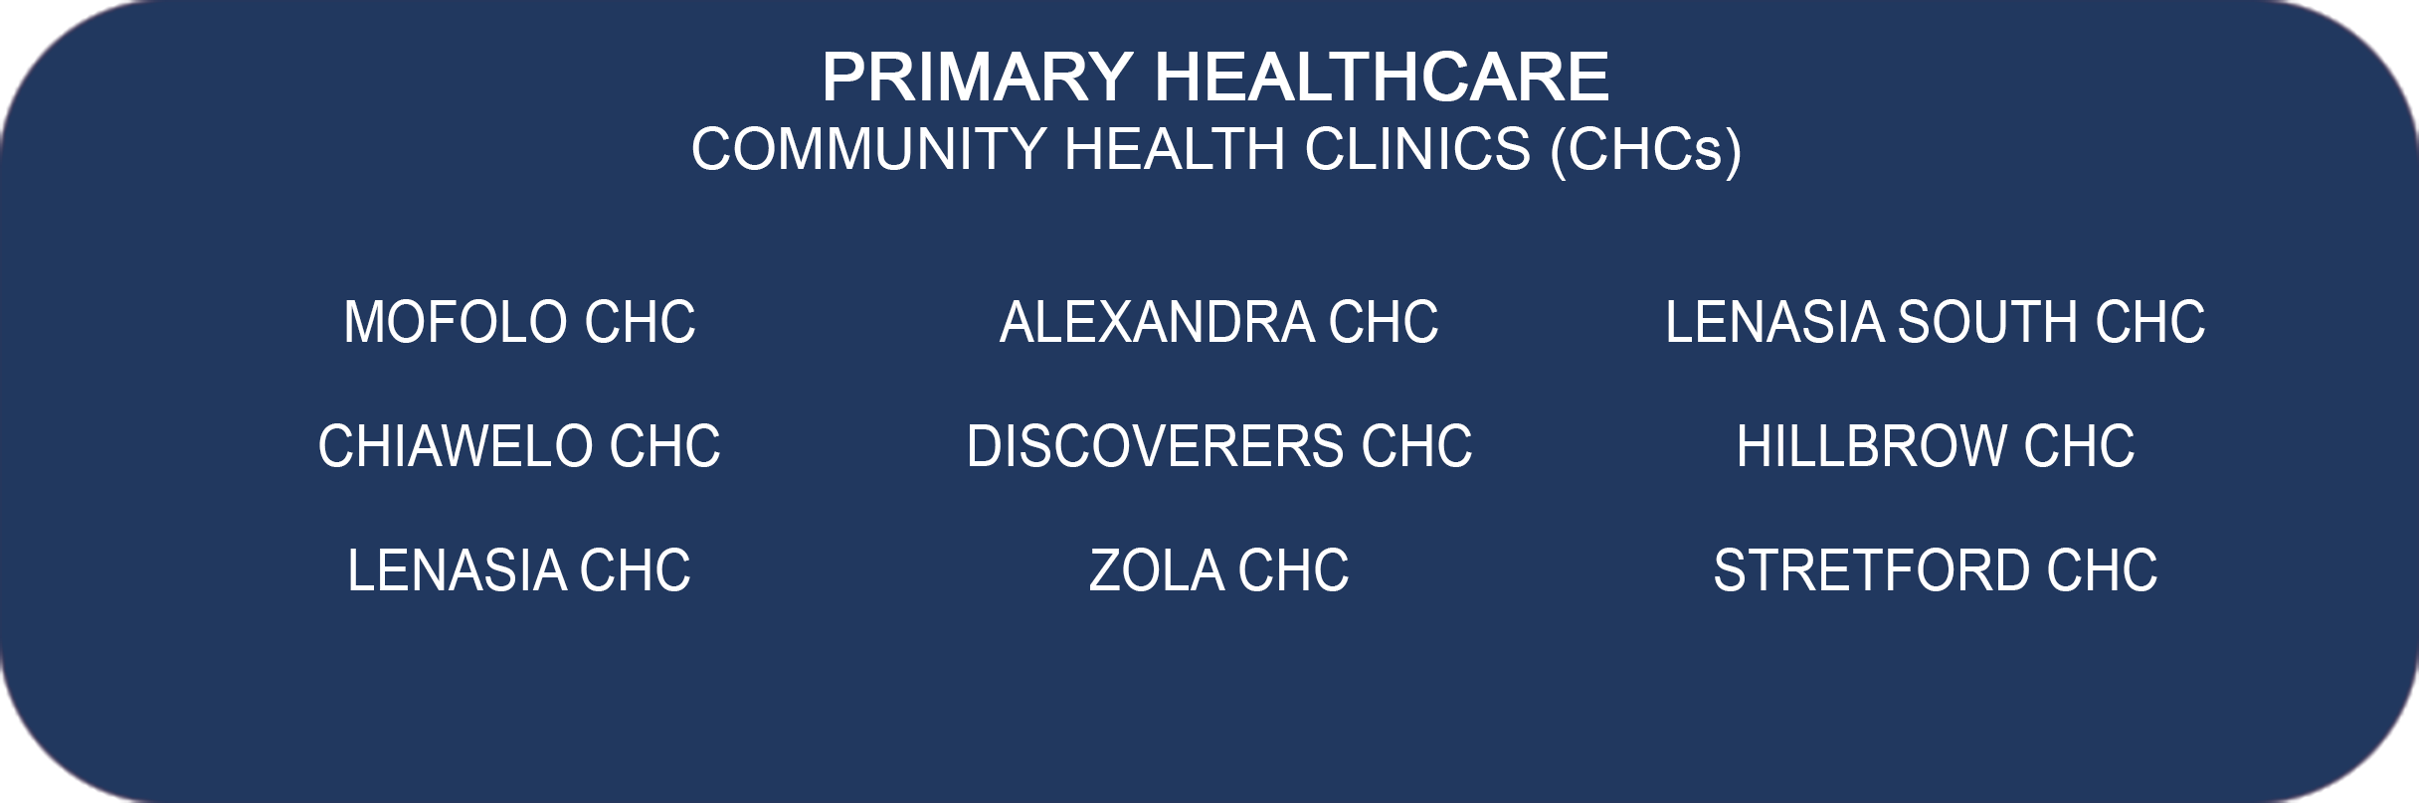

REGION A – REFERRAL PATHWAY
THE CITY OF JOHANNEDBURG AND THE WEST RAND
Notes:
The South African hospital network is administered through its various provincial metropolitan regions, <CLICK> with hospitals structured to provide services in a categorised service level system. <CLICK> The role of PHC is to provide screening and assessment at a community level for a range of disabilities. <CLICK> The role of special needs schools is to develop a special education programme for each learner, based on the child’s learning capabilities.

Slide 5


Methodology
A qualitative research design
Descriptive phenomenology
Bracketing (epoché)
Qualified SLTs
Purposive sampling
JOHANNESBURG HEALTH DISTRICT
2024 RESEARCH CONFERENCE
#JoburgResearch2024
Notes:
A qualitative research design was appropriate for this study, specifically the approach of phenomenology. <CLICK> Descriptive phenomenology was chosen for this study as the researcher sought to understand and describe the phenomenon as experienced by the participants. <CLICK> Bracketing was used during the enquiry process. <CLICK> Qualified SLTs working with children with CP in the public health and education sectors were asked to participate in the study. They were included based on certain criteria. <CLICK> The sampling strategy that was used was purposive sampling.

Slide 6

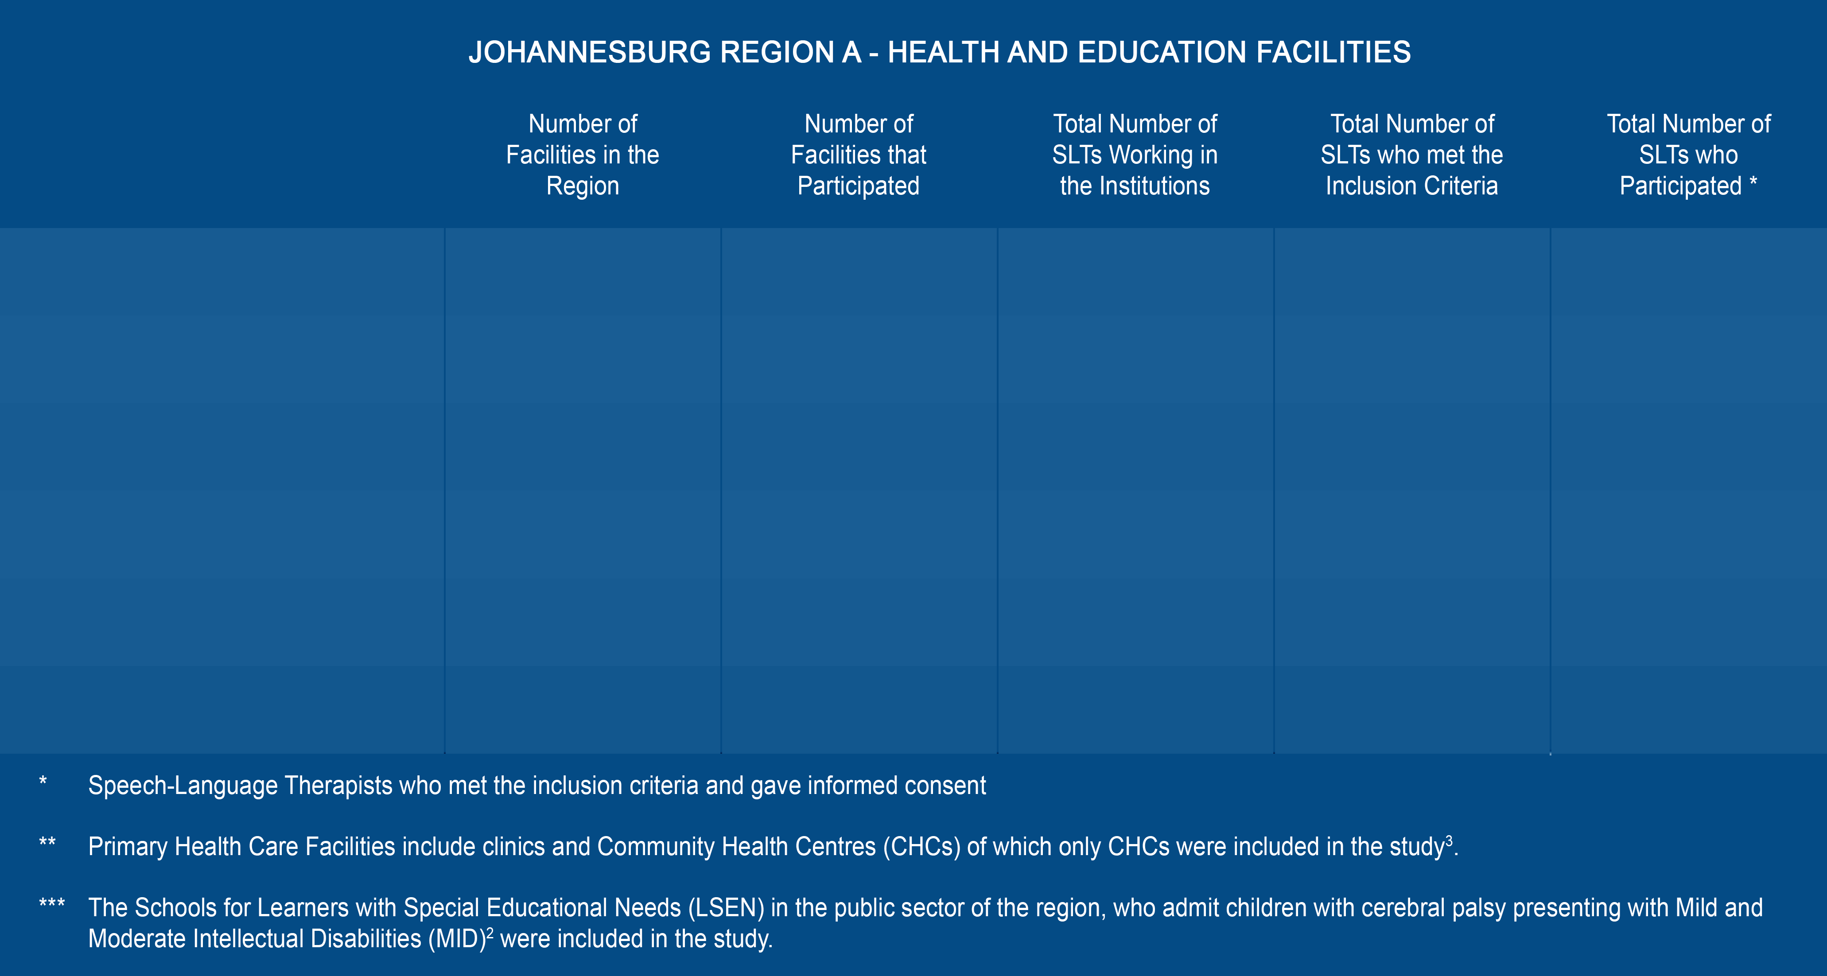
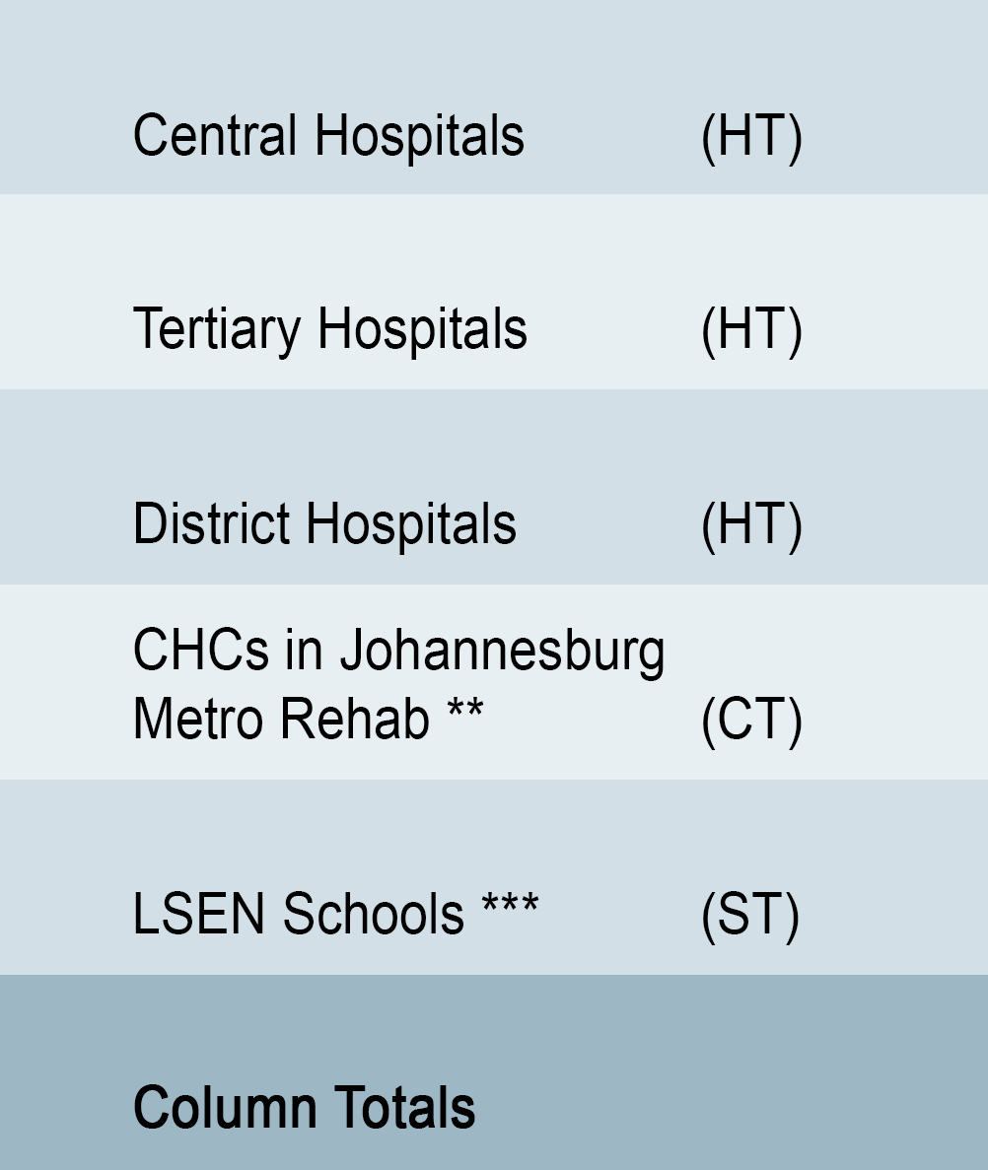
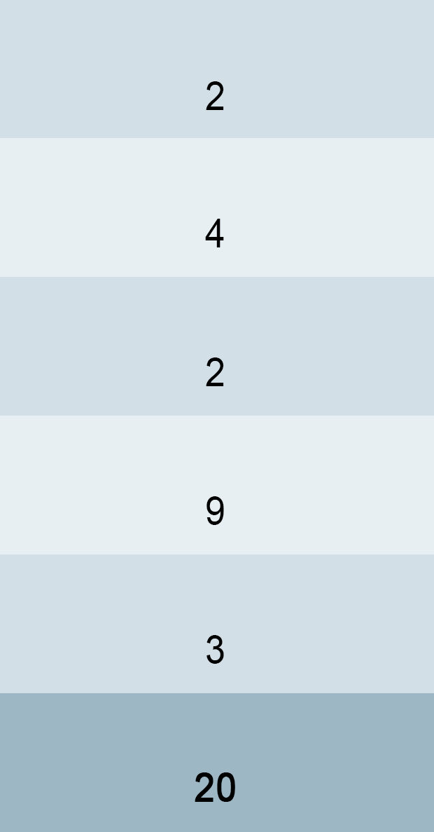
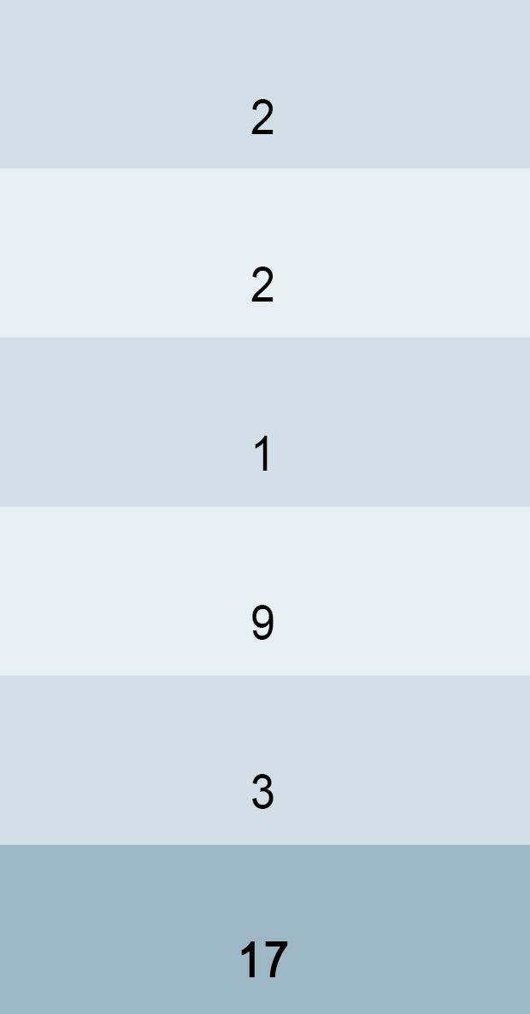
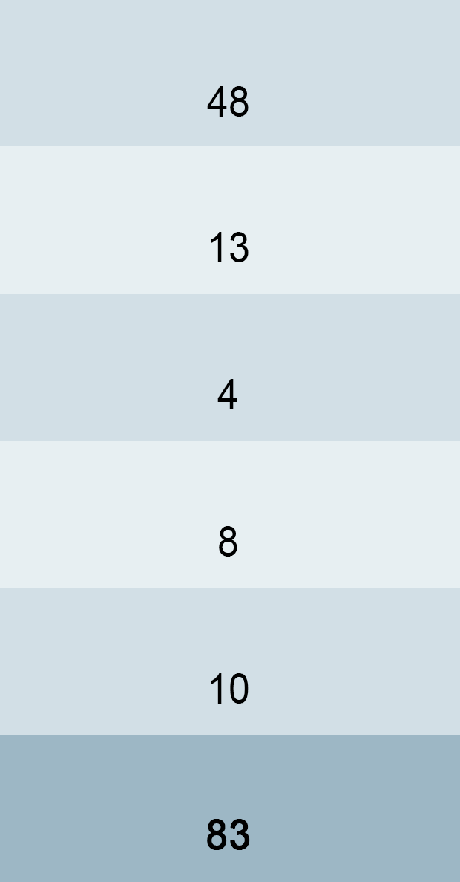
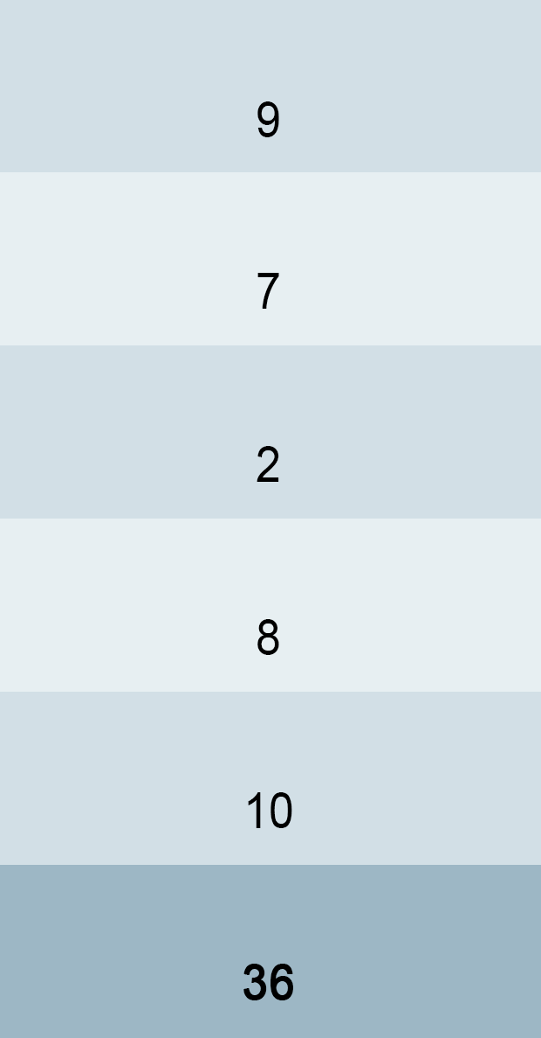

JOHANNESBURG HEALTH DISTRICT
2024 RESEARCH CONFERENCE
#JoburgResearch2024
Notes:
This table shows: <CLICK> the number of facilities in the Region, <CLICK> the number of those facilities that participated; <CLICK> the number of SLTs working in those public health and education institutions; <CLICK> and those who met the inclusion criteria, <CLICK> and ultimately who were interviewed. <CLICK> It can be noted that there is a high participation rate of appropriate participants.

Slide 7
Methodology
JOHANNESBURG HEALTH DISTRICT
2024 RESEARCH CONFERENCE
A qualitative research design
Descriptive phenomenology
Bracketing (epoché)
Qualified SLTs
Purposive sampling
Pilot study
Semi-structured interview:
  Focus Group Interviews
  One-to-One (Depth) Interview
Interviews were audio-recorded
Thematic Analysis:
Ensuring trustworthiness:
  Credibility
  Confirmability
  Dependability
  Transferability
#JoburgResearch2024
Notes:
A Pilot Study was conducted to refine the interview protocol. <CLICK> A semi-structured interview was used. These interviews allowed me to alter wording and language level as needed during the interview. An interview protocol was used for asking questions and recording answers during the depth interview and focus groups. <CLICK> 8 Focus group interviews and one depth interview, lasting 30-60 minutes each, were conducted in the hospitals, CHCs and school settings where there was a team of therapists working with children with CP. <CLICK> Each participant that agreed to be a part of the study was required to sign consent for the interview to be audio-recorded. <CLICK> Thematic analysis was used when analysing the data.
<CLICK> I attempted to ensure credibility, <CLICK> confirmability, <CLICK> dependability, and <CLICK> transferability of the study.

Slide 8












Results
“The kids, even they wouldn’t be able to say thank you, you know the simple smile that you get, or the fact that they are able to swallow a little bit better than before … just the small things, it just changed my attitude a little bit more.” (HT)
“I think it’s when they actually achieve something which makes life easier for them. They weren’t able to reach out to the world, and make their needs known, and thanks to therapy they have a way of doing that. I think that’s the biggest thing, to make a difference in their life.” (ST)
“I think they are doing the best they can under the circumstances. You can’t expect to make a huge difference if you can only see a child once in three months. So, I think they’re all really trying their best under terrible circumstances, but it’s definitely not enough. It’s definitely, definitely not enough. But not due to their wrongdoing, but because of the system. It’s just too overwhelming.” (ST)
“And I quite enjoy when you make like it’s just a small difference.” (CT)
“So for us it means, we kind of want to help our kids as well. We end up squeezing them in and making exceptions. They end up staying here way past the point they should have been discharged. So I guess it’s also us to blame.” (HT)
“ … but most facilities are like ours. We’re quite understaffed for the caseload that we support, and I think that affects the quality of therapy that we give …” (HT)
The small victories and breakthroughs
“We are actually struggling with putting them in schools because they need ongoing intervention. So here we are working on seeing them past the age of six until they are placed in a school, because we are trying to keep what we have [progress].” (HT)
SLTs’ genuine desire to make a difference in the lives of their patients
“Yeah, comm serves [sic; referring to community service therapists] definitely break services. So there could be a therapist at certain clinics for one year and the next year we don’t. So we build the services then afterwards that’s lost.” (CT)
A general lack of resources
“And the system makes it difficult, because how do they get to the clinic, how do they get to the hospital. It isn’t easy and you know if you have to choose whether to pay money to buy a bread or whether you going to use it for taxi fare, you are going to buy bread.” (ST)
“… the fact that we are understaffed and under-resourced … but I think it filters through to all level of resources and I think we don’t even have the sufficient step-down services available for that continuity …” (ST)
The impact that a family’s low socio-economic status has on the efficacy of therapy
“There’s five million other things for them to worry about, so sitting there at the end of the day and putting speech therapy first is not on their priority list. It’s never going to happen.” (HT)
“It essentially boils down to this gap, of receiving therapy to six years then we don’t know where they are going, where they are placed, if they are receiving the services, that’s the biggest thing. Communication.” (HT)
The chasm between health and education and the distrust it creates
“… the feeding is on point you know. Then the mums disappear. And then they don’t come back for therapy, and then maybe when they realise this is CP, and it means it’s a lifelong condition, then they come back way later. And then like we’ve lost a couple of years where we could’ve done something with the kid.” (HT)
Perceived lack of LSEN school knowledge at Department of Education
“The gap between health and education is so big, it shouldn’t be that big. Our patients go from here, we’ve taken care of them, now please can you help us and carry on this treatment? There’s no communication and at the end of the day both play such an important role … the gap between education and health must be closed …” (HT)
“But the severe intellectually disabled children would be at the school that caters for them, and there are many SID [Severe Intellectual Disability] schools that have correct programmes for them. So … we [a Mild/Moderate Intellectual Disability school] currently have a lot of children that are incorrectly placed here by the Department of Education.” (ST)
“… the Department of Education often won’t accept our suggestion and um, we end up keeping the kids, even if they’re not correctly placed here [LSEN school].” (ST)
“I think getting people from Department of Health and Department of Education sitting down and saying let’s develop the link between the two and not have health this side, education that side. But a middle point with people who are eager on actually developing that … I think that would be a good starting point.” (HT)
“The Department of Education needs to realise the importance of therapists and do their weighting properly when they weight those learners. We’ve been fighting this for years and years and years to get a proper weighting to get a proper establishment, so we can have more therapists, and we have had no results whatsoever.” (ST)
Notes:
Six themes emerged during data analysis of the transcribed interviews. These included: <CLICK> 1. The small victories and breakthroughs; <CLICK> 2. Speech-language therapists’ genuine desire to make a difference in the lives of their patients; <CLICK> 3. A general lack of resources; <CLICK> 4. The impact that a family’s low socio-economic status has on the efficacy of therapy; <CLICK> 5. The chasm between health and education and the distrust it creates; <CLICK> 6. Perceived lack of learners with special educational needs (LSEN) school knowledge at Department of Education.

Slide 9

Conclusions
JOHANNESBURG HEALTH DISTRICT
2024 RESEARCH CONFERENCE
Perceived chasm between the Department of Health and the Department of Education
Sense of frustration from participants working in both sectors.
Interinstitutional collaboration.
Administrative hurdles.
A perceived lack of willingness by the Department of Education to engage in collaborative protocols with SLTs working with children with CP.
A failure of the system to place children into LSEN schools.
A need for effective policy implementation.
A consultative process with allied health professions.
#JoburgResearch2024
Notes:
By far the most prominent theme which emerged from the analysis of the data collected, is that of a perceived chasm between the DoH and the DoE in the referral process of children. <CLICK> There was a sense of frustration from participants working in both sectors highlighting the need to address the perceived lack of communication between the health and education sectors in the region. The frustration appeared to be with the administrators at the district level of the education sector. <CLICK> I found that inter-institutional collaboration assists in the mitigation of therapeutic regression of each child that can occur as a result of handover from one institution to the next. Where given the opportunity, relationships between participants at different institutions in Gauteng Region A have been created. <CLICK> However, administrative hurdles in the provincial DoH and the DoE make it difficult for collaborative inter-institutional relationships to develop.
Participants working at public hospitals reported that they were not asked to provide detailed progress reports of children for the purposes of LSEN school placement, whilst participants working at LSEN schools were reportedly not consulted during the admissions process of each child. <CLICK> The lack of consultation was attributed to a perceived lack of willingness by the DoE to engage in collaborative protocols with SLTs working with children with CP. <CLICK> It can therefore be concluded that a failure of the system to place children into LSEN schools that cater for their specific needs, is detrimental in establishing and maintaining the effectiveness of those institutions. <CLICK> Effective policy implementation, specifically at the GDE, could be instrumental in removing barriers to communication and ensuring that therapeutic gains made at hospital and clinic levels are carried over reliably into the therapeutic environment at LSEN schools in Gauteng. <CLICK> Furthermore, a consultative process with allied health professions, including SLTs, occupational therapists, physiotherapists, as well as educational psychologists working at LSEN schools, could substantially reduce the incidence of inappropriate admissions.

Slide 10

Further research should be conducted at the Department od Education to further investigate the details of the perceived chasm.
JOHANNESBURG HEALTH DISTRICT
2024 RESEARCH CONFERENCE
Recommendations for future research
Clinical implications of findings
Improved interdepartmental communication
Improved collaboration between professionals working in health and those working in education.
A cohesive plan needs to be formulated and executed in order to bridge this chasm.
Further research could also include investigating the perceptions of the doctors making diagnoses.
Further investigations similar to the current study should be conducted with other health professionals working in the Departments of Health and Education in Gauteng as well as other provinces
#JoburgResearch2024
Notes:
Recommendations for future research <CLICK> As the DoE is responsible for placing children in schools, further research should be conducted at the DoE to further investigate the details of the perceived chasm. With the insights obtained from such an investigation, further recommendations can be made for the implementation of improved communication procedures and strategies between institutions. These recommendations could include the formulation, implementation, and evaluation of programmes to improve communication between the provincial Departments of Health and Education. This communication needs to be bidirectional and create opportunities for the DoE to inform the DoH of the services available in LSEN schools, and for the DoH to be able to share relevant referral information about a child when assisting with school placement. This communication should be conducted in a manner that fosters trust. Although the study was set out to investigate the (dis)continuity of speech-language therapy services for children with CP in the public sector specifically, the results highlighted that some of the contributing factors fall outside the purview of SLTs. <CLICK> Further research could also include investigating the perceptions of the doctors making diagnoses and referring to the educational districts for LSEN school placement. Their perceptions of the various LSEN schools and motivations for recommending one school as opposed to another, can further increase understanding regarding and possible improvement of the referral process in general. <CLICK> Lastly, further investigations similar to the current study should be conducted with other health professionals, such as physiotherapists and occupational therapists working in the Departments of Health and Education in Gauteng as well as other provinces, to establish whether there is a correlation in results found in this study. <CLICK> Clinical implications of findings <CLICK> Improved inter-departmental communication is encouraged, which may result in <CLICK> improved collaboration between professionals working in health and those working in education. <CLICK> The results of this study suggest that a cohesive plan needs to be formulated and executed in order to bridge this chasm. This may facilitate communication, collaboration, education, as well as resource-sharing between the two departments. Bidirectional communication enabled by a cohesive plan may improve the referral pathway and result in improved handover and carryover of therapeutic strategies into appropriate LSEN schools, preventing children from ‘falling through the cracks’ (HT). This will also assist caregivers in making the transition from the health setting into the education setting and improve their trust in the ‘system’ and individual institutions.

Slide 11
“It is not beyond our power to create a world in which all children have access to a good education. Those who do not believe this have small imaginations.”
- Nelson Mandela
JOHANNESBURG HEALTH DISTRICT
2024 RESEARCH CONFERENCE
Firstly, I would like to express my sincere gratitude and appreciation to my supervisor, Dr Berna Gerber. Her unwavering support, guidance, knowledge and motivation during this process was invaluable to me. Berna, your expertise, professionalism and calm and caring nature is what I admired and valued the most. Thank you for being a significant part of my academic journey.
And finally, to my husband Stephen Lydall, who has been my constant support and encouragement throughout this process. Thank you for sharing in my excitement, being my sounding board and ‘thesaurus’, and for eagerly administering your creative and artistic ingenuity to this document. You and Benjamin are my entire world.
To my editor, Lilané Joubert, thank you for your technical acumen and valuable recommendations.
A very special thanks goes to my loving family and amazing friends. Thank you for being a part of my tribe, for always believing in me and encouraging me to reach for the stars.
Acknowledgements
I am so grateful to the participants in my study for their honest contributions to this work.
I gratefully acknowledge the funding I received towards my study, from The Harry Crossley Foundation.
1946–2016
Αυτή η διατριβή είναι αφιερωμένη στη μνήμη των γονιών μου, του Ιωάννη Προδρόμου Μεσσιαν (1946-2016) και της Γαρουφαλίας Μεσσιαν (1962-2019)
1962–2019
This thesis is dedicated in memory of my parents, Iaonnis Prodromos Messian (1946-2016) and Garoufalia Messian (1962-2019)
#JoburgResearch2024
Notes:
Thank you so much for listening ☺

