Slide 1



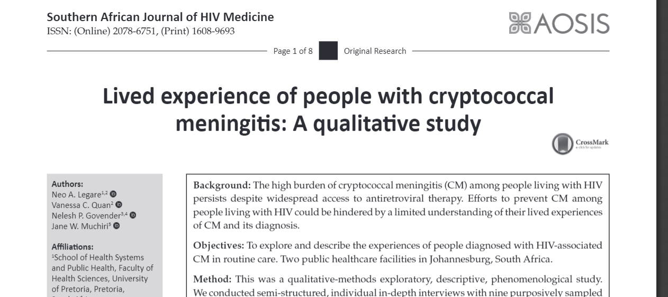


Lived experiences of people with cryptococcal meningitis: A qualitative-methods study
JOHANNESBURG HEALTH DISTRICT
2024 RESEARCH CONFERENCE
Neo Legare, Vanessa Quan, Nelesh Govender & Jane Muchiri
#JoburgResearch2024

Slide 2
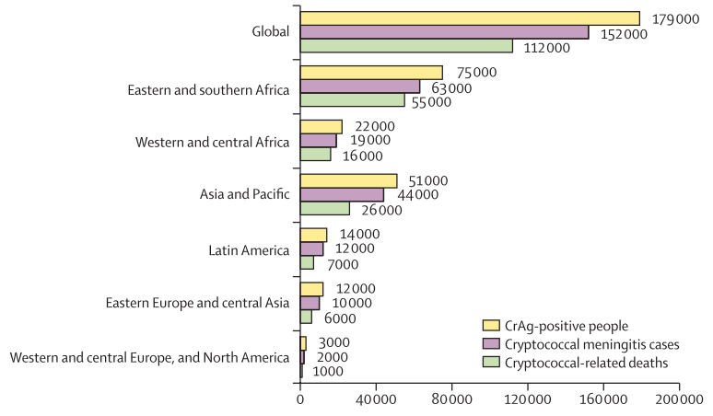
Introduction
Global estimate 152 000 incident cases [1] - 54% of cases occurring in Africa. Despite ART access.
CM account for 19% AIDS-related deaths [1]
SA has the highest estimated burden of CM [1] - 23, 000 cases per annum
National incidence of laboratory-confirmed CM in 2021 [2] - 67 cases per 100,000 PLHIV
Efforts to prevent CM could be hindered by limited understating of lived experience
Objectives: To explore and describe the experiences of people diagnosed with HIV-associated CM in routine care. Two public healthcare facilities in Johannesburg, South Africa.
[1] Rajasingham R, Govender NP, Jordan A, et al. The global burden of HIV-associated cryptococcal infection in adults in 2020: a modelling analysis. Lancet Infect Dis. 2022;22(12):1748–1755. doi:10.1016/S1473-3099(22)00499-6
[2] GERMS-SA. Germs-Sa: Annual Surveillance Review 2020. 2019;49
#JoburgResearch2024
Notes:
Globally 152 00 incidence of HIV associated CM. 19% account for AIDS related dearth

Slide 3
Method
Qualitative exploratory descriptive, phenomenological study
Conducted semi-structured, individual in-depth interviews with 9 purposively sampled participants (5 men and 4 women)
Analysis manual using 4 Steps Moustakas phenomenological approach which is Modification of the Stevick-Colaizzi-Keen methods
PLHIV (outpatients & inpatients) ≥18 years old with confirmed laboratory CM. GCS15/15. ≥10days in-patient, post-diagnosis & ≥30 days for outpatient post-diagnosis
#JoburgResearch2024

Slide 4
Results
Experience of cryptococcal meningitis symptoms
Participants described headache as being more severe than any other pain they had ever experienced, even worse than labour pains.
‘The pain is more severe as compared to the labour pain. I have three children, but I never had a big pain that I got here from that. It’s better [labour pains]. You forget about it, but I’ll never forget about that pain.’ (Participant 1, Female, 37 years old)
Impact of cryptococcal meningitis diagnosis and symptoms
Reported poorer quality of life and increased sense of being more dependent on others. Feeling depressed and isolated themselves from friends to avoid questions around their health.
‘Nah it makes me feel depressed because whenever someone … if my friends see me, where have you been? I’m like, I’ve been around. What’s wrong? Nothing’s wrong. But obviously, they could see the weight was going down.’ (Participant 5, Male, 22 years old) )
Cryptococcal meningitis treatment experience
Participants with serial lumbar punctures (LP) to decreases intracranial pressure (ICP) mentioned that the LP helped to relieve headaches. Three participant indicated that the LP was painful and didn’t help: these 3 participants only had LP at diagnosis.
Participants indicated that they received better care at the hospital than that offered by GPs before being admitted in hospital. Inpatients felt they received effective treatment from PHC.
‘An Indian doctor and another doctor did it. They did it so nicely. Instantly when it just was finished here with my back, then all the pain went up, everything went away.’ (Participant 1, Female, 37 years old)
#JoburgResearch2024

Slide 5
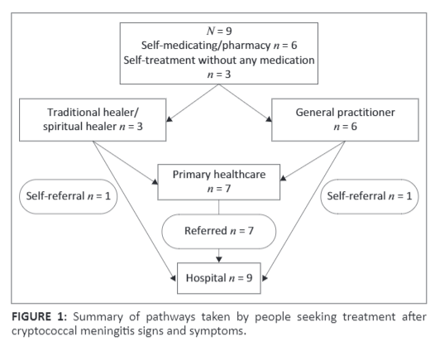
Results
Health seeking behavior
Participants initially sought help for their symptoms from other sources and not from health professionals.
Barriers to HIV and CM care
Participants identified healthcare workers’ negative attitudes, their own unhealthy lifestyle and generally poor CM knowledge as barriers to effective HIV and CM care.
‘At the clinic, they are so rude. You see me. I’m a domestic worker. I clean for the pastor. I clean every day. Now I send my children to go and fetch the pills. Then they don’t want to give those children the pills. Then they say I must come. Why must I come? And when they, I need that money, you see? I can’t say to the pastor that I can’t work today. I must go to the clinic. The pastor doesn’t want to hear that.’ (Participant 1, Female, 37 years old)
‘I think because last November I didn’t drink my medication, I think, November and December. I think maybe, it is the cause, I don’t know. Every day I was drinking and the timings I had to drink pills, I was drunk.’ (Participant 6, Male, 41 years old)
‘I just got some tablets, Panado® and Disprin®, just that.’ (Participant 7, Male, 45 years old)
‘Just buying the over-the-counter medication just thinking it’s just a headache, and then after I went to the GP, then still no change. I went to the GP again, they say that it’s migraine, but then still no change. That is when I decided to go to the clinic.’ (Participant 2, Female, 38 years old)
#JoburgResearch2024

Slide 6
Conclusion and Recommendations
JOHANNESBURG HEALTH DISTRICT
2024 RESEARCH CONFERENCE
People with HIV-associated CM face adverse consequences prior to and upon diagnosis, alongside personal and health-system challenges that impede timely access to quality healthcare.
Challenges contribute to delayed diagnosis and linkage to care, resulting in late presentation and starting of treatment.
Barriers identified in this study may explain poor retention in care and virological failure on ART among patients with HIV-associated CM.
CM-related health education should be integrated into post-HIV counselling for patients starting ART who are at risk of CM (e.g., CD4 count ≤ 200, positive reflex CrAg test, and high HIV viral loads).
Patients who are aware of the symptoms may be more likely to seek early treatment for CM.
Further studies are needed to understand healthcare workers’ attitudes and assess the knowledge of GPs on the current guidelines for the diagnosis, prevention, and management of cryptococcal disease in adults.
#JoburgResearch2024

Slide 7
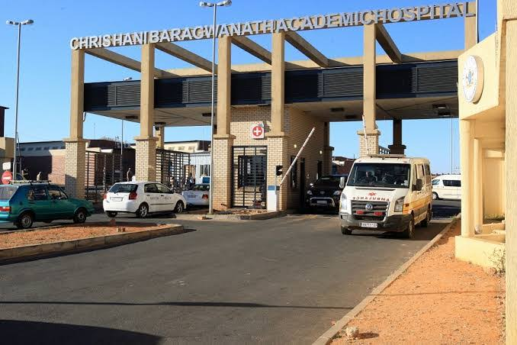
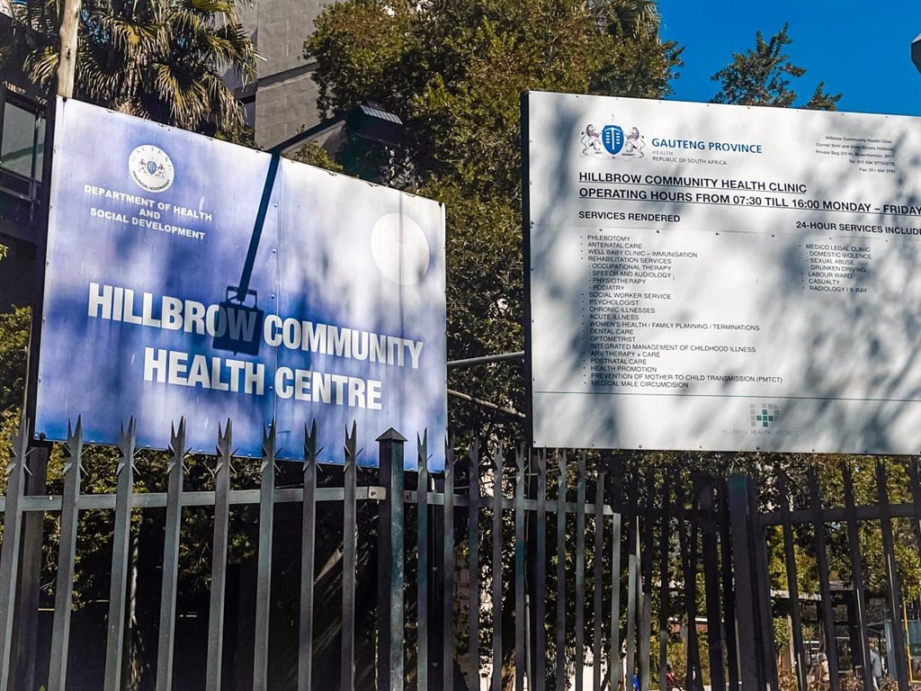
ACKNWOLEDGEMENT
JOHANNESBURG HEALTH DISTRICT
2024 RESEARCH CONFERENCE
Thanks to all participants who shared their experiences
GERMS-SA team.
#JoburgResearch2024

