Slide 1





Development of Neonatal Nursing Intensive Care Competencies: A Mapping Review
JOHANNESBURG HEALTH DISTRICT
2024 RESEARCH CONFERENCE
Researcher: Kerry-Ann Singaram
Supervisors: Dr Susan Armstrong & Dr Meghan Botes
#JoburgResearch2024

Slide 2
INTRODUCTION & BACKGROUND
JOHANNESBURG HEALTH DISTRICT
2024 RESEARCH CONFERENCE
Parents therefore look to NICU’s as a source of hope in assisting in the recovery of their child (Hagen, et al., 2019).
The end goal of a NICU attainment of stability where possible (Namnabati, et al., 2016).
Therefore, for this goal to be achieved it is critical to ensure that staff are functioning at a high level of expertise.
The Council of International Neonatal Nurses has deemed Neonatal Nursing has a highly specialised field.
#JoburgResearch2024

Slide 3
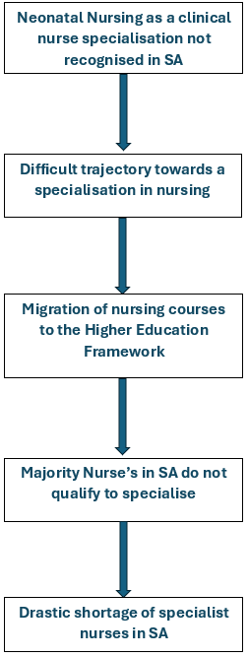
Current state of Nursing Education in South Africa
JOHANNESBURG HEALTH DISTRICT
2024 RESEARCH CONFERENCE
#JoburgResearch2024

Slide 4
Research Question
JOHANNESBURG HEALTH DISTRICT
2024 RESEARCH CONFERENCE
How can singly qualified nurses working in neonatal ICU’s best be supported to gain additional knowledge required to care for compromised neonates?
#JoburgResearch2024

Slide 5
Research Objective
JOHANNESBURG HEALTH DISTRICT
2024 RESEARCH CONFERENCE
To explore the competencies recommended in local and international literature required to care for compromised neonates.
#JoburgResearch2024

Slide 6
Part 1: Mapping Review
JOHANNESBURG HEALTH DISTRICT
2024 RESEARCH CONFERENCE
Emerging review and differs from that of a scoping and systematic review in that it focuses on targeted journals on specified topics within a defined time period.
Journals were selected purposively on their likelihood to publish research relevant to neonatal nursing, international Scopus (2017) SCImago Journal and country Rank was used to determine highest ranking journals in the field of neonatal nursing.
No review question guided by the objective of the mapping review.
Data extraction tool used for synthesis of data.
All articles from January 2020 to March 2022 were considered for the mapping review.
#JoburgResearch2024

Slide 7
Competencies identified
JOHANNESBURG HEALTH DISTRICT
2024 RESEARCH CONFERENCE
Implement a range of advanced procedures, treatments and interventions in accordance with the developed care plan for the management of identified conditions.
Implement a range of advanced procedures, treatments, and interventions in accordance with the developed care plan for the prevention of identified conditions.
Use appropriate assessments to identify actual and potential risks to safety and security, take appropriate action.
4. Initiate, develop, and continue therapeutic relationships using a range of advanced communication and interpersonal skills with families of neonates.
#JoburgResearch2024

Slide 8
What then?
JOHANNESBURG HEALTH DISTRICT
2024 RESEARCH CONFERENCE
Followed by survey at NNICUs in Gauteng.
Developed a 3-month blended short course on Neonatal Intensive Care Nursing for singly qualified R/Ns.
Incentive: CPD points and advanced knowledge and skills to improve clinical outcomes.
In process of validating programme.
#JoburgResearch2024

Slide 9
Challenges on the field
JOHANNESBURG HEALTH DISTRICT
2024 RESEARCH CONFERENCE
Staff shortages
High workload
High patient acuity
#JoburgResearch2024

Slide 10
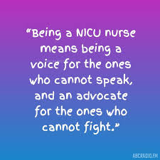
Thank you!
JOHANNESBURG HEALTH DISTRICT
2024 RESEARCH CONFERENCE
#JoburgResearch2024

