Slide 1





Risk factors associated with childhood mortality in the Soweto and Thembelihle Health and Demographic Surveillance System: 2018 to 2022
JOHANNESBURG HEALTH DISTRICT
2024 RESEARCH CONFERENCE
Takwanisa Machemedze, Megan Dempster, Maatla Temane, Nqaba Mthimkhulu, Siobhan Johnstone, Ziyaad Dangor, Shabir, A. Madhi
#JoburgResearch2024

Slide 2
Background
JOHANNESBURG HEALTH DISTRICT
2024 RESEARCH CONFERENCE
UN SDG3, target 3.2:
  By 2030, end preventable deaths of newborns and children under 5 years of age, with all countries aiming to reduce:
    neonatal mortality to at least as low as 12 per 1,000 live births and
    under-5 mortality to at least as low as 25 per 1,000 live births.
South Africa SDGs Country Report 2023 (Stats SA):
  South Africa already reached the goal of neonatal mortality but had not reached the targets set for reducing under-5 mortality
Targets evaluated at national level may not be reflective of different local levels.
  Vision of leaving no one behind.
#JoburgResearch2024

Slide 3
Study context
JOHANNESBURG HEALTH DISTRICT
2024 RESEARCH CONFERENCE
Child Health and Mortality Prevention Surveillance (CHAMPS) network.
  One of the aims: to understand causes of death in children under-five years of age.
Health and Demographic Surveillance System (HDSS)
  Routine data collection of key demographic events: births, deaths, in- and out-migration.
  Provide population denominators.
Minimally invasive tissue sampling (MITS)
  Obtain post-mortem samples of lung, brain, liver and other organs to help determine cause of death.
  Panel of experts review all MITS data: clinicians, pathologists, epidemiologists, and laboratorians, and more.
  Chris Hani Baragwanath Academic Hospital, Johannesburg, South Africa
#JoburgResearch2024

Slide 4
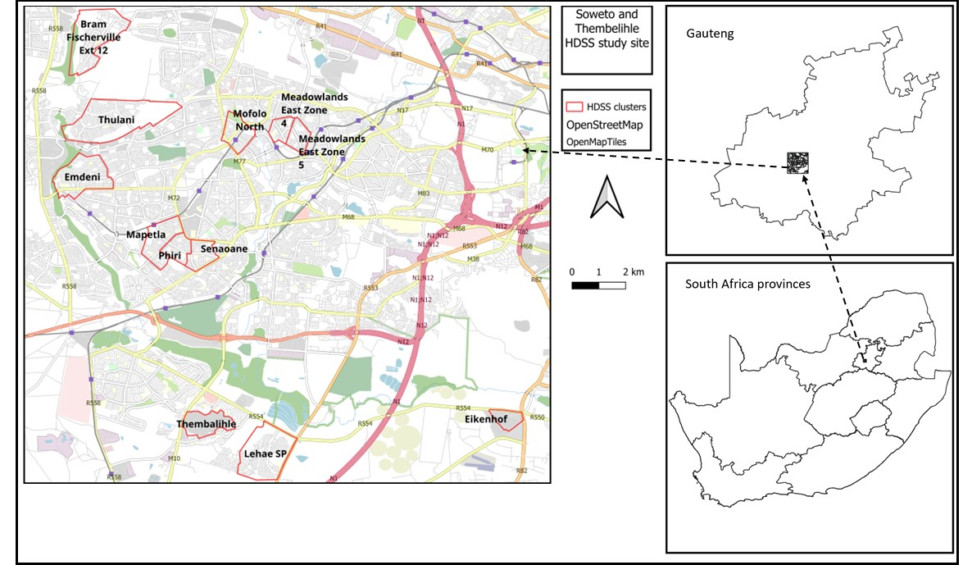
Study site
JOHANNESBURG HEALTH DISTRICT
2024 RESEARCH CONFERENCE
#JoburgResearch2024

Slide 5
Objectives and Methods
JOHANNESBURG HEALTH DISTRICT
2024 RESEARCH CONFERENCE
Objectives
To determine the level of childhood mortality among children born in the Soweto and Thembelihle HDSS (SaT-HDSS) study site
To explore risk factors associated with the risk of childhood death in the SaT-HDSS study site.
To explore variations in the identified common underlying cause of death among different age groups of children under five.
Methods
Data: HDSS, MITS
Statistical analysis:
  ratios, rates,
  Cox proportional hazards model
  Descriptive counts and proportions
#JoburgResearch2024

Slide 6
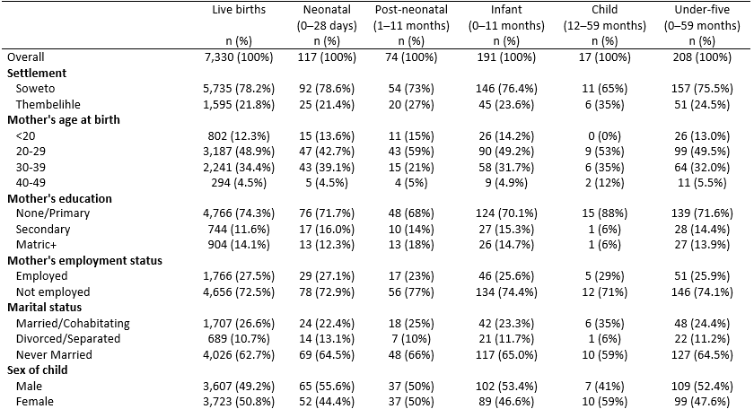
Results: Sample characteristics (1)
JOHANNESBURG HEALTH DISTRICT
2024 RESEARCH CONFERENCE
#JoburgResearch2024

Slide 7
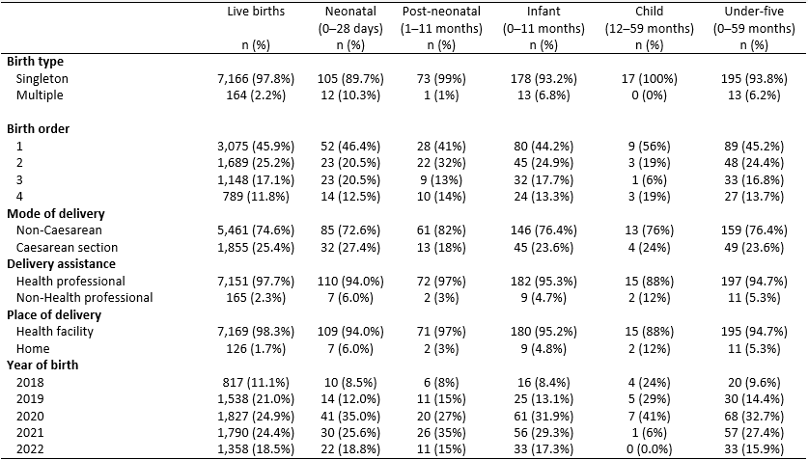
Results: Sample characteristics (2)
JOHANNESBURG HEALTH DISTRICT
2024 RESEARCH CONFERENCE
#JoburgResearch2024

Slide 8
Results: Overall under-five mortality rates
JOHANNESBURG HEALTH DISTRICT
2024 RESEARCH CONFERENCE
 | Neonatal | Post-neonatal | Infant | Child | Under-five
 | (0–28 days) | (1–11 months) | (0–11 months) | (12–59 months) | (0–59 months)
Deaths | 117 | 74 | 191 | 17 | 208
Mortality ratio/1000 LB | 16.0 | 10.1 | 26.1 | 2.3 | 28.4
Mortality rate/1000 PY | 16.3 (13.6-19.5) | 11.4 (9.1-14.3) | 28.4 (24.8-32.6) | 1.7 (1.1-2.8) | 30.1 (25.8-35.3)
#JoburgResearch2024

Slide 9
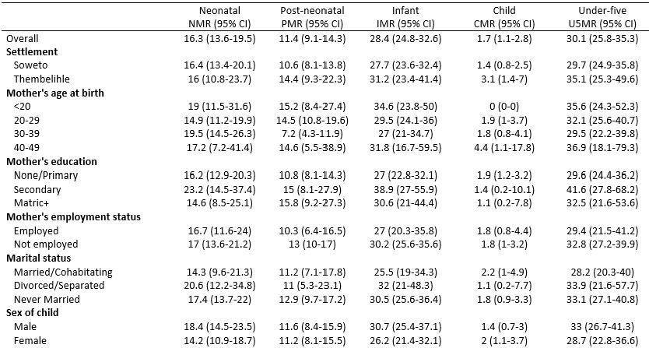
Results: disaggregated under-5 mortality rates (1)
JOHANNESBURG HEALTH DISTRICT
2024 RESEARCH CONFERENCE
#JoburgResearch2024

Slide 10
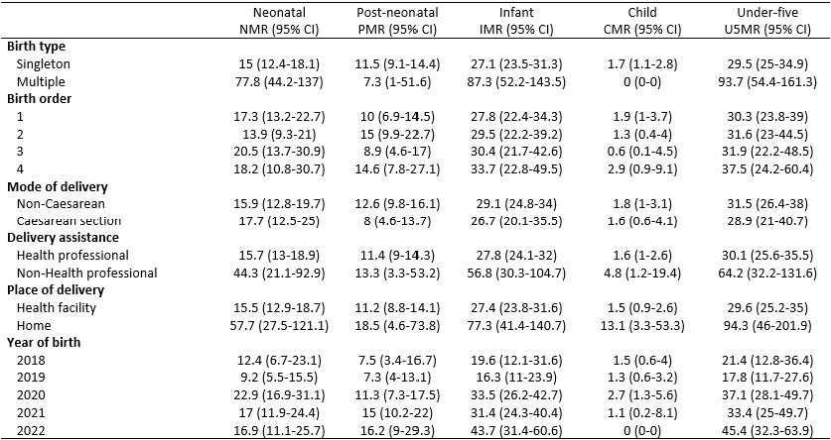
Results: disaggregated under-5 Mortality rates (2)
JOHANNESBURG HEALTH DISTRICT
2024 RESEARCH CONFERENCE
#JoburgResearch2024

Slide 11
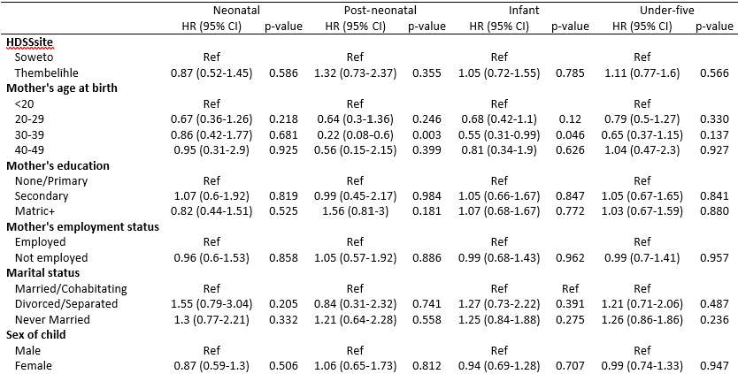
Results: Mortality Risk factors (1)
JOHANNESBURG HEALTH DISTRICT
2024 RESEARCH CONFERENCE
#JoburgResearch2024

Slide 12
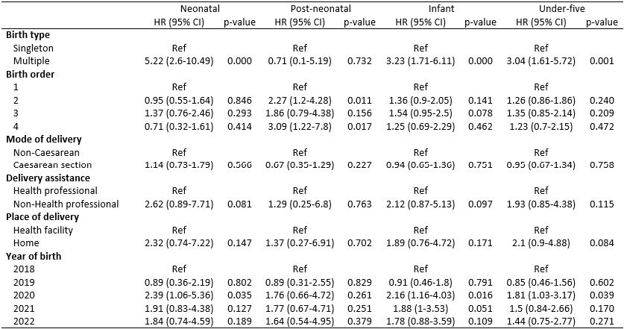
Results: Mortality Risk factors (2)
JOHANNESBURG HEALTH DISTRICT
2024 RESEARCH CONFERENCE
#JoburgResearch2024

Slide 13
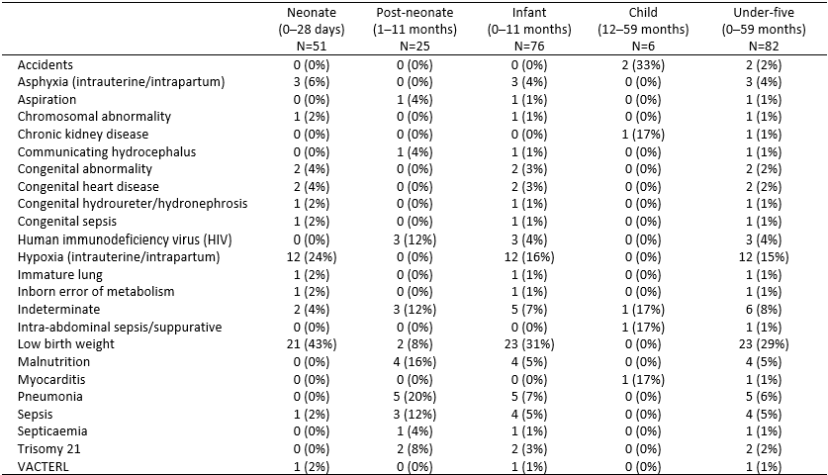
Results: Underlying cause of death
JOHANNESBURG HEALTH DISTRICT
2024 RESEARCH CONFERENCE
#JoburgResearch2024

Slide 14
Conclusion and recommendations
JOHANNESBURG HEALTH DISTRICT
2024 RESEARCH CONFERENCE
Conclusions
Most under-five deaths were among children under one year.
Both neonatal and under-five mortality rate were slightly above the UN SDG targets.
Mortality rates disproportionately high among multiple births compared to singletons, and children born at home compared to a health facility.
The risk of childhood death was significantly higher among multiple births.
Recommendations
Need for support for early and continued ANC to identify potential pregnancy complications at an early stage.
Need for health education on preventing accidents in 1-4 year olds.
#JoburgResearch2024

Slide 15
Acknowledgements
JOHANNESBURG HEALTH DISTRICT
2024 RESEARCH CONFERENCE
All HDSS and MITS participants
The HDSS and MITS staff at VIDA.
Funders: Gates foundation
#JoburgResearch2024

