Slide 1





PATIENTS’ ATTITUDE AND EXPERIENCES TOWARDS AUTOMATED PHARMACY DISPENSING UNITS IN JOHANNESBURG, SOUTH AFRICA
JOHANNESBURG HEALTH DISTRICT
2024 RESEARCH CONFERENCE
Presented By: Hethel Chouhan
#JoburgResearch2024

Slide 2


Contents
JOHANNESBURG HEALTH DISTRICT
2024 RESEARCH CONFERENCE
Introduction and Background
Study Aim and Objectives
Methodology
Results and Discussion
Limitations
Recommendations
References
#JoburgResearch2024

Slide 3

Introduction and Background
JOHANNESBURG HEALTH DISTRICT
2024 RESEARCH CONFERENCE
Access to medicines
Staff shortages
Facilities are overburdened
Patients spend a long time travelling to clinics
Manual systems
Scaling up access to ART
#JoburgResearch2024

Slide 4

Introduction and Background Continued
JOHANNESBURG HEALTH DISTRICT
2024 RESEARCH CONFERENCE
Technological changes and Automated dispensing systems
PDUs – first of its kind
Open for extended hours
Limited studies done
#JoburgResearch2024

Slide 5
Introduction and Background Continued
JOHANNESBURG HEALTH DISTRICT
2024 RESEARCH CONFERENCE
Patient gets assessed at clinic.
Bulk medication dispensed at CDU.
Bulk medication delivered to PDU.
SMS sent to patient.
Patient selects script.
Computer system reads the card.
Patient presents card and enters PIN code.
Patient arrives at PDU.
PDU picks and labels medication.
ATM dispenses medication.
Patient takes medication.
Patient receives receipt.
Call Centre assists patient with queries.
Patient consults through audio-video link.
Schematic Diagram of PDU Process
#JoburgResearch2024

Slide 6
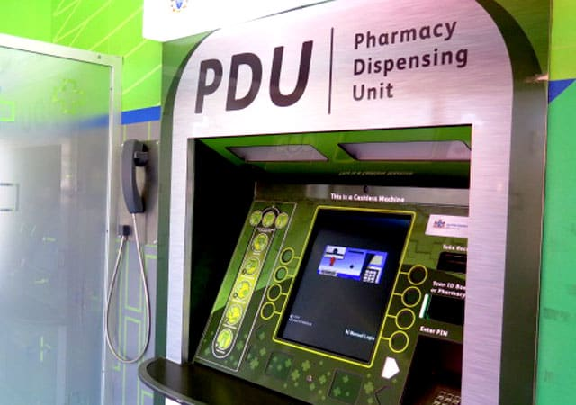
Introduction and Background Continued
JOHANNESBURG HEALTH DISTRICT
2024 RESEARCH CONFERENCE
The Pharmacy Dispensing Unit from a patient’s view
The robotic dispensing system
#JoburgResearch2024

Slide 7
Study Aim and Objectives
JOHANNESBURG HEALTH DISTRICT
2024 RESEARCH CONFERENCE
To determine and describe the attitude of patients towards collecting chronic care medication.
To explore the experiences of patients towards the PDUs.
To compare and correlate the different attitude and experiences between patients at the three PDUs.
#JoburgResearch2024

Slide 8
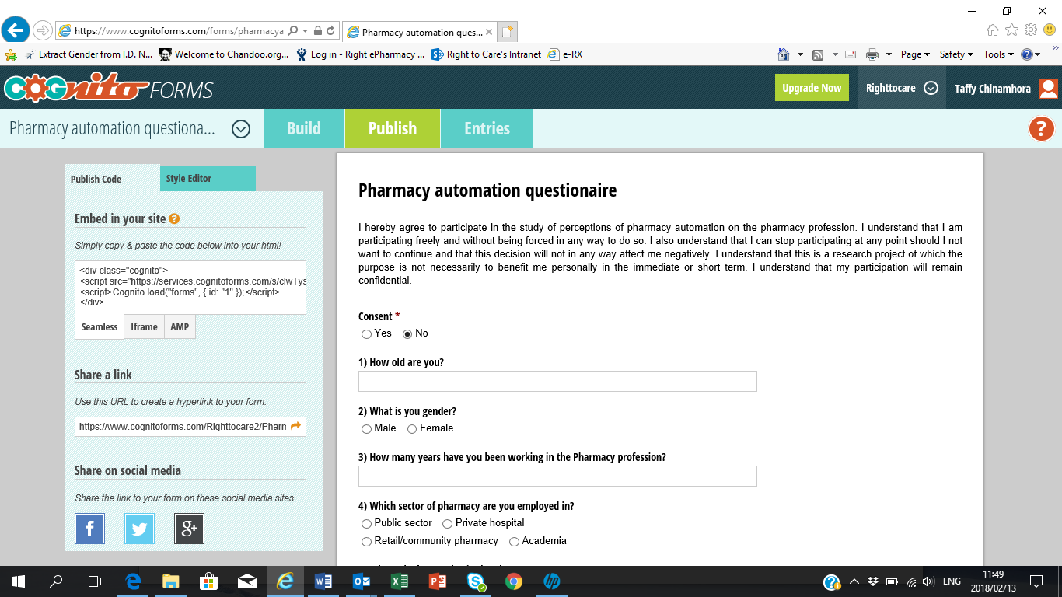

Methodology
JOHANNESBURG HEALTH DISTRICT
2024 RESEARCH CONFERENCE
Cross Sectional Quantitative Design
Alex Plaza
Ndofaya Mall
Bara Mall
3
SPSS, Chi-Square, One-way Anova Tests and Excel
Patients collecting chronic care medication > 18yrs (over 2 months)
Pilot study = 10% of total sample size
Sample size = 624
#JoburgResearch2024

Slide 9
Results and Discussion
JOHANNESBURG HEALTH DISTRICT
2024 RESEARCH CONFERENCE
Patients’ Experiences at the PDU
#JoburgResearch2024

Slide 10
Results and Discussion Continued
JOHANNESBURG HEALTH DISTRICT
2024 RESEARCH CONFERENCE
Patients’ Experiences with Communication and Medication at the PDU
#JoburgResearch2024

Slide 11
Results and Discussion Continued
JOHANNESBURG HEALTH DISTRICT
2024 RESEARCH CONFERENCE
Patients’ Waiting Times
#JoburgResearch2024

Slide 12
Results and Discussion Continued
JOHANNESBURG HEALTH DISTRICT
2024 RESEARCH CONFERENCE
Patients’ Attitude in terms of Satisfaction towards PDU
#JoburgResearch2024

Slide 13
Results and Discussion Continued
JOHANNESBURG HEALTH DISTRICT
2024 RESEARCH CONFERENCE
Patients’ Attitude towards Using PDU
#JoburgResearch2024

Slide 14

Limitations
JOHANNESBURG HEALTH DISTRICT
2024 RESEARCH CONFERENCE
Only Conducted at 3 PDU sites
Number of neutral responses
Covid 19 Restrictions
Limited access to literature
#JoburgResearch2024

Slide 15

Recommendations
JOHANNESBURG HEALTH DISTRICT
2024 RESEARCH CONFERENCE
Data collection processes through telephonic patient interviews
Benefits and challenges of PDUs need to be analysed
Holistic approach to healthcare
PDUs - 24-hour services
Changes in current models
Future studies on other innovative projects
Comparative studies between different decongestion models
Patients’ perceptions studies on public and private service models
Engagement between NDoH and NGOs
Implementation of NHI.
Huge benefits global scale
#JoburgResearch2024

Slide 16
References
JOHANNESBURG HEALTH DISTRICT
2024 RESEARCH CONFERENCE
Anacleto, TA., Perini, E., Rosa, MB. & Cesar, CC. 2005. Medication errors and drug-dispensing systems in a hospital pharmacy. Clinics, 60(4): 325 - 332.
Chen, S., Cheng, A. & Mehta, K. 2013. A review of telemedicine business models. Telemedicine and e-Health, 19(4): 287 - 297.
Kapur, R. 2018. Interrelationship between education, technology and development.
Mars, M. 2012. Introduction: e-Health in Africa. Telemedicine and e-Health, 18(1): 3 - 4.
National Department of Health, 2017. National health insurance for South Africa, towards universal health coverage, white paper. [online] Available at: https//www.health.gov.za/index.php/nhi. [Accessed on: 20/05/2018].
National eHealth strategy in South Africa. 2012. [online] Available at: https://www.health-e.org.za/wp-content/uploads//South-Africa-eHealth-Strategy-2012-2017.pdf. [Accessed on: 18/05/2018].
Pederson JP. 2004. International directory of company histories, Volume 65. Farmington Hills, MI: St. James Press.
Right ePharmacy eRx Solutions Programme, 2018.
Right ePharmacy. 2020. Collect & GoTM smart lockers. [online] Available at: https://rightepharmacy.co.za/solutions/collect-and-go-smart-lockers/ [Accessed on: 22/06/2020].
Silber, D. 2004. The case for eHealth. Studies in Health Technology and Informatics, 100(2): 3 - 27.
WHO. 2012. eHealth at WHO. Geneva: WHO. [online]. Available at: http://www.who.int/ehealth/about/en/. [Accessed on: 10/01/2021].
#JoburgResearch2024

Slide 17

JOHANNESBURG HEALTH DISTRICT
2024 RESEARCH CONFERENCE
#JoburgResearch2024

