Slide 1




Using laboratory CD4 test results (<200cells/µl) to identify sub-districts and facilities with advanced HIV disease (AHD) in the Johannesburg Health District (Johannesburg Metro)
Coetzee L^{1,2}, Cassim N^{1,2}, da Silva P^{1,2}
¹National Priority Programme (NPP), National Health Laboratory Service (NHLS), Johannesburg, South Africa
²Wits Diagnostics Innovation Hub (DIH), Faculty of Health Sciences, University of Witwatersrand, Johannesburg, South Africa
Johannesburg Health District: 2024 Research Conference 28-29 August 2024, Johannesburg

Slide 2
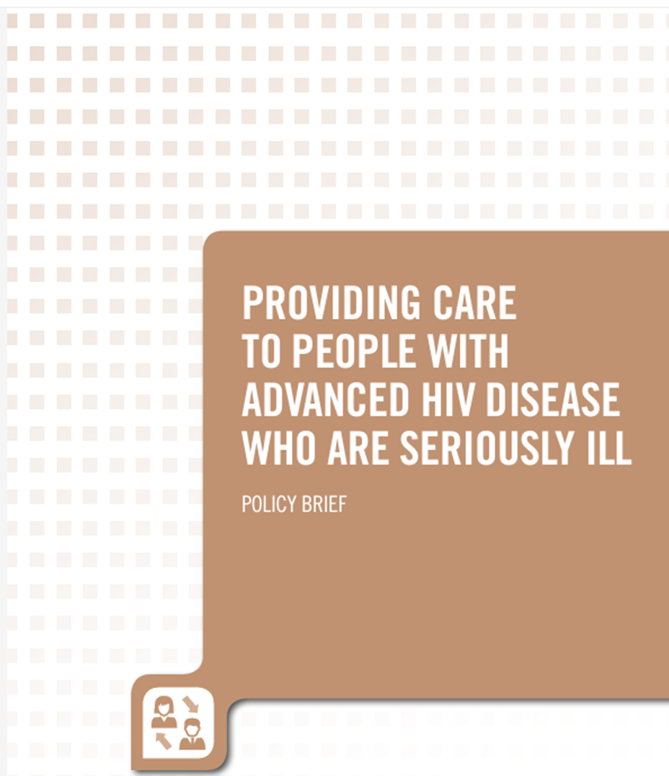
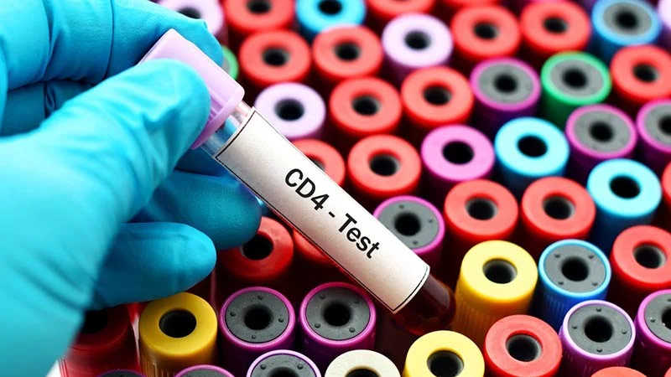
Background
WHO defines PLHIV with AHD as a CD4 cell count <200cells/µl or clinical stage 3 or 4 in adults and adolescents
CD4 is the preferred immune marker of HIV disease severity
AHD associated with higher risk of co-infections
Tuberculosis and Cryptococcal meningitis
Increased morbidity and mortality
Laboratory data to monitor HIV trends
From national to facility level
The aim of this study was to assess the AHD burden in sub-districts (regions) and facilities within the greater Johannesburg Health District (JHD)

Slide 3
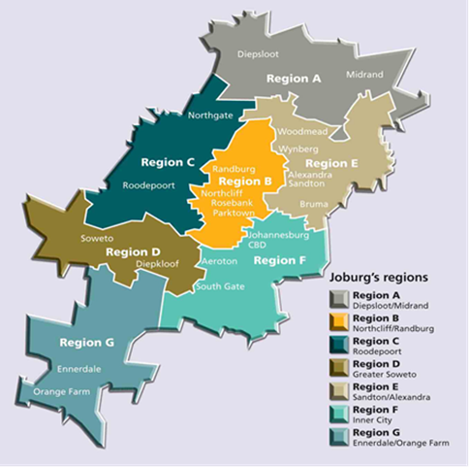
Methodology
https://www.commonwealthofnations.org/partner/city-of-johannesburg-metropolitan-municipality/
CD4 testing is done at 4 NHLS laboratories
Data :
Specimen-level CD4 data for 2023 calendar year was retrieved from the NHLS/CDW
Data collected for district, Sub-district (Regions A to G) and Health Facilities
Categories:
Gender: Male, Female and Unknown
Age: categories included <10, 10-14, 15-24, 25-34, 35-44, 45-55, >55 years and unknown
CD4 absolute count categories reported: <100, 100-200, total ≤200 cells/µl
Data analysed with SAS 9.4 and map created with ArcGIS
Calculations done by district, sub-district, health facility, age and gender categories
Level of AHD (<100, 100-200 and combined <200 cells/µl)

Slide 4
Results: JHD and Sub-Districts
190 524 CD4 specimens were tested in 2023 in JHD
Reporting AHD in 23,6% of specimens tested
Regional level:
Most specimens tested and highest median CD4 reported for Region D (34,8%)
Highest AHD level noted in Region A (Diepsloot/Midrand) at 26,4% , with lowest median CD4
Equivalent distribution between CD4<100 vs CD4 100-200 cells/µl across Regions
Median CD4 of AHD specimens was 102 (47-154) cell/µl

Slide 5

Distribution Map of AHD at Facility Level
AHD bins were created from 9,0-53,8% (n=5)
45,6% facilities reported AHD in <25% of total specimens
49,6% facilities reported AHD in 25-35% of total specimens
8 facilities >35% of specimens with AHD
These had higher levels of CD4<100 vs 100-200
Correlate with median CD4 of 74 (28-136) cells/µl
Highest at Sizwe TD Hospital (53,8%) – predominantly TB patients

Slide 6
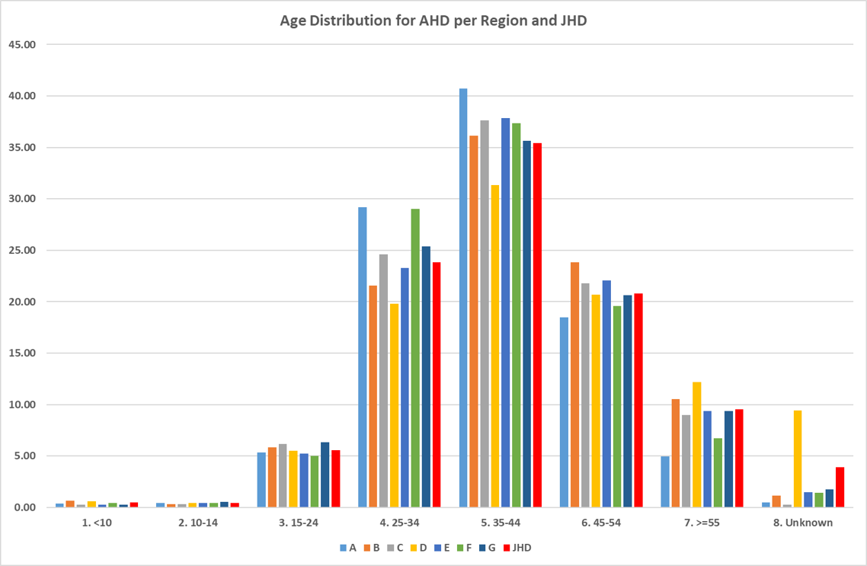
Age and Gender Distribution of AHD
AHD >20% in age 25-34
AHD>30% in age group 35-44 years
Region A highest % contribution at 40,7%
All regions but B and C showed >males vs females AHD
Region E highest at 52,9% Males vs 46% Females
M:F ratio across all CD4 specimens was 1,95:1
Females make up 62% of all specimens tested

Slide 7
Summary of findings
Conclusions | Challenges | Recommendations
JHD reported AHD in 23.6% specimens vs National level of 20,4% for 2023 Region A highest at 26,4% | Laboratory results not linked to patient care, i.e. ART status or VL failure | Continued monitoring of AHD levels in JHD at sub-district and facility level NHLS reports/dashboard development shared with JHD and regional HIV co-ordinators
AHD varied at facility level in all Regions 8 facilities with AHD levels >35% With higher levels for CD4<100, i.e. more immune compromised patients | 5% of specimens don’t have age and gender data captured | Assess contributing factors for AHD at facilities Patient loss to follow-up Reasons for late presentation especially among men
Gender and age distributions followed national trends for AHD More older males presenting with AHD |  | Encourage CD4 testing for patients failing treatment (VL>50 copies) for earlier intervention
 |  | Link clinical and laboratory data to improve management of AHD

