Slide 1





Exploring The Social Factors Contributing To HIV Prevalence Amongst African Female Migrants Residing In Hillbrow Johannesburg, South Africa
JOHANNESBURG HEALTH DISTRICT
2024 RESEARCH CONFERENCE
Dzunisani Baloyi Shikwambana
#JoburgResearch2024

Slide 2
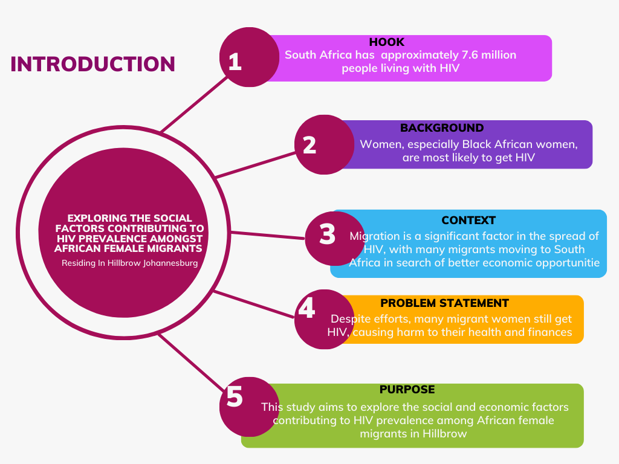
JOHANNESBURG HEALTH DISTRICT
2024 RESEARCH CONFERENCE
#JoburgResearch2024

Slide 3
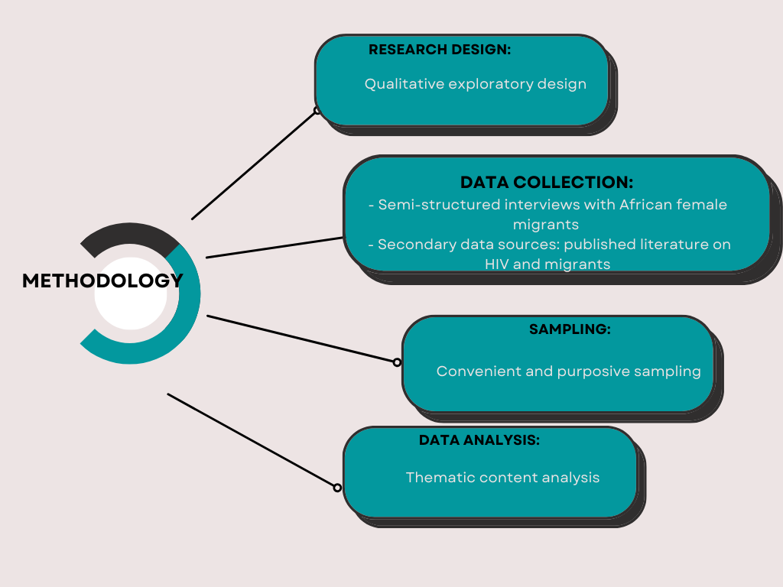
JOHANNESBURG HEALTH DISTRICT
2024 RESEARCH CONFERENCE
#JoburgResearch2024

Slide 4
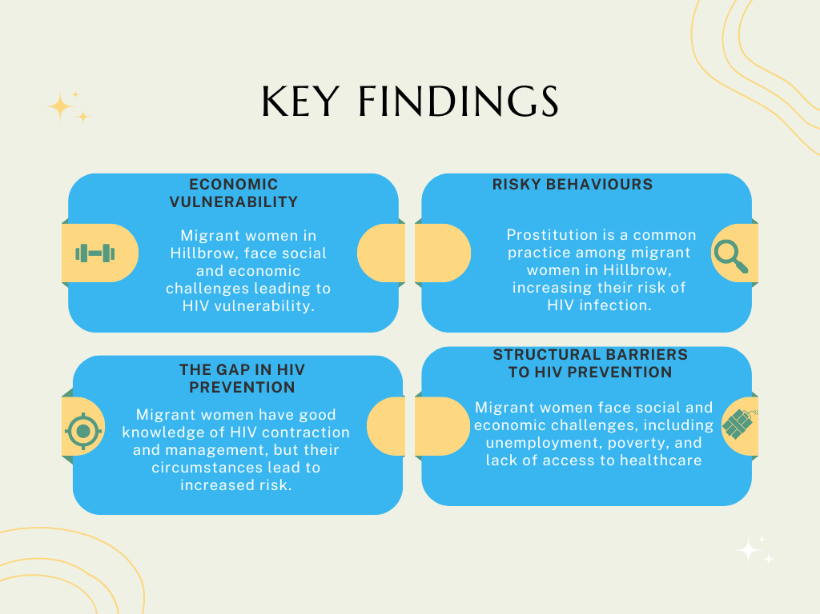
JOHANNESBURG HEALTH DISTRICT
2024 RESEARCH CONFERENCE
#JoburgResearch2024

Slide 5
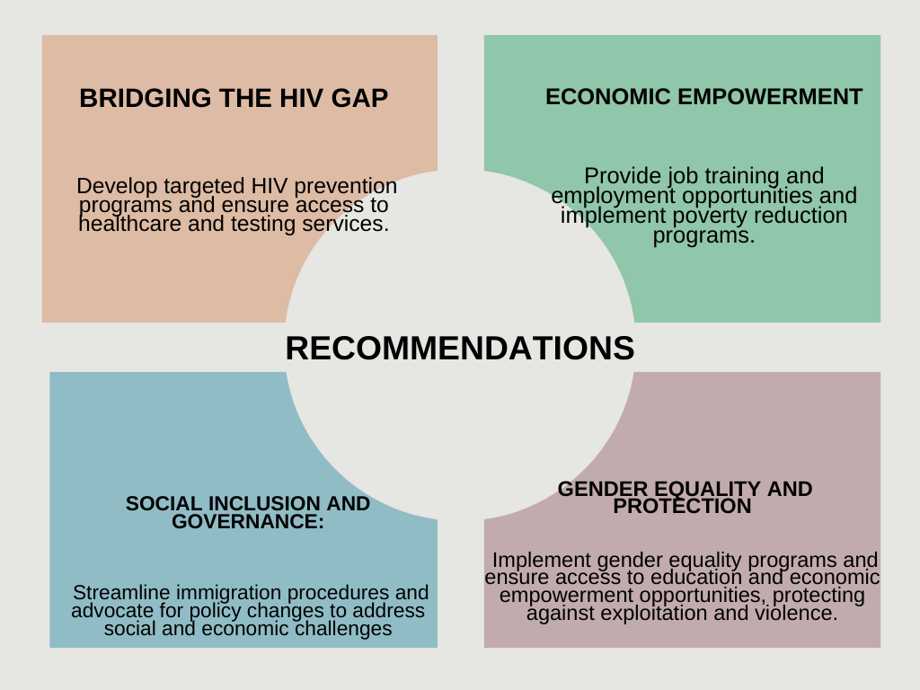
JOHANNESBURG HEALTH DISTRICT
2024 RESEARCH CONFERENCE
#JoburgResearch2024

