Slide 1






SARS-CoV-2 seroprevalence in a cohort of individuals from Gauteng and Eastern Cape, 2022 - 2023
JOHANNESBURG HEALTH DISTRICT
2024 RESEARCH CONFERENCE
Caitlyn Slabbert
28 August 2024
#JoburgResearch2024

Slide 2
Introduction
JOHANNESBURG HEALTH DISTRICT
2024 RESEARCH CONFERENCE
In December 2019, a cluster of patients with pneumonia of unknown aetiology was detected in Wuhan, China
By January 2020, a Public Health Emergency of International Concern (PHEIC) was declared the World Health Organisation (WHO) and by March 2020, it escalated into global a pandemic
Timeline of the COVID-19 pandemic – South Africa
Slide courtesy: Sue Aitken
#JoburgResearch2024

Slide 3
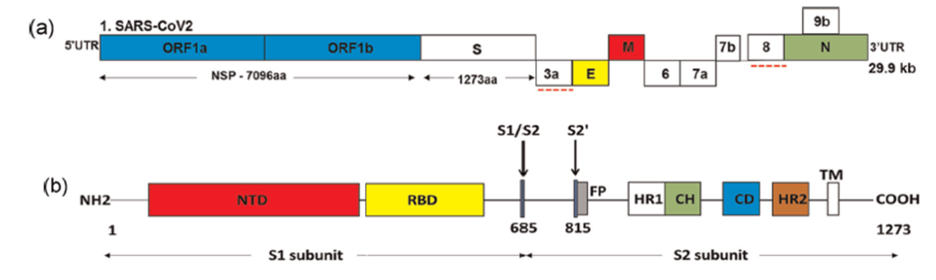
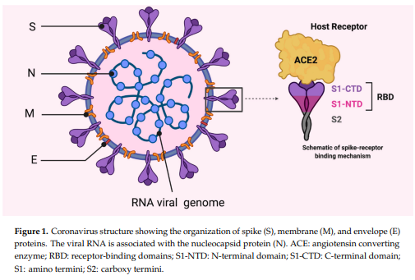
JOHANNESBURG HEALTH DISTRICT
2024 RESEARCH CONFERENCE
SARS-CoV-2: Genome and virion structure
SARS-CoV-2 spike
Most abundant protein on the surface of the virus
Binds to the host cell receptor and mediates entry into the cell
Target protein included in vaccines
Trimeric protein (3 copies of the same protein)
SARS-CoV-2 nucleocapsid
Not included in the vaccine
Indication of natural infection
Mahmood et al., 2020 Vaccines 8:443 doi:10.3390/vaccines8030443
Slide adapted: Jinal N. Bhiman
#JoburgResearch2024

Slide 4
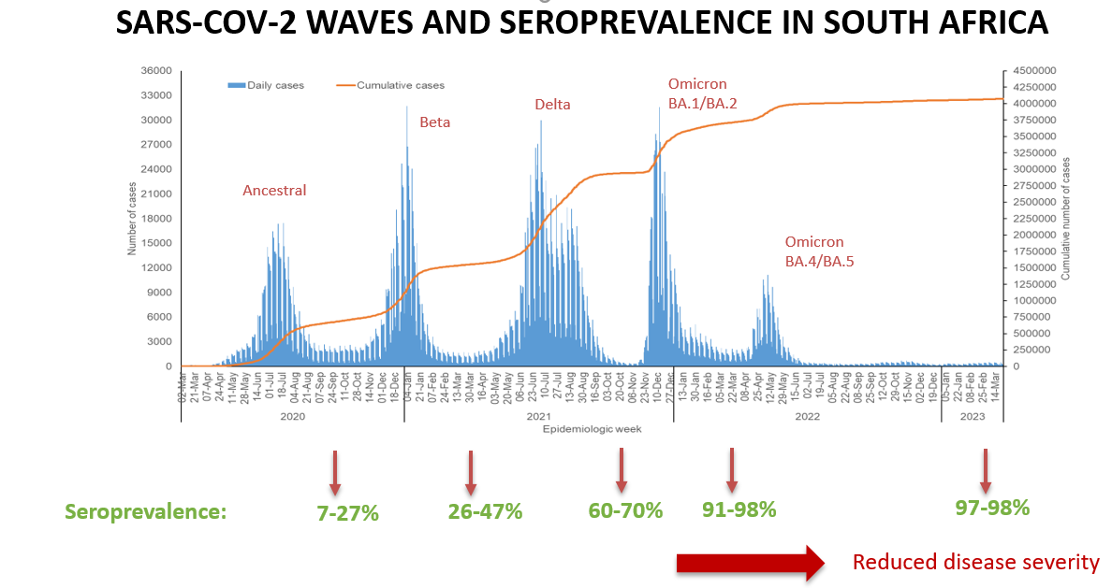
JOHANNESBURG HEALTH DISTRICT
2024 RESEARCH CONFERENCE
Slide courtesy: Nicole Wolter
#JoburgResearch2024

Slide 5
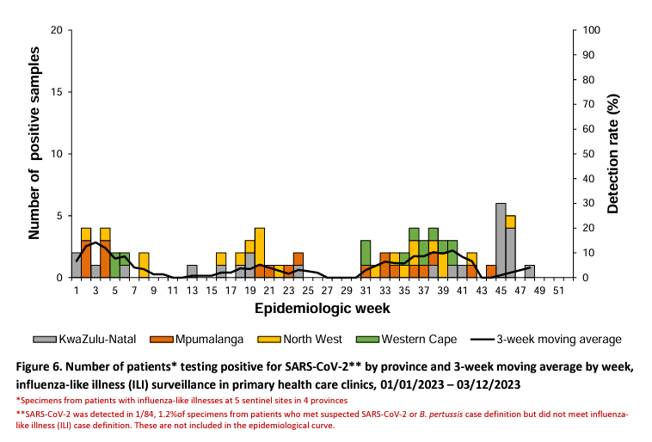
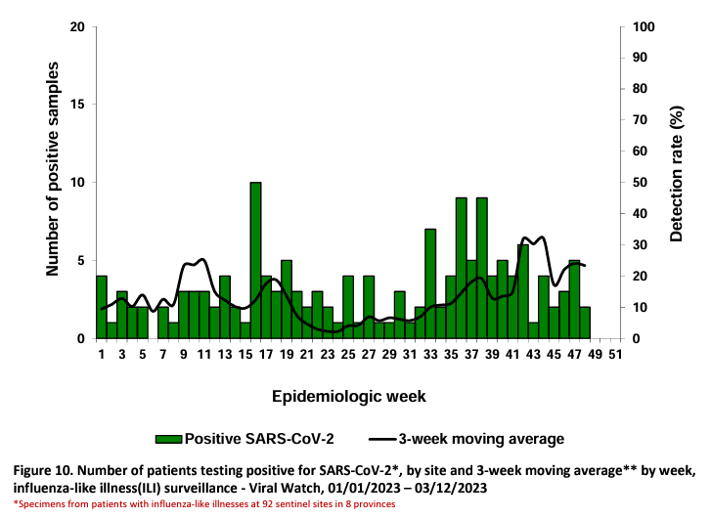
JOHANNESBURG HEALTH DISTRICT
2024 RESEARCH CONFERENCE
#JoburgResearch2024

Slide 6
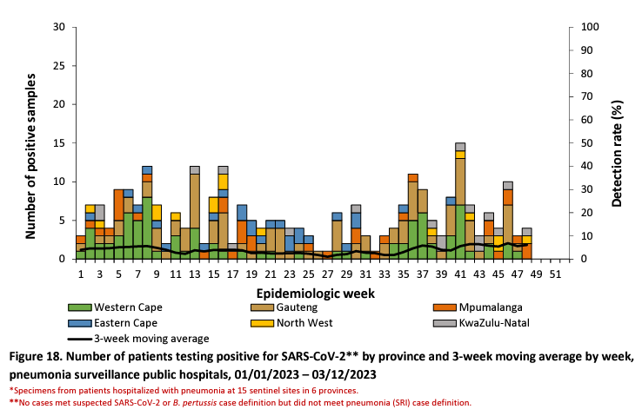
JOHANNESBURG HEALTH DISTRICT
2024 RESEARCH CONFERENCE
Weekly Respiratory Pathogens Surveillance Report available:
https://www.nicd.ac.za/diseases-a-z-index/disease-index-covid-19/surveillance-reports/weekly-respiratory-pathogens-surveillance-report-week/
#JoburgResearch2024

Slide 7
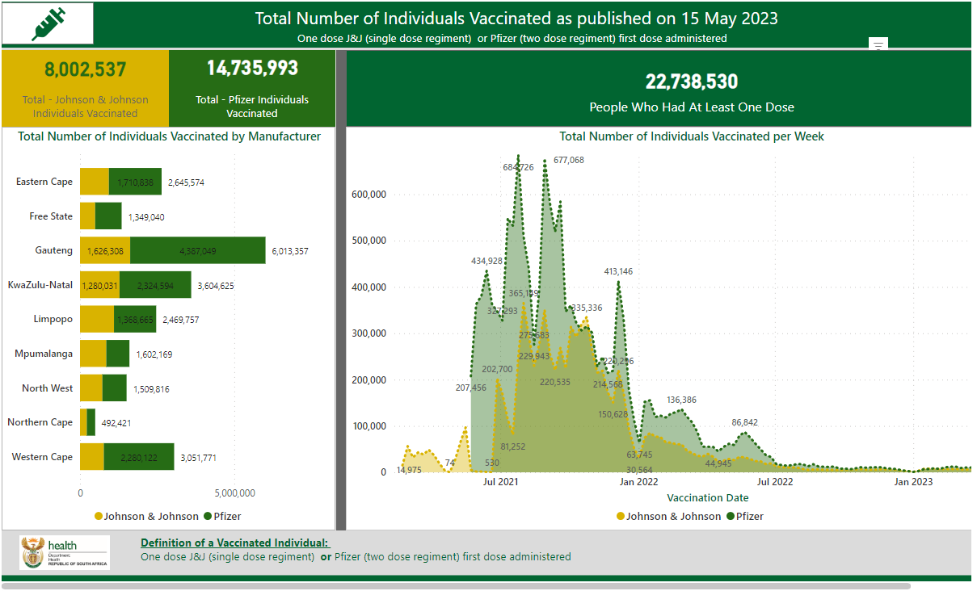
JOHANNESBURG HEALTH DISTRICT
2024 RESEARCH CONFERENCE
#JoburgResearch2024

Slide 8

JOHANNESBURG HEALTH DISTRICT
2024 RESEARCH CONFERENCE
Aim
To develop multi-pathogen immunoassays to assess the seroprevalence of SARS-CoV-2 and other pathogens of public health importance in South Africa, through repeat multi-pathogen surveys in 2022 and 2023 to guide public health decision making
Objectives
To develop and validate multi-pathogen bead-based immunoassays
To estimate the seroprevalence of SARS-CoV-2 and other pathogens of public health importance in South Africa after the fifth and subsequent SARS-CoV-2 epidemic waves through repeated longitudinal surveys
Monitor SARS-CoV-2 antibody responses due to natural infection and/or vaccination in individuals over time
#JoburgResearch2024

Slide 9
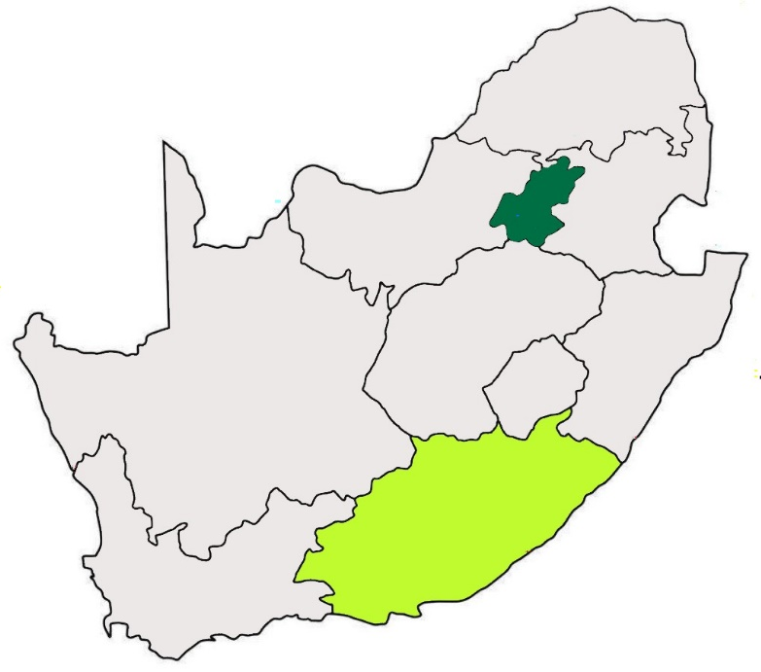


Study Design
JOHANNESBURG HEALTH DISTRICT
2024 RESEARCH CONFERENCE
Three serosurveys conducted on a cohort of individuals in two South African provinces:
Eastern Cape (predominantly rural)
Gauteng (predominantly urban)
Round 1
Round 2
Round 3
Oct 2022 – Dec 2022
Apr 2023 – Jun 2023
Oct 2023 – Dec 2023
#JoburgResearch2024

Slide 10

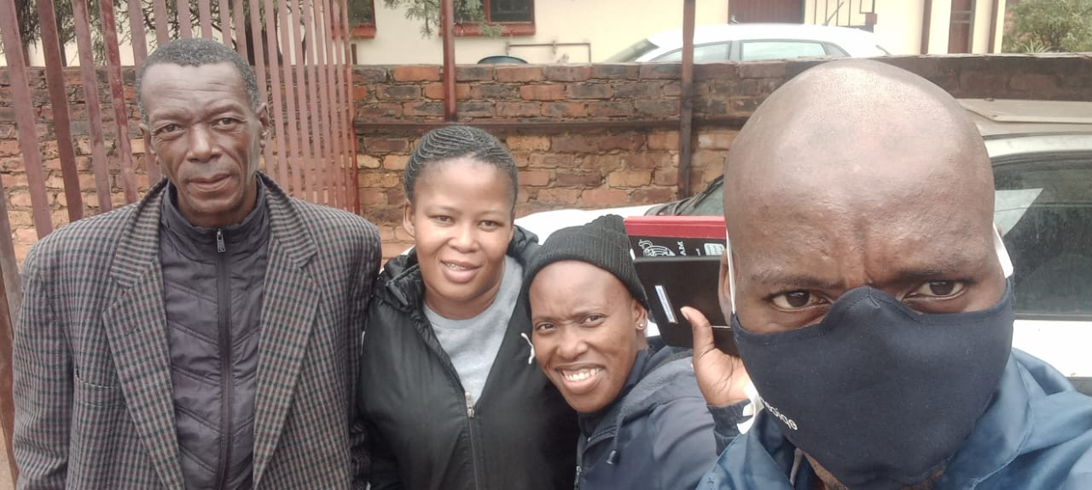

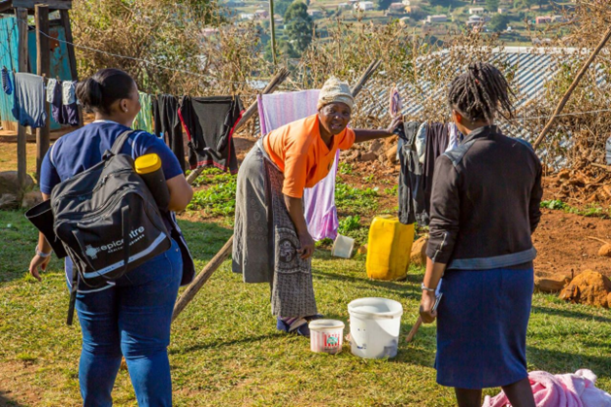
JOHANNESBURG HEALTH DISTRICT
2024 RESEARCH CONFERENCE
One individual per household was then randomly selected to participate
The participants were selected by age strata (<5, 5-12, 13-18, 19-24,25-39, 40-59 and ≥60 years) to ensure representation of all age groups.
1500 participants were selected from each province, total sample size of 3000 individuals
Each subsequent survey round aimed to achieve a follow-up rate of 80% among the cohort members
#JoburgResearch2024

Slide 11
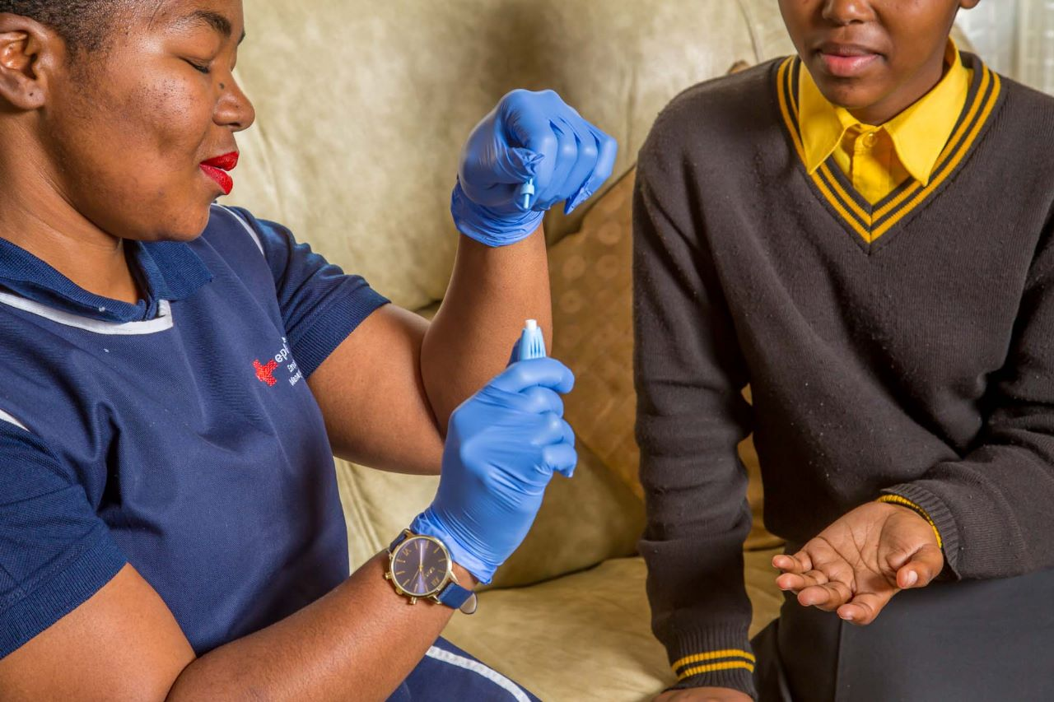
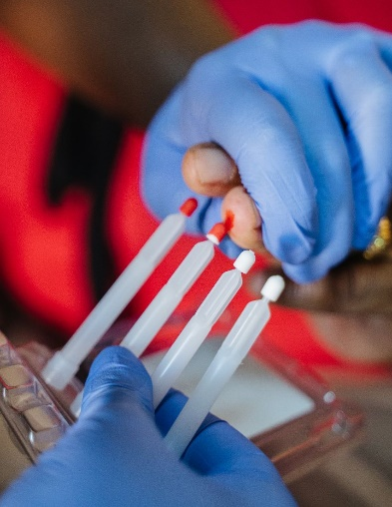
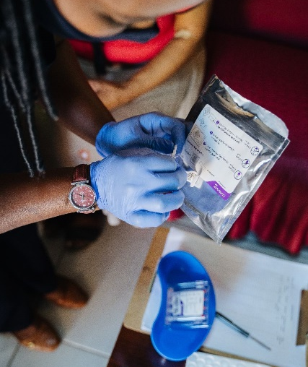
JOHANNESBURG HEALTH DISTRICT
2024 RESEARCH CONFERENCE
Data and specimen collection
Trained field workers collected participant information on demographics, underlying illness, COVID-19 and influenza vaccination history, EPI vaccination for children aged <15 years, and previous SARS-CoV-2 laboratory diagnosis.
Fieldworkers collected dried blood spot samples using a volumetric absorptive microsampling (VAMS; Mitra) device from all participants (n=3000)
#JoburgResearch2024

Slide 12
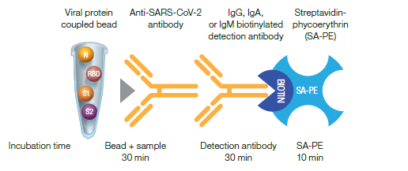
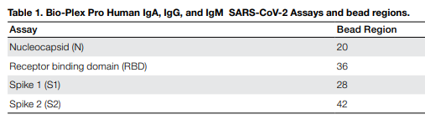
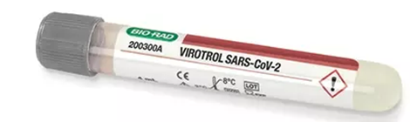

Materials and Methods
JOHANNESBURG HEALTH DISTRICT
2024 RESEARCH CONFERENCE
Bio-Plex Pro Human IgG SARS-CoV-2 N/RBD/S1/S2 serology assay (BioRad, USA) was used to measure antibody levels
#JoburgResearch2024

Slide 13
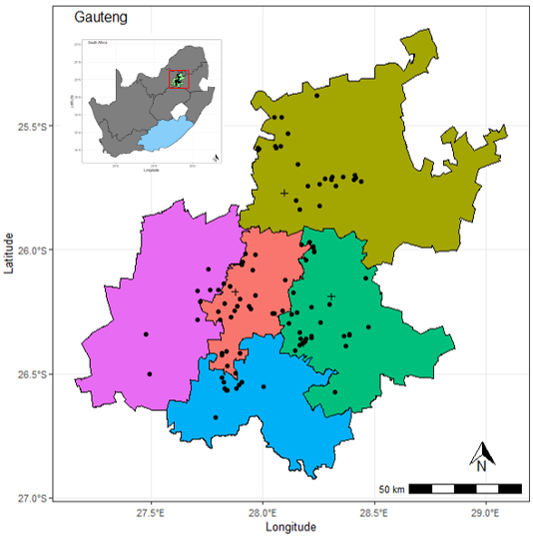
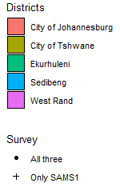
Results
JOHANNESBURG HEALTH DISTRICT
2024 RESEARCH CONFERENCE
#JoburgResearch2024

Slide 14
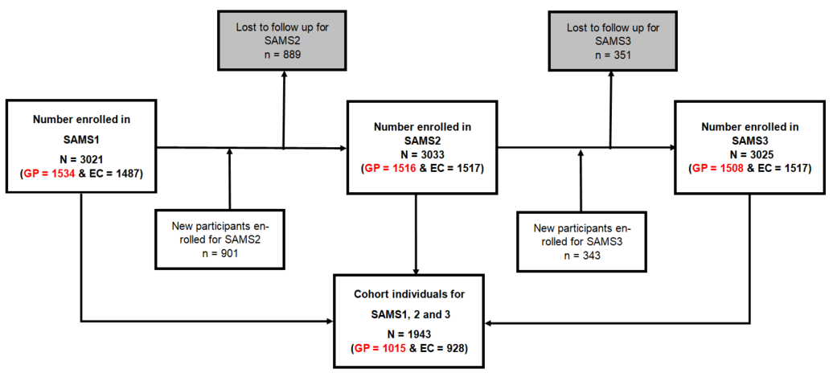
Results
JOHANNESBURG HEALTH DISTRICT
2024 RESEARCH CONFERENCE
#JoburgResearch2024

Slide 15
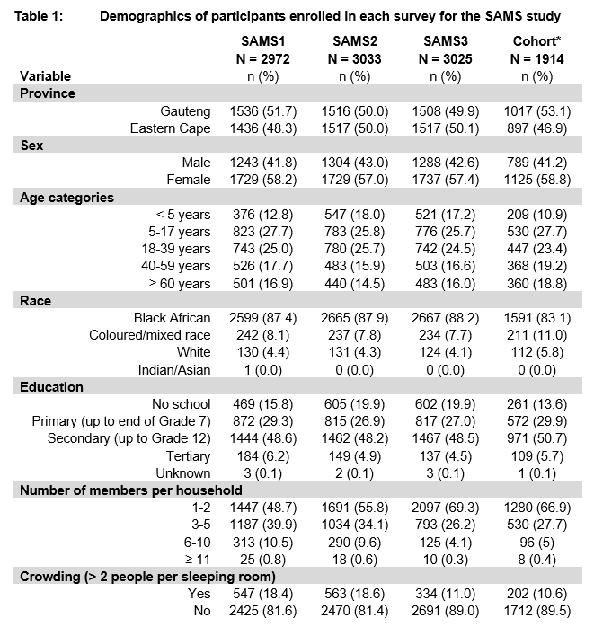
Results
JOHANNESBURG HEALTH DISTRICT
2024 RESEARCH CONFERENCE
#JoburgResearch2024

Slide 16
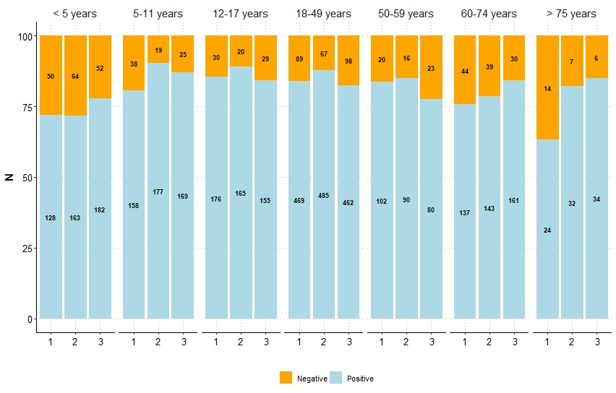
Results
JOHANNESBURG HEALTH DISTRICT
2024 RESEARCH CONFERENCE
≥
#JoburgResearch2024

Slide 17
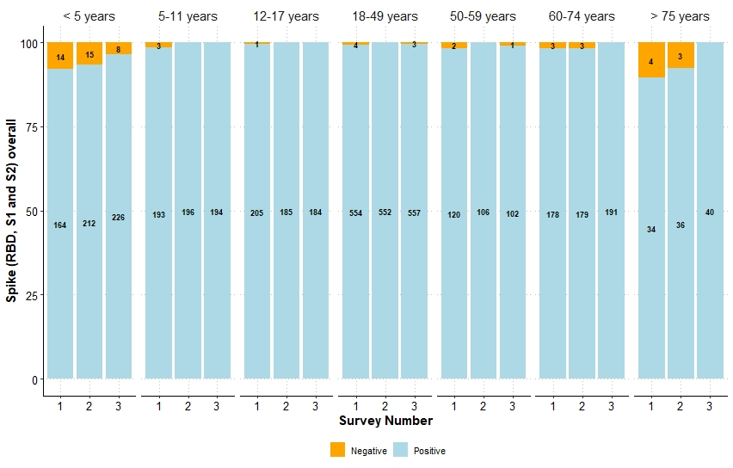
Results
JOHANNESBURG HEALTH DISTRICT
2024 RESEARCH CONFERENCE
≥
#JoburgResearch2024

Slide 18
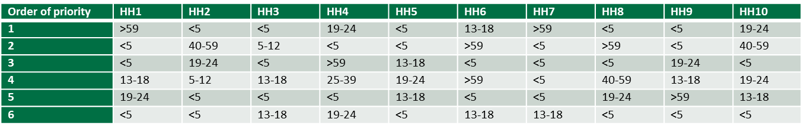
Challenges and Lessons Learned
JOHANNESBURG HEALTH DISTRICT
2024 RESEARCH CONFERENCE
Age Strata Sample target
One household member enrolled per household, with equal number of participants per age strata
Modification of the kish grid - frequency at which the age group is listed was inversely proportional to the probability of selection (HUTS data)
Towards end of fieldwork, had not met targets for children, for remaining households only enrolled children. If no children were available, we used snowball sampling:
Ask each household if they knew other households within the same ward that had children <19 years. Random selection of snowball households until sample size was met
#JoburgResearch2024

Slide 19
Challenges and Lessons Learned
JOHANNESBURG HEALTH DISTRICT
2024 RESEARCH CONFERENCE
Accessing vaccination records to confirm status
Road to health card (RTHC) required for each child aged <15 years to confirm vaccinations
Availability of RTHCs was poor for SAMS1, especially in children >5 years of age
Contact details collected in SAMS1, and households were followed up during SAMS1 to ask if the RTHC had been located
In SAMS2 and 3, households were contacted before being visited and requested to have the RTHC available for the visit, which greatly improved the availability of RTHCs
#JoburgResearch2024

Slide 20
Conclusions
JOHANNESBURG HEALTH DISTRICT
2024 RESEARCH CONFERENCE
Seroprevalence to SARS-CoV-2 remains high post pandemic which is likely due to ongoing circulation of SARS-CoV-2 in communities.
Future SARS-CoV-2 serosurveys are most useful if done as longitudinal studies using quantitative assays
VAMS devices offer an easy-to-use and convenient specimen collection method that perform well in laboratory testing, BUT the establishment of comparable cut-offs with serum needs to be addressed
#JoburgResearch2024

Slide 21




Acknowledgements
JOHANNESBURG HEALTH DISTRICT
2024 RESEARCH CONFERENCE
The participants who have agreed to be part of the study
Department of Health and district counsellors for supporting this research
The Epicentre data and field work teams (Cherie Cawood and David Khanyile)
The Genesis team (Sue Aitken, Tamika Fellows, and Sinalo Gqunu)
Amelia Buys, Wilhelmina Ubbink, Cayla Reddy, Kerry Ann Padayachee, Michaela Davids, Nokuthula Linda and Zenzile Tshabalala of the Centre for Respiratory Diseases and Meningitis, NICD
Collaborators and co-investigators: Cheryl Cohen (CRDM), Nicole Wolter (CRDM), Anne von Gottberg (CRDM), Sibongile Walaza (CRDM), Jackie Kleynhans (CRDM), Jocelyn Moyes (CRDM), Mignon du Plessis (CRDM), Fahima Moosa (CRDM), Penny Moore (CHIVSTIs), Jinal Bhiman (CHIVSTI), Harry Moultrie (CTB), Kerrigan McCarthy (CVI), Nishi Prabdial-Sing (CVI), Jimmy Khosa, Yannik Roell (University of Colorado, USA)
This work was supported by the Bill and Melinda Gates Foundation (Grant number: INV-039758)
#JoburgResearch2024

