Slide 1






Factor Structure and Concurrent Validity of the Severity of Violence Against Women Scale in South Africa
Amy Zheng, Anthony J. Rosellini, Jeremy C. Kane, Kristina Metz, Srishti Sardana, Ross Greener, Sithabile Mngadi, Pertunia Manganye, Lawrence C. Long, Donald M. Thea, Laura Murray, Matthew Fox, Mwamba Mwenge, Saphira Munthali-Mulemba, Sophie Pascoe
Johannesburg Health District Research Conference
Notes:
Hello everyone, my name is Amy Zheng and I am excited to present this work on behalf of my co-authors.

Slide 2
Background
Intimate Partner Violence
  50% of women in South Africa have reported lifetime experiences of physical and/or sexual intimate partner violence
  18% of women in South Africa have reported intimate partner violence in the last 12 months
Notes:
Intimate partner violence (IPV) is defined as physical, sexual, emotional, and/or psychological abuse and violence within a partnership. Specifically in the context of South Africa 50% of women have ever reported experiencing IPV and 18% have reported experiencing IPV within the last 12 months.

Slide 3
Background
Underreporting of intimate partner violence
  Sensitive nature of the topic
  Stigma
  Lack of services available leading to missed diagnoses
Notes:
However IPV is frequently underreported for a variety of reasons

Slide 4
Background
Underreporting of intimate partner violence because…
  Sensitive nature of the topic
  Stigma
  Lack of services available leading to missed diagnoses
United Nations Sustainable Development Goal 5: Achieving gender equality ad empowering women and girls by 2030
  Reducing intimate partner violence is key to achieving this goal
Notes:
As part of the UN’s SDGs, Goal 5 is achievement of gender equality. Given these factors, accurate identification and assessment of IPV is key to helping women reduce their experiences of IPV, which will be instrumental in achieving this goal.

Slide 5
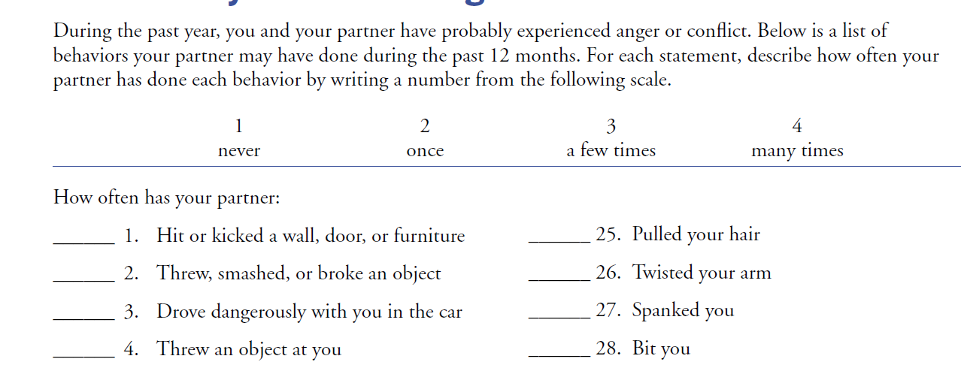
Severity of Violence Against Women Scale
46-item questionnaire
Evaluates the frequency of threats and violence perpetrated by a woman’s partner over the past year
Notes:
One such tool to identify and assess IPV is the SVAWS. It is a 46-item questionnaire that evaluates the frequency of threats and violence perpetrated by a woman’s partner over the past year. For context, this scale was created in the US and the experiences of IPV is highly dependent on cultural context. Therefore, our goal was to evaluate whether this scale would be appropriate to use within the South African Context.

Slide 6

Methods
Study Population
  Women
    Living with HIV and initiated onto ART
    Receiving HIV care from Zola Clinic in Soweto and Themba Lethu Clinic at Helen Joseph Hospital
    Enrolled in randomized control trial evaluating the effect of a mental health intervention

Slide 7
Methods
Study Population
  Women living with HIV and initiated onto ART
    Receiving HIV care from Zola Clinic in Soweto and Themba Lethu Clinic at Helen Joseph Hospital
    Enrolled in randomized control trial evaluating the effect of a mental health intervention
Exploratory Factor Analysis – Evaluate how questions are correlated with one another to form sub-scales

Slide 8
Findings
“Simple Assault” – Actions of mild assault/threats
    Threatening you, property, etc.
    Grabbing, hitting, punching, etc.
Notes:
Based on the analysis, we found 3 sub-types of violence. The first dimension we defined as “simple assault” therefore women who reported instances of being threatened were also more likely to report instances of being grabbed, hit, punched, etc.

Slide 9
Findings
“Simple Assault” – Actions of mild assault/threats
    Threatening you, property, etc.
    Grabbing, hitting, punching, etc.
“Aggravated Assault” – Acts of violence with objects like sticks or weapons
    Threatening you with an object
    Using a knife or gun
Notes:
The second dimension of violence was “Aggravated Assault” which largely encompasses the threat and violent acts with objects like sticks or weapons. So women who reported being threatened with an object were more likely report their partner using a weapon such as a gun on them.

Slide 10
Findings
“Simple Assault” – Actions of mild assault/threats
    Threatening you, property, etc.
    Grabbing, hitting, punching, etc.
“Aggravated Assault” – Acts of violence with objects like sticks or weapons
    Threatening you with an object
    Using a knife or gun
Sexual Violence
Notes:
The final dimension of violence was sexual violence which encompasses sexual activity such as demanding sex and intercourse, oral, and anal sex against the person’s will

Slide 11
Key Takeaways
Findings suggest SVAWS is appropriate to use within the South African context and able to capture how violence is acted out and defined
SVAWS could be used as a potential tool to help identify women who are experiencing intimate partner violence and link them to services
“Aggravated Assault” as a construct is important given South Africa’s high rates of gun ownership
Notes:
Based on these results we found that SVAWS was appropriate to use within the South African context despite initially being created for a US context. It was able to identify three key constructs of how violence is perpetrated
This is especially important as gun ownership within South Africa is highly prevalence and the literature demonstrates a clear link between gun ownership and increased risk of violence against women

Slide 12
Thank you!

