Slide 1





“Improving Cancer Awareness and Knowledge in Johannesburg and iLembe Districts through a Tailored Community-Based Educational Intervention ”
JOHANNESBURG HEALTH DISTRICT
2024 RESEARCH CONFERENCE
Sr. Sibongile Ramotshela
Date : 28 August 2024
#JoburgResearch2024

Slide 2
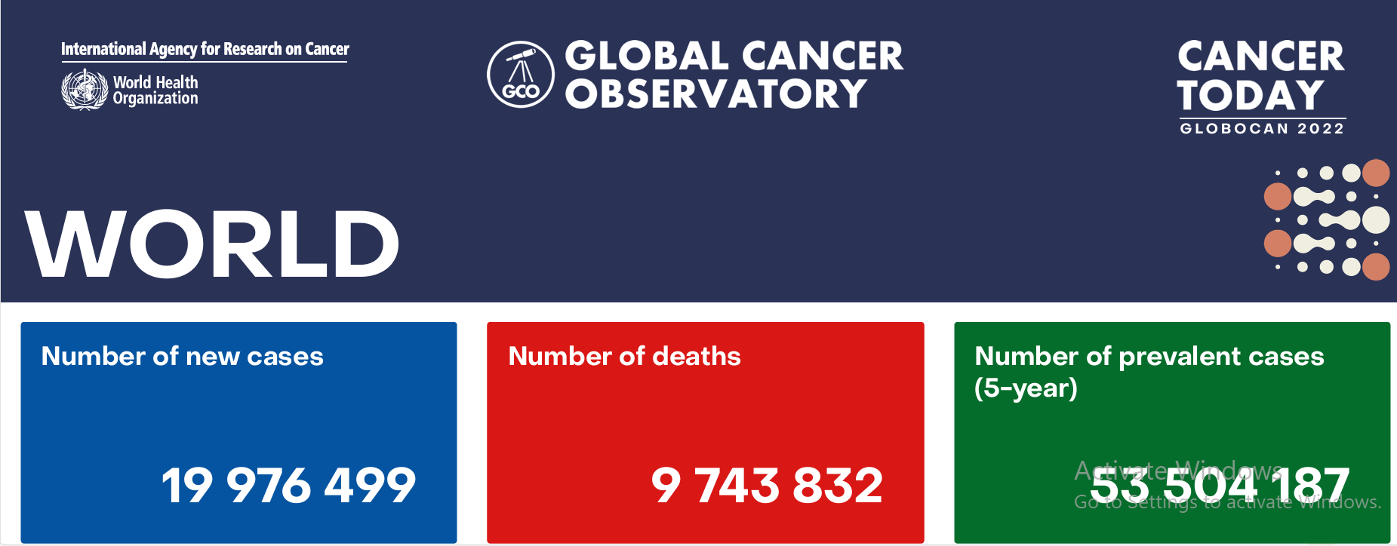
Context: Global challenge of cancer and its impact worldwide
JOHANNESBURG HEALTH DISTRICT
2024 RESEARCH CONFERENCE
Cancer is a leading cause of death globally, with an estimated 19.3 million new cases and nearly 10 million deaths in 2022 alone.
The disease burden is not uniformly distributed; low- and middle-income countries (LMICs) like SA bear the brunt of the global cancer burden, accounting for approximately 70% of cancer deaths.
The need for effective cancer control measures, including prevention, early detection, and treatment, is critical in reducing the global cancer burden.
However, significant disparities exist in the availability and accessibility of these services, particularly in resource-limited settings.
#JoburgResearch2024

Slide 3
The role of PHC and disparities in cancer care
JOHANNESBURG HEALTH DISTRICT
2024 RESEARCH CONFERENCE
In South Africa, cancer presents a significant public health challenge, exacerbated by the country's socio-economic disparities.
The healthcare system, heavily relies on Primary Health Care (PHC) which faces challenges in providing comprehensive cancer care.
PHC services are the frontline of healthcare delivery, especially in rural and underserved areas, making them crucial for early detection of cancer.
However, disparities in cancer care, such as limited access to screening, diagnostic services, and specialized treatment, are prevalent.
Addressing these disparities through community-based interventions is essential to improving cancer outcomes in South Africa.
#JoburgResearch2024

Slide 4
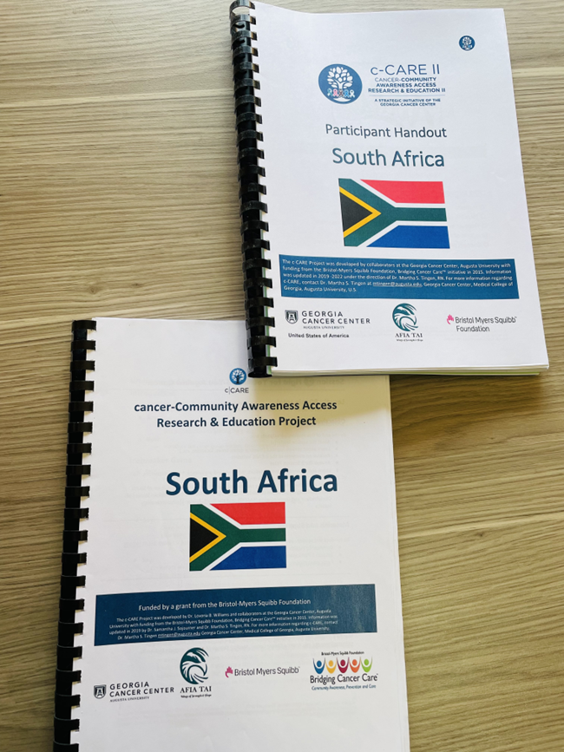
Study Objective
JOHANNESBURG HEALTH DISTRICT
2024 RESEARCH CONFERENCE
This study aimed to bridge the cancer care gap by adapting the Georgia Centers’ Cancer-Community Awareness Access Research & Education (c-CARE) module to the South African context.
The c-CARE module, originally developed to improve cancer awareness and access to care in the United States, was tailored to meet the unique cultural, linguistic, and healthcare needs of communities in Johannesburg and iLembe Districts.
By training traditional health practitioners, community health workers, and faith-based leaders and traditional health practitioner's, the study sought to enhance cancer awareness, promote early detection, and improve access to cancer care services at the community level.
#JoburgResearch2024

Slide 5
Methods
JOHANNESBURG HEALTH DISTRICT
2024 RESEARCH CONFERENCE
The adaptation process employed a seven-step approach to tailor the program for use in new contexts.
Structured surveys were administered before the training sessions to evaluate participants' knowledge both prior to and following the training with the adapted module.
Data collection was facilitated through REDCap tools, and the analysis was performed using Stata 13.1.
The survey encompassed 107 participants, with a median age of 48 years for females and 51 years for males.
#JoburgResearch2024

Slide 6
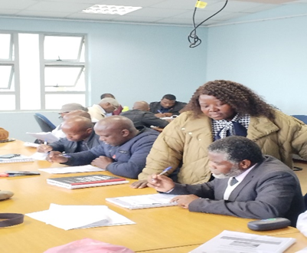
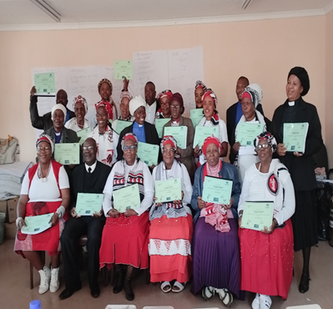
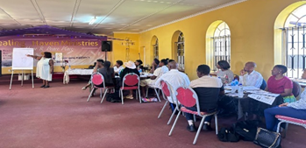
Training and mentorship
From January 2023 to February 2024, the project trained 107 participants, including traditional health practitioners (THPs), community health workers (CHWs), faith-based organizations (FBOs), and health professionals.
Of these, 73 participants implemented the project, conducting community awareness activities and receiving mentorship.
A total of 31 mentorship sessions were held in various settings, including churches, schools, old age homes, and clinics, reaching 19,537 people.
These sessions led to 4,133 screenings for PSA, Pap smears, and breast tests, with 512 individuals referred to health facilities for further care.

Slide 7
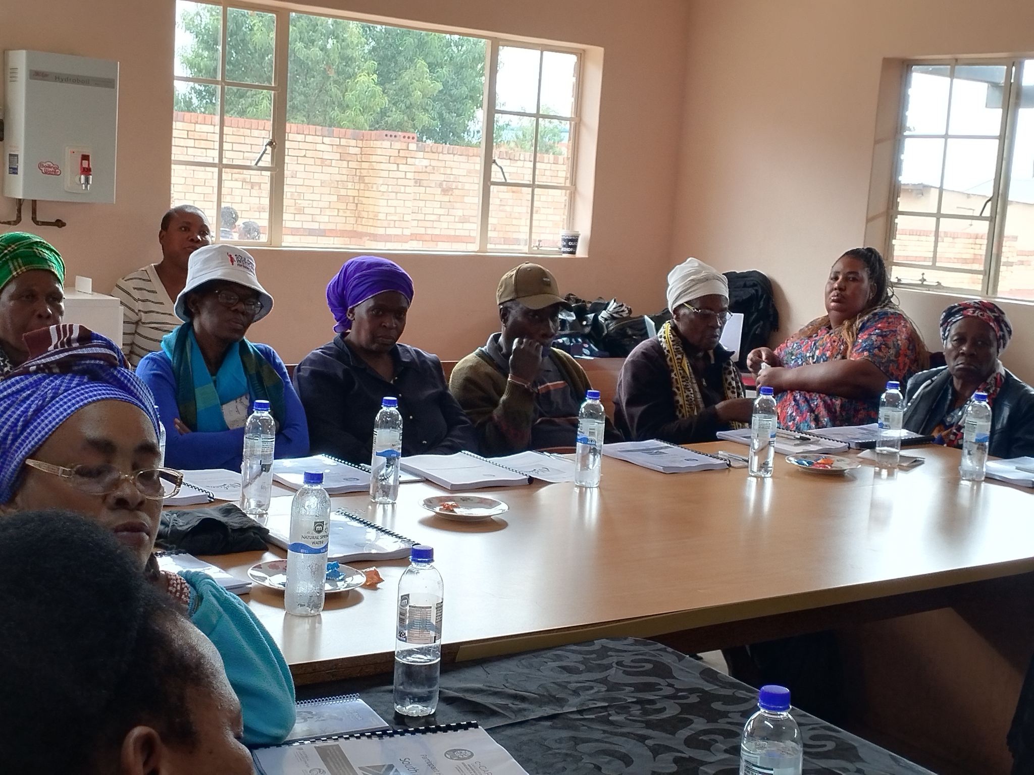
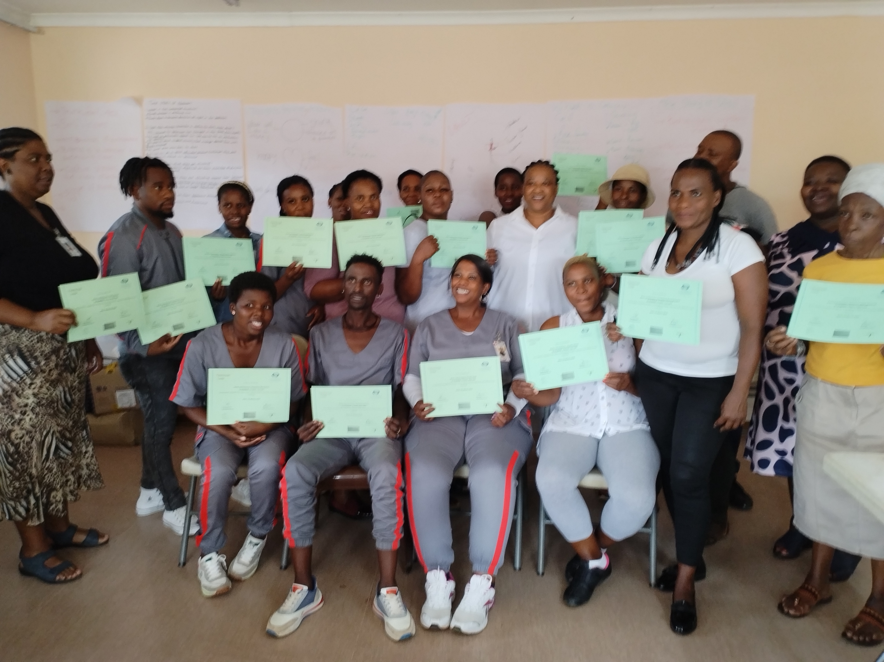
Results
JOHANNESBURG HEALTH DISTRICT
2024 RESEARCH CONFERENCE
The c-CARE module was adapted for the South African context, required extensive cultural and linguistic adjustments.
Key changes included streamlining cancer screening recommendations, restructuring the lung cancer module to incorporate tobacco cessation, simplifying the hormone section in the breast cancer module, and adding cervical cancer and snuff use due to local prevalence.
A significant proportion of participants had attained secondary or higher education (90.7% of females and 74.6% of males, P<0.001).
Pre- and post-training surveys revealed significant improvements in cancer awareness and knowledge among participants in Gauteng and KwaZulu-Natal.
For example, awareness of multiple myeloma increased by 70% (from 26.7% to 96.7%), prostate cancer awareness rose from 52.5% to 98.3%, and lung cancer awareness increased by 22.4% (from 74.3% to 96.7%).
Breast cancer awareness improved from 93.4% to 98.7%, and cervical cancer awareness grew from 84.8% to 96.0%, with better understanding of HPV. However, despite these gains, there remain persistent fears around cancer screening.
#JoburgResearch2024

Slide 8
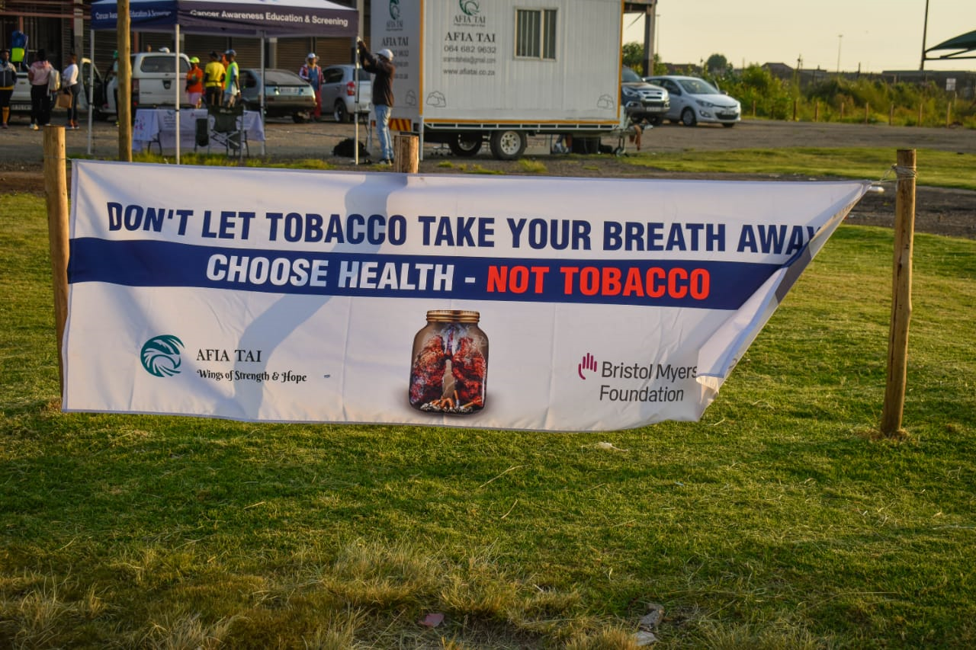
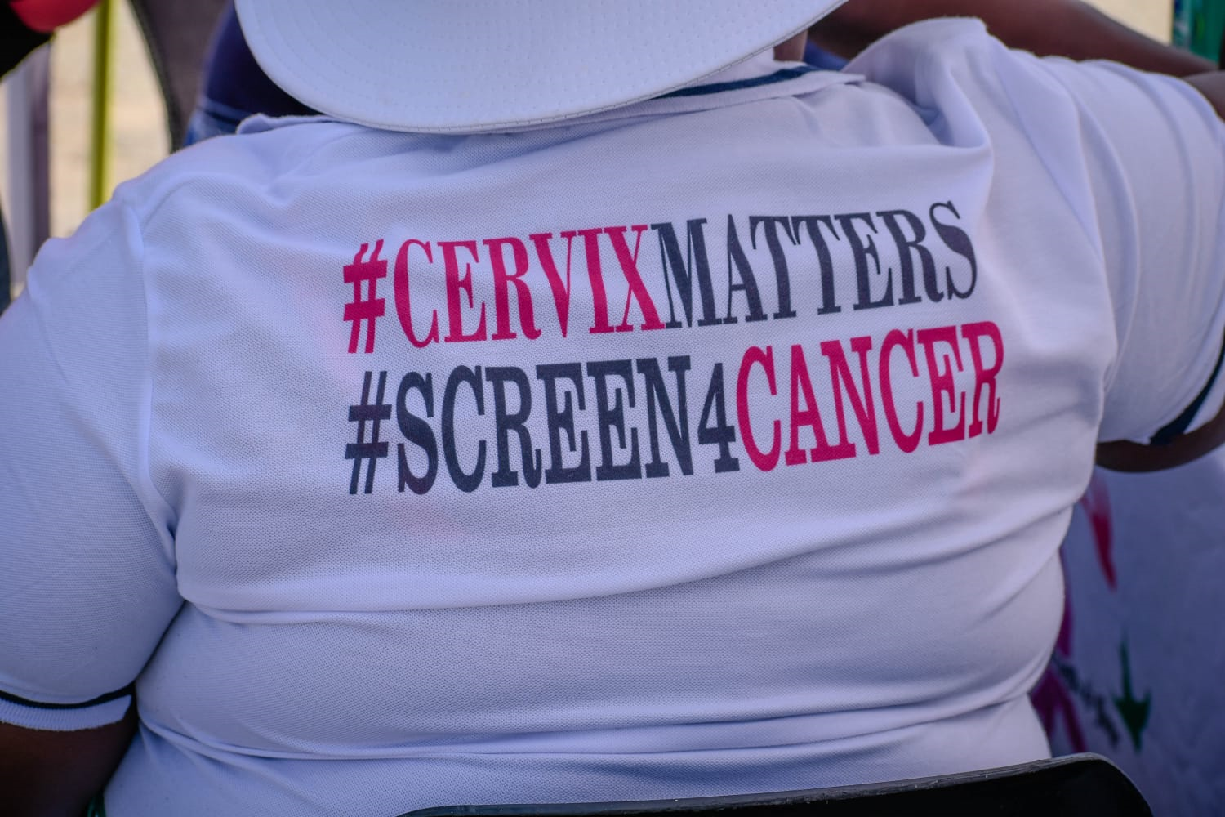
Recommendations for the Johannesburg District
JOHANNESBURG HEALTH DISTRICT
2024 RESEARCH CONFERENCE
Strengthen Community-Based Education
Enhance Training and Mentorship Programs to CHWs. THPs and FBL
Incorporate cancer screening to CHWs data collection tools.
Address Persistent Fears, stigma and Stigmas related to cancer at community level.
PHC Facilities:
Strengthen partnerships between community-based initiatives and healthcare facilities to ensure seamless referrals and follow-up care for individuals identified during screenings.
#JoburgResearch2024

Slide 9


