Slide 1










HIV treatment adherence challenges in postpartum women living with HIV in the OPPTIM Study, Johannesburg, South Africa
JOHANNESBURG HEALTH DISTRICT
2024 RESEARCH CONFERENCE
Lee Fairlie, Shobna Sawry, Sherri Pals, Gayle Sherman, Jean Le Roux, Bernadette Ngeno, Leigh Berrie, Karidia Diallo, Mackenzie Hurlston Cox, Mary Mogashoa, Surbhi Modi for the OPPTIM (Optimised Postpartum PMTCT Testing for Infants and their Mothers) Study Team
#JoburgResearch2024

Slide 2
Background
JOHANNESBURG HEALTH DISTRICT
2024 RESEARCH CONFERENCE
Adherence to HIV treatment is challenging for postpartum women living with HIV (WLHIV) and viral load non-suppression and loss to follow-up is frequent.
Suboptimal adherence results in an increased viral load (VL) with risks for vertical and horizontal HIV transmission to their infant.
We used data from the OPPTIM study to describe HIV treatment adherence in postpartum WLHIV.
The OPPTIM (Optimised Postpartum PMTCT Testing for Infants and their Mothers) clinical trial in Johannesburg, South Africa, was designed to evaluate adherence to ART and factors associated with sub-optimal adherence, to improve postnatal PMTCT outcomes.
We used PCR point-of-care testing (POCT) in a randomised non-blinded operational clinical trial in two primary health facilities in Johannesburg, South Africa, and describe participants’ adherence to HIV treatment
#JoburgResearch2024

Slide 3
Methods
JOHANNESBURG HEALTH DISTRICT
2024 RESEARCH CONFERENCE
Enrolment:
Between July 2018–April 2019
Sites: Esselen Street Clinic & Hillbrow CHC
405 postpartum WLHIV aged ≥18 years and their HIV-negative infants (PCR-confirmed at enrolment) were enrolled at their 6–14-week immunization visits
Randomisation - 2 arms.
204 women to Arm 1 - standard-of-care (SOC) laboratory-based VL testing at enrolment, 6, 12 and 18 months.
201 women to Arm 2 - SOC laboratory-based VL testing plus additional POC GeneXpert HIV-1 VL testing at enrolment, 6, 9, 12, 15 and 18 months.
All infants had SOC HIV tests plus POC GeneXpert HIV-1 Qual testing (early infant diagnosis (EID) POCT) at 6, 9, 12, 15 and 18 months.
Questionnaire
Sociodemographic and adherence questionnaires (30-day visual analog scale with <95% considered sub-optimal adherence) administered at each visit.
Analysis
Multiple logistic regression model examining risk factors for sub-optimal adherence at each visit, with standard errors for the model adjusted for correlation among multiple visits for each woman
#JoburgResearch2024

Slide 4
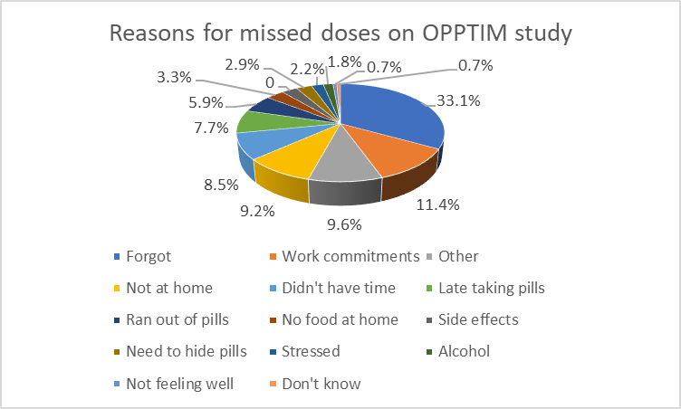
Results – Sub-optimal adherence (<95%)
JOHANNESBURG HEALTH DISTRICT
2024 RESEARCH CONFERENCE
405 WLHIV participants, 1445 visits
arm 1, 204; arm 2, 201
Sub-optimal adherence - at 306 (21.2%) visits,
no statistically significant difference between arms.
Main reasons for <95% adherence at any visit:
forgetting (33.1%)
work commitments (11.4%)
not being at home (9.2%)
insufficient time (8.5%)
taking medication late (7.7%) (Figure)
Visit where <95% adherence reported
38/299 (12.7%) had a VL ≥1000 cps/ml
114/299 (38.1%) had VL ≥50 copies/ml
Visits with ≥95% adherence reported
63/1123 (5.6%) had VL ≥ 1000copies/ml
329/1123 (29.3%) had VL ≥50 copies/ml
#JoburgResearch2024

Slide 5
Results – Risk factors for sub-optimal adherence
JOHANNESBURG HEALTH DISTRICT
2024 RESEARCH CONFERENCE
Variable | N (%) with <95% adherence | Unadjusted OR (95% CI) | Adjusted OR (95% CI)
Country of birth
South Africa | 150 (23.9) | 1.36 (0.97, 1.92) | 1.35 (0.95, 1.92)
Other | 156 (19.1) | ref | ref
Married
Yes | 109 (17.4) | 0.77 (0.53, 1.12)
No | 89 (21.6) | ref
Employed
Yes | 207 (22.8) | 1.41 (1.05, 1.90) | 1.40 (1.01, 1.94)
No | 99 (18.4) | ref | ref
Trimester of antenatal care
First | 102 (19.0) | 0.46 (0.26, 0.82) | 0.44 (0.25, 0.78)
Second | 164 (20.9) | 0.51 (0.30, 0.88) | 0.50 (0.29, 0.86)
Third or none | 40 (32.5) | ref | ref
Breastfeeding
Yes | 250 (20.2) | 0.61 (0.43, 0.86) | 0.63 (0.43, 0.93)
No | 56 (27.5) | ref | ref
ART before Pregnancy
Yes | 131 (17.2) | ref
No | 135 (25.6) | 1.70 (1.18, 2.45)
Unknown | 40 (25.5) | 1.62 (0.96, 2.72)
Intimate partner violence
Yes | 25 (32.1) | 1.72 (1.07, 2.78) | 1.52 (0.92, 2.53)
No or no partner | 275 (20.3) | ref | ref
Non-monogamous partner
Yes | 44 (27.2) | 1.42 (0.98, 2.08) | 1.60 (1.08, 2.36)
No or no partner | 262 (20.4) | ref | ref
Risk factors for sub-optimal adherence:
Being employed
Having a non-monogamous partner.
Protective factors for sub-optimal adherence:
Breastfeeding
first/second trimester ANC first booking
#JoburgResearch2024
Notes:
Perceived advantages of same-day on-site VL POCT included: feeling they were doing very well with their treatment (49%); knowing VL sooner (46%); and providing peace of mind (41%).
These perceptions are further illustrated in the Word cloud visualisation of free text responses from participants regarding POC testing for themselves and their infants, indicating frequency of usage of words.

Slide 6
Conclusions & Recommendations
JOHANNESBURG HEALTH DISTRICT
2024 RESEARCH CONFERENCE
WLHIV reported sub-optimal adherence at 21.2% of visits, with reasons representing complexities faced by postpartum women.
Additionally, almost one-third of WLHIV reporting ≥95% adherence had VL≥ 50 copies/ml, which suggests that reliance on self-reported adherence is insufficient.
VL monitoring and adherence support is essential in the postpartum period where risks for sub-optimal adherence and VL non-suppression are high.
At the time of enrollment, all women were receiving an efavirenz-based regimen. Efavirenz has a low genetic barrier to resistance – need to explore effects of sub-optimal adherence among WLHIV on DTG-based regimens.
Efforts to improve adherence, VL suppression, and engagement in care remain important in postpartum women, especially those who seek antenatal care late in pregnancy.
Challenges:
High attrition rate, with 38% of women discontinuing the study before 18 months of follow-up, reducing generalizability of the study findings. It is likely that women who were lost to follow-up were at particularly high risk of virologic nonsuppression, VF, and potentially resistance
#JoburgResearch2024

Slide 7
Thank you
JOHANNESBURG HEALTH DISTRICT
2024 RESEARCH CONFERENCE
The participants and their children who have given their time to participate in the study
The OPPTIM study team
Funders
Co-authors
#JoburgResearch2024

