Slide 1










Perception and acceptability of point-of-care HIV viral load and early infant HIV testing among postpartum women living with HIV in Johannesburg, South Africa
JOHANNESBURG HEALTH DISTRICT
2024 RESEARCH CONFERENCE
Shobna Sawry, Jean Le Roux, Bernadette Ng’eno, Sherri Pals, Surbhi Modi, Gayle Sherman, Leigh Berrie, Karidia Diallo, Mackenzie Cox, Mary Mogashoa & Lee Fairlie
#JoburgResearch2024

Slide 2
Background
JOHANNESBURG HEALTH DISTRICT
2024 RESEARCH CONFERENCE
Although prevention of mother-to-child transmission of HIV (PMTCT) interventions have been remarkably successful in reducing the number of children infected with HIV and improving maternal health, some gaps remain.
To prevent vertical HIV transmission, optimised viral load (VL) monitoring among postpartum women living with HIV (WLHIV) and infant HIV testing are essential.
The OPPTIM (Optimised Postpartum PMTCT Testing for Infants and their Mothers) clinical trial in Johannesburg, South Africa, was designed to evaluate approaches to maternal viral load (VL) monitoring and infant HIV testing strategies to improve postnatal PMTCT outcomes.
We used PCR point-of-care testing (POCT) in a randomised non-blinded operational clinical trial in two primary health facilities in Johannesburg, South Africa, and describe participants’ acceptance, and perception of advantages and usefulness of POCT.
#JoburgResearch2024

Slide 3
Methods
JOHANNESBURG HEALTH DISTRICT
2024 RESEARCH CONFERENCE
Enrolment:
  Between July 2018–April 2019
  Sites: Esselen Street Clinic & Hillbrow CHC
  405 postpartum WLHIV aged ≥18 years and their HIV-negative infants (PCR-confirmed at enrolment) were enrolled at their 6–14-week immunization visits
Randomisation - 2 arms.
  204 women to Arm 1 - standard-of-care (SOC) laboratory-based VL testing at enrolment, 6, 12 and 18 months.
  201 women to Arm 2 - SOC laboratory-based VL testing plus additional POC GeneXpert HIV-1 VL testing at enrolment, 6, 9, 12, 15 and 18 months.
  All infants had SOC HIV tests plus POC GeneXpert HIV-1 Qual testing (early infant diagnosis (EID) POCT) at 6, 9, 12, 15 and 18 months.
Questionnaire
  Structured interviewer-administered questionnaire at their 12-month study visit with 5-point ordinal Likert scale and multiple-choice questions on EID POCT (women in Arm 1 and Arm 2) and maternal VL POCT (women in Arm 2 only). Frequencies of responses are presented.
#JoburgResearch2024

Slide 4
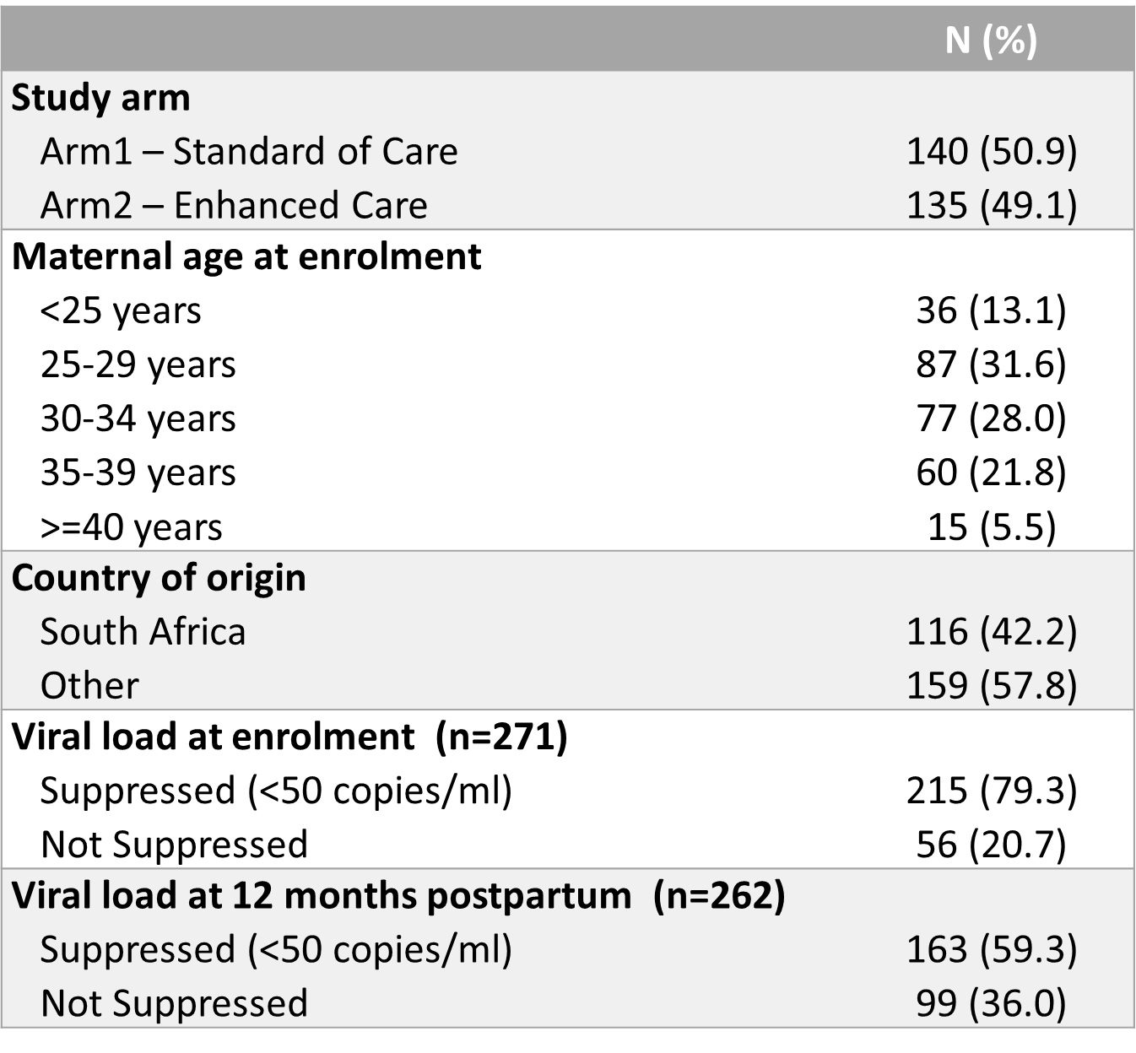
Results – Demographic & Clinical Characteristics
JOHANNESBURG HEALTH DISTRICT
2024 RESEARCH CONFERENCE
Of 405 enrolled WLHIV, 275(68%) completed the questionnaire:
58% were non-South African
67% were 18–34 years & 33.1% were ≥35 years.
The proportion of women with an unsuppressed VL increased from 21% at enrolment to 36% by 12-months postpartum.
VL POCT (92%) and infant HIV POCT (90%) results were available within 2 hours.
#JoburgResearch2024

Slide 5

Results - Perceived advantages of maternal VL and infant EID POCT
JOHANNESBURG HEALTH DISTRICT
2024 RESEARCH CONFERENCE
 |  | n | (%)
Advantages of maternal VL POCT | It made me realise that I was doing very well with my treatment | 66 | (48.9)
 | I knew my viral load sooner than usual | 62 | (45.9)
 | Gives peace of mind | 55 | (40.7)
 | It made me realise that I needed to take my treatment better | 53 | (39.3)
 | Saves time and cost of returning to clinic | 48 | (35.6)
 | Useful to share information with family | 19 | (14.1)
 | When my VL was high I went to the counsellor for extra adherence counselling | 15 | (11.1)
Advantages of EID POCT | Gives peace of mind | 140 | (50.9)
 | Confirms child's HIV sooner | 134 | (48.7)
 | Saves time and cost of returning to clinic | 92 | (33.5)
 | Helps determine whether its safe to breastfeed baby | 88 | (32.0)
 | Allows for opportunistic infection prevention | 77 | (28.0)
 | Useful to share information with family | 41 | (14.9)
 | Other | 2 | (0.7)
multiple options selected
#JoburgResearch2024
Notes:
Perceived advantages of same-day on-site VL POCT included: feeling they were doing very well with their treatment (49%); knowing VL sooner (46%); and providing peace of mind (41%).
These perceptions are further illustrated in the Word cloud visualisation of free text responses from participants regarding POC testing for themselves and their infants, indicating frequency of usage of words.

Slide 6
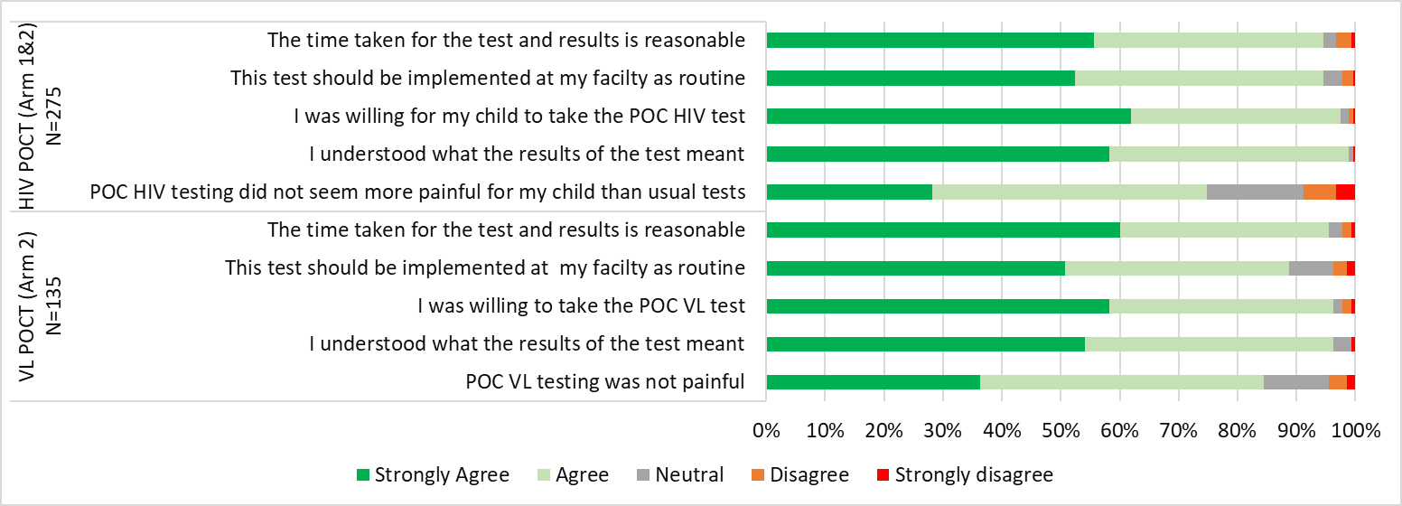
Results: Level of agreement with statements on HIV POCT for infants and
VL POCT in postpartum women
JOHANNESBURG HEALTH DISTRICT
2024 RESEARCH CONFERENCE
#JoburgResearch2024
Notes:
Most respondents felt comfortable or very comfortable with an onsite VL POCT (130/135, 96%) and infant HIV POCT (255/275, 93%).
Perceived advantages of same-day on-site VL POCT included: feeling they were doing very well with their treatment (49%); knowing VL sooner (46%); and providing peace of mind (41%) (Table 2).
For both infant HIV and postpartum VL POCT, >95% agreed or strongly agreed that the time to results was reasonable, were willing to use POCT, and understood test results for themselves and/or their child.
There were no significant differences in responses by study site or study arm.

Slide 7
Conclusions & Recommendations
JOHANNESBURG HEALTH DISTRICT
2024 RESEARCH CONFERENCE
Unsuppressed VL during postpartum period is a huge concern
  elevated VL increased from 21% at enrolment to 36% by 12-months postpartum
  Breastfeeding and subsequent pregnancy increases risk of vertical transmission to infant
Infant EID & maternal VL POCT provided majority of respondents with same-day results.
WLHIV were receptive to POCT, appreciated same-day results, recognized advantages of POCT and found POCT acceptable.
POC PCR testing can be used in a non-research setting to optimise viral load and infant HIV monitoring among postpartum women living with HIV.
Given cost, training, throughput (GX-4) and maintenance requirements on GXP instrument, further explore more focused use of POC testing at facilities.
Challenges:
  Space at facility to explore true POC testing. All research activities occurred at Research site linked to facilities (30-50m walk from facility)
  Retention in study low - women are very mobile, infants are sent back to home country, Women return to work so can’t attend study visits
  Poor routine care follow-up visits attended, review of NHLS lab results - No unique patient identifier, cross-province migration, spelling issues made linking challenging.
#JoburgResearch2024

Slide 8
Thank you
JOHANNESBURG HEALTH DISTRICT
2024 RESEARCH CONFERENCE
The participants and their children who have given their time to participate in the study
The OPPTIM study team
Funders
Co-authors
#JoburgResearch2024

