Slide 1





FAMILY CAREGIVERS OF CANCER PATIENTS’ UNDERSTANDING OF THE DISEASE AND THEIR COPIG STRATEGIES
JOHANNESBURG HEALTH DISTRICT
2024 RESEARCH CONFERENCE
DR FELISTUS NDAMBA
UNIVERSITY OF PRETORIA
#JoburgResearch2024

Slide 2
OVERVIEW
JOHANNESBURG HEALTH DISTRICT
2024 RESEARCH CONFERENCE
Presentation focus
Caregivers and their tasks
Research approach
Findings
Conclusions
Recommendations
#JoburgResearch2024

Slide 3
PRESENTATION FOCUS
JOHANNESBURG HEALTH DISTRICT
2024 RESEARCH CONFERENCE
The presentation discusses the caregivers of cancer patients' knowledge of the disease and their coping strategies and provides recommendations thereof which encourages partnership and collaboration of healthcare professionals and the development of caregiving materials.
#JoburgResearch2024

Slide 4
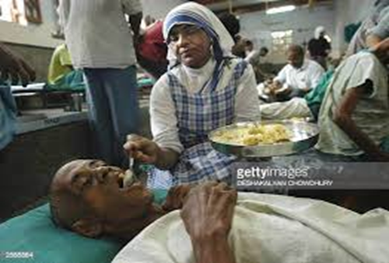
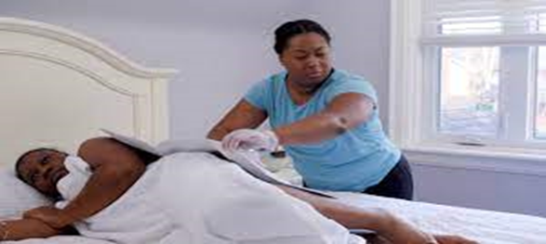

Caregivers and tasks
JOHANNESBURG HEALTH DISTRICT
2024 RESEARCH CONFERENCE
Blood relatives, partners, friends, neighbours and extended support community
Tasks:
Primary source of support- physical, emotional and psychological
Practical care of the patient (Revenson, Griva, Luszczynska, Morrison, Panagopoulou, Vilchinsky & Hagedoorn, 2016:5)
Day to day basic activities
Medically skilled caregiving tasks (Adelman, Tmanova, Delgado, Dion
& Lachs, 2014:1053; Glauber & Day, 2018:538)
Little information and insufficient preparation
Stressful to care for a cancer patient
#JoburgResearch2024

Slide 5
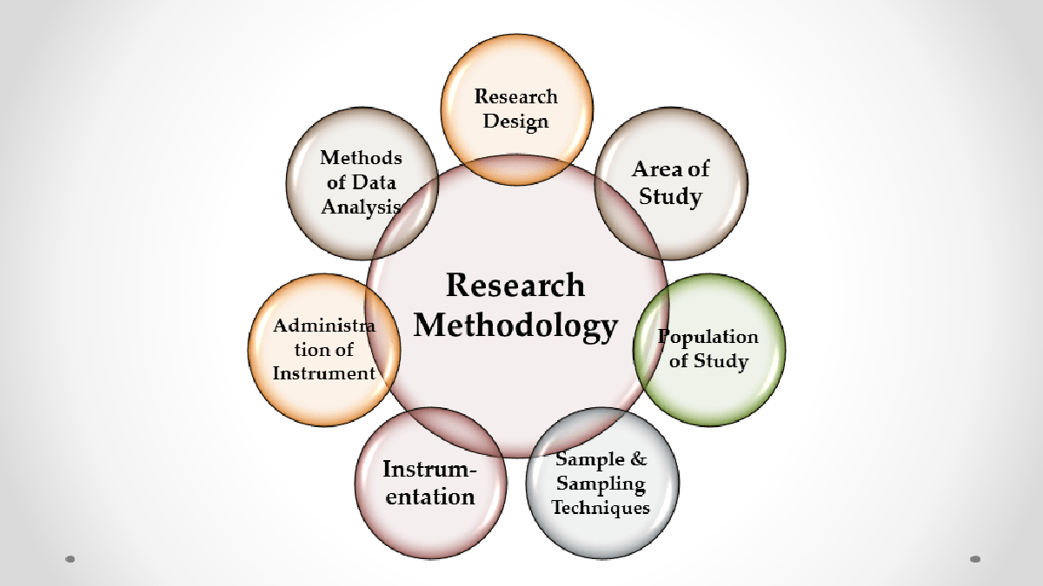
Research Methodology
JOHANNESBURG HEALTH DISTRICT
2024 RESEARCH CONFERENCE
Qualitative approach
Designs- phenomenological, exploratory, descriptive and contextual
Population- caregivers in Gauteng province
17 caregivers- 13 females and 4 males, 8 Africans & 9 whites
Sampling methods- purposive and snowball
Face to face interviews- interview schedule
Data analysis- Tesch’s stepwise plan
#JoburgResearch2024

Slide 6
Findings on the caregiver’s knowledge of cancer
JOHANNESBURG HEALTH DISTRICT
2024 RESEARCH CONFERENCE
The majority of caregivers had limited knowledge/ understanding (14 participants)
I don’t understand anything about cancer. (P9, Female, 51 years)
No, nothing [understanding of cancer]. (P3, Male, 30 years)
Used prior knowledge (training as professional caregivers- 3 participants)
Not clear in explaining the disease- focus on hearsay or speculation
Healthcare professionals fail to explain the disease to the family- complicated medical terms, no time for family conferencing
#JoburgResearch2024

Slide 7



Caregivers’ self-care strategies
JOHANNESBURG HEALTH DISTRICT
2024 RESEARCH CONFERENCE
Share feelings with someone
Stay at work for longer hours
Cry
Play games
Family support- practical, visits, calls
Spirituality and prayer
Respite care
Domestic workers and home-based carers
#JoburgResearch2024

Slide 8

Caregivers’ self-care strategies…cont
JOHANNESBURG HEALTH DISTRICT
2024 RESEARCH CONFERENCE
Hope and stay positive
To always stay positive and not to cry in front of him. I didn’t
want to cry in front of him or to show him that I am upset. I Just
want to tell him all the time that everything will be fine… I try to
stay positive but within myself i was positive but you know you
don’t want to tell him that I am also very worried, it is also painful
for me, you don’t want to go through this. So it’s not easy. You
take a day by day. Like some days are stones and some days
are diamonds. Some days are very hard, other days not so hard…
(P5, Female, 63a years)
#JoburgResearch2024

Slide 9

Conclusion
JOHANNESBURG HEALTH DISTRICT
2024 RESEARCH CONFERENCE
Providing care to a cancer patient is strenuous and stressful
It was astounding to witness the resilience of caregivers-
eyes covered in pain
Sotho saying. “Mosadi o tshwara thipa ka bogaleng” which can be
translated as “A woman holds the knife at the sharp end”
(Mobe, 2022).
-For caregivers to see the pain of their loved ones until death is an
indication of courage and bravery on their side
#JoburgResearch2024

Slide 10
Recommendations
JOHANNESBURG HEALTH DISTRICT
2024 RESEARCH CONFERENCE
Training workshops can be arranged for caregivers -different types of cancers, treatment methods, caregiving information.
Share information (cancer and caregiving) through webcasts, podcasts, PowerPoint presentations, video clips and audio-recordings in caregivers’ languages.
Collaboration of healthcare professional with CANSA to empower individuals, families and communities through awareness campaigns about cancer, importance of cancer screening and where to get help
Enhance caregiver’s self-care- encourage them to ask for help, regular visits, use mobile application reminder to go for regular check-ps
Provide psychosocial support to enhance caregiver’s well-being- using online platforms such as Microsoft Teams, Zoom or Google Meet.
#JoburgResearch2024

Slide 11

Recommendation…cont
JOHANNESBURG HEALTH DISTRICT
2024 RESEARCH CONFERENCE
Provide face-to-face or virtual caregiving training and facilitate support groups to improve caregiver capacity. Use virtual platforms such as Skype, Zoom, Google Meet, Microsoft Teams or WhatsApp video conferencing for networking with caregivers.
Complimenting caregivers’ unwavering support- have a special day event to appreciate caregivers (Caregiver Appreciation Day) for the unwavering support they provide to patients without receiving any payment.
Voluntary initiatives- encourage people to offer their time to help caregivers. Volunteers to receive formal training, to offer for an hour or two of support to caregivers. Volunteers could clean the home and run errands for the family. In compliance with POPI Act.
#JoburgResearch2024

Slide 12
References
JOHANNESBURG HEALTH DISTRICT
2024 RESEARCH CONFERENCE
Adelman, R., Tmanova, L.L., Delgado, D., Dion, S. & Lachs, M.S. 2014. Caregiver burden a clinical review. Journal of the American Medical Association (JAMA), 311(10):1052-1060.
Glauber, R. & Day, M.D. 2018. Gender, spousal caregiving, and depression: Does paid work matter? Journal of Marriage and Family, 80:537-554.
Revenson, T.A., Griva, K., Luszczynska, A., Morriso, V., Panagopoulou, E.V., Vilchinsky, N. & Hagedoorn, M. 2016. Caregiving in the illness context. London Borough of Camden, UK: Palgrave MacMillan.
#JoburgResearch2024

Slide 13

JOHANNESBURG HEALTH DISTRICT
2024 RESEARCH CONFERENCE
#JoburgResearch2024

