Slide 1





JOHANNESBURG HEALTH DISTRICT
2024 RESEARCH CONFERENCE
Investigating Healthcare Worker’s Use Of Mobile Phone Messaging Applications (Apps) For Their Daily Work In Primary Health Care
Simon Lewin^{1,2}, Janan Janine Dietrich^{2,3,4,} Mamakiri Mulaudzi⁵, Tondani Mudau^{2,5}, Lerato Tsotetsi^{2,3}, Tanya Doherty²
¹ Department of Health Sciences Ålesund, Faculty of Medicine and Health Sciences, Norwegian University of Science and Technology (NTNU), Norway.
² Health Systems Research Unit, South African Medical Research (SAMRC), Bellville, South Africa.
³African Social Sciences Unit of Research and Evaluation (ASSURE), Faculty of Health Sciences, University of the Witwatersrand, Johannesburg, South Africa.
⁴ Perinatal HIV Research Unit (PHRU), Faculty of Health Sciences, University of the Witwatersrand, Johannesburg, South Africa.
⁵ School of Human and Community Development, Department of Psychology, University of the Witwatersrand, Johannesburg, South Africa
Presenter Prof Janan Dietrich
#JoburgResearch2024

Slide 2
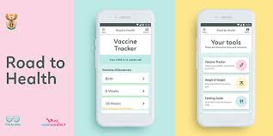
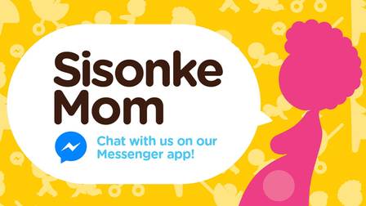
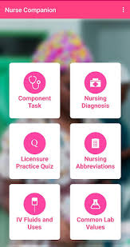
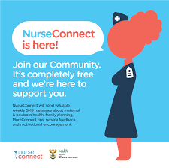
JOHANNESBURG HEALTH DISTRICT
2024 RESEARCH CONFERENCE
Introduction
  The Department of Health has initiated major mobile health (mHealth) interventions to provide information to mothers and health care workers
  Mobile apps including the following have been used to address health challenges and improve the health system
Road to Health
MomConnect
Companion Nurse
NurseConnect
#JoburgResearch2024

Slide 3

JOHANNESBURG HEALTH DISTRICT
2024 RESEARCH CONFERENCE
Introduction
Mobile health (mHealth) interventions are rapidly becoming significant tools for enhancing health service delivery and workforce performance.
Alongside these formal interventions, healthcare workers are using affordable and accessible internet-based mobile phone applications and in-app messaging services (referred to here as ’mobile phone messaging apps’) informally to overcome day-to-day challenges in their work and deliver health services.
The use of these informal messaging applications by healthcare workers to perform their required work has not been researched.
#JoburgResearch2024

Slide 4
JOHANNESBURG HEALTH DISTRICT
2024 RESEARCH CONFERENCE
Aim
The aim of this study was to obtain a better understanding of the purposes for which health workers are using messaging apps informally to identify the communication gaps that formal HMIS platforms are not addressing adequately.
Objective
To investigate the use of mobile phone messaging apps for daily work among healthcare workers and managers in South Africa.
#JoburgResearch2024

Slide 5

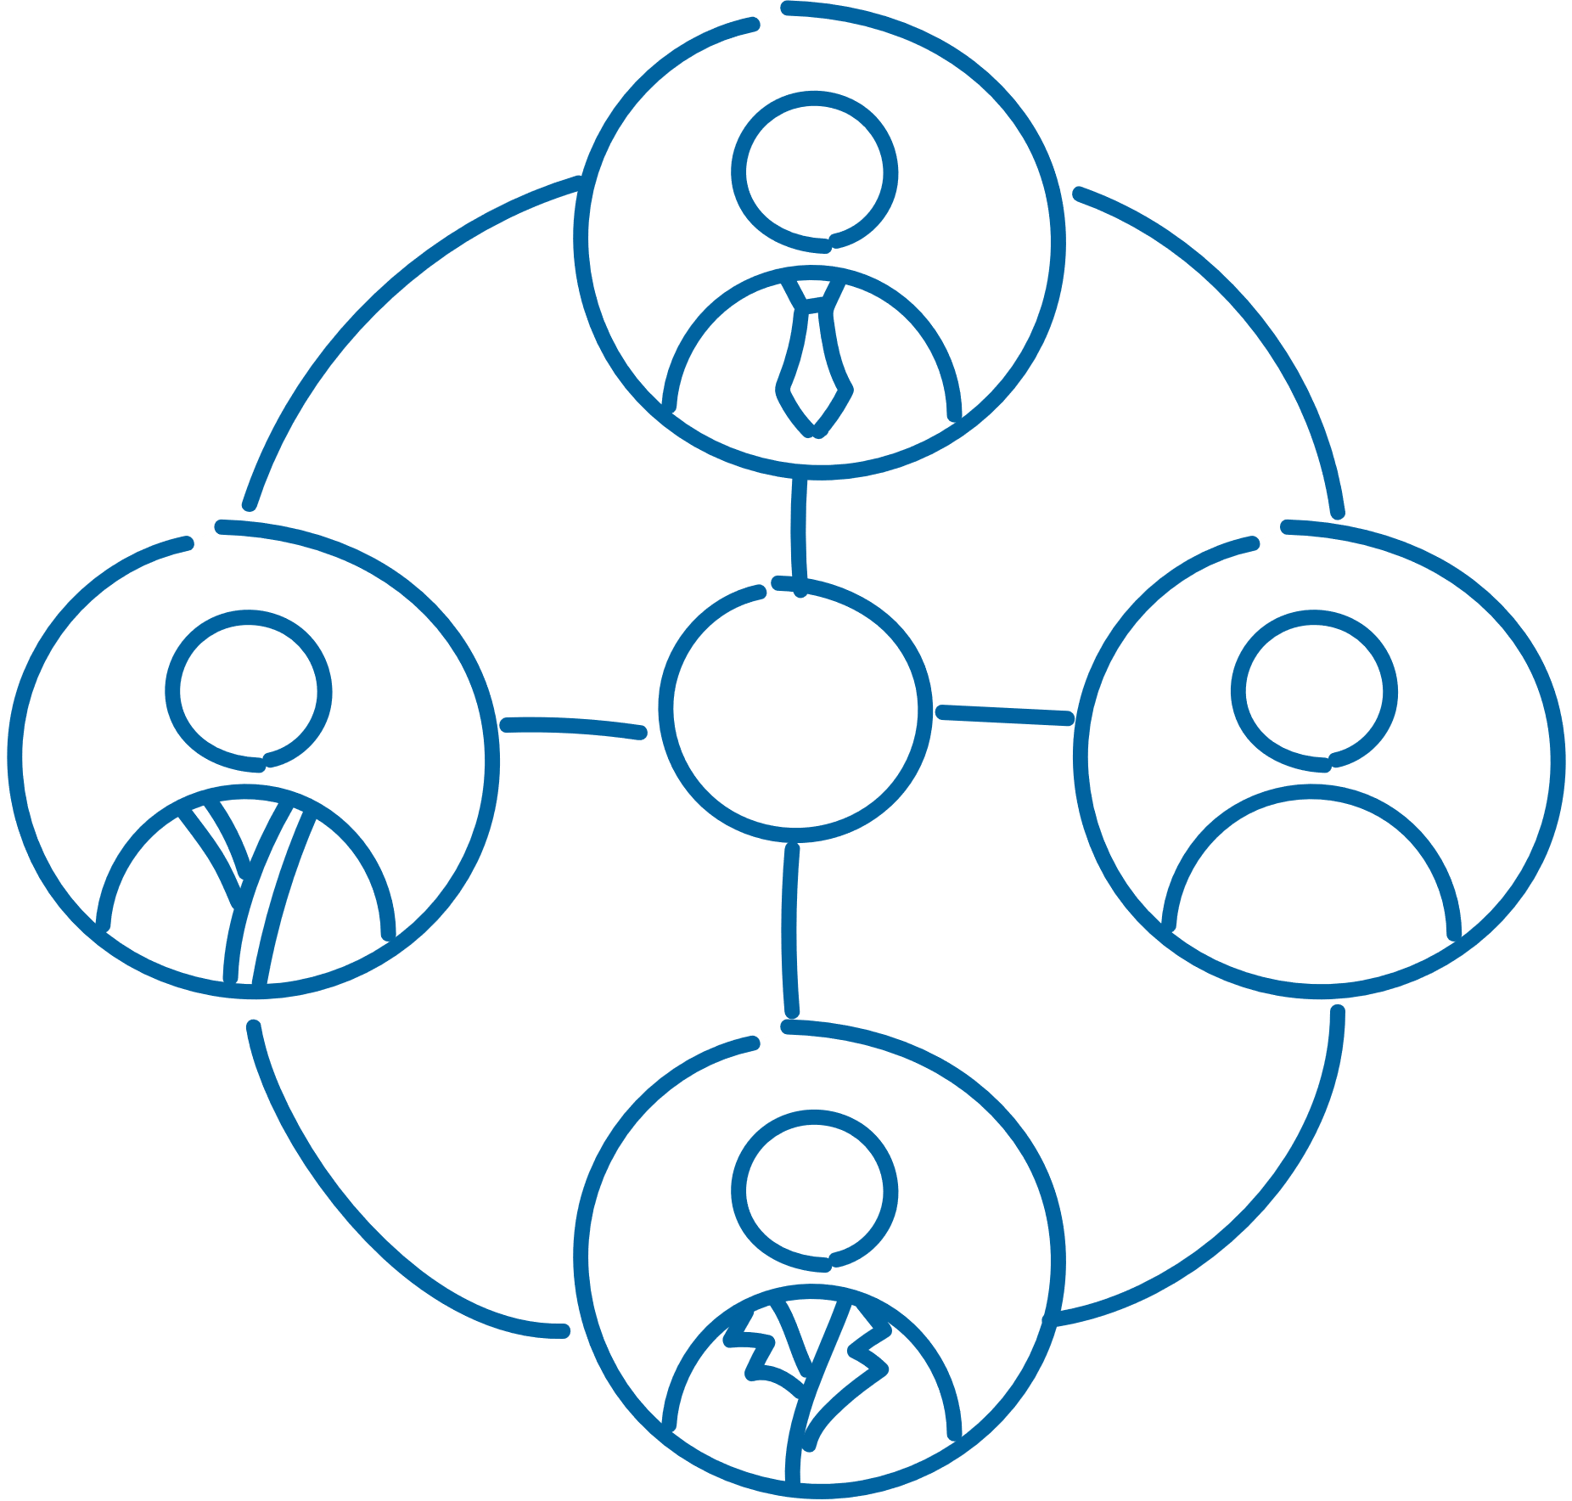


JOHANNESBURG HEALTH DISTRICT
2024 RESEARCH CONFERENCE
Method
A cross-sectional anonymous online survey designed on RedCap
Eligible participants included those 18 years and older
Healthcare workers in the private or public sectors in South Africa were recruited via the Health and Welfare Sector Education and Training Authority database.
Data were analysed on STATA SE (18). Descriptive frequencies and percentages were generated for participant demographics and characteristics of app use
#JoburgResearch2024

Slide 6
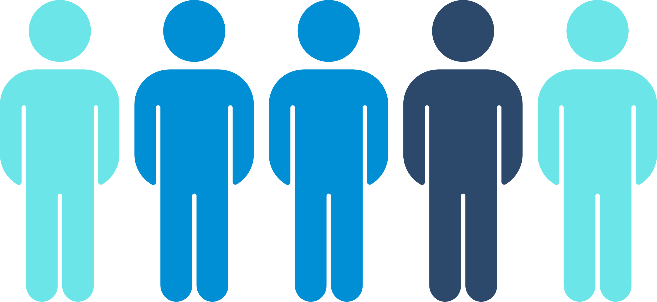



JOHANNESBURG HEALTH DISTRICT
2024 RESEARCH CONFERENCE
Results Demographics
48 819 were emailed the survey and
2 174 healthcare workers participated
Largest group of participants worked in private sector medical practice (36.6%) and based in urban areas (81.4%).
Majority of participants were female 73.8%, Caucasion 70.4% and spoke English 53.7%
Most had a postgraduate degree (58%) as their highest level of education, with medical doctors being the largest group of participants by current job title (35%).
#JoburgResearch2024

Slide 7


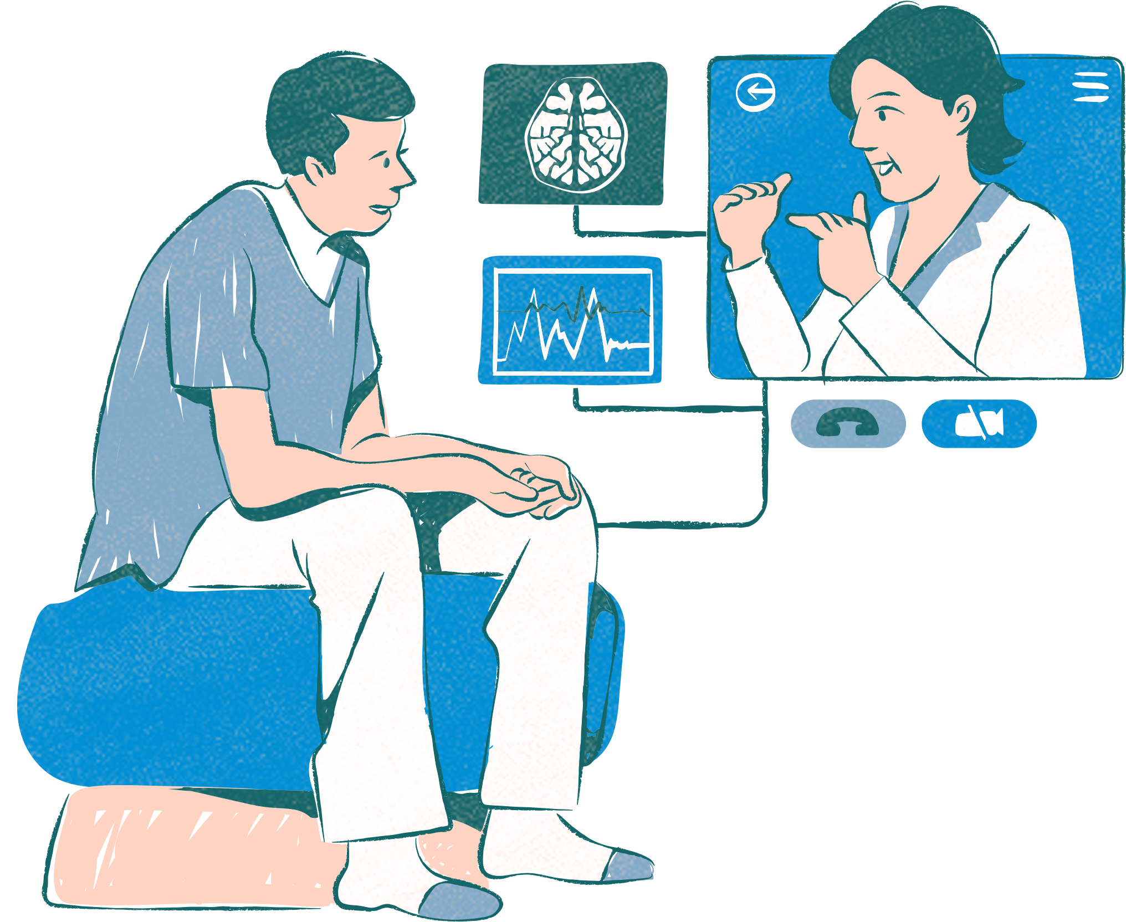

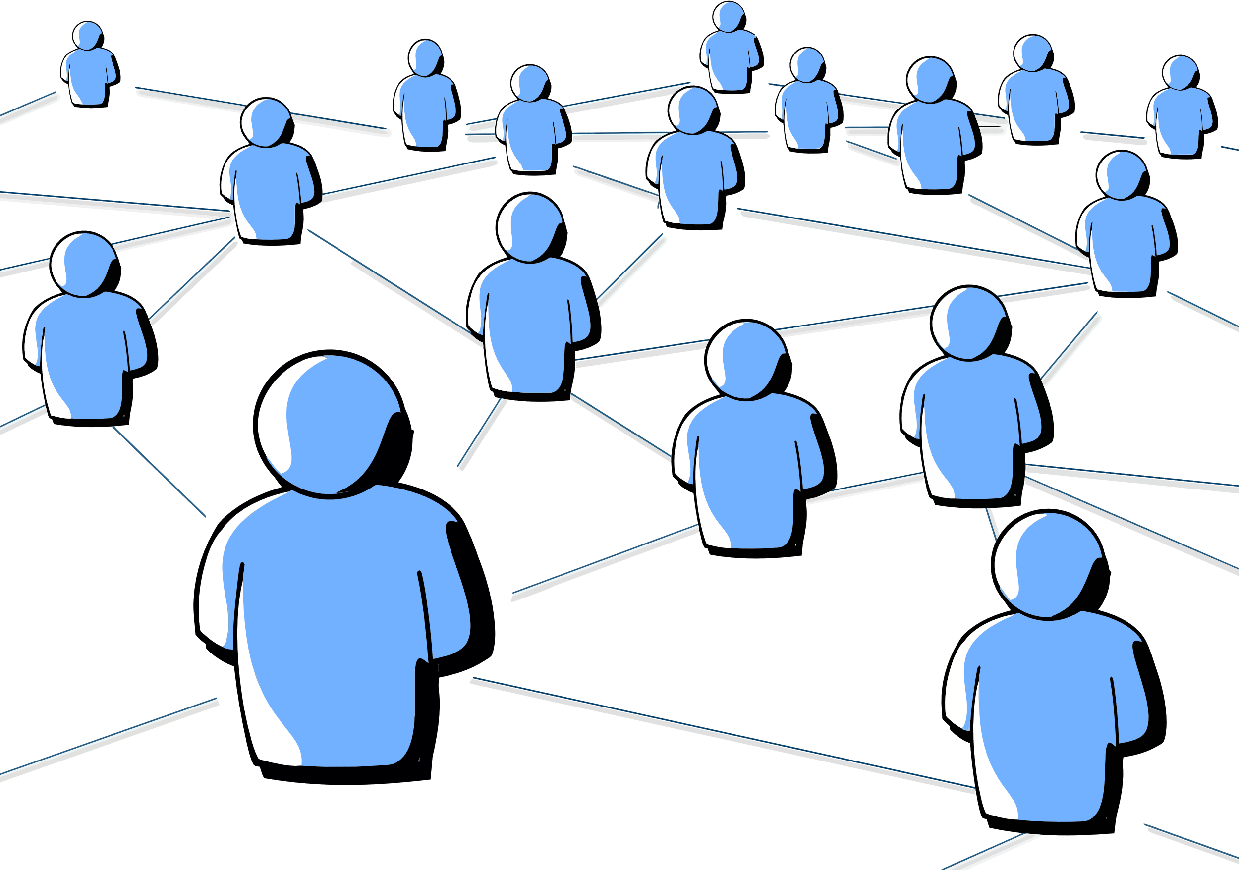
JOHANNESBURG HEALTH DISTRICT
2024 RESEARCH CONFERENCE
Results App Use
At least 90% of participants reported using a messaging app for work-related communication with WhatsApp (84%) as the most used messaging app.
Nearly 95% of participants belonged to at least one messaging app group while 28.5% belonged to five groups or more.
Messaging apps were also used for sharing appointment times and reminders (44.7%) and providing advice (28.5%) to patients.
App use across the public and private sectors and types of healthcare facilities was similar. Most healthcare workers (79.3%) did not receive a mobile phone data allowance.
Participants reported using messaging apps for connecting with colleagues (52.1%)patient referrals (50.6%) information on patient clinical management (47.5%) and sharing new clinical guidelines (43.3%).
#JoburgResearch2024

Slide 8
JOHANNESBURG HEALTH DISTRICT
2024 RESEARCH CONFERENCE
Discussion
    Informal use of messaging apps by healthcare workers to perform their daily work is common and supports core healthcare functions in the public and private sectors.
    Study strengths:
      large sample size
      wide diversity of health worker cadres
      private and public sectors.
    Study weaknesses:
      Survey respondents mostly English speaking, Caucasian, females with postgraduate qualifications.
      urban settings
      private sector.
#JoburgResearch2024
Notes:
Informal use of messaging apps by healthcare workers to perform their daily work is common and including communication with colleagues and patients is prevalent and supports core healthcare functions in public and private sectors.
health care, so public sector health care workers and managers and rural health care workers are relatively under-represented in the data. HCWs experiences of informal use were not explored qualitatively but work on that is in progress. Our aim here was to gather a broad picture of the extent and pattern of use.
8

Slide 9
JOHANNESBURG HEALTH DISTRICT
2024 RESEARCH CONFERENCE
Conclusion
    We found that purposes of messaging apps included sharing information with colleagues in the same geographic area; discussing patient referrals with another healthcare worker; asking colleagues for advice on clinical management of patients; sharing appointment times and reminders with patients; and providing advice to patients.
    The widespread informal use of messaging apps most likely highlights both their ease of use and wide penetration but also gaps or constraints within available formal systems for sharing information with patients and among healthcare workers.
    Financial cost to healthcare workers of informal use – most reported that they do not receive allowances to support this use, particularly those working in the public sector. This places an unfair and inequitable burden on healthcare workers.
    South Africa’s digital health strategy needs to consider informal uses of mobile phones, including messaging app use. Guidance is needed on ways of supporting this use, such as provision of Wi-Fi and data allowances, while managing potential downsides.
#JoburgResearch2024

Slide 10




JOHANNESBURG HEALTH DISTRICT
2024 RESEARCH CONFERENCE
Acknowledgements
#JoburgResearch2024

