Slide 1


Reducing Vertical Transmission Rates through Integrated Postnatal Care for Women Living with HIV and their Infants
JOHANNESBURG HEALTH DISTRICT
2024 RESEARCH CONFERENCE
August 2024
#JoburgResearch2024

Slide 2
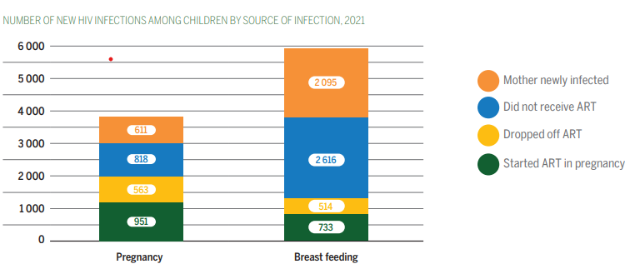
Background
HIV positivity rate at public antenatal clinics 27,5 % in South Africa
Vertical transmission preventions efforts have reduced rates of vertical transmission to 2.7%
Suboptimal postpartum engagement in care, especially after transitioning from antenatal clinics to regular adult HIV care.
Postnatal period presents higher risk: Mothers are more likely to be lost from care during the postnatal period
A meta-analysis of 51 global studies only 53% of women had optimal adherence postpartum.
Increased HIV transmission through breastfeeding
~ 70% of new vertical HIV transmissions occurred in the breastfeeding period
~80% of this vertical transmission during breastfeeding took place in the first 6 months after birth.
#JoburgResearch2024

Slide 3

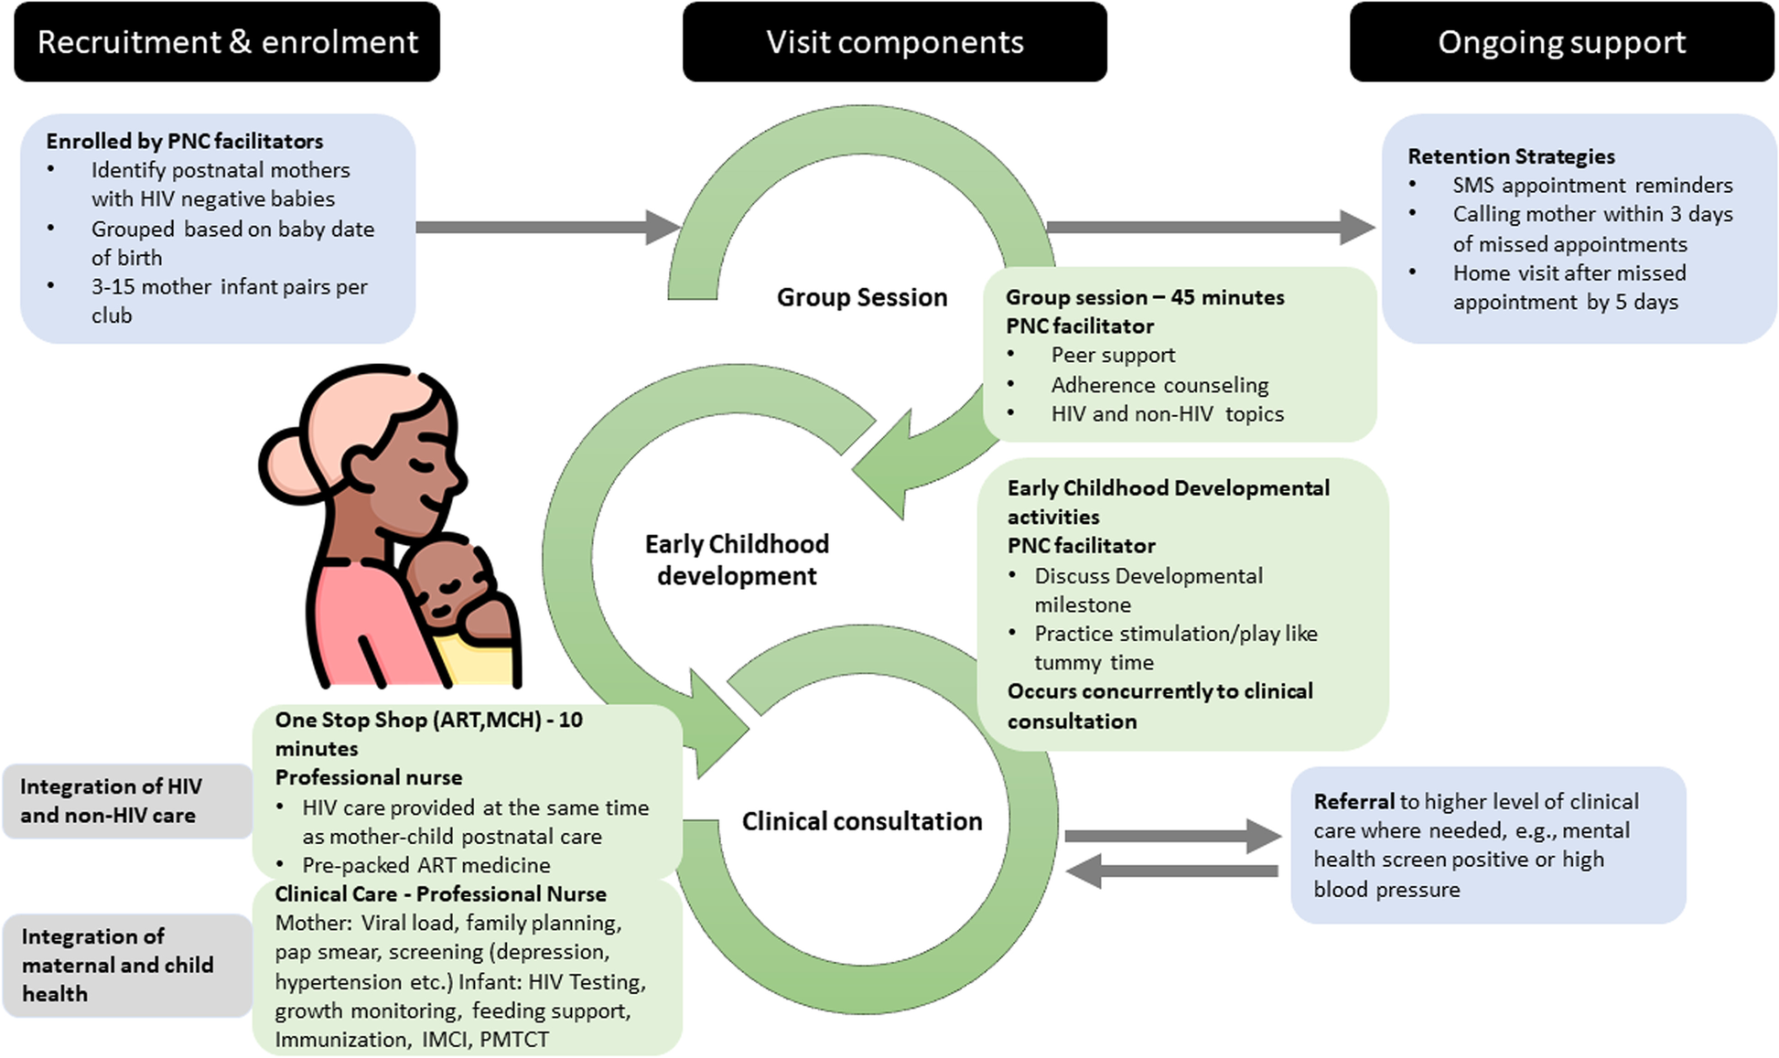
Post Natal Club (PNC) Model
A Holistic, Patient-Centered Care Model developed by Doctors Without Boarders (MSF) This model is designed to meet the medical needs of both HIV-positive mothers and their at-risk infants. It also offers comprehensive peer support, psychosocial support, and early childhood development services.
Eligibility: HIV-positive mothers and HIV-exposed infants.
Recruitment Period: During antenatal care visits and postnatal consultations, continuing until the infant's exit testing at 18 months.
Approach: Uses the Mother Baby Pairs model to ensure mothers attend with their babies.
#JoburgResearch2024

Slide 4
Implementation of PNCs in Johannesburg District
Anova, funded by PEPFAR/USAID, supported the Department of Health (DoH) in implementing PNCs
Implementation sites were purposively selected based on the health facilities' expressed interest
Objective
To compare vertical transmission rates of HIV-exposed infants (HEIs) between facilities with and without PNCs.
Study Overview
Period: January - December 2023
Location: 137 facilities in Johannesburg District
PNC Club Distribution
5 facilities with both virtual and in-person PNCs
7 facilities with only in-person PNCs
16 facilities with only virtual PNCs
#JoburgResearch2024

Slide 5
Positivity rate- Comparing Positivity Rates Across Facility (PNC vs Non-PNC)
Non-PNC facilities show a 0.50%vs 0.27% (p-value=0.070). positivity rate, indicating a slightly higher infection rate compared to PNC facilities.
PNC facilities had lower positivity rates at 6 months (0.32%) vs. non-PNC (0.61%) (p-value=0.358) .
Positivity rate 10 weeks
Positivity rate 6 months
0,50% (n=44/8883)
0.61%
(n=15/2479)
0,27%
(n=12/4523)
0.32%
(n=4/1256)
PNC Facility
Non-PNC Facility
PNC Facility
Non-PNC Facility

Slide 6




Positivity rate at 10 weeks- Comparing Positivity Rates Across Facility by Type of PNC offered
Title Goes Here
0.09%
0.26%
0.34%
0.50%
Minimal positivity for physical PNC
Physical-only PNCs had a 0.09% positivity rate at -suggesting a protective effect against vertical transmission.
Lower positivity with
both PNC types
Facilities with both physical and virtual PNCs showed a 0.26% PCR positivity rate - potential effectiveness in reducing transmission.
Virtual-only PNCs
0.34% positivity
Non-PNC facilities
0.50%

Slide 7
Positivity rate at 6 months- Comparing Positivity Rates Across Facility by Type of PNC offered
WHO criteria for elimination of vertical
transmission of HIV requires a less than
0.05% transmission rate
0.0%
0.35%
0.34%
0.61%
Both PNC Facilities
Physical PNC Facilities
Virtual PNC Facilities
Non-PNC facilities showed a positivity rate of 0.61%, indicating a higher prevalence compared to PNC options.
Facilities offering both virtual and physical PNCs reported a 0% positivity rate, suggesting that this combined approach may effectively mitigate positivity cases.
Facilities that provide only physical PNCs had a positivity rate of 0.35%. This might that while physical PNCs are beneficial, they may not be as effective as integrated service models.

Slide 8
Consideration
Key observation
PNC implementation in facilities may not have been random.
Potential for selection bias could introduce confounding factors in the observed results.
Differences in mother demographics and clinic performance between PNC and non-PNC could affect outcomes.
Facilities offering PNCs showed a trend towards lower PCR positivity rates compared to non-PNC facilities.
The trend was non-significant but indicated potential benefits of PNCs in reducing transmission.
No positive PCR results in PNC facilities were linked to PNC-enrolled HEIs.
This suggests a potential effectiveness of PNCs in preventing vertical transmission.
#JoburgResearch2024

Slide 9
Recommendation
Further research is needed to understand why some mothers enroll in PNCs while others do not.
Factors such as accessibility, awareness, and cultural beliefs may play a role.
Understanding these factors is important for improving PNC enrollment
Expand PNC Model
Expand the PNC model to other facilities to reduce missed opportunities for vertical transmission.
This expansion requires adequate resources and training for healthcare providers.
Education for Community Members
Improve education on the benefits of grouped postnatal PNC.
Focus on community outreach programs to raise awareness.
Recognize Excellence
Organize annual awards to recognize clinics with effective PNC.
This recognition can motivate other clinics to improve their PNC services.
Awards should be based on measurable outcomes such as reduction in vertical transmission.
#JoburgResearch2024

Slide 10
Thank You

