Slide 1





Invasive pneumococcal disease surveillance in Gauteng Province, South Africa, 2018-2022
JOHANNESBURG HEALTH DISTRICT
2024 RESEARCH CONFERENCE
JHD PHC Conference 28-29 August
Mokupi Manaka, M. Tsitsi, C.Verwey, D. Moore, M .Mulaudzi, J. Nel, G. Reubenson, N. Madlala, D. Mawela, C. Cohen, L. de Gouveia, M. du Plessis, J. Kleynhans, K. Ndlangisa, H. Skosana, S. Walaza, V. Quan, A. von Gottberg, S. Meiring for GERMS-SA
#JoburgResearch2024

Slide 2
IPD still accounts for substantial mortality especially in infants, elderly and people living with HIV
JOHANNESBURG HEALTH DISTRICT
2024 RESEARCH CONFERENCE
therefore…
Use of higher valency PCV formulations in high risk groups may be able to reduce the ongoing disease burden
People living with HIV would benefit from higher uptake of ART
#JoburgResearch2024
Notes:
I would rather say…IPD still accounts for substantial MORBIDITY and MORTALITY…

Slide 3
BACKGROUND
JOHANNESBURG HEALTH DISTRICT
2024 RESEARCH CONFERENCE
Invasive pneumococcal disease(IPD) remains an important cause of morbidity and mortality
AIM: describe IPD in Gauteng(GP)
#JoburgResearch2024

Slide 4
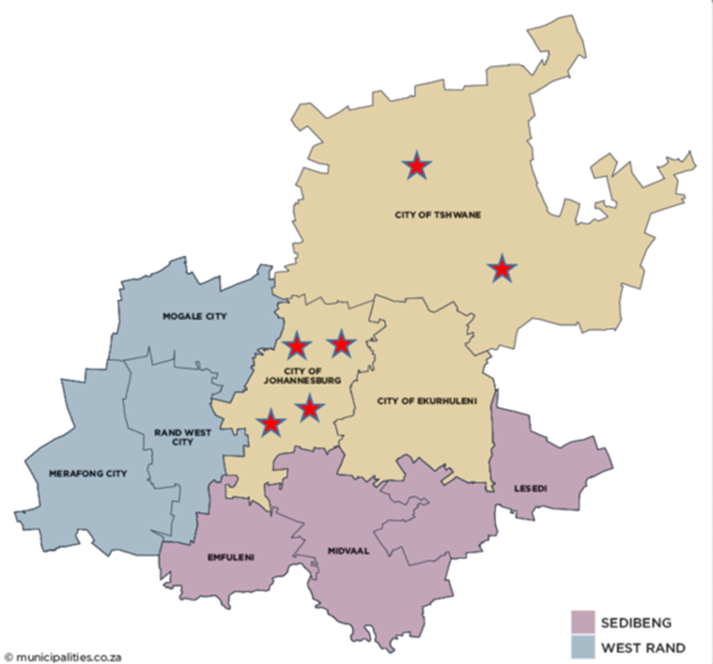
METHODS
JOHANNESBURG HEALTH DISTRICT
2024 RESEARCH CONFERENCE
Surveillance of laboratory-confirmed IPD was conducted from 2018-2022 in GP
Clinical data were collected from six sentinel hospital sites
Incidence rates were calculated using population provincial denominators
CHBAH
CMAH
HJH
RMMCH
DGM
SBAH
#JoburgResearch2024

Slide 5
RESULTS
Incidence of invasive pneumococcal Disease, 2018-2022, GP
(N=2,770)
JOHANNESBURG HEALTH DISTRICT
2024 RESEARCH CONFERENCE
#JoburgResearch2024

Slide 6
IPD cases by gender, 2018-2022, GP (N=2,726)
JOHANNESBURG HEALTH DISTRICT
2024 RESEARCH CONFERENCE
In-hospital mortality by age category, 2018-2022, GP (N=1,213)
#JoburgResearch2024

Slide 7
Risk factors for IPD, 2018-2022, GP (N=2,432)
JOHANNESBURG HEALTH DISTRICT
2024 RESEARCH CONFERENCE
Prematurity (less than 5 years) | 10% | 22/224
Cigarette Smoking (More than 14 years) | 11% | 109/971
HIV infected | 63% | 641/1237
HIV uninfected | 37% | 377/1237
On ARVs | 50.10% | 321/641
ARV Naive | 42.10% | 270/641
CD4<200 | 54.60% | 350/641
CD4>200 | 23.40% | 150/641
#JoburgResearch2024

Slide 8
Potential serotype coverage of invasive pneumococcal disease by various pneumococcal conjugate vaccines and age categories, Gauteng, (N=1,804 isolates serotyped)
JOHANNESBURG HEALTH DISTRICT
2024 RESEARCH CONFERENCE
#JoburgResearch2024

Slide 9
CONCLUSION
JOHANNESBURG HEALTH DISTRICT
2024 RESEARCH CONFERENCE
CONCLUSION
RECOMMENDATIONS
RECOMMENDATIONS
Ten years after introduction of routine infant pneumococcal vaccination, IPD still accounts for substantial morbidity and mortality
Especially in infants, elderly. PLWH and those with respiratory comorbidities
Ten years after introduction of routine infant pneumococcal vaccination, IPD still accounts for substantial morbidity and mortality
Especially in infants, elderly. PLWH and those with respiratory comorbidities
Use of higher valency PCV formulations may be able to reduce the ongoing disease burden
PLWH would benefit from a higher uptake of ART
Use of higher valency PCV formulations may be able to reduce the ongoing disease burden
PLWH would benefit from a higher uptake of ART
#JoburgResearch2024

Slide 10



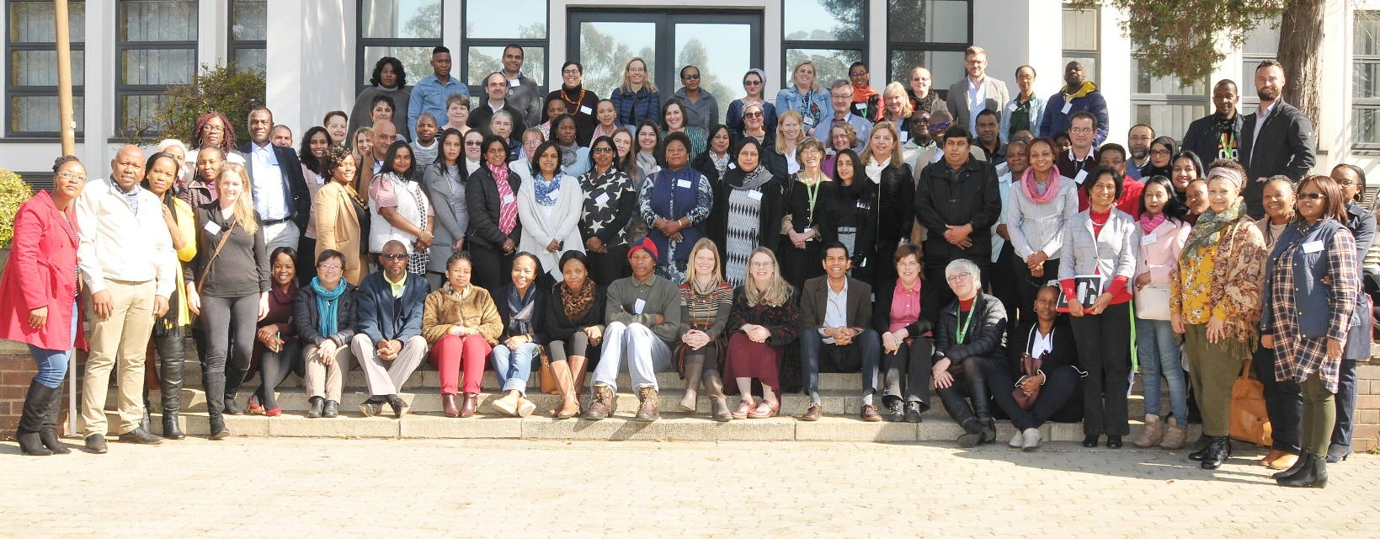
JOHANNESBURG HEALTH DISTRICT
2024 RESEARCH CONFERENCE
Thank you to all participating patients, laboratory, clinical and administrative staff for submitting case reports and isolates
NICD Centre staff:
CED: Bolele Disenyeng, Dineo Bogoshi, Lesego Thipenyane, Lizzy Madiwani, Mzikazi Dickmolo, Nomsa Tau, Rembuluwani Netshikweta, Sandrama Nadan, Shannon Williams, Tersia Kruger, Tshegofatso Ntshabele, Tumiso Moketla
CHARM: Amanda Shilubane, Boitumelo Kgoale, Boniwe Makwakwa, Ernest Tsotetsi, Gloria Molaba, Gift Sandhleni, Mbali Dube, Mpho Thanjekwayo, Naseema Bulbulia, Nikiwe Power, Rosah Mabokachaba, Rotondwa, Miriam Mwamba, Mudau, Rubeina Badat, Ruth Mogokotleng, Sabelle Jallow, Serisha Naicker, Silondiwe Nzimande, Tsidiso Maphanga
CRDM: Dineo Mogale, Fahima Moosa, Happy Skosana, Kedibone Ndlangisa, Maimuna Carrim, Noluthando Duma, Rivionia Nero, Sibusisiwe Zulu, Thembi Mthembu
CEZPD: Angelina Seko, John Ratabane, Lisa Ming Sun, Ntswaki Seolwanyane, Shareen Boughan, Thandokuhle Tshabalala
DPHSR: Emily Sikanyika, Tsakane Nkuna, Yoliswa Qulu
GERMS-SA: Loyiso Mnqokoyi, Vanessa Pearce (EC); Bonita van der Westhuisen, George Papsig, Kabelo Finger, Monnya Motlhapi, Thabo Mokoena (FS); Anwar Hoosen, Barry Bhagoobhai, Charl Verwey, David Moore, Dini Mawela, Gary Reubenson, Grace Ntlemo, Jeannette Wadula, Jeremy Nel, Lauren Richards, Lesego Mothibi, Maphoshane Nchabeleng, Masego Moncho, Merika Tsitsi, Moamokgethi Moshe, Mohammed Said, Molebogeng Kolojane, Nazir Ismail, Nicolette du Plessis, Rispah Chomba, Sarah Stacey, Sne Ndzandzaba, Teena Thomas, Theunis Avenant, Trusha Nana, Vindana Chibabhai (GA); Douglas Wilson, Fathima Naby, Halima Dawood, Khine Swe Swe Han, Lisha Sookan, Mbongiseni Dlamini, Nomonde Dlamini, Praksha Ramjathan, Prasha Mahabeer, Prathna Bhola, Romola Naidoo, Sumayya Haffejee, Surendra Sirkar, Venesh Rajkumar (KZN); Ken Hamese, Phetho Mangena, Ruth Lekalakala, Virginia Ntswane (LP); Aretha Mokgoadi, Gugu Mncube, Isaac Mofokeng, Lerato Motjale, Mbongiseni Nkambule, Ndalamo Makatu, Thembi Mbowane, Thulisile Maphosa (MP); Eugenie Elliott, Pieter Jooste (NC); Ebrahim Variava, Ignatius Khantsi, Omphile Mekgoe (NW); Adrian Brink, Andrew Whitelaw, Angela Dramowski, Anthea Ryan, Arifa Parker, Elizabeth Prentice, Heather Finlayson, James Nuttal, Jantjie Taljaard, Kessendri Reddy, Sipho Dlamini (WC); Ebrahim Hoosien, Inge Zietsman, Terry Marshall, Xoliswa Poswa (AMPATH); Chetna Govind, Juanita Smit, Keshree Pillay, Sharona Seetharam , Victoria Howell (LANCET); Catherine Samuel, Marthinus Senekal, Colleen Bamford (PathCare); Andries Dreyer, Louis Marcus, Warren Lowman (Vermaak and Vennote); Adrian Puren, Anne von Gottberg, Anthony Smith, Azwifarwi Mathunjwa, Bhavani Moodley, Caroline Maluleka, Cecilia Miller, Charlotte Sriruttan-Nel, Cheryl Cohen, Jacqueline Weyer, Jackie Kleynhans, Jenny Rossouw, John Frean, Kate Bishop, Kerrigan McCarthy, Liliwe Shuping, Linda de Gouveia, Linda Erasmus, Lucille Blumberg, Marshagne Smith, Martha Makgoba, Mignon du Plessis, Mimmy Ngomane, Mokupi Manaka, Nelesh Govender, Neo Legare, Nicola Page, Nishi Prabdial-Sing, Nombulelo Hoho, Olga Perovic, Phuti Sekwadi, Rudzani Mashau, Ruth Mpembe, Ruth Mogokotleng, Sabelle Jallow, Sibongile Walaza, Sunnieboy Njikho, Susan Meiring, Susan Nzenze, Tiisetso Lebaka, Tuelo Matotong, Vanessa Quan, Veerle Msimang, Wendy Ngubane (NICD).
Provincial surveillance teams: Badikazi Matiwana, Sandisiwe Joyi (EC); Khasiane Mawasha, Thandeka Kosana (FS); Chulumanco Nkosi, Deborah Makobe, Dikeledi Leshaba, John Mothlasi, Kamohelo Van Eck, Molly Morapeli, Nthabiseng Motati, Ntombizanele Nkomo, Ophtia Kaoho, Patience Ngube, Phindile Ngema, Phumelelo Mavundla, Rachel Nare, Venesa Kok, Vusi Ndlovu, Zodwa Kgaphola (GA); Indran Naidoo, Nelisiwe Buthelezi, Nhlakanipho Malinga, Nkoshinathi Mbhele, Nondumiso Amahle Khoza, Nothando Mthembu, Thobeka Simelane Shandu (KZN); Tebogo Mangena (LP); Elizabeth Motaung, Gift Mnisi, Kgashane Rapaledi, Lesley Ingle, Ndugiselo Muravha, Sam Chongo, Tumelo Thlomelang, Zanele Sewele, Godfrey Ndlovu (MP); Bernard Motsestse, Kholiwe Mgidlana, Koketso Manaka, Sebongile Quariva, Seipati Matshogo, Tshwanelo Mahloko, Yvette Nero (NW); Babalwa Magawu, Charlene Isaacs, Cheryl Mentor, Kholofelo Lebelo, Lerato Qoza, Msimelelo Madlingozi , Nazila Shalabi, Phathiswa Ranyana, Portia Maphumulo, Priscilla Mouton, Sinesipho Makaluza, Yonela Zokufa, Zama Mfundisi (WC)
#JoburgResearch2024

