Slide 1





Exploring the perspectives of healthcare workers on their use of mobile phone messaging applications (apps) at work: A qualitative study in South Africa
JOHANNESBURG HEALTH DISTRICT
2024 RESEARCH CONFERENCE
Simon Lewin^{1,2}, Janan Janine Dietrich^{2,3,4}, Mamakiri Mulaudzi⁵, Tondani Mudau^{2,6}, Lerato Tsotetsi^{2,3}, Tanya Doherty²
¹ Department of Health Sciences Ålesund, Faculty of Medicine and Health Sciences, Norwegian University of Science and Technology (NTNU), Norway.
² Health Systems Research Unit, South African Medical Research (SAMRC), Bellville, South Africa.
³African Social Sciences Unit of Research and Evaluation (ASSURE), Faculty of Health Sciences, University of the Witwatersrand, Johannesburg, South Africa.
⁴ Perinatal HIV Research Unit (PHRU), Faculty of Health Sciences, University of the Witwatersrand, Johannesburg, South Africa.
⁵ School of Human and Community Development, Department of Psychology, University of the Witwatersrand, Johannesburg, South Africa
Prof Janan Dietrich
#JoburgResearch2024

Slide 2


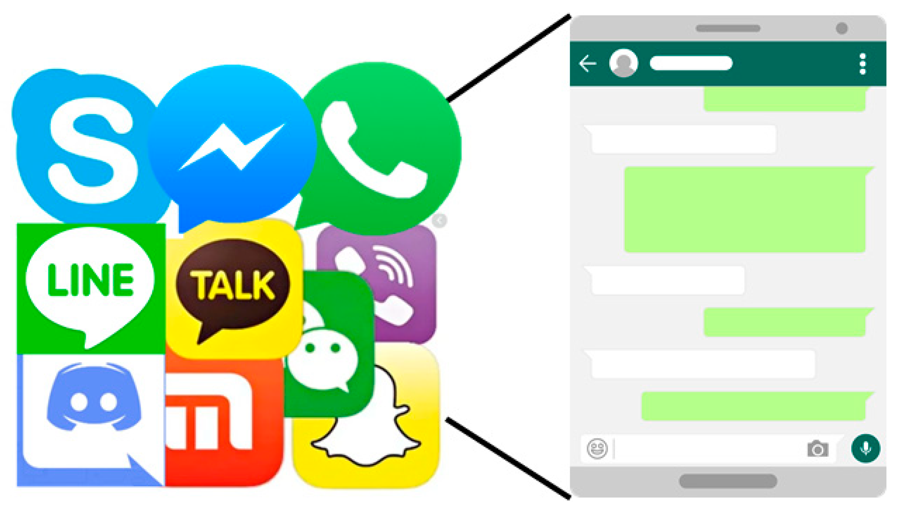
BACKGROUND
JOHANNESBURG HEALTH DISTRICT
2024 RESEARCH CONFERENCE
Mobile phone-based instant messaging (IM) apps, such as WhatsApp, are used increasingly for communication in the health workplace, particularly to connect healthcare workers to colleagues and patients.
However, there is limited knowledge of the ways in which Whatsapp is being used and what healthcare workers and managers see as the benefits and challenges of app use
#JoburgResearch2024

Slide 3

RESEARCH AIM
JOHANNESBURG HEALTH DISTRICT
2024 RESEARCH CONFERENCE
This study explored the extent and purposes of mobile phone messaging app use by healthcare workers in two South African provinces .
#JoburgResearch2024

Slide 4

METHODOLOGY
JOHANNESBURG HEALTH DISTRICT
2024 RESEARCH CONFERENCE
Research Design
Recruitment
Eligibility Criteria
Qualitative Approach
Purposive sampling approach.
Healthcare workers employed in public health primary care facilities in Gauteng and the Free State
In-Depth Interviews and Observations (n=16)
#JoburgResearch2024
Notes:
We used a variety of qualitative methods, including shadowing healthcare workers and how they utilise mobile phones during work and also observations of the WhatsApp groups for a certain period of time to Monitor conversations and level of interactions

Slide 5

DEMOGRAPHICS
JOHANNESBURG HEALTH DISTRICT
2024 RESEARCH CONFERENCE
#JoburgResearch2024
Notes:
We had 16 interviews in total (8 in Gauteng and 8 in FS)
Our interviews were also split amongst participants from urban facilities and participants from rural

Slide 6








RESULTS
JOHANNESBURG HEALTH DISTRICT
2024 RESEARCH CONFERENCE
Communicating information with colleagues
Obtaining and sharing patient information
Obtaining Clinical Advice
Sharing Clinical
Guidelines
#JoburgResearch2024
Notes:
Whatsapp was the main messaging used by participants. They used Whatsapp for a range of purposes: included communicating information to colleagues timeously, for instance regarding meetings, workshifts and supplies; management issues; obtaining and sharing patient information, such as test results; obtaining clinical advice from other healthcare workers; and sharing clinical guidelines. Participants saw the advantages of this app as being able to get quicker responses and decreasing the need for physical meetings. Participants also identified disadvantages including the use of personal phones and data costs; and implications for work-private life boundaries. Although many were positive about Whatsapp use, most noted that there were no clear workplace regulations on this informal use or on how costs should be covered.

Slide 7

JOHANNESBURG HEALTH DISTRICT
2024 RESEARCH CONFERENCE
EXPECTATION FOR USE OF PERSONAL RESOURCES (PHONE AND DATA)
QUICKER RESPONSES
DECREASES NEED FOR PHYSICAL MEETINGS
01
01
VIOLATION OF WORK/LIFE BALANCE
02
02
BENEFITS
CHALLENGES
SHARE INFORMATION EFFECTIVELY
NO CLEAR GUIDELINES OR REGULATIONS
03
03
04
04
MINIMIZES DELAYS CAUSED BY LACK OF RESOURCES
MAY POTENTIALLY DISADVANTAGE THOSE WITHOUT SMART PHONES
#JoburgResearch2024

Slide 8

CONCLUSION
JOHANNESBURG HEALTH DISTRICT
2024 RESEARCH CONFERENCE
Guidelines and regulations on the use of WhatsApp and other messaging apps may need to be developed
This would support effective integration into the healthcare system and address the disadvantages identified
#JoburgResearch2024
Notes:
Healthcare workers and managers in South Africa are using Whatsapp for day-to-day work requirements and see many benefits of this informal use. However, guidance on the use of Whatsapp needs to be developed to support effective integration into the healthcare system and to address the disadvantages identified

Slide 9




ACKNOWLEDGEMENTS
JOHANNESBURG HEALTH DISTRICT
2024 RESEARCH CONFERENCE
#JoburgResearch2024

