Slide 1





Unraveling the Intersection of HIV and Hepatitis C among Males who Inject Drugs
JOHANNESBURG HEALTH DISTRICT
2024 RESEARCH CONFERENCE
Presented by: Mohammed Majam
Director: Medical Technologies
Ezintsha Research Centre
Faculty of Health Sciences, University of the Witwatersrand, Johannesburg
#JoburgResearch2024

Slide 2
DECLARATION OF INTEREST
JOHANNESBURG HEALTH DISTRICT
2024 RESEARCH CONFERENCE
Employment: Ezintsha, Wits Health Consortium, Wits University
Consulting: Health Science Tech, National Aids Programme Saudi Arabia
TWG/GDG: World Health Organisation, SA NDOH
Funding: PSI, UNITAID, BMGF, FIND, Independent Dx Manufacturers
All directly to employer
#JoburgResearch2024

Slide 3
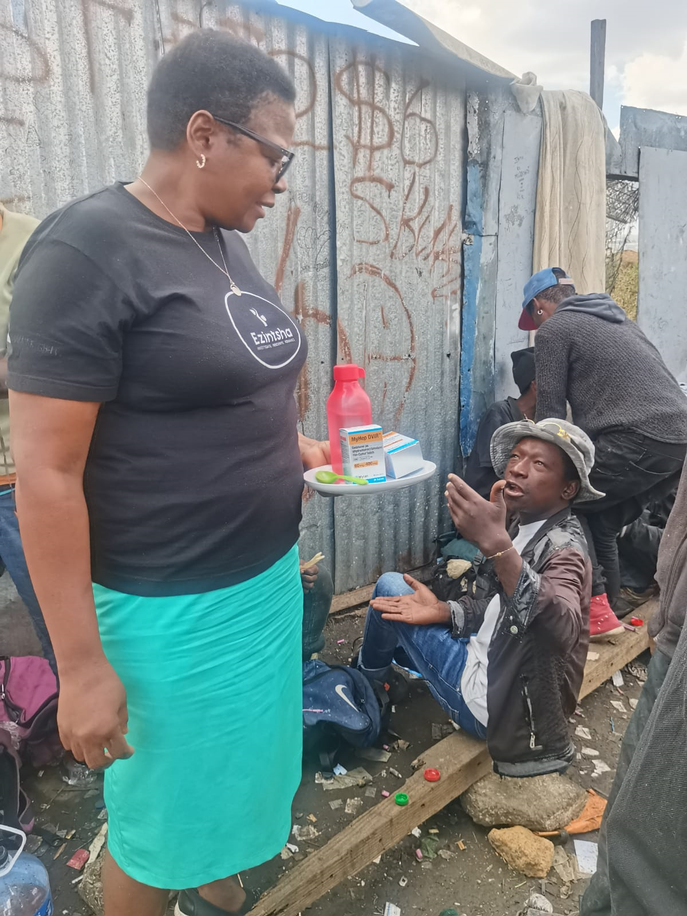
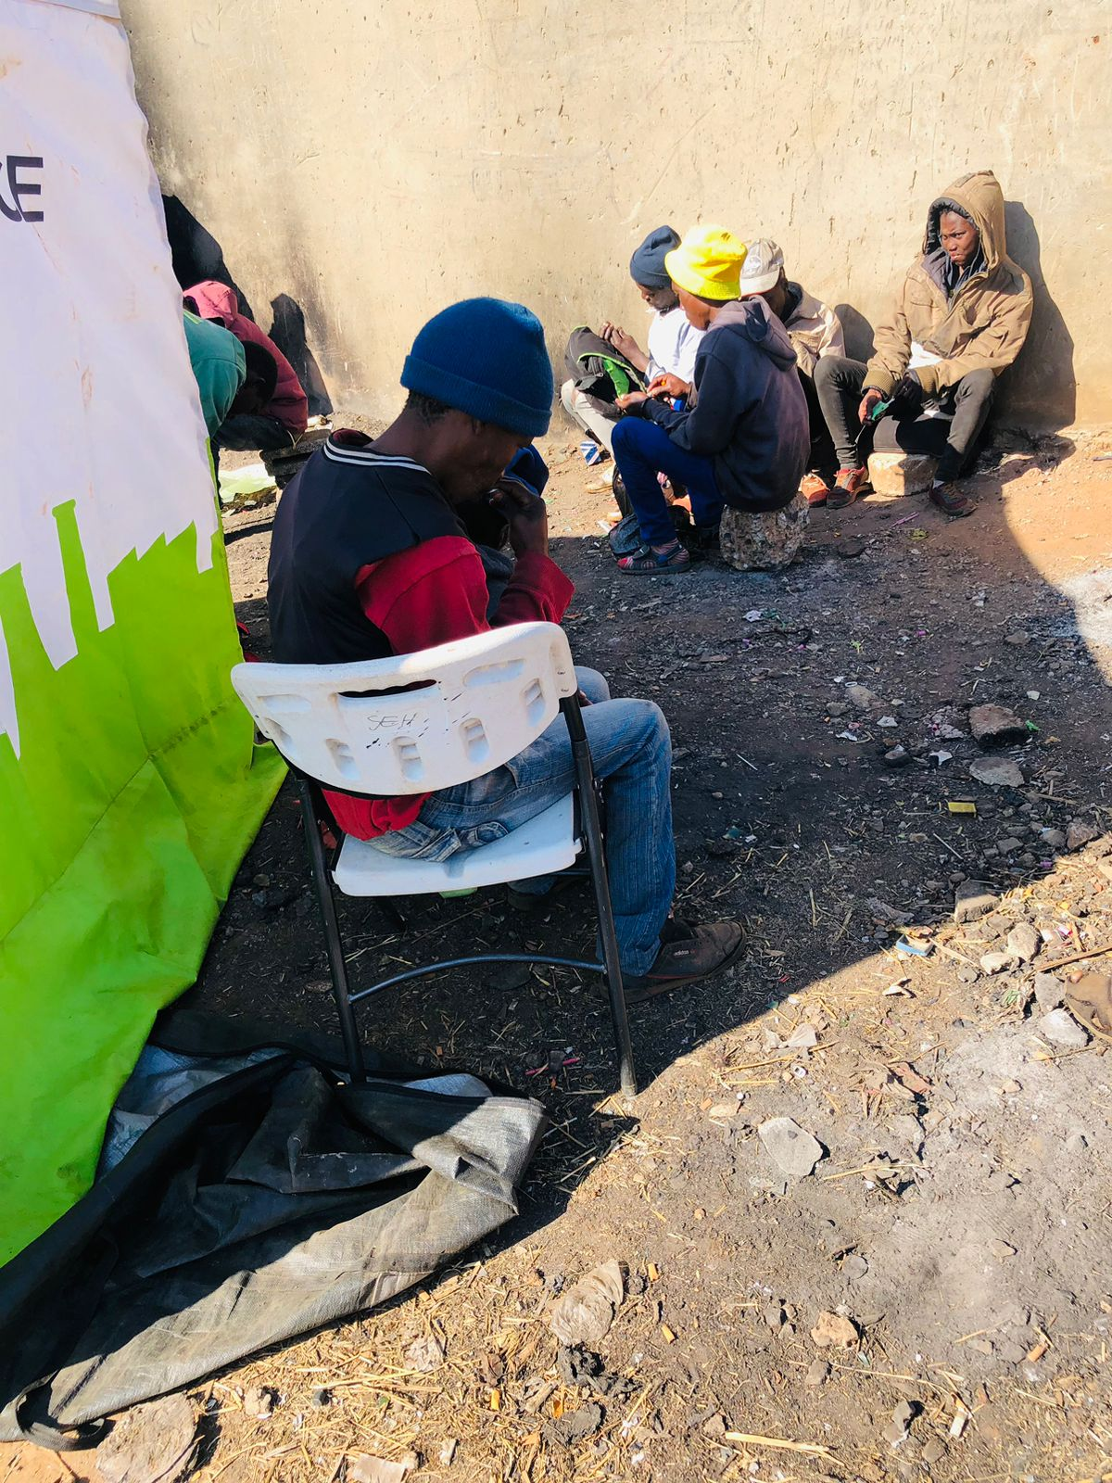
Introduction
JOHANNESBURG HEALTH DISTRICT
2024 RESEARCH CONFERENCE
Recognizing the urgent need to address Hep C, the World Health Organization (WHO) has stressed the importance of community-based testing approaches to achieve HCV elimination goals.
Drawing on the success of HIV self-testing, Hepatitis C Virus Self-Testing (HCVST) has emerged as a promising strategy to expand testing coverage and reach populations traditionally underserved by conventional testing methods.
The co-infection of Human Immunodeficiency Virus (HIV) and Hepatitis C Virus (HCV) poses a significant public health concern, particularly within the demographic of males who inject drugs (MWID). This intersection of viral infections presents complex challenges, as individuals engaging in injection drug use are at heightened risk for acquiring both HIV and HCV.
#JoburgResearch2024

Slide 4
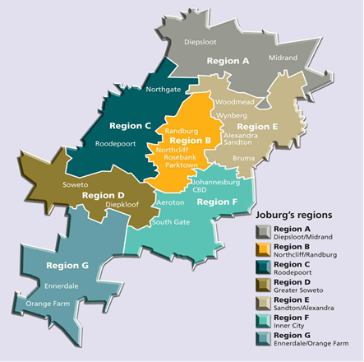
Primary Objectives, AIMS of the Study
JOHANNESBURG HEALTH DISTRICT
2024 RESEARCH CONFERENCE
Objectives
Primary
To measure the effectiveness of HCVST in HCV testing uptake, linkage to confirmatory testing, diagnosis and treatment among KPs in Johannesburg.
Secondary
To evaluate the lay users’ interaction with the self test kit in terms of effectiveness and efficiency, i.e. successful / unsuccessful completion and difficulty of the critical steps as per the Instructions for Use in on site testing modalities
To assess participant’s adherence to the recommended HCV treatment and completion of regimen
Methods
Study design: A prospective observational study to assess the effectiveness of Hepatitis- Virus Self-Testing (HCVST) in diagnosing Hepatitis C virus (HCV) among key populations (KP) in South Africa.
We did this through:
Assisted implementation of Hepatitis C Virus self-tests in Johannesburg (Region A-G), South Africa to further understand their operational characteristics (acceptability, feasibility, usability) and impact within KPs (PWIDs, PWUDs, MSM, SWs). We integrated HCVST with existing HIV services offered to KPs at the Yeoville Harm Reduction Site and Outreach Programs
#JoburgResearch2024

Slide 5
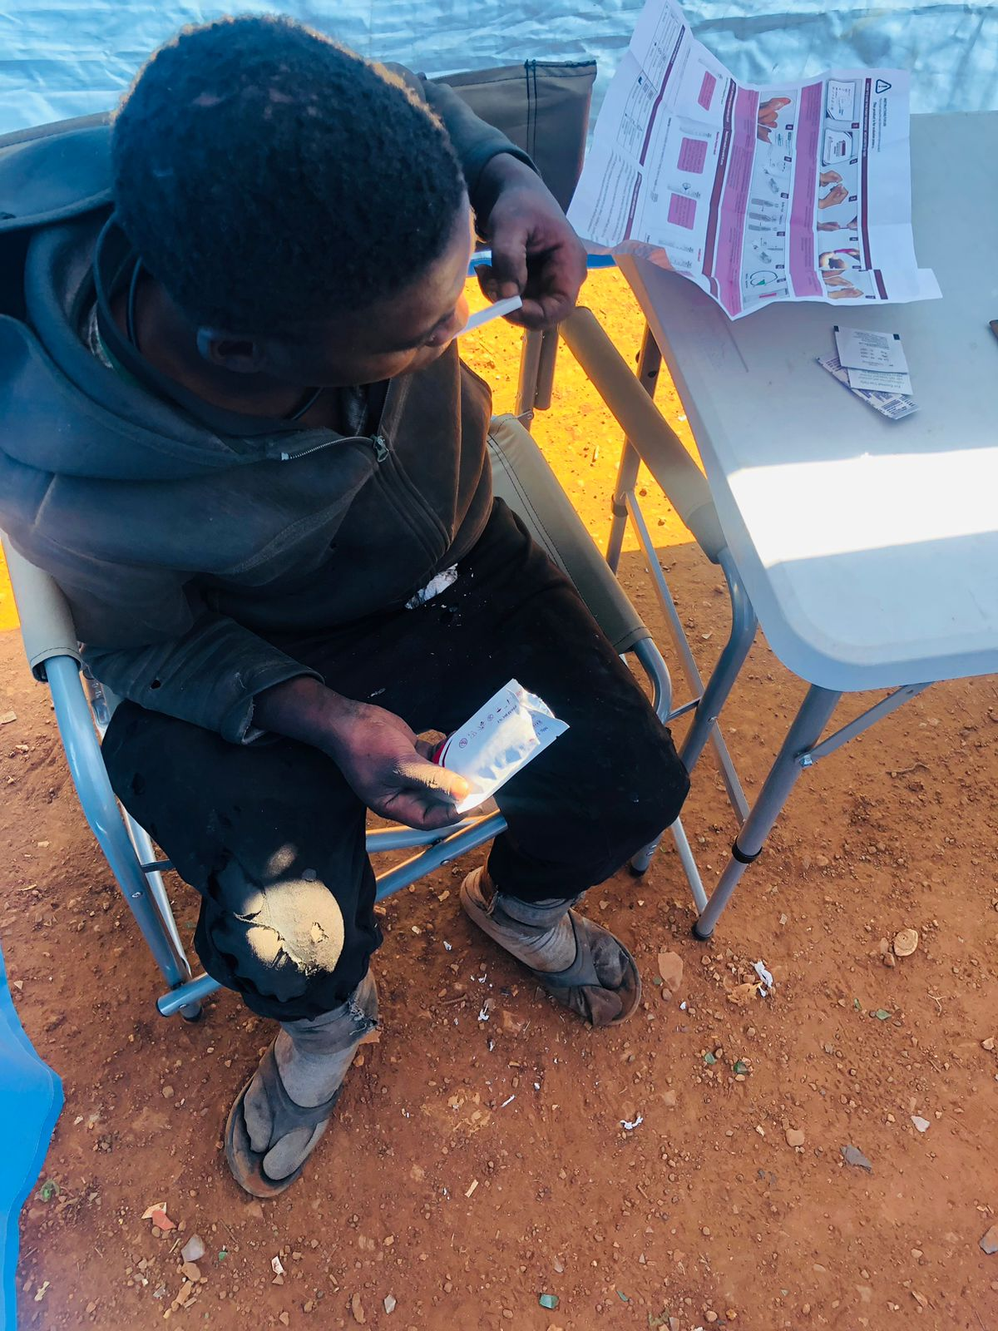
Methodology
JOHANNESBURG HEALTH DISTRICT
2024 RESEARCH CONFERENCE
In one model, we provided Hepatitis C Virus self-tests (both oral-fluid and blood-based) during HIV service visits.
In the other model, community-based HCV self-testing (HCVST) was conducted through outreach efforts.
This comprehensive approach aims to understand the intricate relationship between HIV and HCV among males who inject drugs.
By offering HCV self-tests in different key populations, we aim to gain insights into their acceptance and the feasibility of self-testing.
Individuals who tested positive for HCV on the self-test were given the option for confirmatory testing.
Those confirmed positive for HCV on polymerase chain reaction (PCR) were eligible to receive free Direct Acting Antivirals as part of the study.
#JoburgResearch2024

Slide 6
Results
JOHANNESBURG HEALTH DISTRICT
2024 RESEARCH CONFERENCE
From June 2023 to December 2023, a total of 1058 males who inject drugs participated in the study.
Out of these, 874 (82.6%) tested positive on the HCV self-test.
Among the positive results, 754 individuals (71.3%) were confirmed positive through PCR testing.
#JoburgResearch2024

Slide 7
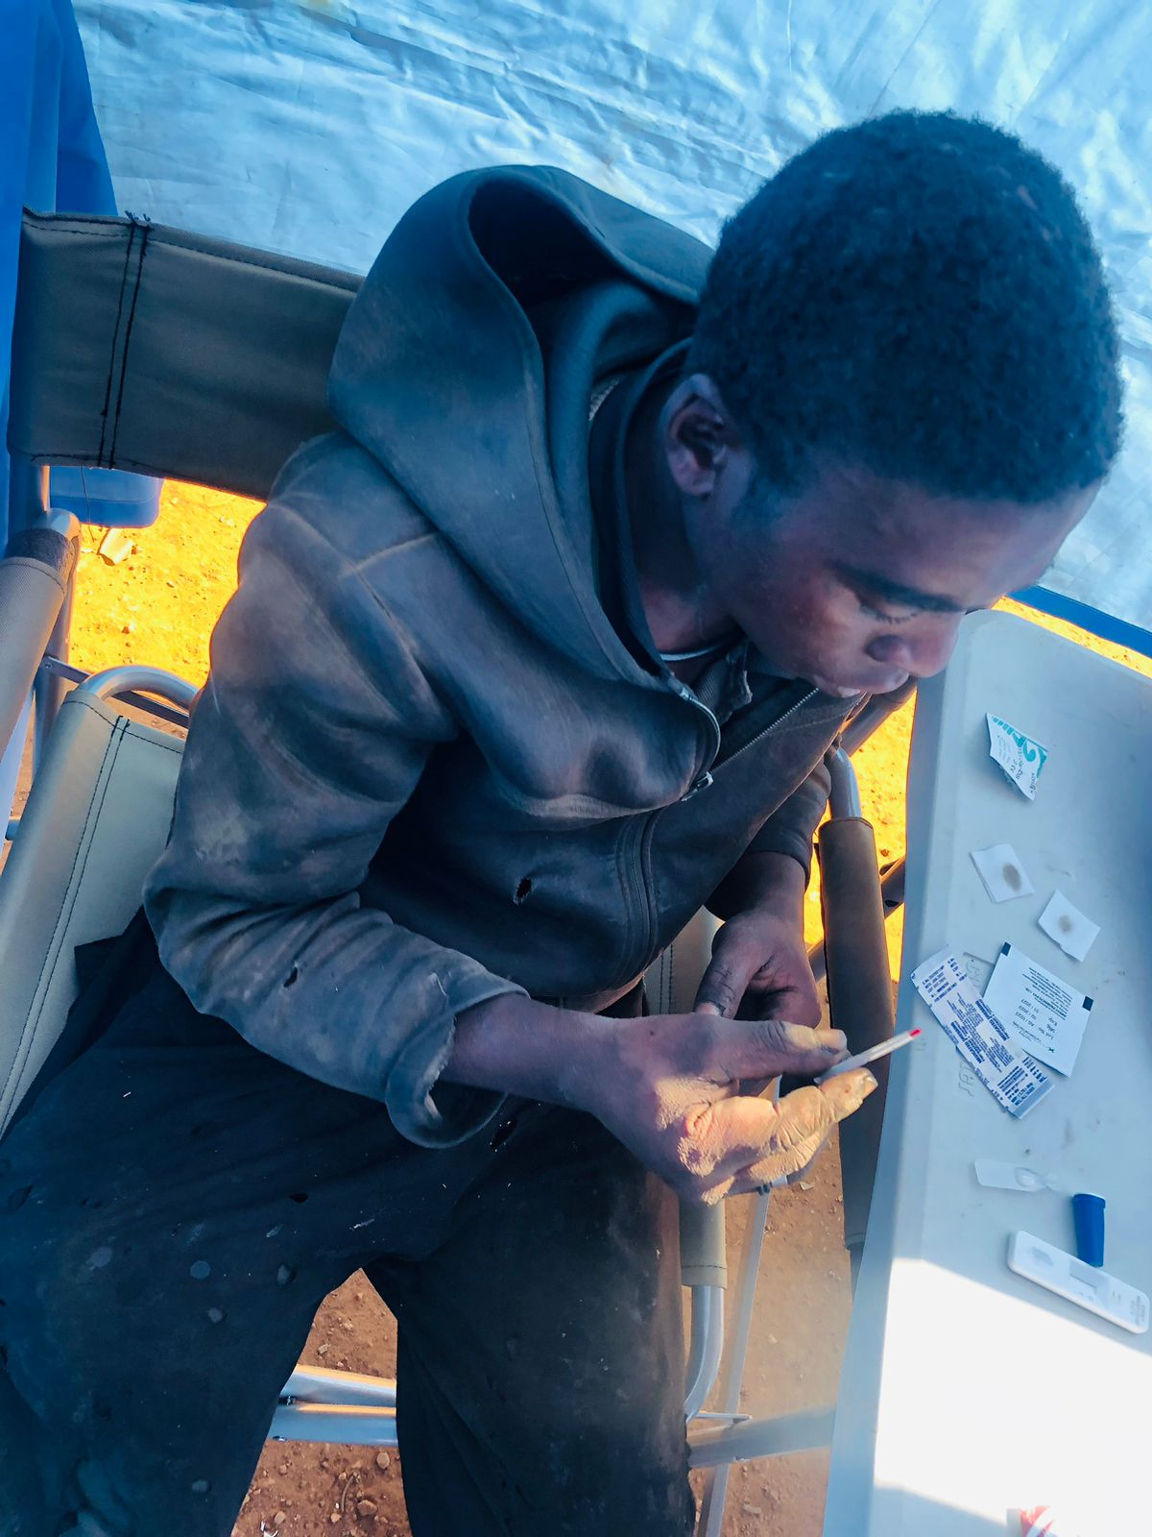
Results…cont
JOHANNESBURG HEALTH DISTRICT
2024 RESEARCH CONFERENCE
For those who visited the sites for HIV services, 274 had undergone HIV testing. Among them, 84 (30.7%) tested positive, while 190 (69.3%) tested negative.
The study found that 1005 participants (95%) admitted to injecting multiple times a day, and a significant number, 1032 (97.5%), had never been tested for Hepatitis C before.
Notably, 90% of the participants expressed a willingness to conduct future self-tests using an HCV self-test.
#JoburgResearch2024

Slide 8
Conclusion
JOHANNESBURG HEALTH DISTRICT
2024 RESEARCH CONFERENCE
Ultimately, our findings underscore the need for comprehensive public health strategies that address the specific challenges faced by men who inject drugs, promoting both awareness and accessibility to testing services for HIV and Hepatitis C.
The integration of HCVST into existing HIV services vice versa represents a step forward in advancing public health initiatives that target key populations and contribute to the control of these epidemics.
#JoburgResearch2024

Slide 9

THANK YOU
JOHANNESBURG HEALTH DISTRICT
2024 RESEARCH CONFERENCE
Contact: Mohammed Majam
Director Medical Technologies
mmajam@ezintsha.org
+27828260180
#JoburgResearch2024

