Slide 1





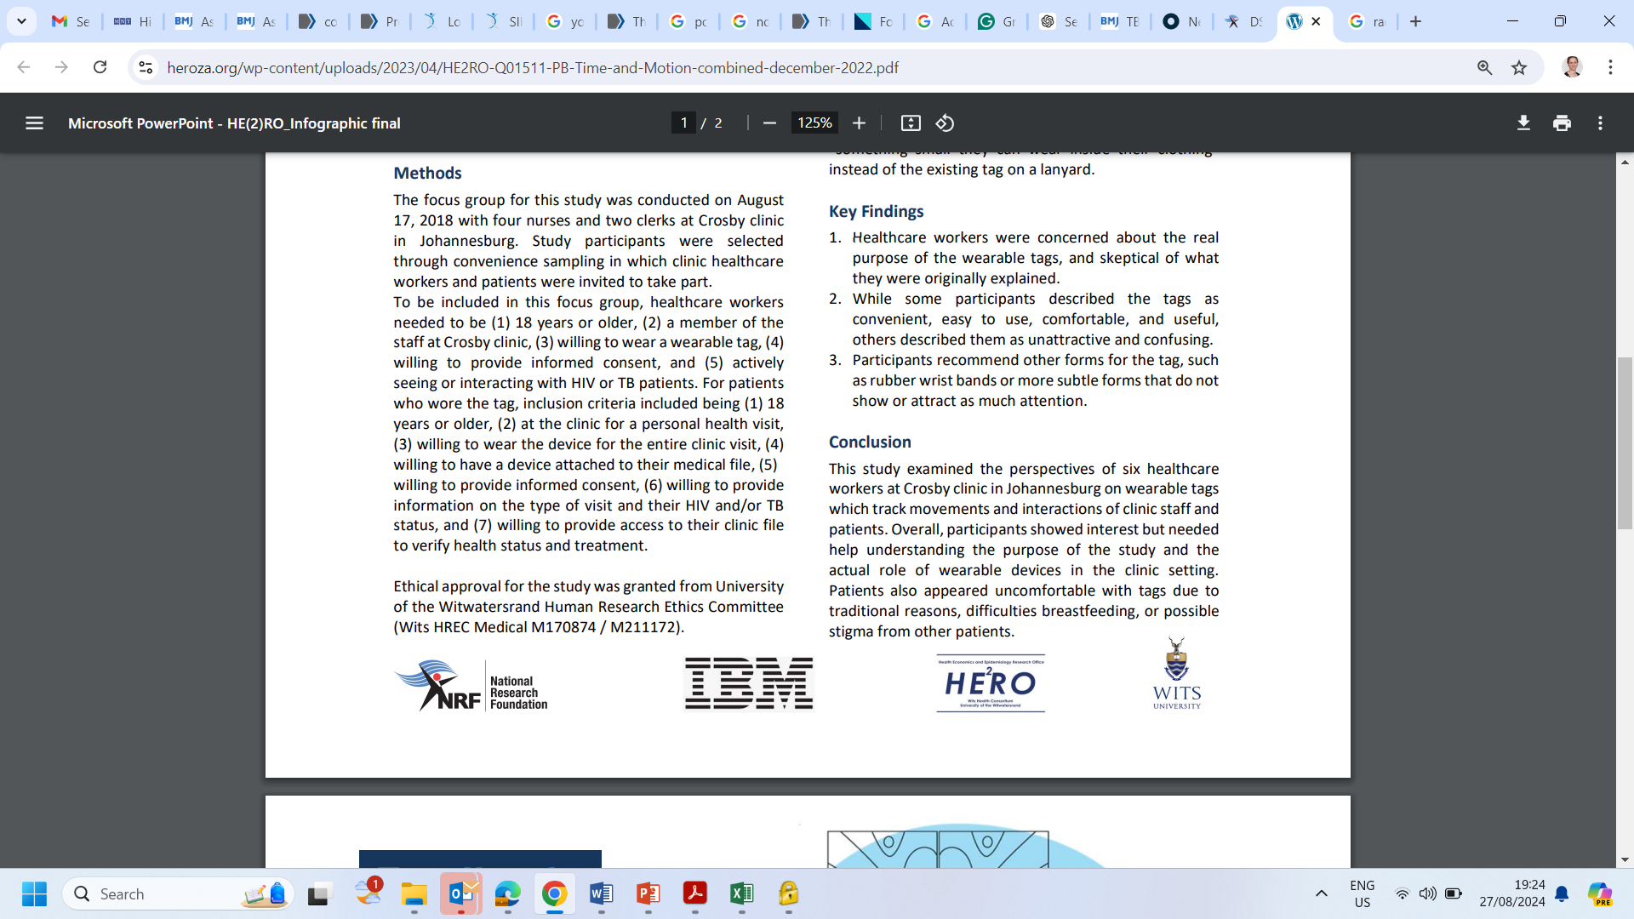
Perspectives of healthcare workers on the novel electronic technology of wearable tags
Galvin M, N Musakwa, M Molapo, M Magadla, D Mapiye, T Kurien, S Makhanya, E Vos, D Evans
Health Economics and Epidemiology Research Office, Wits Health Consortium
Faculty of Health Sciences, University of the Witwatersrand, Johannesburg, South Africa

Slide 2
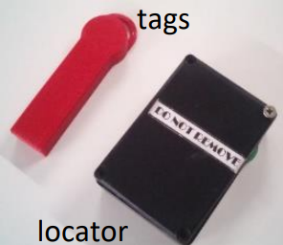
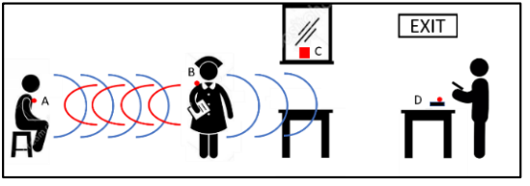
Background
Time and Motion - studies rely on passive observation and specific activities are timed, others ask staff to keep a log file to estimate the time spent on a specific activity, but both are subject to observer errors.
HE2RO and IBM investigators worked together to develop non-invasive electronic devices or “wearable tags” to conduct a time and motion (TIM) study.
Novel electronic technology to assess operational efficiency of HIV clinics in Johannesburg.

Slide 3
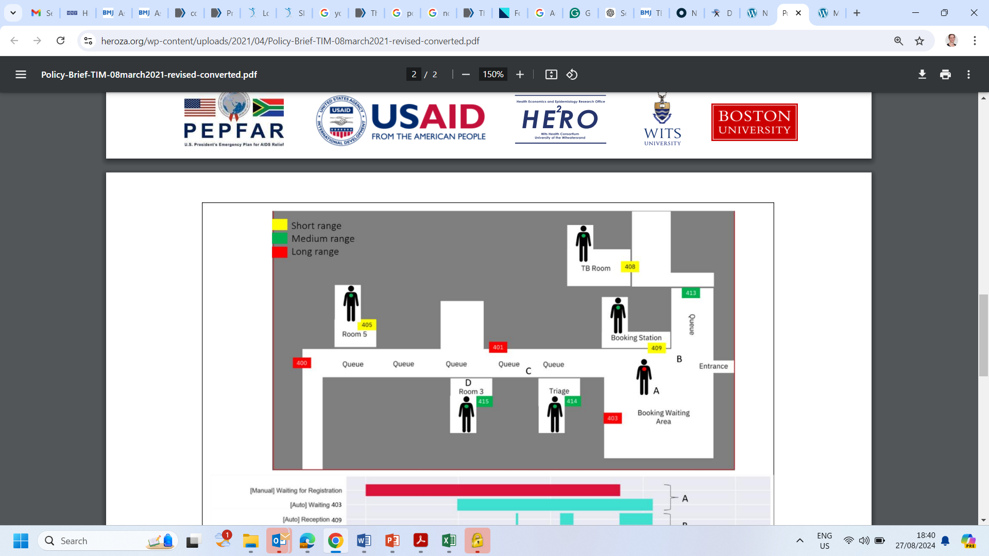




Background
Mapped facilities
&
placed locators
Recruited HCWs
& assigned tags
Recruited patients
& assigned tags
Passive observation “manual data verification”

Slide 4
Background
Mapped facilities
&
placed locators
Recruited HCWs
& assigned tags
Recruited patients
& assigned tags
Passive observation “manual data verification”
AIM: Perspectives of healthcare workers on the novel electronic technology of wearable tags

Slide 5
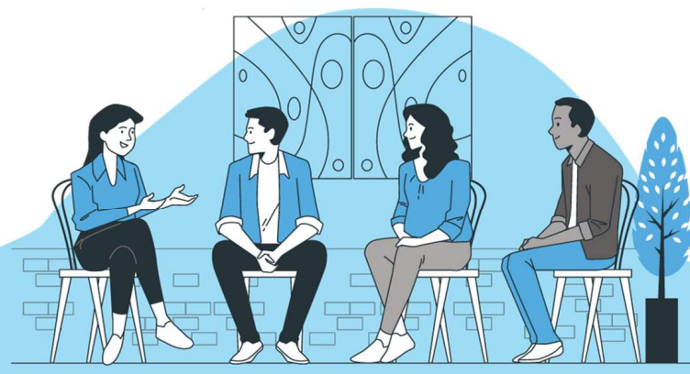

Methods
FGDs with nurses and clerks at a primary healthcare facility in Johannesburg.
Convenience sampling was used to select healthcare workers who were
18 years or older,
a member of the staff at the clinic,
willing to wear a wearable tag,
willing to provide informed consent, &
actively seeing/ or interacting with HIV or TB patients.
FGDs were translated and transcribed verbatim and thematically analysed using NVivo analysis software.
Health Economics and Epidemiology Research Office (HE²RO)

Slide 6
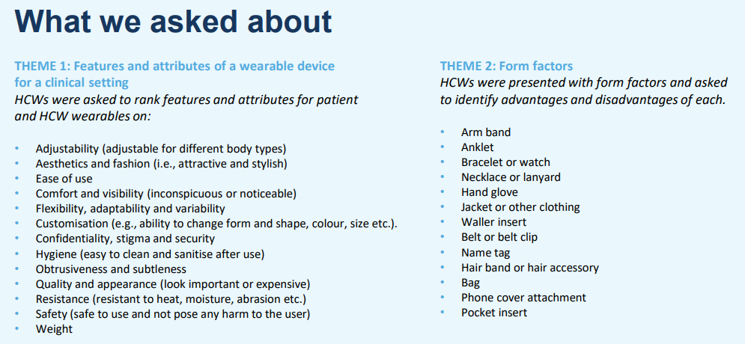
Health Economics and Epidemiology Research Office (HE²RO)

Slide 7

Health Economics and Epidemiology Research Office (HE²RO)

Slide 8
Summary
Healthcare workers were concerned about the real purpose of the wearable tags, and skeptical of what they were originally explained.
While some participants described the tags as convenient, easy to use, comfortable, and useful, others described them as unattractive and confusing.
Participants recommend other forms for the tag, such as rubber wrist bands or more subtle forms that do not show or attract as much attention.
Overall, participants showed interest but needed help understanding the purpose of the study and the actual role of wearable devices in the clinic setting.
Patients also appeared uncomfortable with tags due to traditional reasons, difficulties breastfeeding, or possible stigma from other patients.
Health Economics and Epidemiology Research Office (HE²RO)

Slide 9



Thank You
For Your Attention
information@heroza.org
+27 10 001 7930
www.heroza.org

