Slide 1





Nursing colleges in higher education: Determinants of organisational readiness for change
JOHANNESBURG HEALTH DISTRICT
2024 RESEARCH CONFERENCE
Authors:
PY Mudzi & J Bruce
Faculty of Health Sciences
University of the Witwatersrand
#JoburgResearch2024

Slide 2
Introduction and background
JOHANNESBURG HEALTH DISTRICT
2024 RESEARCH CONFERENCE
Understanding organisational readiness is crucial for successful change implementation.
Anecdotes exist, but empirical research on public nursing colleges' readiness for transitioning to higher education is lacking.
Existing criteria for programme accreditation might not capture college leadership's perspective on readiness for the transition process.
Public nursing colleges are governed by provincial DoH, and they would need to undergo significant change during the higher education integration process.
Last intake for legacy nursing programmes was 2019
#JoburgResearch2024

Slide 3
Aim & Objectives
JOHANNESBURG HEALTH DISTRICT
2024 RESEARCH CONFERENCE
Aim: To determine the readiness of public nursing colleges for integration into higher education.
Objectives:
To determine the nursing college managers and nursing education directors’ change commitment to the integration process.
To determine the nursing college managers and nursing education directors’ change efficacy towards the integration process.
To establish the overall nurse managers’ perceived readiness of nursing colleges for integration into higher education.
#JoburgResearch2024

Slide 4
Methodology
JOHANNESBURG HEALTH DISTRICT
2024 RESEARCH CONFERENCE
Research design: descriptive, cross-sectional quantitative study.
Population: 75 participants (n=75) from a target population of 88 nursing college managers and nursing education directors (N=88).
Sampling: Purposive, across three provinces: rural, urban and mixed urban and rural settings.
Data collection: a cross-sectional, survey design was used to administer the ORIC scale to measure the change efficacy and change commitment of nursing colleges.
Data Analysis: descriptive statistics, Mann-Whitney U test for two groups and Kruskal-Wallis test for between two or more variable differences.
#JoburgResearch2024

Slide 5
Participant demographics (n=75)
JOHANNESBURG HEALTH DISTRICT
2024 RESEARCH CONFERENCE
Variable | Frequency (n) | Percentage (%)
Province of Employment
Urban province nursing college | 9 | 12.0
Rural province nursing college | 55 | 73.3
Mixed urban and rural province nursing college | 11 | 14.7
Years of Teaching Experience
0-5 | 13 | 17.3
6-10 | 16 | 21.3
11-15 | 16 | 21.3
16-20 | 16 | 21.3
>20 | 14 | 18.7
Highest Level of Qualification
Bachelor’s degree | 27 | 36.0
Postgraduate/ Higher Postgraduate Diploma | 2 | 2.7
Master’s degree | 36 | 48.0
PhD | 10 | 13.3
#JoburgResearch2024

Slide 6
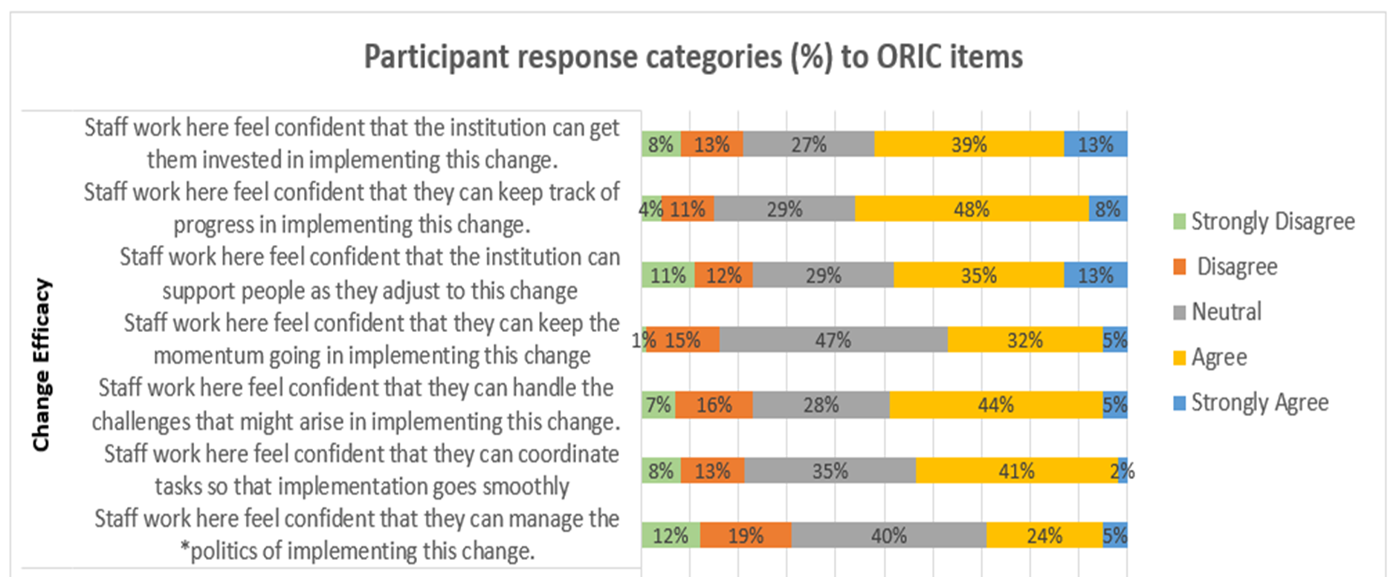
Participant response categories (%) to ORIC items
JOHANNESBURG HEALTH DISTRICT
2024 RESEARCH CONFERENCE
#JoburgResearch2024

Slide 7
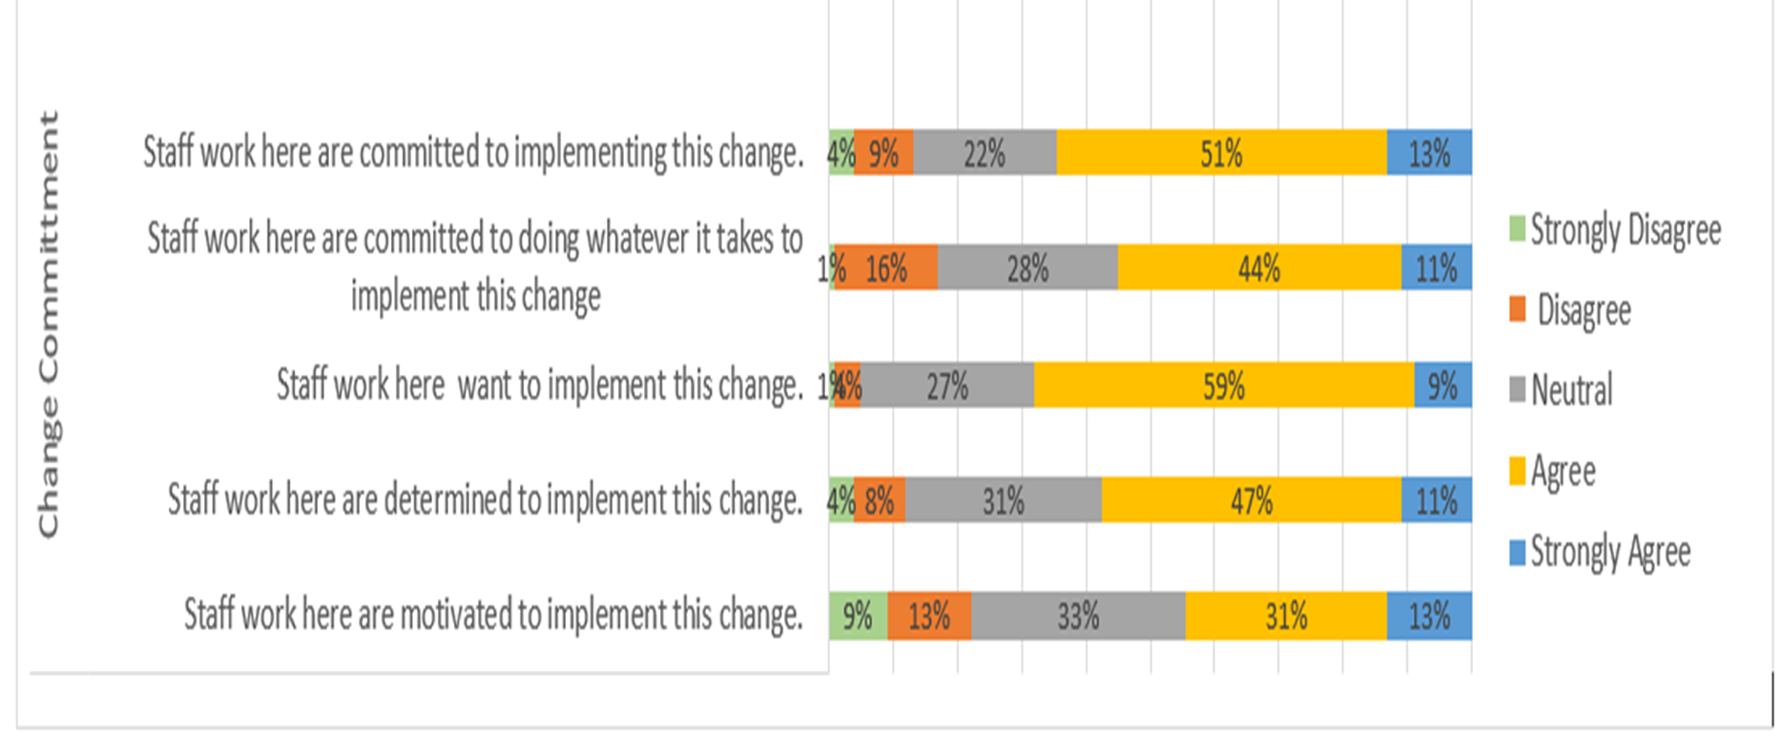
Participant response categories (%) to ORIC items
JOHANNESBURG HEALTH DISTRICT
2024 RESEARCH CONFERENCE
#JoburgResearch2024

Slide 8
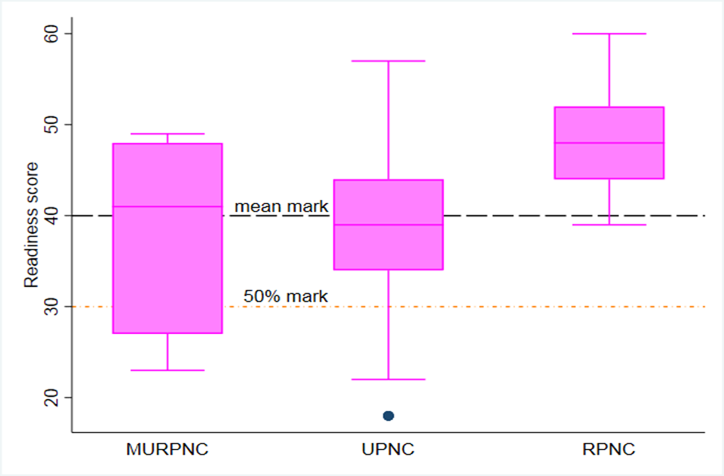
Readiness for change in the three nursing colleges
JOHANNESBURG HEALTH DISTRICT
2024 RESEARCH CONFERENCE
The rural province nursing college had the highest level of readiness (median: 48, IQR: 44-52).
The overall readiness of the nursing colleges was assessed by aggregating individual scores and calculating the mean (Adelson et al., 2021);
The threshold for readiness to change was a mean of 40; Mean scores:
Change efficacy: 22.7
Change commitment: 17.5
Overall mean score: 40.2 (marginal level of readiness)
#JoburgResearch2024

Slide 9
Factors influencing organisational readiness
JOHANNESBURG HEALTH DISTRICT
2024 RESEARCH CONFERENCE
There were statistically significant differences in readiness levels among the nursing colleges to implement change (p= 0.04).
Participants with >20 years of teaching experience perceived higher readiness levels to change than the less experienced staff (48, IQR: 42-49), p=0.003.
No significant differences were found based on gender (p=0.13), qualification level (p = 0.88) , and employee designation (p = 0.32).
#JoburgResearch2024

Slide 10
Limitations
JOHANNESBURG HEALTH DISTRICT
2024 RESEARCH CONFERENCE
Use of online and face-to-face modes to administer the ORIC survey across provinces may potentially affect data collection uniformity.
The study was conducted in nursing colleges across three different geographic locations there may be variances among other public nursing colleges that were not part of the study.
Low participation by members in the nursing education and training directorate.
#JoburgResearch2024

Slide 11
Recommendations
JOHANNESBURG HEALTH DISTRICT
2024 RESEARCH CONFERENCE
Leverage determinants of change readiness
Conduct needs assessments in the nursing colleges to identify barriers to readiness for change.
Develop strategies to manage politics of change
Strengthen stakeholder engagement at the onset of change (include. reps from nurse educators, practitioners, and regulatory bodies, policy makers) - balance power dynamics.
Develop location-specific strategies to enhance readiness
Consider infrastructure, resources, and cultural differences when developing strategies for different locations.
Focus on the challenges faced by historically disadvantaged nursing colleges.
Ensure active leadership involvement
Promote regular communication between district health authorities and nursing college leaders.
Motivation
Incentives, recognition, career advancement, CPD.
#JoburgResearch2024
Notes:
Politics – communication, decision making, power relations within the institution

Slide 12
References
JOHANNESBURG HEALTH DISTRICT
2024 RESEARCH CONFERENCE
Adelson, P., Yates, R., Fleet, J., Mckellar, L., 2021. Measuring organisational readiness for implementing change (ORIC) in a new midwifery model of care in rural South Australia. BMC Health Services Research 21(1), 368. DOI:10.1186/s12913-021-06373-9.
Armstrong, S.J., Geyer, N. & Bell, C.A. 2019. The capacity of South African nursing education institutions to meet healthcare demands: a looming disaster? International Journal of Africa Nursing Sciences, 10:92-101. https://doi.org/10.1016/j.ijans.2019.01.009.
Maes, G. & Van Hootegem G. 2022. Power and politics in different change discourses. Administrative Sciences, 12(2):64. https://doi.org/10.3390/admsci12020064.
Makhanya, N.J., Matahela, V.E., & Buthelezi, G. (2022). Responding to post-school education policy reforms: a case study on the incorporation of nursing colleges into the post-school education and training system of South Africa. Global Journal of Health Science, 14(9), 39-40. https://doi.org/10.5539/gjhs.v14n9p29.
Rowold, J. & Abrell-Vogel, C. 2014. The influence of leaders' commitment to change on the effectiveness of transformational leadership in change situations – a multilevel investigation. Journal of Organisational Change Management, 27(6):900-921. https://doi.org/10.1108/JOCM-07-2012-0111
Shea, C.M., Jacobs, S.R Shea et al., Esserman, D.A., Bruce, K., Weiner, B.J., 2014. Organizational readiness for implementing change: a psychometric assessment of a new measure. Implementation Science 9, 7. https://doi.org/10.1186/1748-5908-9-7.
Storkholm, M.H., Mazzocato, P., Tessma, M.K. & Savage, C. 2018. Assessing the reliability and validity of the Danish version of organisational readiness for implementing change (ORIC). Implementation Science, 13:78. https://doi.org/10.1186/s13012-018-0769-y.
Weiner, B.J., Lewis, M.A., Linnan, L.A., 2009. Using organization theory to understand the determinants of effective implementation of worksite health promotion programs. Health Educ Res. 24 (2), 292–305. DOI: 10.1093/her/cyn019.
#JoburgResearch2024

Slide 13

JOHANNESBURG HEALTH DISTRICT
2024 RESEARCH CONFERENCE
#JoburgResearch2024

