Slide 1





Integrated Hepatitis C virus Self-Testing and HIV Services among People who inject and use Drugs in Johannesburg
JOHANNESBURG HEALTH DISTRICT
2024 RESEARCH CONFERENCE
Mohammed Majam
Ezintsha Research Centre
Faculty of Health Sciences, University of the Witwatersrand, Johannesburg
#JoburgResearch2024

Slide 2
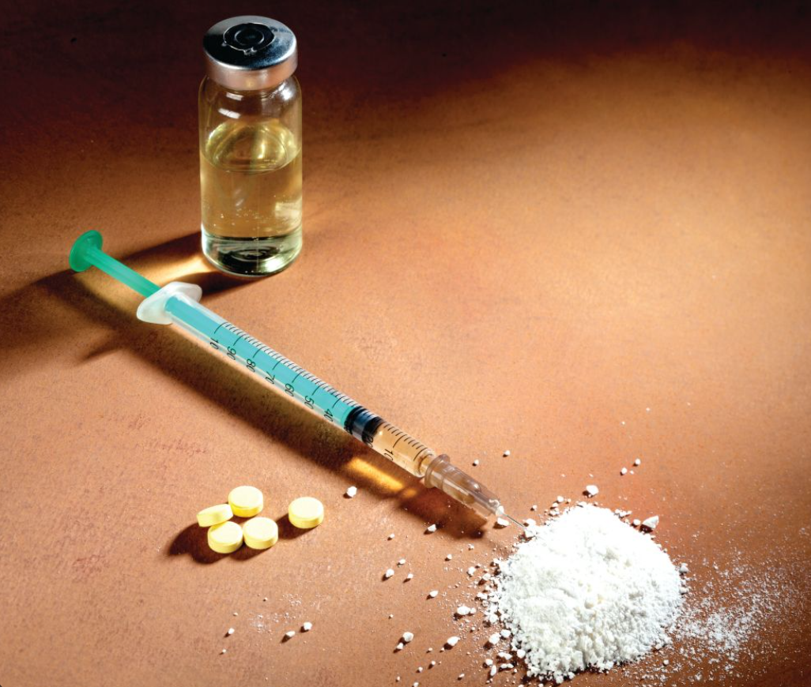
Background
JOHANNESBURG HEALTH DISTRICT
2024 RESEARCH CONFERENCE
Approximately 13 million people globally inject drugs, and 1.7 million of those are living with HIV
People who inject and use drugs (PWIDs and PWUDs) are at higher risk of contracting both HIV and hepatitis C
This vulnerable population, particularly those who test positive for HCV RNA, encounters challenges regarding healthcare access, treatment adherence, and co-management of both infections
The coexistence of HIV and HCV among this population requires a detailed understanding of:
Epidemiological (Healthcare utilisation, high prevalence of drug usage, concentrated epidemics)
Clinical (delayed diagnoses and treatment, high viral load, shared injection needles, frequent injection practices)
Socio-behavioral factors (Poverty, unemployment, transactional sex, lack of education)
These coinfection poses complex health implications that’s affects disease progression, treatment outcomes, and overall morbidity and mortality rates
#JoburgResearch2024

Slide 3

Study implementation Objectives
JOHANNESBURG HEALTH DISTRICT
2024 RESEARCH CONFERENCE
To evaluate the effectiveness of Hepatitis C Virus (HCVST) in diagnosing HCV among the key population
To explore operational characteristics and impact within these high-risk populations (PWIDs and PWUDs) by integrating HCVST with existing HIV services
#JoburgResearch2024

Slide 4
Methods
JOHANNESBURG HEALTH DISTRICT
2024 RESEARCH CONFERENCE
Study implementation duration: July 2023- January 2024
Study population: High-risk population all genders (PWIDs and PWUDs)
Targeted population number: 1600
Study sites: Harm reduction sites, partnered clinic (Yeoville-Anova) in Johannesburg
#JoburgResearch2024

Slide 5

Results
JOHANNESBURG HEALTH DISTRICT
2024 RESEARCH CONFERENCE
960824 HCV RNA positive confirmed
96313 Participants tested for HIV
960824 HCV RNA positive confirmed
99
HIV positive confirmed
Medical history collected before DAA initiation
55
initiated on ART
960Linkage to care
#JoburgResearch2024

Slide 6
Conclusion
JOHANNESBURG HEALTH DISTRICT
2024 RESEARCH CONFERENCE
The study highlights the successful integration of HCV self-testing with HIV services, revealing a high burden of HCV among people who inject drugs (PWID) and people who use drugs (PWUD).
Focused on HIV, the findings stress the importance of linking individuals to care for confirmatory testing, treatment, and adherence
The rates of HIV co-infection underscore the need for comprehensive healthcare approaches for high-risk populations.
#JoburgResearch2024

Slide 7

Recommendations
JOHANNESBURG HEALTH DISTRICT
2024 RESEARCH CONFERENCE
Remove punitive laws, policies and practice to enable health interventions
A comprehensive package of services (HIV, PrEP, PEP, STIs, etc.) to address these infectious diseases in people who inject drugs
Increase more harm reduction interventions to reduce transmission of HIV, HCV and other infectious diseases
Avoid general stigma and social exclusion of PWIDs and PWUDs
Access to healthcare facilities without being discriminated
#JoburgResearch2024

Slide 8
Acknowledgement of Funders and collaborators
JOHANNESBURG HEALTH DISTRICT
2024 RESEARCH CONFERENCE
PSI, UNITAID
ANOVA Team
Ezintsha Medical Technologies team
#JoburgResearch2024

