Slide 1





Virological Suppression at the time of delivery in HIV positive pregnant women on ART at South Rand Hospital
JOHANNESBURG HEALTH DISTRICT
2024 RESEARCH CONFERENCE
Jessica Robertson, Imaan Hassim, Kemolemo Tseki, Mamolatelo Kgare, Sara Yenson-Demetrio, Ismaeel Chohan & Adam Sarlie
Supervisors: Dr Coceka Mnyani & Dr Mimie Jordaan
#JoburgResearch2024

Slide 2
Introduction
JOHANNESBURG HEALTH DISTRICT
2024 RESEARCH CONFERENCE
In 2023, 7,7 million people were living with HIV in SA, 63,6% were women of childbearing age
Mother-to-child transmission (MTCT) rates have declined from >20% in 2003 to 2,39% in 2023
There are still >1 000 infants per 100 000 live-births newly infected with HIV yearly
Maternal VL = important risk factor for MTCT
VL done antenatally, at delivery, 6 months postpartum & 6 monthly while breastfeeding (coverage still suboptimal)
#JoburgResearch2024
Notes:
Fast forward to 2023, where th

Slide 3
Aim
JOHANNESBURG HEALTH DISTRICT
2024 RESEARCH CONFERENCE
To determine the rate of viral suppression at delivery in pregnant WLWH on ART who delivered at SRH from 1 July to 31 December 2021
Objectives
To assess the number of pregnant WLWH on ART that had VL testing during pregnancy & at delivery & the proportion that were virally suppressed
To determine the factors influencing viral suppression at delivery
To evaluate infant birth HIV PCR testing & results
#JoburgResearch2024

Slide 4
Methodology
JOHANNESBURG HEALTH DISTRICT
2024 RESEARCH CONFERENCE
Conducted at South Rand Hospital (SRH) obstetrics unit in Johannesburg, Gauteng
Retrospective record review of pregnant WLWH who delivered at SRH between 1st July - 31st December 2021
The total study population was 311
Data from only 199 files was collected due to difficulties obtaining patient records
Data extracted from maternity case records & NHLS website
Data captured onto a standardised collection tool on the RedCap database
#JoburgResearch2024

Slide 5
Results: Demographics
JOHANNESBURG HEALTH DISTRICT
2024 RESEARCH CONFERENCE
Mean age = 31,39 years (SD= 5,68)
Median gravidity = 3 (IQR= 1-3)
Median parity = 1 (IQR= 1-2)
178 (89,45%) primigravid participants
195 (97,99%) booked participants
#JoburgResearch2024

Slide 6
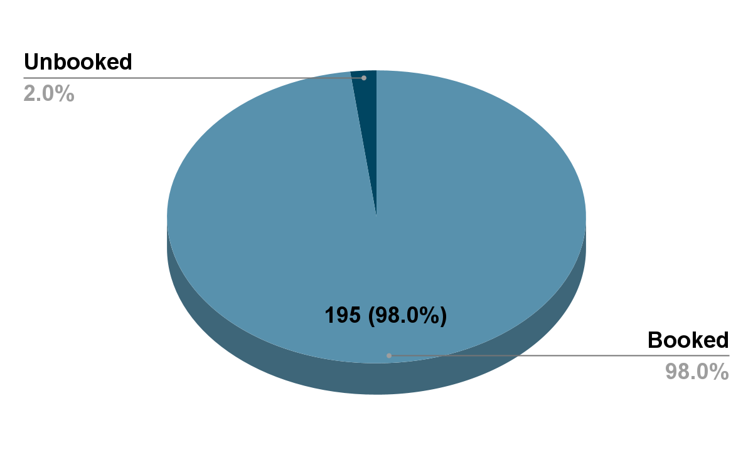
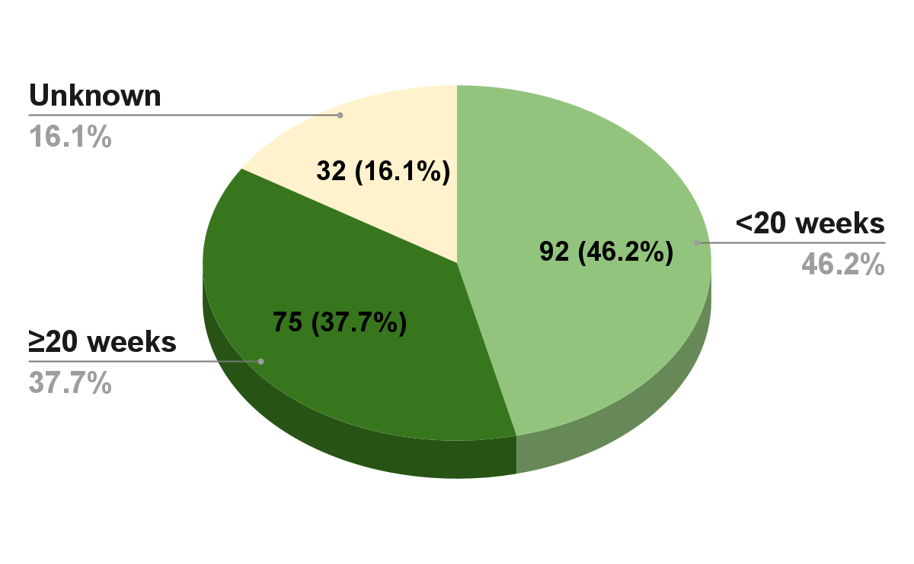
Results : Demographics
JOHANNESBURG HEALTH DISTRICT
2024 RESEARCH CONFERENCE
Figure 2: Number of WLWH booked for ANC
Figure 3: Timing of 1st ANC visit
#JoburgResearch2024

Slide 7
Results: HIV Treatment
JOHANNESBURG HEALTH DISTRICT
2024 RESEARCH CONFERENCE
Timing of ART initiation Before pregnancy During pregnancy Unknown | Number of women (n) 131 65 3 | Percentage (%) 66,84 33,16 1,51
Duration on ART at delivery ≥3 months before delivery <3 months before delivery Unknown | Number of women (n) 172 18 9 | Percentage (%) 86,87 9,09 4,52
#JoburgResearch2024

Slide 8
Results: HIV Treatment
JOHANNESBURG HEALTH DISTRICT
2024 RESEARCH CONFERENCE
ART regimen TLD TEE Not specified | Number of women (n) 103 55 41 | Percentage (%) 51,76 27,64 20,60
#JoburgResearch2024

Slide 9
Results: Baseline CD4 Count
JOHANNESBURG HEALTH DISTRICT
2024 RESEARCH CONFERENCE
144 (72.7%) had a known baseline CD4 count
Median (IQR) of 435 cells/ml (288-632)
Baseline CD4 count (cells/ml) ≥500 350-499 200-349 <200 Not documented | Number of women (n) 63 36 24 22 54 | Percentage (%) 43,45 24,83 16,55 15,17 27,64
#JoburgResearch2024

Slide 10
Results: VL Testing During Pregnancy
JOHANNESBURG HEALTH DISTRICT
2024 RESEARCH CONFERENCE
At least 1 ANC VL test Yes No | Number of women (n) 148 51 | Percentage (%) 74,37 25,63
Number of ANC VL tests 0 1 2 | Number of women (n) 51 133 15 | Percentage (%) 25,63 66,83 7,54
1st VL Test Result Suppressed (<50 copies/ml) Unsuppressed (≥50 copies/ml) No barcode | Number of women (n) 103 42 3 | Percentage (%) 69,59 28,38 2,03
#JoburgResearch2024

Slide 11
Results: Pregnancy Outcomes
JOHANNESBURG HEALTH DISTRICT
2024 RESEARCH CONFERENCE
176 (89,34%) participants gave birth at ≥37 weeks gestation
135 (67,84%) participants had an NVD
Birth weights
  ≥2500g: 179 (89,95%)
  <2500g: 20 (10,05%)
#JoburgResearch2024

Slide 12
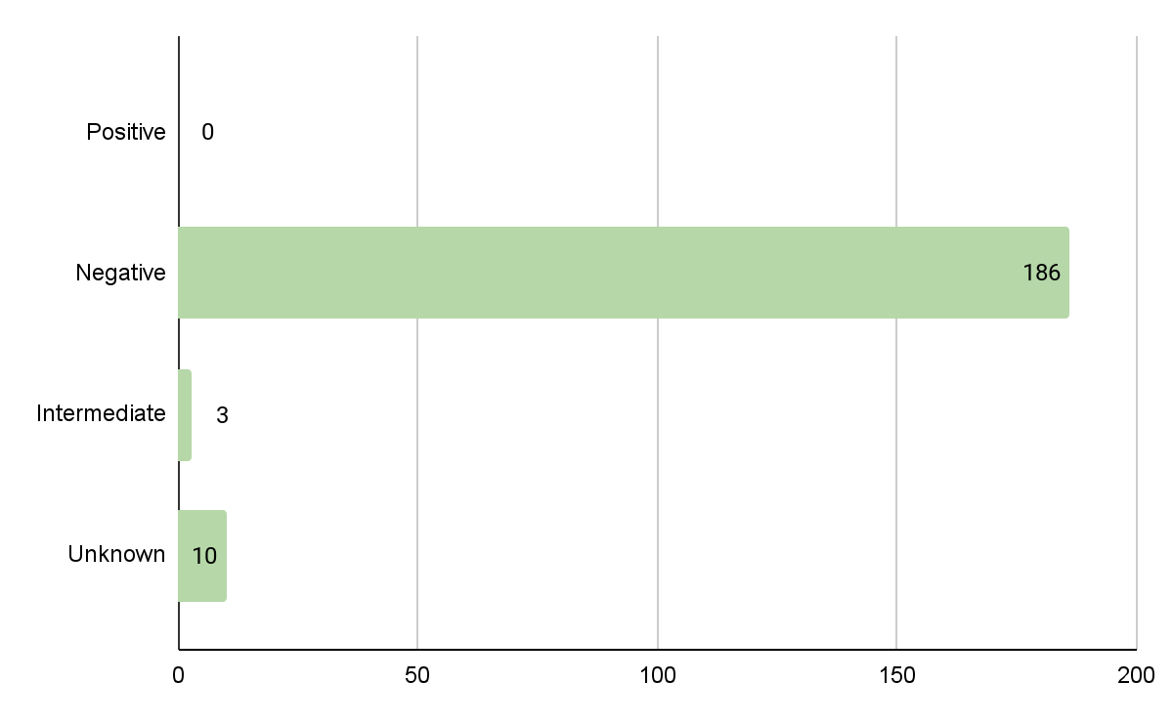
JOHANNESBURG HEALTH DISTRICT
2024 RESEARCH CONFERENCE
Figure 4: Infant HIV PCR Result at Birth
#JoburgResearch2024

Slide 13
Results: VL Trends at Delivery
JOHANNESBURG HEALTH DISTRICT
2024 RESEARCH CONFERENCE
Viral Load (copies/mL) <50 50-999 ≥1000 | Number of women (n) 141 12 19 | Percentage (%) 70,85 6,03 9,55
Suppressed (<50) Unsuppressed (≥50) | 141 31 | 70,85 15,58
#JoburgResearch2024

Slide 14
Results: Factors Associated with Delivery Viral Suppression
JOHANNESBURG HEALTH DISTRICT
2024 RESEARCH CONFERENCE
Demographics & Clinical Characteristics | Number of virally suppressed women n(%) | P- value
Employment Employed Unemployed | 78 (82,11) 59 (85,51) | 0.047
Timing of 1st ANC visit <20 weeks ≥20 weeks | 81 (88,04) 58 (77,33) | 0.009
Baseline CD4 count (cells/ml) ≥500 350-499 200-349 <200 | 51 (92,73) 25 (73,53) 16 (76,19) 10 (58,82) | 0.010
Birth weight (g) ≥2500 <2500 | 132 (85,16) 9 (52,94) | 0.001
#JoburgResearch2024

Slide 15
Discussion
JOHANNESBURG HEALTH DISTRICT
2024 RESEARCH CONFERENCE
No association between number of VL tests & suppression
VL suppression associated with:
  Early booking
  Employment
  Full-term deliveries
  Birth weight
VL suppression not associated with:
  Mode of delivery
Most women not changed from TEE to TLD
Majority had low baseline CD4 count, inverse relationship between CD4 & delivery VL
Majority delivery VLs were suppressed
Majority of birth PCRs were negative
#JoburgResearch2024

Slide 16
Limitations & Challenges
JOHANNESBURG HEALTH DISTRICT
2024 RESEARCH CONFERENCE
Single study site
Retrospective study
  Data collected depended on recorded notes in the files, therefore some factors not always available
  Unavailability of laboratory results in maternal case records
36,0% (n=112) of files not sourced due to administrative difficulties, poor record keeping, lack of electronic filing system
#JoburgResearch2024

Slide 17
Recommendations
JOHANNESBURG HEALTH DISTRICT
2024 RESEARCH CONFERENCE
Future management:
Encourage early booking
Encourage HCWs to transition patients from TEE to TLD regimen
Routine VL testing
Improved documentation & electronic record keeping
Print stickers with patient details in each file
Future studies:
More study sites with larger sample sizes
Follow up on “intermediate” birth PCRs
Follow up of breastfeeding maternal VL
Follow up of infant PCR throughout
period of exposure
Study other potential influences
on MTCT
#JoburgResearch2024
Notes:
Print stickers with patient details in each file (reduces spelling errors, easier follow-up of VL results)

Slide 18
Conclusion
JOHANNESBURG HEALTH DISTRICT
2024 RESEARCH CONFERENCE
Viral suppression was below 95-95-95 2030 UNAIDS targets
Displayed improvement - indicating progress towards PMTCT goals
Positive impact of 2019 PMTCT guidelines
Future studies with more representative populations are recommended to better evaluate the effectiveness of PMTCT in South Africa
#JoburgResearch2024

