Slide 1







Disseminating U=U at HIV counseling improves retention and viral suppression: evidence from a randomized trial in South Africa
Dorina Onoya & Jacob Bor
Tembeka Sineke, Rachel King, Sharon Kgowedi, Mandisa Dukashe, Bruce Richman, Robert Inglis
Johannesburg Health District Research Conference • 28-29 Aug 2024 • Wits SPH

Slide 2
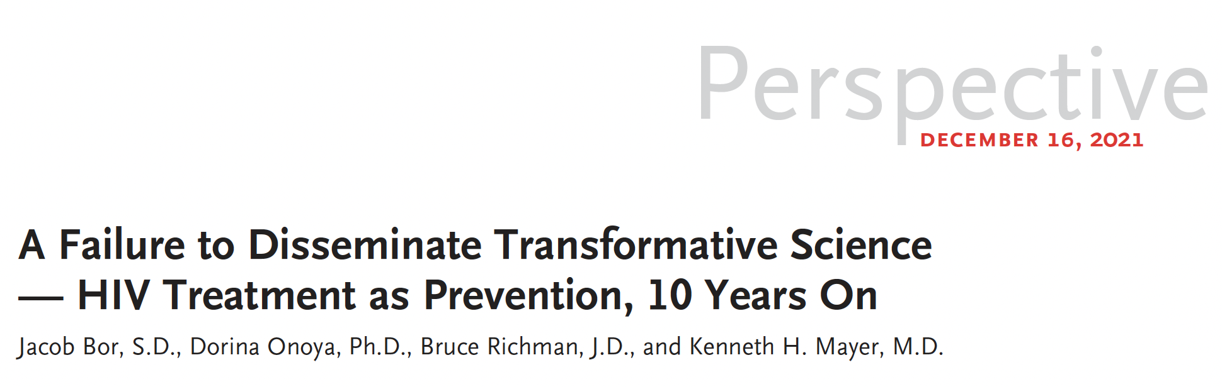


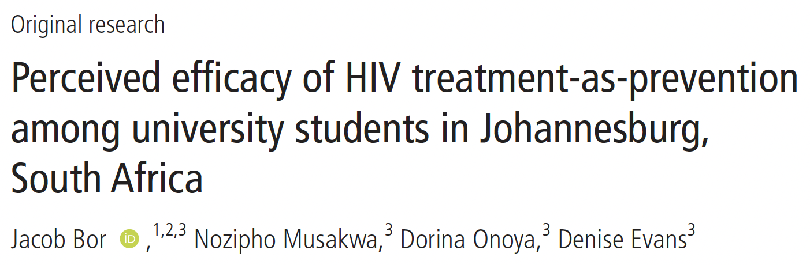

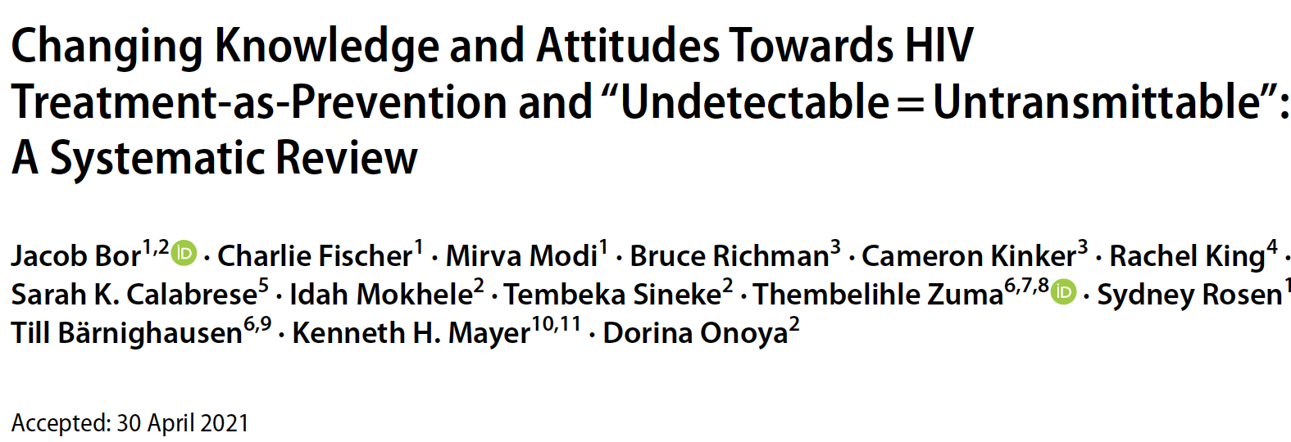
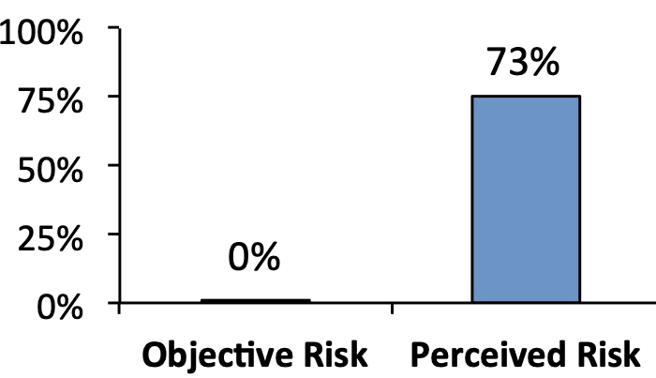
The science of HIV TasP & U=U is clear but has not been widely disseminated in sub-Saharan Africa
Objective vs. perceived risk of HIV transmission in a mixed-status couple if PLHIV is on ART and virally suppressed.

Slide 3
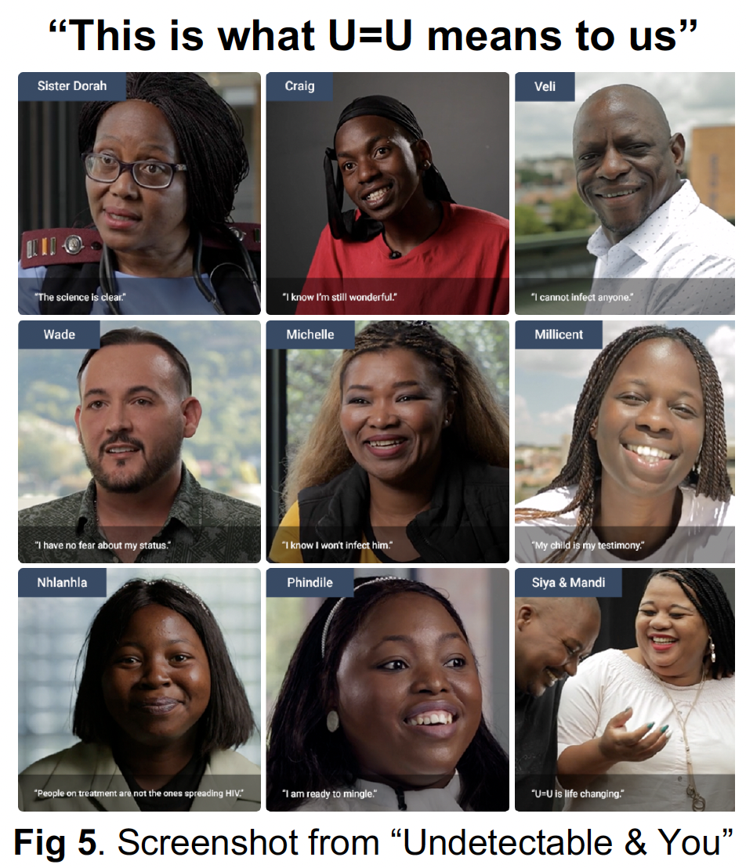
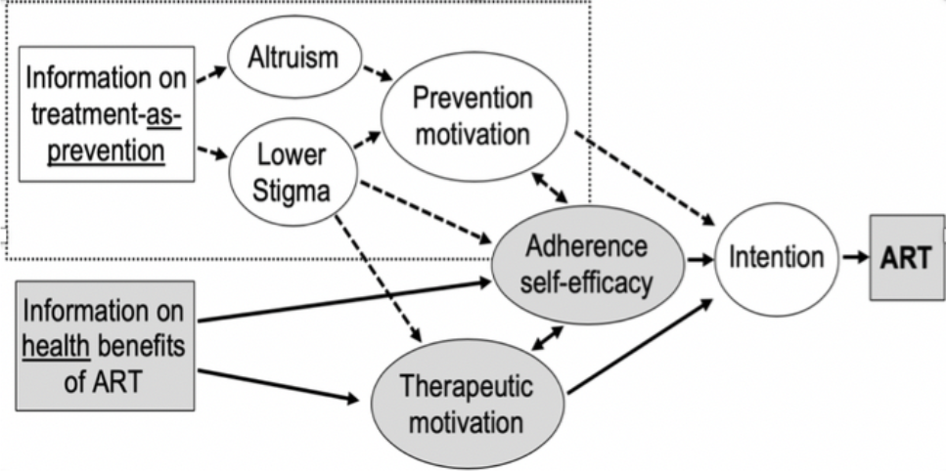

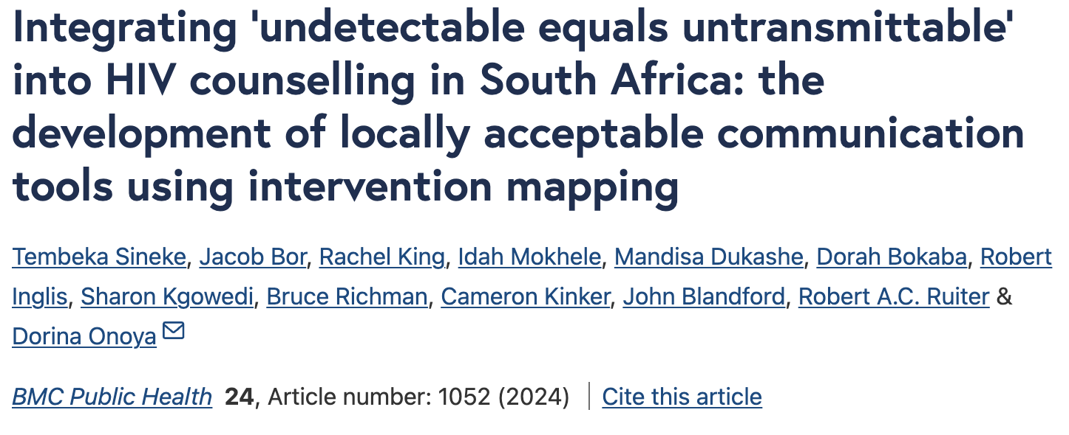
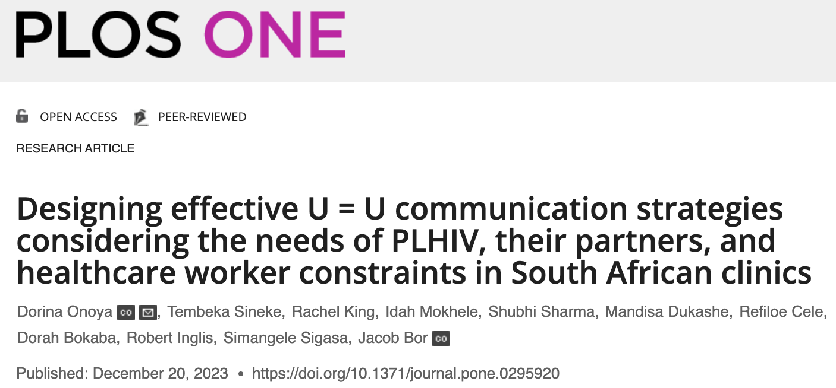
Based on theory & formative research

Slide 4
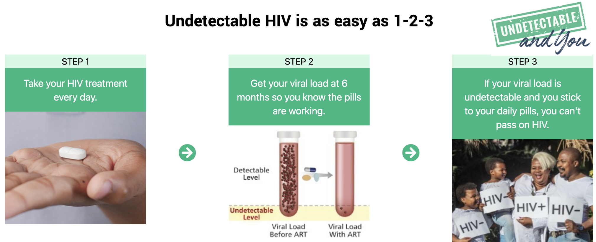
Simple messaging, tied to behaviors

Slide 5
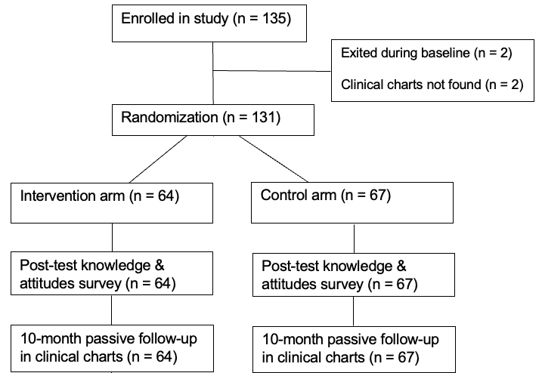
Evaluated in a pilot randomized trial
Recruitment took place November 2022 – May 2023.
SURVEY OUTCOMES: Participants survey at baseline and immediately after interacting with the intervention
CLINICAL OUTCOMES: Participants were followed up via clinical charts for 10 months days to assess:
Retention in care (ART medication pick-ups through 6 months) and
Documented viral suppression (at 3-10 months)
“Undetectable & You”
“Standard care”

Slide 6
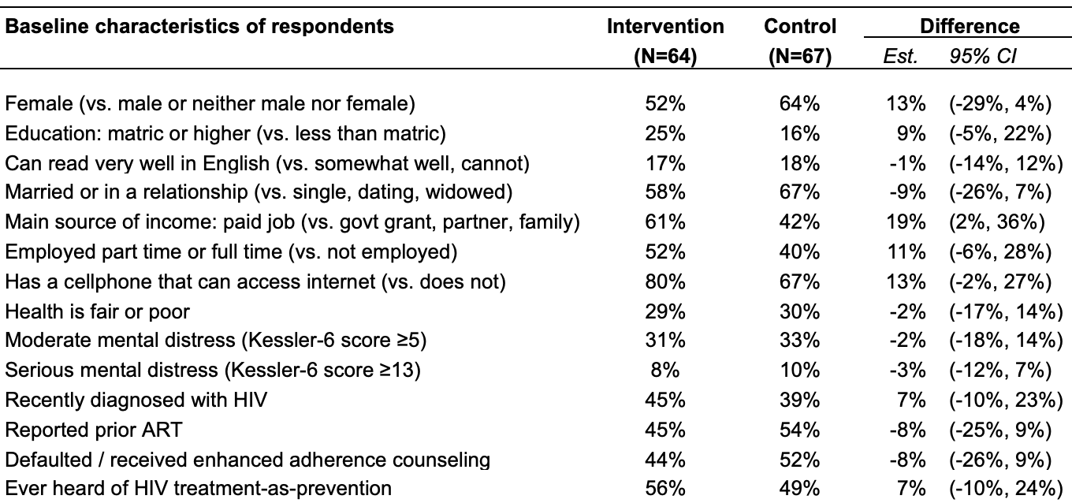
Sample characteristics at baseline
We see some differences, as expected, due to chance.
Results are robust to adjustment on imbalanced covariates.

Slide 7
Engagement and Acceptability of the App
Acceptability: over 95% agreed
“The App was easy to use”
“I would feel comfortable using the App”
“The videos were engaging”
“The information presented was clear”
“I could relate to some of the characters”
“The App should be shared with other PLHIV”
Sharing the App:
96% of participants with a phone downloaded the App
Of these, 100% shared the the App with someone, 52% with a current partner
Staff observation
Participant seemed excited while watching the trailer. He went out to fetch his partner that tested negative to come watch with him.

Slide 8
Impact on retention in care
Effect on retention increases with time suggesting change in underlying ART motivation.

Slide 9
Impact on documented viral suppression
Primary outcome:
VL monitored, recorded in clinical chart, and <200 at 3-10 mo
33% in control group
52% in trt group
+19%, p=0.028

Slide 10
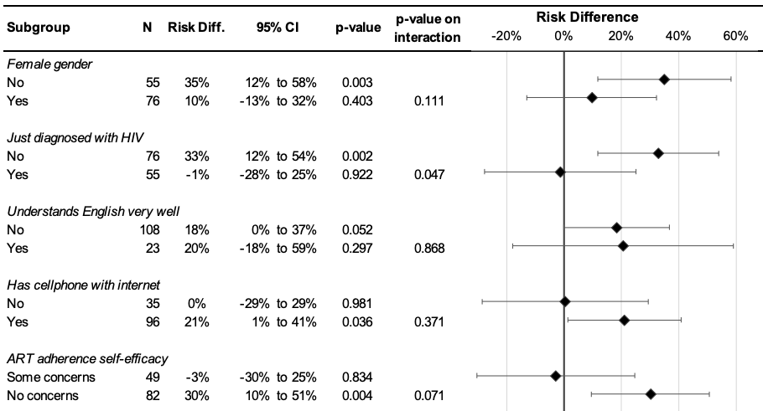
Subgroup analysis: impact on VL<200
Effect biggest in men and persons who previously disengaged from care.
Large effect even if not English fluent.
Effect biggest for those with smartphone & w/o adherence barriers.

Slide 11
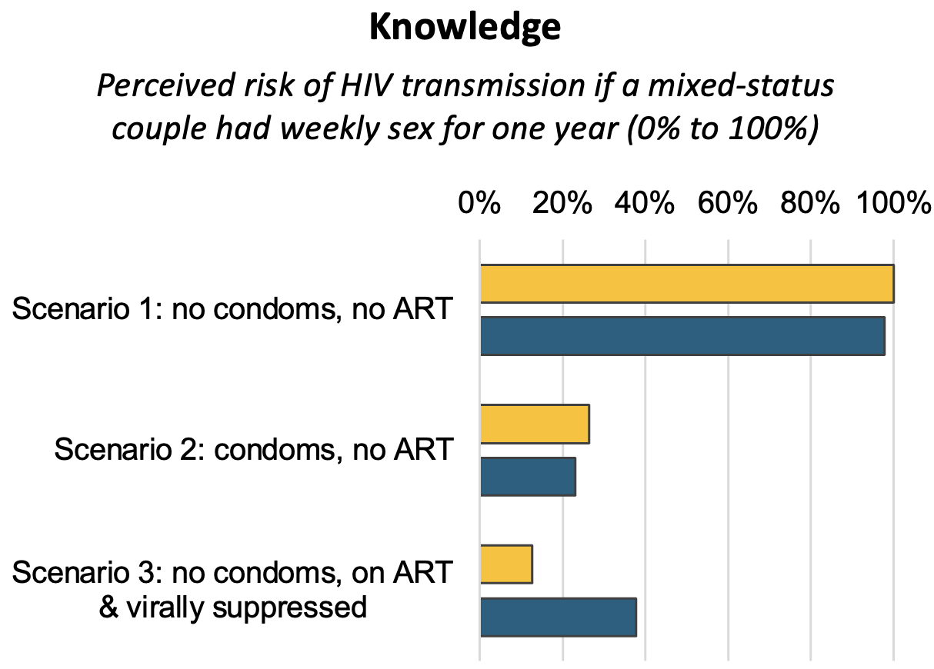
Impact on knowledge
Staff observation
Participant looked interested, also shocked and surprised by the information. Encouraged.
% Agree or Strongly Agree with the following statements | Control | Intervention | p-val.
If I had an HIV-neg. partner, I would feel comfortable having sex without a condom. | 5% | 3% | 0.54
If I had an HIV-neg. partner, I would feel comfortable having sex without a condom if I was on ART and virally suppressed. | 21% | 43% | 0.04
2%
p=0.17
3%
p = 0.64
-25%
p = 0.001
Increase in comfort having condomless sex was conditional on viral suppression. No indication that U=U takes away from condom prevention message or leads people to take HIV transmission less seriously

Slide 12
Related to Featured Stories
Nhlanhla. It taught me not to be ashamed about my status because I am not the only one who has a virus.
When Craig explained about when he found out about his status and the steps he took afterwards. It gave me relief from worrying about the future.
Siya & Mandi. Since my partner tested negative, if he could see this couple’s story it will help us in our relationship.
Phindile. I am in a relationship and my partner tested negative recently. We discussed that if I become HIV positive will he stay and he said he won't leave. I hope that when I tell him this weekend he will stand by his words.
Veli. His message gave me hope for the future. Knowing that I will be able to date again as normal. I need only to take my pill everyday
The couple gave me hope for me and my partner since we have different HIV status. It also makes me feel that I can look forward to the future.
Notes:
THERE ARE 100+ QUOTES LIKE THIS!!!!

Slide 13
Key takeaways
First RCT evidence showing U=U can improve retention and viral suppression
Increased knowledge about transmission risks with ART.
Addressed major motivational barriers to ART, including concerns around managing HIV status in relationships
Very high acceptability. Participants shared App w/partners and others.
Working with NDOH to scale-up and evaluate further.

Slide 14

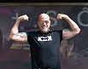


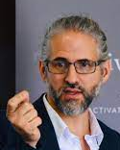

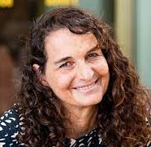
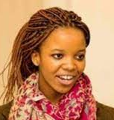
Thank you to our many collaborators!
…and more!!!

Slide 15
THANK YOU

