Slide 1





Spatial distribution of notifiable malaria cases in the City of Johannesburg 2015-2019
JOHANNESBURG HEALTH DISTRICT
2024 RESEARCH CONFERENCE
Mnqweno Funcuza MPH,
Environmental Health Practitioner
City of JHB
Health Department: Environmental health
#JoburgResearch2024

Slide 2
CONTENTS
JOHANNESBURG HEALTH DISTRICT
2024 RESEARCH CONFERENCE
BACKGROUND
AIM OF THE STUDY
METHODOLOGY
RESULTS
RECOMMENDATIONS
CONCLUSION
#JoburgResearch2024

Slide 3
BACKGROUND
JOHANNESBURG HEALTH DISTRICT
2024 RESEARCH CONFERENCE
Malaria is one of the acute communicable diseases transmitted by Anopheline mosquitos to humans and is endemic in 108 countries worldwide.
Most malaria epidemics in African highland countries are caused by Plasmodium falciparum (P. falciparum),
The disease affects both children and adults.
The City of Johannesburg, South Africa lies in a highland area of the country with an altitude of 1 753m above sea level.
#JoburgResearch2024

Slide 4
AIM
JOHANNESBURG HEALTH DISTRICT
2024 RESEARCH CONFERENCE
The aim of the study was to determine the spatial distribution of notifiable malaria cases in the City of Johannesburg during the period 2015-2019
#JoburgResearch2024

Slide 5
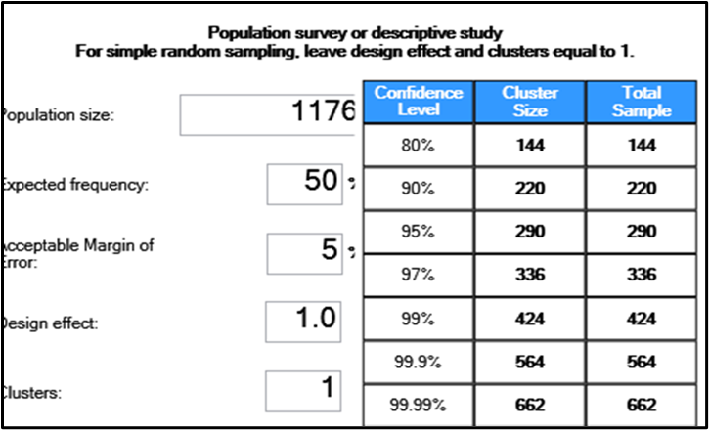
SAMPLE SIZE
JOHANNESBURG HEALTH DISTRICT
2024 RESEARCH CONFERENCE
Sample Size Estimation Using EPINFO 7.2
#JoburgResearch2024

Slide 6
METHODOLOGY
JOHANNESBURG HEALTH DISTRICT
2024 RESEARCH CONFERENCE
Quantitative, descriptive cross-sectional research design
Global positioning system coordinates derived from captured addresses of individuals whose laboratory tests confirmed malaria diagnosis was used to evaluate malaria prevalence and clusters. Google maps was used to locate the coordinates for each address, which were then analysed in ArcGIS to identify possible clusters.
This tool identifies statistically significant spatial clusters of high values (hot spots) and low values (cold spots).
Data analysis was performed using the Statistical Package for Social Science (SPSS). The analysis included descriptive analysis, to generate frequency distribution of variables of study participants in connection with the outcome measure being; malaria.
#JoburgResearch2024

Slide 7
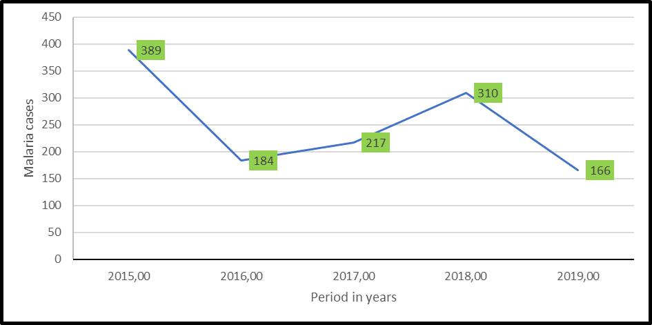
RESULTS
JOHANNESBURG HEALTH DISTRICT
2024 RESEARCH CONFERENCE
Prevalence of malaria cases by year between 2015 and 2019 in the City of Johannesburg, South Africa
#JoburgResearch2024

Slide 8
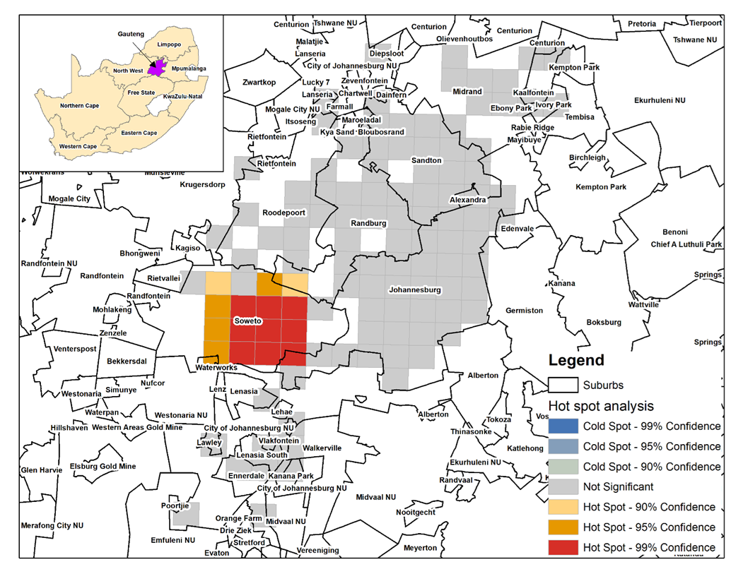
RESULTS
JOHANNESBURG HEALTH DISTRICT
2024 RESEARCH CONFERENCE
Clusters of malaria cases in the City of Johannesburg, 2015 - 2019
#JoburgResearch2024

Slide 9
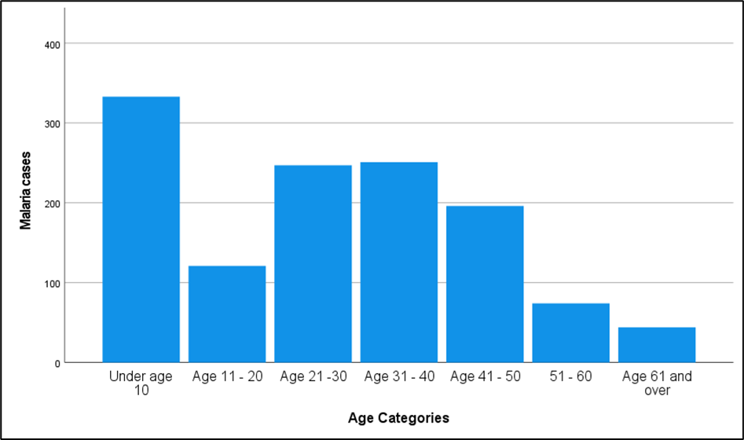
RESULTS
JOHANNESBURG HEALTH DISTRICT
2024 RESEARCH CONFERENCE
Age distribution of participants
#JoburgResearch2024

Slide 10
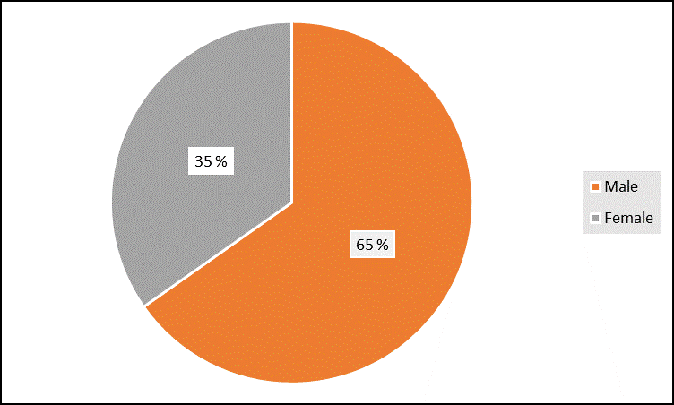
RESULTS
JOHANNESBURG HEALTH DISTRICT
2024 RESEARCH CONFERENCE
Distribution of Participants by gender
#JoburgResearch2024

Slide 11
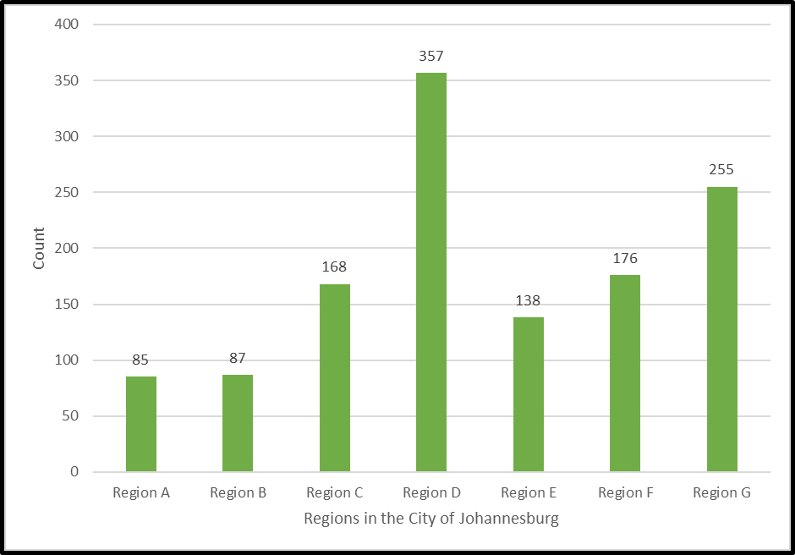
RESULTS
JOHANNESBURG HEALTH DISTRICT
2024 RESEARCH CONFERENCE
Distribution of Participants by region
#JoburgResearch2024

Slide 12
RECOMMENTATIONS
JOHANNESBURG HEALTH DISTRICT
2024 RESEARCH CONFERENCE
Cross-border malaria initiatives
Since malaria is mainly transmitted along its northern and eastern borders, South Africa must collaborate on malaria control with its neighbouring countries
The key strategy must be to ensure policy harmonization and synchronization of malaria interventions such as case management, vector control, surveillance and health promotion across bordering districts countries and endemic provinces.
#JoburgResearch2024

Slide 13
CONCLUSION
JOHANNESBURG HEALTH DISTRICT
2024 RESEARCH CONFERENCE
Imported malaria is a critical obstacle to achieving elimination
Improved strategies to identify and characterize high-risk importation groups will enable targeting and tailoring of interventions
Guidelines and policies that govern how key stakeholders, such as industries employing migrant workers and non-government organizations (NGOs) working with displaced populations, address malaria importation must be in place to ensure appropriate implementation of diagnostic and treatment policy
#JoburgResearch2024

Slide 14
JOHANNESBURG HEALTH DISTRICT
2024 RESEARCH CONFERENCE
THANK YOU
#JoburgResearch2024

