Slide 1





FACTORS CONTRIBUTING TO ATTRITION OF NURSE EDUCATORS AT A GAUTENG PUBLIC NURSING EDUCATION INSTITUTION
b
JOHANNESBURG HEALTH DISTRICT
2024 RESEARCH CONFERENCE
BY DM SHIRINDA
28.08.2024
#JoburgResearch2024

Slide 2
INTRODUCTION AND BACKGROUND
JOHANNESBURG HEALTH DISTRICT
2024 RESEARCH CONFERENCE
There is attrition of nurse educators at the selected public nursing education institution in the Gauteng Province.
Nurse educators leave the institution within two years of employment and this study explored factors that contribute to this attrition.
Globally, the most common identified factors that causes shortage of nurse educators leading to attrition of nurse educators are high workload and role demands
#JoburgResearch2024

Slide 3
PROBLEM STATEMENT
JOHANNESBURG HEALTH DISTRICT
2024 RESEARCH CONFERENCE
Most of nurse educators leave the institution as from eight months of employment to maximum of 5years employment
As these nurse educators leave the institution, it is not easy to replace them leaving few nurse educators who have to teach large number students.
This result in increased workload to the remaining nurse educators
Literature search focusing on factors that contribute to the attrition of nurse educators is inadequate and this study aimed to close this gap of knowledge.
#JoburgResearch2024

Slide 4
PURPOSE
JOHANNESBURG HEALTH DISTRICT
2024 RESEARCH CONFERENCE
This study aimed to determine the factors contributing to the attrition of nurse educators in Gauteng public nursing education institution
OBJECTIVE
To explore and describe the factors contributing to the attrition of nurse educators in Gauteng public nursing education institution
#JoburgResearch2024

Slide 5
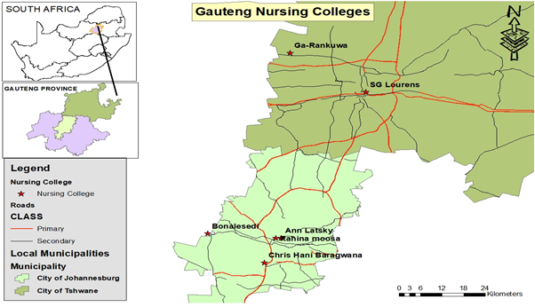
design and methodology study setting
JOHANNESBURG HEALTH DISTRICT
2024 RESEARCH CONFERENCE
#JoburgResearch2024

Slide 6
DESIGN
JOHANNESBURG HEALTH DISTRICT
2024 RESEARCH CONFERENCE
Explorative, descriptive qualitative research was used to obtain relevant information to achieve the research objectives.
#JoburgResearch2024

Slide 7
METHODOLOGY
JOHANNESBURG HEALTH DISTRICT
2024 RESEARCH CONFERENCE
The study was conducted in Gauteng public nursing education institutions in South Africa.
Non-probability, purposive sampling approach to select twenty participants who had left nursing education institutions within two years of employment.
Factors that contribute to attrition were explored using an unstructured one-on-one interview.
The interviews were conducted in the participant's offices in their new place of work until data saturation.
Tesch's eight processes was used to analyse data.
Ethical principles and trustworthiness were followed: credibility, transferability, dependability and confirmability
#JoburgResearch2024

Slide 8
METHODOLOGY
JOHANNESBURG HEALTH DISTRICT
2024 RESEARCH CONFERENCE
Ethical consideration:
Ethical clearance from UNIVEN.
Permission : Chris Hani Baragwanath Campus
Ethical standards such as informed consent form, confidentiality and anonymity maintained
#JoburgResearch2024

Slide 9
RESULTS
JOHANNESBURG HEALTH DISTRICT
2024 RESEARCH CONFERENCE
This study revealed two themes: the contributory factors to attrition of nurse educators and on-the-job challenges experienced by nurse educators.
Four sub-themes that emerged from the first theme include paradoxical experiences causing suffering at multiple levels, emotional suffering, unreasonable allocated workload, and lack of recognition of nurse educators' clinical experience and qualifications.
Two sub-themes that emerged from the second theme include poor interpersonal relationships, communication with other nurse educators, and shortage of resources.
#JoburgResearch2024

Slide 10
CONCLUSION
JOHANNESBURG HEALTH DISTRICT
2024 RESEARCH CONFERENCE
The attrition of nurse educators at South Africa's public nursing education institutions undermines the ability of the country to improve health care outcomes.
The frustration of new nurse educators and their hostile reception from experienced colleagues could lead to attrition.
Public nursing education institutions are competing with other health facilities like hospitals and clinics, offering a better working environment concerning, higher positions better salaries and reduced workload.
#JoburgResearch2024

Slide 11
LIMITATION
JOHANNESBURG HEALTH DISTRICT
2024 RESEARCH CONFERENCE
The results cannot be transferred to another setting because the study was contextualised within a selected PNEI.
#JoburgResearch2024

Slide 12
Recommendations
JOHANNESBURG HEALTH DISTRICT
2024 RESEARCH CONFERENCE
The study recommends that the Department of Health should:
Revisit and review policies related to the salaries and employment of nurse educators in order to attract and retain them and reduce attrition.
Consider the high competition within PNEIs and other health facilities like hospitals and clinics offering better working environments, managerial support, higher positions, and better salaries.
Benchmark with other institution of higher education like universities which offers better working conditions and salaries for nurse educators
Further research is needed to develop strategies, guidelines, and programs for attracting and retaining nurse educators.
#JoburgResearch2024

Slide 13

ACKNOWLEDGEMENT
JOHANNESBURG HEALTH DISTRICT
2024 RESEARCH CONFERENCE
University of Venda
My Supervisors Prof SA Mulondo and Prof NH Shilubane
HWSETA for funding
Chris Hani Baragwanath Campus
Participants: Lecturers
#JoburgResearch2024

