Slide 1





DIABETIC FOOT COMPLICATIONS IN PRIMARY HEALTHCARE CLINICS IN GAUTENG
JOHANNESBURG HEALTH DISTRICT
2024 RESEARCH CONFERENCE
PRESENTED BY: MASEGO NKOMO
RESEARCHERS: CHARLIE DUMA, PHAKAMANI NDABA AND MASEGO NKOMO
SUPERVISORS: MRS G JENKINS AND MRS Y CHOONARA
DATE: 28-29 AUGUST 2024
#JoburgResearch2024

Slide 2
BACKGROUND
JOHANNESBURG HEALTH DISTRICT
2024 RESEARCH CONFERENCE
Globally, diabetes has become one of the most common metabolic diseases, due to rapid urbanization in developing countries.
Foot complications as a result of diabetes include the following: nail conditions, ulceration, deformities, infections and finally amputation.
In South Africa, PHC clinics are the first point of contact in health care. These PHC clinics are expected to see many diabetic patients.
However, no empirical data on the frequency of diabetic foot problems presenting at this level of care currently exists.
The aim of this study was to identify common diabetic foot complications in PHC clinics.
#JoburgResearch2024

Slide 3
METHODOLOGY
JOHANNESBURG HEALTH DISTRICT
2024 RESEARCH CONFERENCE
STUDY DESIGN & SETTING
A qualitative, retrospective design was used for this study.
Using a self-constructed data collecting tool, information was gathered from the files of diabetic patients who visited Mayfair clinic, Bez Valley clinic and Crosby Municipal clinic.
STUDY POPULATION
Diabetic patients at Mayfair clinic, Bez Valley clinic and Crosby Municipal clinic between 2018 and 2021.
Males and females with ages ranging between 40 and 75 years who are Type 1 and Type 2 diabetics.
The study sample consisted a minimum of 30 patients files per clinic, thus giving us a total minimum of 90 files.
#JoburgResearch2024

Slide 4
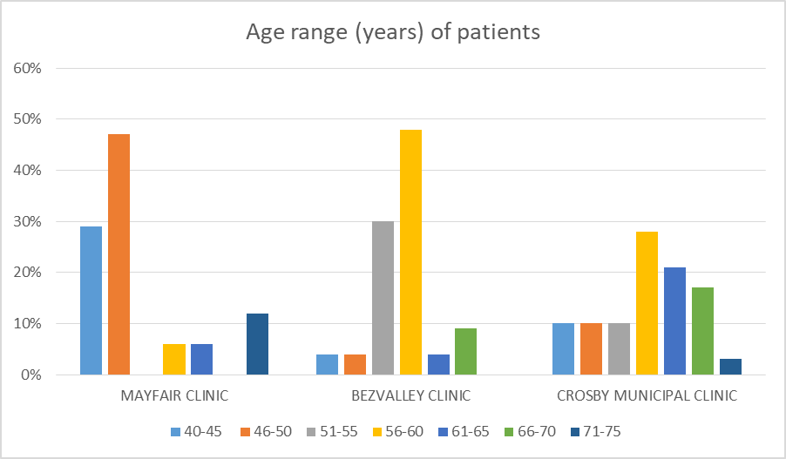
RESULTS
JOHANNESBURG HEALTH DISTRICT
2024 RESEARCH CONFERENCE
1. Age
Figure 1 shows that the most prevalent age range of patients with diabetic foot complications were between 46-50 years (47%) at Mayfair clinic, 56-60 years (47.83%) at Bezvalley clinic and 56-60 years (27.59%) at Crosby Municipal clinic.
#JoburgResearch2024

Slide 5
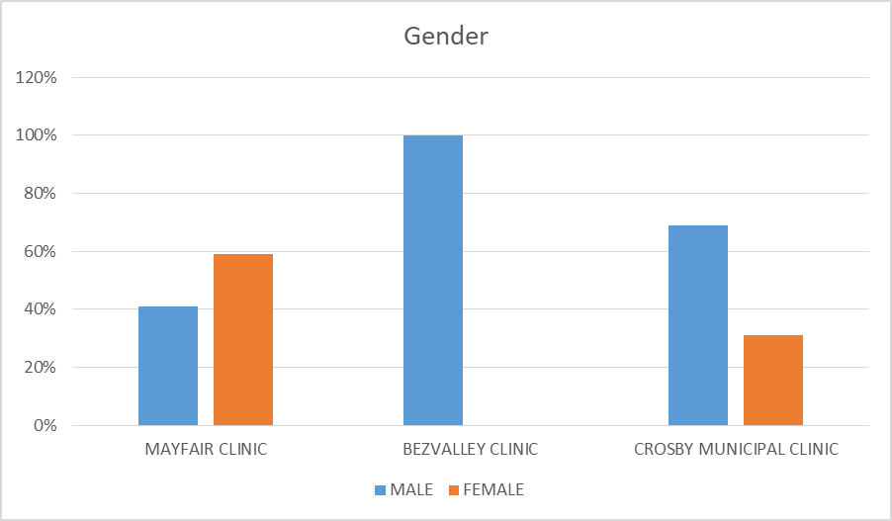
RESULTS
JOHANNESBURG HEALTH DISTRICT
2024 RESEARCH CONFERENCE
2. Gender
Figure 2 shows that the majority of patients at 59% were females at Mayfair clinic, however 100% of patients were males at Bezvalley clinic and 69% of patients were males at Crosby Municipal clinic.
#JoburgResearch2024

Slide 6
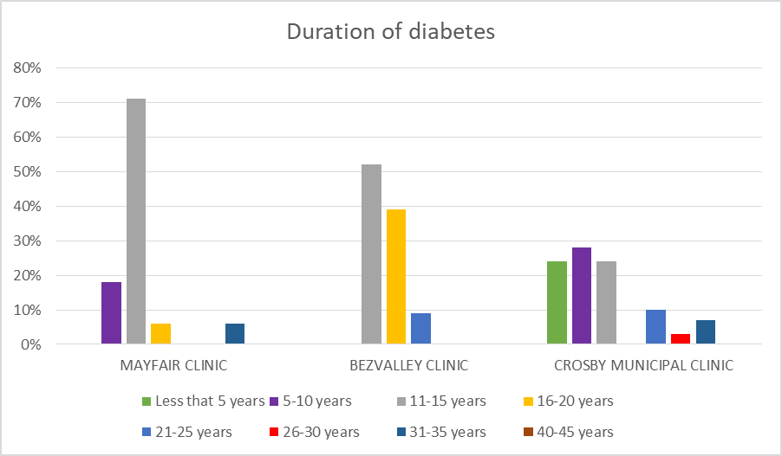
RESULTS
JOHANNESBURG HEALTH DISTRICT
2024 RESEARCH CONFERENCE
3. Duration of diabetes
Figure 3 shows that the majority of patients at Mayfair clinic (70.59%) had diabetes for a period of 11-15 years, the majority (52.17%) at Bezvalley clinic also had diabetes for 11-15 years, whereas the majority (27.59%) at Crosby Municipal clinic had diabetes for 5-10 years.
#JoburgResearch2024

Slide 7
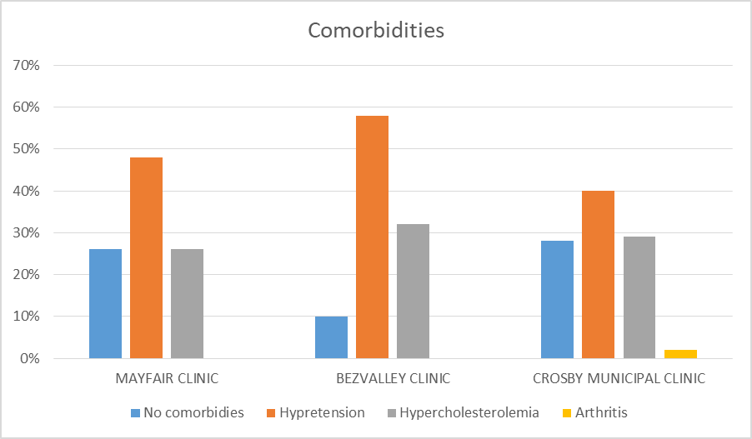
RESULTS
JOHANNESBURG HEALTH DISTRICT
2024 RESEARCH CONFERENCE
4. Comorbidities
Figure 4 shows that the most prevalent comorbidity was hypertension with 48% patients at Mayfair clinic, 58.06% at Bezvalley clinic and 40% at Crosby Municipal clinic.
#JoburgResearch2024

Slide 8
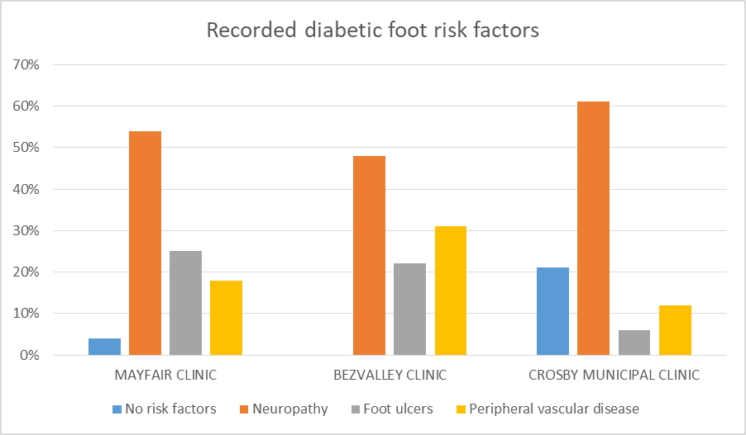
RESULTS
JOHANNESBURG HEALTH DISTRICT
2024 RESEARCH CONFERENCE
5. Recorded diabetic foot risk factors
Figure 5 shows that neuropathy was the most recorded diabetic foot risk factor with 53.57% prevalence at Mayfair clinic, 47.83% at Bezvalley clinic and 60.61% at Crosby Municipal clinic.
#JoburgResearch2024

Slide 9
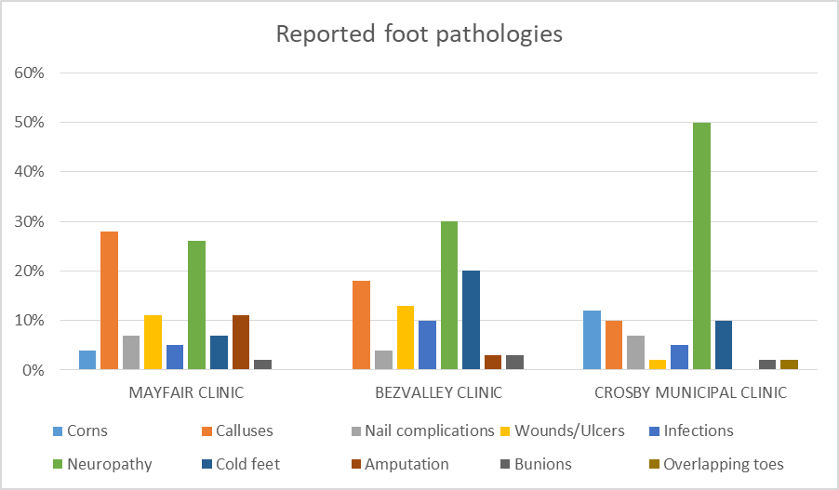
RESULTS
JOHANNESBURG HEALTH DISTRICT
2024 RESEARCH CONFERENCE
6. Reported foot pathology
Figure 6 shows calluses were the most reported foot pathologies at Mayfair clinic (28.07%), however neuropathy was the most reported foot pathology at Bezvalley (29.58%) and at Crosby Municipal clinic (50%).
#JoburgResearch2024

Slide 10
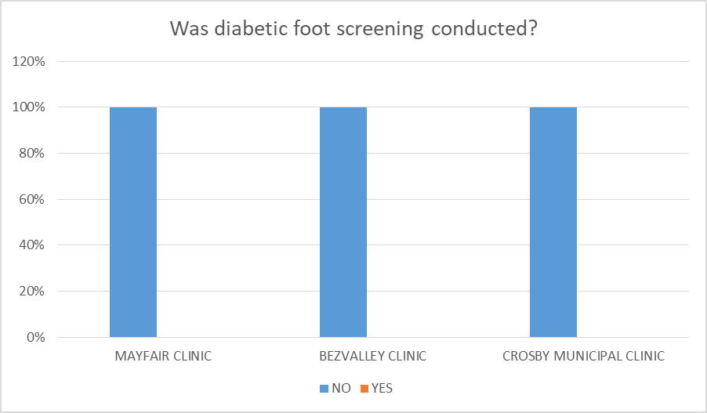
RESULTS
JOHANNESBURG HEALTH DISTRICT
2024 RESEARCH CONFERENCE
7. Diabetic foot screening
Figure 7 shows that no diabetic foot screenings were performed at Mayfair clinic, Bezvalley clinic and Crosby Municipal clinic.
#JoburgResearch2024

Slide 11
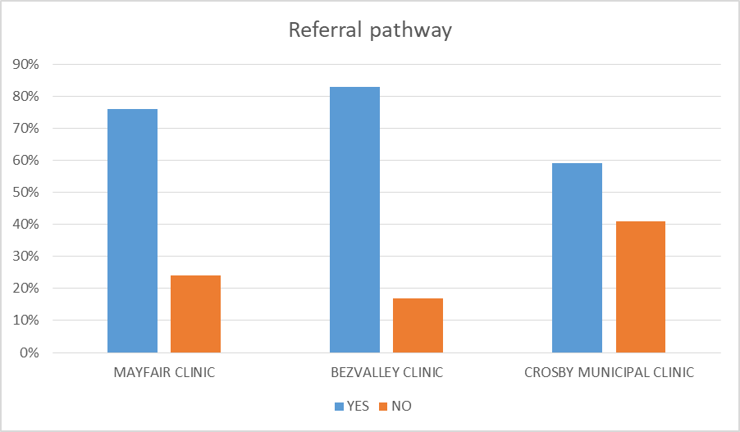
RESULTS
JOHANNESBURG HEALTH DISTRICT
2024 RESEARCH CONFERENCE
8. Referral pathway
Figure 8 shows that the PHC clinics had a multidisciplinary approach to patients with diabetic foot complications as 76.47% of patients were referred to a specialist at Mayfair clinic, 82.61% at Bezvalley and 58.62% at Crosby Municipal clinic.
#JoburgResearch2024

Slide 12
CONCLUSION
JOHANNESBURG HEALTH DISTRICT
2024 RESEARCH CONFERENCE
The overall results of this study reveals that the reported complications were corns, calluses, nail complications, wounds, infections, neuropathy, cold feet, amputation, bunions and overlapping toes.
The care of all diabetic patients requires a thorough physical examination of the feet and lower limbs as well as a review of medical history.
To reduce the risk of lower extremity amputation in patients with ulcers, infections, peripheral vascular disease, and peripheral neuropathy, frequent examinations are indicated.
This study found that no diabetic foot screening was performed amongsts patients with diabetic foot complications at the three selected clinics where treatment was provided by nurses.
#JoburgResearch2024

Slide 13
CONCLUSION
JOHANNESBURG HEALTH DISTRICT
2024 RESEARCH CONFERENCE
Podiatrists are qualified to screen patients, diagnose, treat, and put into practice therapy modalities that would improve patients' quality of life and reduce the risk of diabetic foot-related morbidity and mortality.
Since PHC is the first point of contact with patients, making the podiatry profession known and for ensuring proper patient referral, it is also recommended that podiatrists be easily accessible to PHC settings before being promoted to tertiary hospitals.
#JoburgResearch2024

Slide 14
RECOMMENDATIONS FOR FUTURE STUDY
JOHANNESBURG HEALTH DISTRICT
2024 RESEARCH CONFERENCE
Future studies could also confirm the predominant type of diabetes and compare diabetic foot complications between type 1 and type 2 diabetic patients at Mayfair clinic, Bez Valley clinic and Crosby Municipal clinic.
In this study only matured patients aged from 40-75 were included, future studies may be conducted with focus on the younger generation to compare the most common diabetic foot complications between the two.
#JoburgResearch2024

Slide 15

JOHANNESBURG HEALTH DISTRICT
2024 RESEARCH CONFERENCE
THANK
YOU!
#JoburgResearch2024

